Slide 1

CO-2 – Probability Session-11: Session Topic: Higher Order Moments, Variance, Standard Deviation Probability, Statistics and Queueing Theory (Course code: 21MT2103RA)
1
Notes:
1

Slide 2
CO#2 (Probability) - Continuous Random Variables: Uniform, Exponential and Normal Random Variables - Expectation of a Random Variable : Discrete and Continuous Case - Expectation of a Function of a Random Variable - Higher Order Moments, Variance, Standard Deviation
- Jointly Distributed Random Variables
- Joint Distribution Functions, Independent Random Variables
2
Notes:
2

Slide 3


Higher order moments of a Random Variable
If X is a random variable (rv) and Y=g(X), then Y itself is a rv.
If X is a discrete rv, the expectation of Y = g(X) is given by
If X is a continuous rv, the expectation of Y = g(X) is given by
High-order moments are moments beyond 4th-order moments. As with variance, skewness, and kurtosis, these are higher-order statistics, involving non-linear combinations of the data, and can be used for description or estimation of further shape parameters.
3
Notes:
3

Slide 4
Higher order moments of a Random Variable
In mathematics, the moments of a function are quantitative measures related to the shape of the function's graph. High-order moments are moments beyond 4th-order moments.
As with variance, skewness, and kurtosis, these are higher-order statistics, involving non-linear combinations of the data, and can be used for description or estimation of further shape parameters.
The “moments” of a random variable (or of its distribution) are expected values of powers or related functions of the random variable.
The r th moment of X is E(Xr ) In particular, the first moment is the mean, µX = E(X) In particular, the second central moment is the variance, σ 2 X = Var(X) = E[(X − µX) 2 ].
4
Notes:
4

Slide 5
Higher order moments of a Random Variable
We have
So, we can compute the expectation of X^{r} when X is either a discrete rv or a continuous rv using the above formulae.
If E[X^{r}] exists, it is called r^{th} moment of X about the origin.
We will be specially interested in the 2nd order moment of X about the origin,
i.e., E[X²] because it is useful to compute variance of X.
5
Notes:
5

Slide 6


Variance and Standard Deviation
The variance of a random variable X is defined to be
σ²=Var(X)=E[(X−μ)2]
where μ denotes the expected value of X
σ²=Var(X)=
The variance is a measure of how spread out the distribution of a random variable is. Variance is a measure of the spread of data around the mean of the distribution. Variance is the 2nd moment of X about the mean of X
Note that Var(X) has a different unit than X. For example, if X is measured in meters then Var(X) is in meters².
To solve this issue, we define another measure, called the standard deviation, usually shown as σ_{X}, which is simply the square root of variance.
The standard deviation of a random variable X is defined as
6
Notes:
6

Slide 7
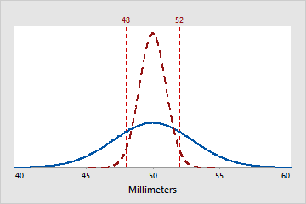
Variance and Standard Deviation
The variance of a random variable X is defined to be
Var(X) =
Variance is a measure of the spread of data around the mean of the distribution. The standard deviation, usually denoted as σ_{X}, is the square root of variance.
The graph shows curves of two
normal distributions with the same
mean = 50mm.
The solid blue
distribution has larger standard
deviation than that of the
dashed red distribution.
7
source: https://support.minitab.com/en-us/minitab-express/1/probability_dist_plot_variance_def.png
Notes:
7

Slide 8
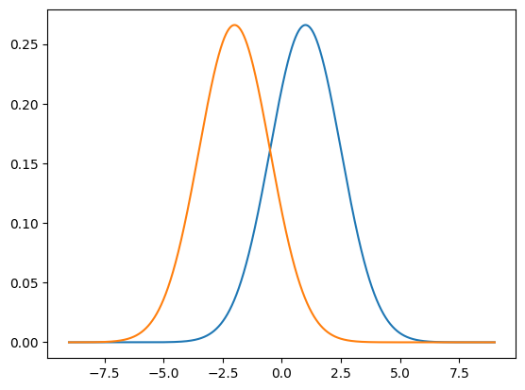
Variance and Standard Deviation
The graph shows two distributions
With different means and Equal Variance
source: Alex Tsun, "Probability & Statistics with Applications to Computing"
8
Notes:
8

Slide 9

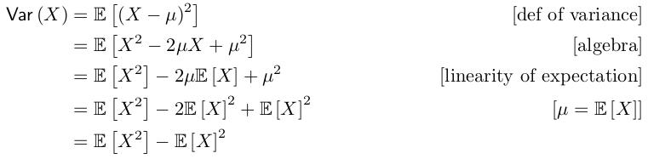
Variance
variance of a random variable X Var(X) =
Computational formula for the variance:
Var(X) =
Proof:
Let µ = E [X] as a shorthand. Then,
Caution: Notice that
9
Notes:
9

Slide 10

Variance of a Discrete Random Variable
Problem:
Let X be a random variable showing the value of the outcome of throwing a fair dice. Compute the standard deviation of X.
Solution: We need to compute E[X] and E[X*X] because variance can be computed as
Since all 6 outcomes are equally likely, the PMF of X is
P(x) = ⅙ for x=1,2,3,4,5,6.
10
Notes:
10

Slide 11

Variance of a Discrete Random Variable
Problem:
Let X be a random variable showing the value of the outcome of throwing a fair dice. Compute the standard deviation of X.
Solution: We need to compute E[X] and E[X*X] because variance can be computed as
Since all 6 outcomes are equally likely, the PMF of X is
P(x) = ⅙ for x=1,2,3,4,5,6.
E[X] = ⅙ [1+2+3+4+5+6] = 7/2
So, E[X*X] = Σ x*x * P(x) = ⅙ [1x1 + 2x2 + 3x3 + 4x4 + 5x5 + 6x6]
= 91/6.
So, Variance = 91/6 - (7/2)(7/2) = 2.92
So, standard deviation of X is =
11
Notes:
11

Slide 12
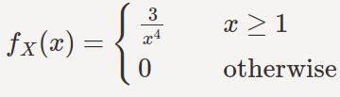
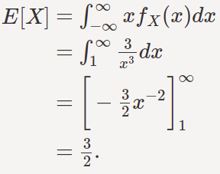
Variance of a Continuous Random Variable
Problem: Compute variance of a continuous rv, X, with the following pdf:
Solution:
12
Notes:
12

Slide 13
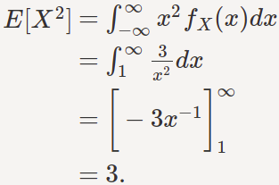
Variance of a Continuous Random Variable
Problem: Compute variance of X with the following pdf:
Solution: E[X] = 3/2
= 3 - (3/2)(3/2) = 3/4
13
source: https://www.probabilitycourse.com/chapter4/4_1_2_expected_val_variance.php
Notes:
13

Slide 14

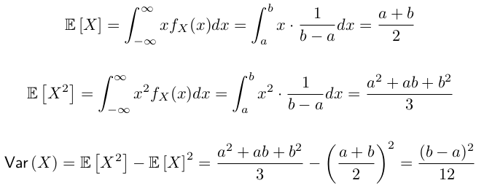
Variance of
a Continuous Uniform Random Variable
Problem: Let X∼Uniform(a,b). Compute variance of X.
Solution: Let us compute E[X] and E[X*X] because variance can be computed as
The pdf of a uniform rv is given by
14
Notes:
14

Slide 15
Variance of
a Continuous Uniform Random Variable
Problem: Let X∼Uniform(a,b). Compute variance of X.
Solution:
The pdf of a uniform rv is given by
15
Notes:
15

Slide 16
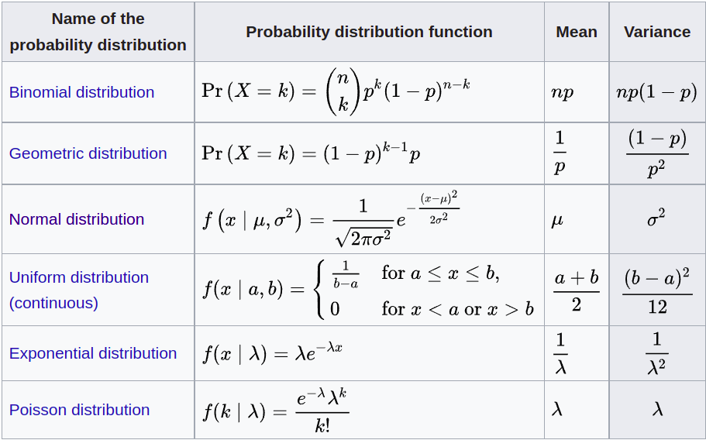
Mean and Variance of common probability distributions
T.
source: https://en.wikipedia.org/wiki/Variance
16
Notes:
16

Slide 17
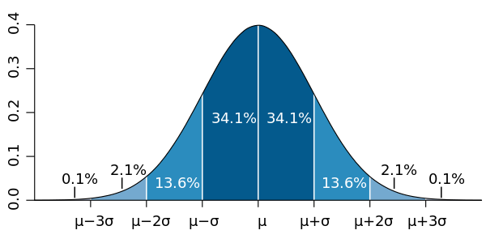
Significance of standard deviation
In case of Normal distribution, 68.2% of the data points lie within one standard deviation around the mean. In other words,
P(X 𝞊 [𝝻 - 𝞂, 𝝻 + 𝞂] ) = 0.68
source: https://en.wikipedia.org/wiki/File:Standard_deviation_diagram_micro.svg
17
Notes:
17

Slide 18
References
* Section 3.3 of TS1: Alex Tsun, Probability & Statistics with Applications to Computing (Available at: http://www.alextsun.com/files/Prob_Stat_for_CS_Book.pdf)
* https://www.probabilitycourse.com/chapter3/3_2_4_variance.php ,
https://www.probabilitycourse.com/chapter4/4_1_2_expected_val_variance.php
* Chapter IX.4 of TP1: William Feller, An Introduction to Probability Theory and Its Applications: Volume 1, Third Edition, 1968 by John Wiley & Sons,Inc.
* https://amsi.org.au/ESA_Senior_Years/SeniorTopic4/4e/4e_2content_4.html
* Video: https://www.youtube.com/watch?v=5CT1DXPp2HY&list=PLeB45KifGiuHesi4PALNZSYZFhViVGQJK
18
Notes:
18

