Slide 1

CO-2 – Probability Session-11: Session Topic: Jointly Distributed Random Variables Probability, Statistics and Queueing Theory (Course code: 21MT2103RA)
1
Notes:
1

Slide 2
CO-2 (Probability) - Continuous Random Variables: Uniform, Exponential and Normal Random Variables - Expectation of a Random Variable : Discrete and Continuous Case - Expectation of a Function of a Random Variable - Higher Order Moments, Variance, Standard Deviation
- Jointly Distributed Random Variables
- Joint Distribution Functions, Independent Random Variables
2
Notes:
2

Slide 3
Multiple Random Variables
In real life, we are often interested in several random variables that are related to each other. For example, suppose that we choose a random family, and we would like to study
the number of people in the family,
the household income,
the ages of the family members, etc.
Each of these is a random variable, and we suspect that they are dependent.
In this session, we will learn tools to study joint distributions of two or more random variables. The concepts are extensions of what we studied for one random variable in the previous classes.
Let us first learn the concept of joint distributions by inspecting two illustrations.
3
Notes:
3

Slide 4
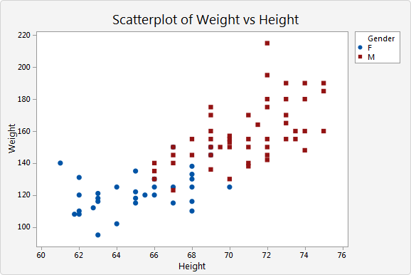
Two Discrete Random Variables
Height and weight: Two correlated random variables:
Range of height: [60,76] inches
Range of weight: [90,220] pounds
As height increases, the weight increases, in general.
So, the height and weight random variables have a relationship / dependence.
source: https://support.minitab.com/en-us/minitab-express/1/scatterplot_*.png
4
Notes:
4

Slide 5
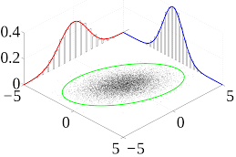
Two Continuous Random Variables
source; en.wikipedia.org
In this case, both variables take any real value in the interval [-5, 5].
The individual pdf of the one variable is shown in red colour, the other in blue colour.
The two continuous random variables seem to have dependence on each other as shown by the green curve.
The green curve shows the joint distribution of two variables.
5
Notes:
5

Slide 6
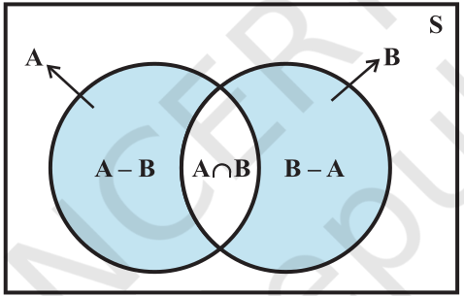
Joint probability: a revision
A statistical measure that calculates the likelihood of two events occurring together and at the same point in time is called joint probability.
Let A and B be the two events, joint probability is the probability of event B occurring at the same time that event A occurs.
Joint probability can also be described as the probability of the intersection of two (or more) events as shown in the Venn diagram.
A and B A ∩ B = {ω : ω ∈ A and ω ∈ B}
P(A ∩ B) is the joint probability of A and B
source: https://ncert.nic.in/textbook.php?kemh1=16-16
6
Notes:
6

Slide 7
Joint Probability Distribution: a glimpse
Let A and B be two random variables which are defined on a probability space. The probability distribution that gives the probability that each of A and B falls in any particular range or discrete set of values specified for that variable is defined as the bivariate joint probability distribution for A and B.
The concept when extended to more than two random variables, it is called a multivariate probability distribution.
The random variables can be discrete or continuous. In this session, we will look at an illustration of a joint probability distribution of two discrete variables.
7
Notes:
7

Slide 8
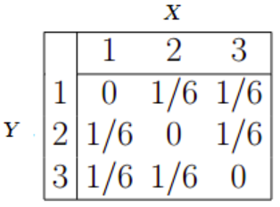
Bivariate Discrete Joint Probability Distribution
Let X and Y be two discrete random variables.
Let their joint probability mass function be denoted as
f(x,y) = P(X = x, Y = y)
The main purpose of the joint distribution is to look for a relationship between the two variables.
The following table (joint PMF) shows the probabilities for events X and Y happening at the same time.
source: https://www.statisticshowto.com/joint-probability-distribution/
8
Notes:
8

Slide 9
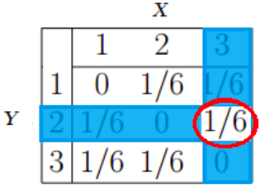
Bivariate Discrete Joint Probability Distribution
You can use the joint PMF table to find probabilities.
For example:
Question: What is the probability for Y = 2 and X = 3?
Answer: Look at the table for the intersection of Y = 2 and X = 3. The answer (1/6) is circled:
Similar idea of joint distribution exists for continuous random variables.
We will learn more about joint probability distributions in the next session.
source: https://www.statisticshowto.com/joint-probability-distribution/
9
Notes:
9

Slide 10
References
* Section 5.1, 5.2 of TS1: Alex Tsun, Probability & Statistics with Applications to Computing (Available at: http://www.alextsun.com/files/Prob_Stat_for_CS_Book.pdf)
* https://www.probabilitycourse.com/chapter5/5_1_0_joint_distributions.php
* https://www.probabilitycourse.com/chapter5/5_2_0_continuous_vars.php
* https://www.statisticshowto.com/joint-probability-distribution
* http://en.wikipedia.org
* https://byjus.com/maths/joint-probability
10
Notes:
10

