Slide 1
Scientific literacy & inquiry (SL&I)
SEMESTER 3
July 29, 2026
Jennifer A. Campbell, PhD, MPH
Course Director

Slide 2
Special topics in Research
Behavioral Economics – Part I

Slide 3
SLI Session | Date | Time Start | Time End | Topic | Instructor | Graded Assessments | USMLE Alignment
Session 1 | 07/29/26 | 1:00 PM | 2:30 PM | Special Topics in Research Part I - Behavioral Economics | Dr. Ekwunife | Active Learning | Epidemiology/population health: Survival Analysis Interpretation
Session 2 | 08/05/26 | 1:00 PM | 2:30 PM | Special Topics in Research Part II - Behavioral Economics | Dr. Ekwunife | Active Learning + UB Learns 3 Attempt Quiz | Epidemiology/population health: Survival Analysis Interpretation
Session 3 | 08/26/26 | 1:00 PM | 2:30 PM | Special Topics in Research Part I - Survival Analysis | Dr. Fraser | Active Learning | Epidemiology/population health: Survival Analysis Interpretation
Session 4 | 09/09/26 | 1:00 PM | 2:30 PM | Special Topics in Research Part II - Survival Analysis | Dr. Fraser | Active Learning + UB Learns 3 Attempt Quiz | Health care policy and economics
Session 5 | 10/07/26 | 1:00 PM | 2:30 PM | Biostats | Dr. Sharma | Active Learning | Distributions of Data; Correlations, Regression, Uses and Interpretation
Session 6 | 10/21/26 | 1:00 PM | 2:30 PM | Biostats | Dr. Sharma | Active Learning + UB Learns 3 Attempt Quiz | Distributions of Data; Correlations, Regression, Uses and Interpretation
Session 7 | 11/04/26 | 1:00 PM | 2:30 PM | Final exam |  | Final exam

Slide 4
Session 1 Outline
Didactics: Healthcare Economics and Healthcare Financing(~45 minutes)
Active Learning (~45 minutes)

Slide 5
Session 1 Learning Objectives
Explain the need for health care insurance.
Explain moral hazard and strategies to avoid moral hazard.
Evaluate adverse selection and strategies to avoid adverse selection.

Slide 6
Alignment of Session Learning Objectives
Session 6 Objectives | Support for MEPO | Alignment with USMLE
Explain the need for health care insurance. Explain moral hazard and strategies to avoid moral hazard. Evaluate adverse selection and strategies to avoid adverse selection. | 6. Systems-Based Practice 6.3 Incorporate considerations of cost awareness and risk-benefit analysis in individual patient and population-based care. 2. Knowledge for Practice 2.1 Demonstrate effective critical thinking, using an investigative and analytic approach. | Healthcare policy and economics.

Slide 7
Healthcare economics & Healthcare financing
Obinna Ekwunife (PhD)
Division of Population Health, Department of Medicine

Slide 8
Objective 1
Explain the need for health care insurance.

Slide 9
Need for health insurance

Slide 10
Need for Health Insurance
Medical care expenditures are:
Uncertain (random illness and injury – who and when)
Variable (can be very expensive)
Right skewed (i.e., skewness > 0). Many people spend nothing in a given year, while a small portion have very high expenditures
What to do?
Borrow?
Save? It is unpredictable and very expensive, making it very difficult to budget for health care expenditures
Insure

Slide 11
What does insurance do?
Spreads financial risk
  Transfers money from the healthy to the sick (within and across people)
It does NOT ensure a return to a healthy state
  Should be called “healthcare cost insurance”
The primary purpose is financial in nature
  To reduce the variance of income (allows consumption smoothing)
  Leave the insured person financially unaffected by a costly, random event.

Slide 12
Objective 2
Explain moral hazard and strategies to avoid moral hazard.

Slide 13
Moral hazard & cost sharing

Slide 14
Moral hazard
Moral hazard refers to behavior deviations that occur when people do not face the full cost of their actions
In the case of healthcare insurance, it is the spending that occurs in excess of what a person would have incurred had they faced the full price of care.

Slide 15
Moral hazard
Two types:
  ex ante moral hazard
    Insurance-induced changes in behavior that alter the probability that an insured event occurs.
    e.g., you engage in risky activities, knowing that you don’t have to pay the full price of the potentially necessary healthcare.
  ex post moral hazard
    Insurance-induced changes in behavior that alter the insured loss after the insured event occurs.
    e.g., after you have some type of accident/illness, you consume more healthcare than if you didn’t have insurance, because you do not face the full cost of its provision.

Slide 16
Moral hazard
Will be more pronounced with more price elastic healthcare services.
  Discretionary, less essential services.
Will be lessened if the insurance policy uses patient-side cost sharing.
  Large deductible
  High coinsurance rates
Notes:
A deductible in healthcare insurance is the amount of money you must pay out of your own pocket for medical services before your insurance starts to pay.
Co-pay is a fixed amount you pay for a healthcare service at the time you get it.
Co-insurance is the percentage of the cost you pay for a covered healthcare service, after you’ve met your deductible.

Slide 17
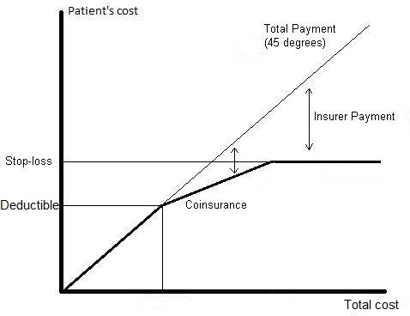
Cost sharing
Designed to reduce moral hazard consumption of healthcare, by making the patient pay some portion of the cost of care.
Deductible = Fixed amount patient must pay before any insurance starts to pay
Coinsurance rate = % of cost patient must pay (after deductible, before stop-loss)
Stop-loss = Maximum payment by patient (i.e., out-of-pocket maximum)
Notes:
A deductible in healthcare insurance is the amount of money you must pay out of your own pocket for medical services before your insurance starts to pay.
Co-pay is a fixed amount you pay for a healthcare service at the time you get it.
Co-insurance is the percentage of the cost you pay for a covered healthcare service, after you’ve met your deductible.

Slide 18
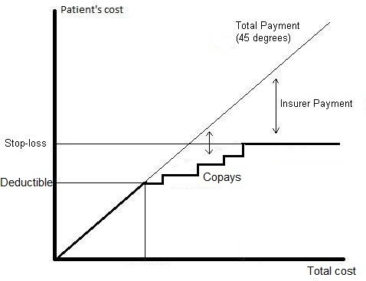
Cost sharing
Designed to reduce moral hazard consumption of healthcare, by making the patient pay some portion of the cost of care.
Co-pay = fixed amount you pay for a healthcare service at the time you get it.
Notes:
A deductible in healthcare insurance is the amount of money you must pay out of your own pocket for medical services before your insurance starts to pay.
Co-pay is a fixed amount you pay for a healthcare service at the time you get it.
Co-insurance is the percentage of the cost you pay for a covered healthcare service, after you’ve met your deductible.

Slide 19
Effect of Cost Sharing
Own-Price Effect
  When the cost of a service goes up, people use it less.
  Example: If my prescription copay rises from $10 to $30, I may cut back on taking the medication.
Cross-Price Effect
  Higher costs for one service can reduce use of other related services.
  Example: If my drug copay rises from $10 to $30, I might also stop visiting my primary care doctor as often.
Offset Effects
  Reduced use of needed care can lead to worse health outcomes.
  Example: Skipping medications now could mean ending up in the ER later.

Slide 20
Tamblyn R, et al (2001). Adverse events associated with prescription drug cost-sharing among poor and elderly persons. JAMA, 285(4), 421-429.
1996 – Quebec reformed its prescription drug insurance
  Expand coverage to groups previously uninsured.
  Increase cost sharing to those previously covered (welfare recipients and the elderly).
Pre reform:
  Welfare recipients and low-income elderly get all drugs for free.
  Non-low income elderly pay $2 per prescription for first 50 fills, then all additional drugs free.
Post reform:
  Aug 1 1996: 25% coinsurance up to $200 for welfare, and $200/500/750 for low/middle/high income elderly.
  Jan 1 1997: $100 deductible for everyone.
Increased out-of-pocket spending for vast majority of beneficiaries

Slide 21
Tamblyn R, et al (2001). Adverse events associated with prescription drug cost-sharing among poor and elderly persons. JAMA, 285(4), 421-429.
The paper examined effects on
  Utilization of essential medications,
  Utilization of less-essential medications,
  ED visits,
  Serious adverse events associated with reductions in drug use.

Slide 22
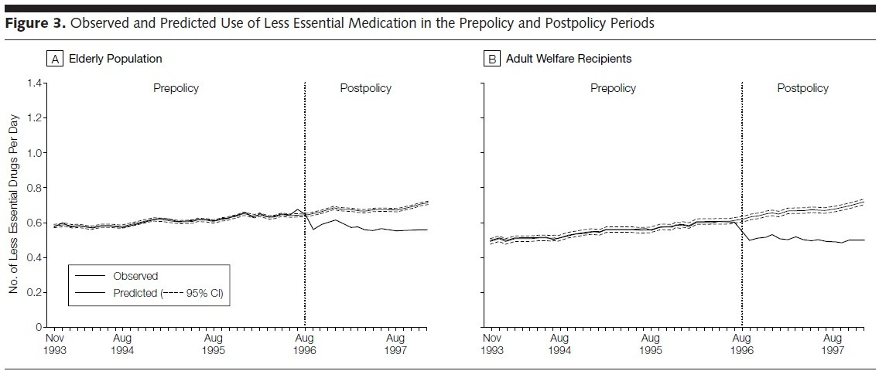

Tamblyn R, et al (2001). Adverse events associated with prescription drug cost-sharing among poor and elderly persons. JAMA, 285(4), 421-429.

Slide 23
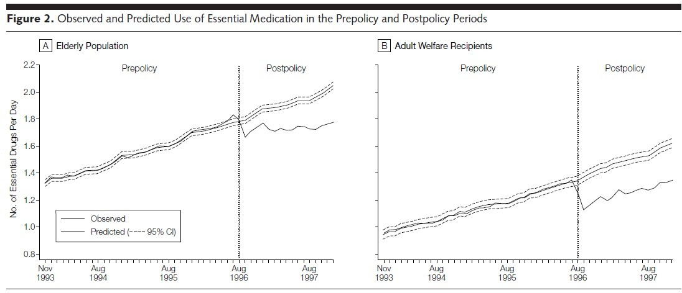

Tamblyn R, et al (2001). Adverse events associated with prescription drug cost-sharing among poor and elderly persons. JAMA, 285(4), 421-429.

Slide 24
Tamblyn R, et al (2001). Adverse events associated with prescription drug cost-sharing among poor and elderly persons. JAMA, 285(4), 421-429.
Offset effects: reductions in use of essential medications were associated with increased adverse health events and ED visits.
  Dose-response relationship: larger reductions in utilization were associated with greater probability of an adverse health event or ED visit.
Main message:
  Cost-sharing is meant to save money by discouraging people from using medications that don’t really improve health.
  But this assumes that individuals will have the capacity to pay for essential drugs, and that they will make rational choices about which drugs to use and abandon.
  In reality, many people cut back on the medicines they actually need. This can lead to worse health and higher costs later—like hospitalizations for conditions that could have been prevented.

Slide 25
First fundamental tradeoff of health insurance
Insurance protects against big financial risks, but too much coverage can encourage people to use more care than necessary (moral hazard).
Generous insurance increases makes people feel safer and more secure, it can also raise overall costs for everyone since people may choose extra or higher-cost services.

Slide 26
Combatting moral hazard from the supply side
Gatekeeper – a delivery model in which the primary care provider (usually the family physician) regulates access to specialist and diagnostic services.
Managed care – Insurance and doctors work together under rules that encourage efficient, high-quality care (e.g., networks, payment systems, monitoring use of services).
Capacity control – uses system-level capacity constraints to limit moral hazard, rather than micro-management of individual decisions by clinicians.
  e.g., Canada – has no patient cost sharing at point of service (for medical care). Waiting times for patients serve as deterrent to reduce moral hazard consumption.

Slide 27
Objective 3
Evaluate adverse selection and strategies to avoid adverse selection.

Slide 28
Risk selection

Slide 29
Risk Selection
Background:
  Insurer costs are driven by the risk status (i.e., healthiness) of its enrollees.
  Insurer spends less if its enrollees are healthier.
  Insurer spends more if its enrollees are sicker.
  It charges premiums based on the average risk of enrollees.

Slide 30
Risk Selection
Risk selection – when an insurance plan ends up attracting mostly healthier or sicker people, depending on how premiums and benefits are set.
Adverse selection – mostly sicker, higher-cost people join the plan.
Favorable risk selection – mostly healthier, lower-cost people join the plan (also called cherry-picking or cream-skimming).
Can happen if insurers design benefits that appeal more to certain groups (e.g., adding gym memberships to attract healthier enrollees).

Slide 31
When does risk selection happen?
People have choices – individuals can pick between different insurance plans.
Unequal information – people know more about their own health than the insurer.
Mismatch in costs – the premium a person pays may not reflect their true healthcare costs.
Result – insurers end up with healthier or sicker groups than expected, depending on who chooses their plan.

Slide 32
Sequence of events in health insurance market
Join a health plan and enter a “risk pool"
Both high and low risk people.
Everyone can have unexpected illnesses or injuries
The health insurer estimates expected medical expenses for the risk pool and calculates premium
When you need healthcare, you and your health insurer share the covered healthcare costs.
  Out-of-pocket costs: copay, deductible, or coinsurance.
Health insurer updates each year.

Slide 33
Confusing terminology alert!
Premium – amount paid by enrollee to be in an insurance plan.
  Typically paid per month (but could be per year, or another length).
  In real world, it’s the sum of the actuarially fair premium (i.e., expected healthcare cost) and loading costs.
Reminder:
  Expected healthcare costs = Actuarially fair premium = the cost of claims
  Loading cost = includes administrative expenses, marketing and sales costs, profit margin and risk margin
Risk premium – the amount in excess of your expected healthcare costs, that you are willing to pay for insurance.
Total WTP = risk premium + expected healthcare costs

Slide 34
Adverse selection and market failure
Assume that there are five risk averse people with differing expected costs in the insurance pool
Person | Expected costs | Risk premium | Willingness to pay | Period 1 Premium=112 | Period 2 | Period 3
1 | 10 | 1 | 11
2 | 50 | 6 | 56
3 | 100 | 15 | 115
4 | 150 | 25 | 175
5 | 250 | 50 | 300
Total | 560
Mean | 112
Insurer Rev
Insurer Costs
Insurer π

Slide 35
Adverse selection and market failure
With a premium of $112, three buy it and two decline
Person | Expected costs | Risk premium | Willingness to pay | Period 1 Premium=112 | Period 2 | Period 3
1 | 10 | 1 | 11 | Decline
2 | 50 | 6 | 56 | Decline
3 | 100 | 15 | 115 | Buy
4 | 150 | 25 | 175 | Buy
5 | 250 | 50 | 300 | Buy
Total | 560
Mean | 112 |  |  | 336
Insurer Rev |  |  |  | 500
Insurer Costs |  |  |  | (164)
Insurer π |  |  |  | 336

Slide 36
Adverse selection and market failure
With a premium of $112, three buy it and two decline
Person | Expected costs | Risk premium | Willingness to pay | Period 1 Premium=112 | Period 2 | Period 3
1 | 10 | 1 | 11 | Decline
2 | 50 | 6 | 56 | Decline
3 | 100 | 15 | 115 | Buy
4 | 150 | 25 | 175 | Buy
5 | 250 | 50 | 300 | Buy
Total | 560
Mean | 112 |  |  | 336
Insurer Rev |  |  |  | 500
Insurer Costs |  |  |  | (164)
Insurer π |  |  |  | 336

Slide 37
Adverse selection and market failure
Insurer loses money, and responds by increasing premium to $167 (mean of EC for person 3, 4, and 5). Now only two of them purchase
Person | Expected costs | Risk premium | Willingness to pay | Period 1 Premium=112 | Period 1 Premium=167 | Period 3
1 | 10 | 1 | 11 | Decline | Decline
2 | 50 | 6 | 56 | Decline | Decline
3 | 100 | 15 | 115 | Buy | Decline
4 | 150 | 25 | 175 | Buy | Buy
5 | 250 | 50 | 300 | Buy | Buy
Total | 560
Mean | 112
Insurer Rev |  |  |  | 336 | 334
Insurer Costs |  |  |  | 500 | 400
Insurer π |  |  |  | (164) | (66)

Slide 38
Adverse selection and market failure
The pattern continues as the healthier individuals drop out of the market, until the market disappears, and adverse selection causes market failure
Person | Expected costs | Risk premium | Willingness to pay | Period 1 Premium=112 | Period 2 Premium=167 | Period 2 Premium=300
1 | 10 | 1 | 11 | Decline | Decline | Decline
2 | 50 | 6 | 56 | Decline | Decline | Decline
3 | 100 | 15 | 115 | Buy | Decline | Decline
4 | 150 | 25 | 175 | Buy | Buy | Decline
5 | 250 | 50 | 300 | Buy | Buy | Buy
Total | 560
Mean | 112
Insurer Rev |  |  |  | 336 | 334 | 200
Insurer Costs |  |  |  | 500 | 400 | 250
Insurer π |  |  |  | (164) | (66) | Decline

Slide 39
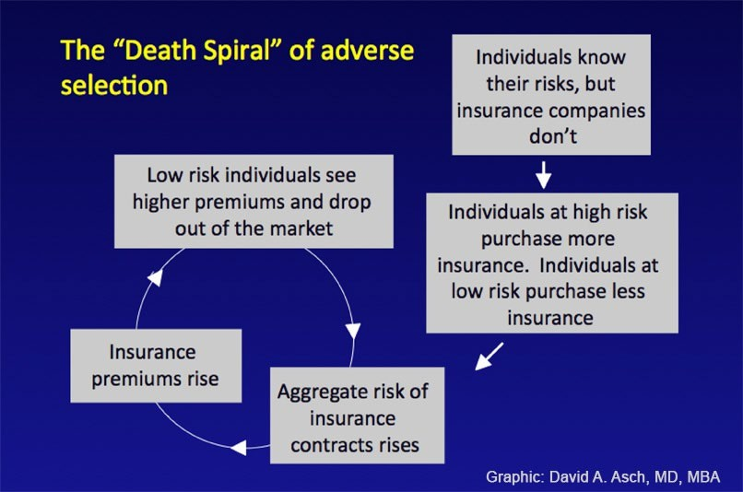
Consequence of adverse selection

Slide 40
Adverse selection – how to address it
When people can choose whether to buy insurance, those who expect high medical costs are more likely to enroll, driving costs up for everyone.
Ways to Reduce the Problem:
Preexisting condition rules – limit how plans handle people with known health issues
Risk adjustment – shift funds from plans with healthier members to those with sicker members.
Group-based or universal coverage – spread risk across larger pools to prevent only high-cost individuals from enrolling (e.g., employer-based insurance, individual mandate, or universal coverage)
NB: The individual mandate is a policy that requires most people to have health insurance or pay a penalty if they do not.
Notes:
In the U.S., the Affordable Care Act (ACA) included an individual mandate to encourage healthy people (not just sick people) to buy insurance.
The idea was to spread risk across a larger pool so premiums stayed more affordable.
The federal penalty was reduced to $0 in 2019, but some states (like California, Massachusetts, and New Jersey) still enforce their own mandates.

Slide 41
Group insurance to reduce selection
How it works:
Insurance is offered to a whole group (like everyone at a workplace).
Premiums are based on the average risk of the group, not each person’s health.
Everyone is automatically covered—young, old, healthy, or sick.
Why it helps:
Low-risk people stay in the pool because they are enrolled with everyone else.
Insurers don’t have to worry only sick people will sign up.
Challenges:
Doesn’t help people who aren’t in a job with benefits.
Can make people feel “locked in” to their jobs just to keep health coverage.

Slide 42
Advantages of Group Insurance
Reduce (or eliminate) adverse selection
Reduce secondary risk
Spread fixed costs
– Loading costs – the portion of your premium that doesn’t pay for healthcare (marketing, administration, etc)
Increase bargaining power for negotiating prices with providers

Slide 43
Primary vs secondary risks
Group insurance reduces “secondary risk”
Two kinds of risk . . .
1. Primary risk → The chance of a costly health event happening to one person.
Example: 5% chance of a $100,000 bill = $5,000 expected cost.
2. Secondary risk → The risk of being wrong about those estimates. Actual costs might be higher or lower than expected.
NB: The bigger the group, the more accurate the estimates → fewer surprises, more stable costs.

Slide 44
Secondary Risk (Variability) Declines as the
Size of Risk Sharing Pool Increases
$8,000
99% Confidence Limit
Expected Value of Claims
$7,000
$6,000
Expected Avg Loss = $5,000
$5,000
$4,000
$3,000
$2,000
200
500
1,000 2,000 5,000
Number of People in Risk Pool
10,000
20,000

Slide 45
Typical Loading Fees by Group Size As a Percent of Benefits
80
70
70
60
50
Percentage
35
40
25
30
20
17.5
11.5
6.5
10
0
Individual
1-10
11-100
100-200
201-1000
1000+

Slide 46
Single payer system enjoys the same advantages of group insurance
Works like one big insurance pool → everyone is covered, so there’s no “cherry-picking” of healthy or sick people.
Because it’s the only buyer of healthcare services, the government has strong bargaining power to negotiate lower prices from hospitals, doctors, and drug companies..

Slide 47
Policies to combat adverse selection
Risk adjustment resolves the problem (in theory):
  Redistributes funds from plans with lower-risk enrollees to plans with higher risk enrollees.
  Plans’ average actuarial risk is determined by enrollees’ individual risk scores; plans with lower actuarial risk will make payments to higher risk plans.
  Payments net to zero.
But…
  Even the most sophisticated approaches to risk measurement leave considerable scope for selection; too many factors associated with healthcare expenditures are unobservable.

Slide 48
Affordable Care Act (ACA)
Several provisions of the ACA could worsen adverse selection:
  No denial for pre-existing
  Tax credits for low and middle income purchasers,
  Health insurance exchanges or marketplaces to expand individual market (i.e., online platforms created by ACA where people can shop for, compare, and buy health insurance plans).
Lots of incentive for insurers to compete by avoiding the sicker enrollees, rather than providing the best value to consumers.
Also, the addition of many new enrollees (who were previously “uninsurable”) was likely to cause premium volatility.
Problem: How do we encourage fair competition and keep the market stable?
  Sounds tough!
Notes:
ACA or Obamacare

Slide 49
ACA: Policies to combat adverse selection
Risk adjustment – Moves money from plans with healthier members to plans with sicker members, so no plan is punished for covering high-risk people.
Reinsurance – Helps insurers by covering part of the costs for very expensive patients.
Risk corridors – Protects insurers from big losses (and limits big profits) by sharing risk with the government.

Slide 50
Jacobs D, Sommers B (2015). Using drugs to discriminate – adverse selection in the insurance marketplace. NEJM, 372:399-402
Even with ACA protections, insurers sometimes design plans to discourage people with costly conditions.
“Adverse tiering” → putting all drugs for a disease into the highest cost-sharing tier.
Example (2014, Florida): All HIV drugs, including generics, were placed in the most expensive tier.
Why? HIV treatment is lifelong and costly → higher risk for insurers.
Similar tactics seen with drugs for cancer, mental illness, diabetes, and arthritis.

Slide 51
Jacobs D, Sommers B (2015). Using drugs to discriminate – adverse selection in the insurance marketplace. NEJM, 372:399-402
Recommendations for how to reduce harms of adverse tiering, and prevent adverse selection:
Price transparency → Make drug costs clear so patients know what they’ll pay..
Limit out-of-pocket costs → Set caps on what patients pay for essential or “protected” medicines (e.g., HIV, cancer drugs).
Fair benefit design → Require marketplace plans to cover drugs at a reasonable value, so patients are not steered away from needed care.

Slide 52
Second fundamental tradeoff of health insurance
Competition vs. adverse selection
– Strategies that we can use to reduce adverse selection tend to reduce competition, and vice versa.

Slide 53
Do you recall the first fundamental tradeoff of health insurance?
Insurance protects against big financial risks, but too much coverage can encourage people to use more care than necessary (moral hazard).
Generous insurance increases makes people feel safer and more secure, it can also raise overall costs for everyone since people may choose extra or higher-cost services.

