Slide 1
Scientific literacy & inquiry (SL&I)
SEMESTER 3
August 5, 2026
Jennifer A. Campbell, PhD, MPH
Course Director

Slide 2
Special topics in Research
Behavioral Economics – Part II

Slide 3
SLI Session | Date | Time Start | Time End | Topic | Instructor | Graded Assessments | USMLE Alignment
Session 1 | 07/29/26 | 1:00 PM | 2:30 PM | Special Topics in Research Part I - Behavioral Economics | Dr. Ekwunife | Active Learning | Epidemiology/population health: Survival Analysis Interpretation
Session 2 | 08/05/26 | 1:00 PM | 2:30 PM | Special Topics in Research Part II - Behavioral Economics | Dr. Ekwunife | Active Learning + UB Learns 3 Attempt Quiz | Epidemiology/population health: Survival Analysis Interpretation
Session 3 | 08/26/26 | 1:00 PM | 2:30 PM | Special Topics in Research Part I - Survival Analysis | Dr. Fraser | Active Learning | Epidemiology/population health: Survival Analysis Interpretation
Session 4 | 09/09/26 | 1:00 PM | 2:30 PM | Special Topics in Research Part II - Survival Analysis | Dr. Fraser | Active Learning + UB Learns 3 Attempt Quiz | Health care policy and economics
Session 5 | 10/07/26 | 1:00 PM | 2:30 PM | Biostats | Dr. Sharma | Active Learning | Distributions of Data; Correlations, Regression, Uses and Interpretation
Session 6 | 10/21/26 | 1:00 PM | 2:30 PM | Biostats | Dr. Sharma | Active Learning + UB Learns 3 Attempt Quiz | Distributions of Data; Correlations, Regression, Uses and Interpretation
Session 7 | 11/04/26 | 1:00 PM | 2:30 PM | Final exam |  | Final exam

Slide 4
Session 2 Outline
Didactics: Healthcare Economics and Healthcare Financing (45 minutes)
Gamified Knowledge Check (25 minutes)
Open Book Quiz Start (20 minutes) Due 08/12

Slide 5
Session 2 Learning Objectives
Explain the role and history of private insurance in the United States.
Explain public insurance and how it differs from private insurance.
Evaluate reimbursement issues.

Slide 6
Alignment of Session Learning Objectives
Session 2 Objectives | Support for MEPO | Alignment with USMLE
Explain the role and history of private insurance in the United States. Explain public insurance and how it differs from private insurance. Evaluate reimbursement issues. | 6. Systems-Based Practice 6.3 Incorporate considerations of cost awareness and risk-benefit analysis in individual patient and population-based care. 2. Knowledge for Practice 2.1 Demonstrate effective critical thinking, using an investigative and analytic approach. | Healthcare policy and economics.

Slide 7
Healthcare economics & Healthcare financing II
Obinna Ekwunife (PhD)
Division of Population Health, Department of Medicine

Slide 8
QUICK REVIEW

Slide 9






Health finance system (simplified) overview
Individuals/ Businesses
Out-of-pocket payments
Healthcare Providers
Taxes
Provider payments
Government
Medicare, Medicaid, CHIP, VA
Premiums
Public employee’s premiums, subsidies
Private Insurers

Slide 10
Objective 1
Explain the role and history of private insurance in the United States.

Slide 11
Private insurance

Slide 12
Who Usually Has Private Health Insurance?
Through Work → People employed by companies that offer health insurance benefits.
Buy It Themselves → Individuals or families who can afford to pay monthly premiums.
With Public Support →
  Medicare Advantage (for seniors/disabled who choose private plan options).
  Health Insurance Marketplace/Exchange (where people can buy plans, sometimes with government subsidies) E.g. TRICARE which is coverage for uniformed services
Notes:
Medicare Advantage (also called Medicare Part C) is a type of health insurance plan in the U.S. offered by private insurance companies that contract with Medicare.

Slide 13
A Quick History of Health Insurance in the U.S.
1929 → A group of Dallas teachers made a deal with Baylor Hospital to cover hospital bills. This became the first Blue Cross plan.
1940s → Only about 9% of Americans had hospital insurance.
World War II era → The government froze wage increment to prevent undue competition for workers but increment in fringe benefits (like health insurance) were allowed. Employers used insurance as a way to attract workers.
1954 → The IRS ruled that health insurance benefits are not taxable income. This made insurance through work even more valuable.
1973 → The HMO Act encouraged employers to offer managed care plans.
2010 → The Affordable Care Act (ACA) required most individuals and employers to provide health insurance coverage.

Slide 14
Tax subsidy for employer sponsored health insurance
History
World War II → Employers could not raise wages (because of wage controls), so they used fringe benefits like health insurance to attract workers.
Good Deal for Workers → These benefits were not taxed, unlike regular wages.
1954 Tax Code → Made this tax break permanent.
Example:
$100 in wages (with ~30% tax) = $70 take-home pay.
$100 in health insurance benefits = full $100 value.
Result: People preferred job-based health insurance since it gave them more coverage and lower out-of-pocket costs than buying insurance themselves.

Slide 15
Effect of the tax subsidy for employer sponsored health insurance
Great if you have a good job → Lots of coverage, sometimes more than you really need.
Not so great if you do not → Non-job insurance became limited, expensive, and harder to find.
Rising costs → Less focus on controlling spending, more high-tech treatments driving prices up.
Unequal impact → Benefits mostly help higher-income workers, while lower-income workers get less.
Workplace challenges → Job-based health insurance led to fights between workers and employers, made people feel “locked in” to their jobs for coverage, and put small businesses at a disadvantage compared to big companies.
Tax system effects → The government collects less tax because employer health benefits are not taxed, so higher tax rates are needed elsewhere to make up the difference.

Slide 16
Two types of employer sponsored insurance
Fully Insured (about 45% of employers)
The insurance company takes on the risk and charges the employer a premium based on group’s risk rating.
Insurance company sets utilization policies.
The insurer sets the rules for what care is covered and how it is used.
Self-Insured (about 55% of employers)
The employer takes on the risk and pays for workers’ health costs directly.
An insurance company may still help with administration (like processing claims).
Employers have more flexibility, and these plans are often exempt from many state regulations.

Slide 17
Types of health insurance (from patient perspective)
Plan Type | Network Rules | Specialist Referrals | Out-of-Network Coverage | Example in Buffalo | Relative Cost
PPO (Preferred Provider Organization) | In-network preferred, but flexible | No referral needed | Yes, at higher cost | Highmark BCBSWNY PPO | 💲💲💲💲 Highest
EPO (Exclusive Provider Organization) | Must use in-network providers | No referral needed | No, except emergencies | Highmark BCBS EPO | 💲💲 💲 Moderate
POS (Point of Service) | In-network encouraged | Yes – referral needed | Yes, at higher cost | Univera POS | 💲💲 Moderate
HMO (Health Maintenance Organization) | Must use in-network providers | Yes – referral from PCP required | No, except emergencies | Independent Health HMO, Univera HMO | 💲 Lowest
Notes:
BCBSWNY PPO - BlueCross BlueShield of Western New York PPO

Slide 18
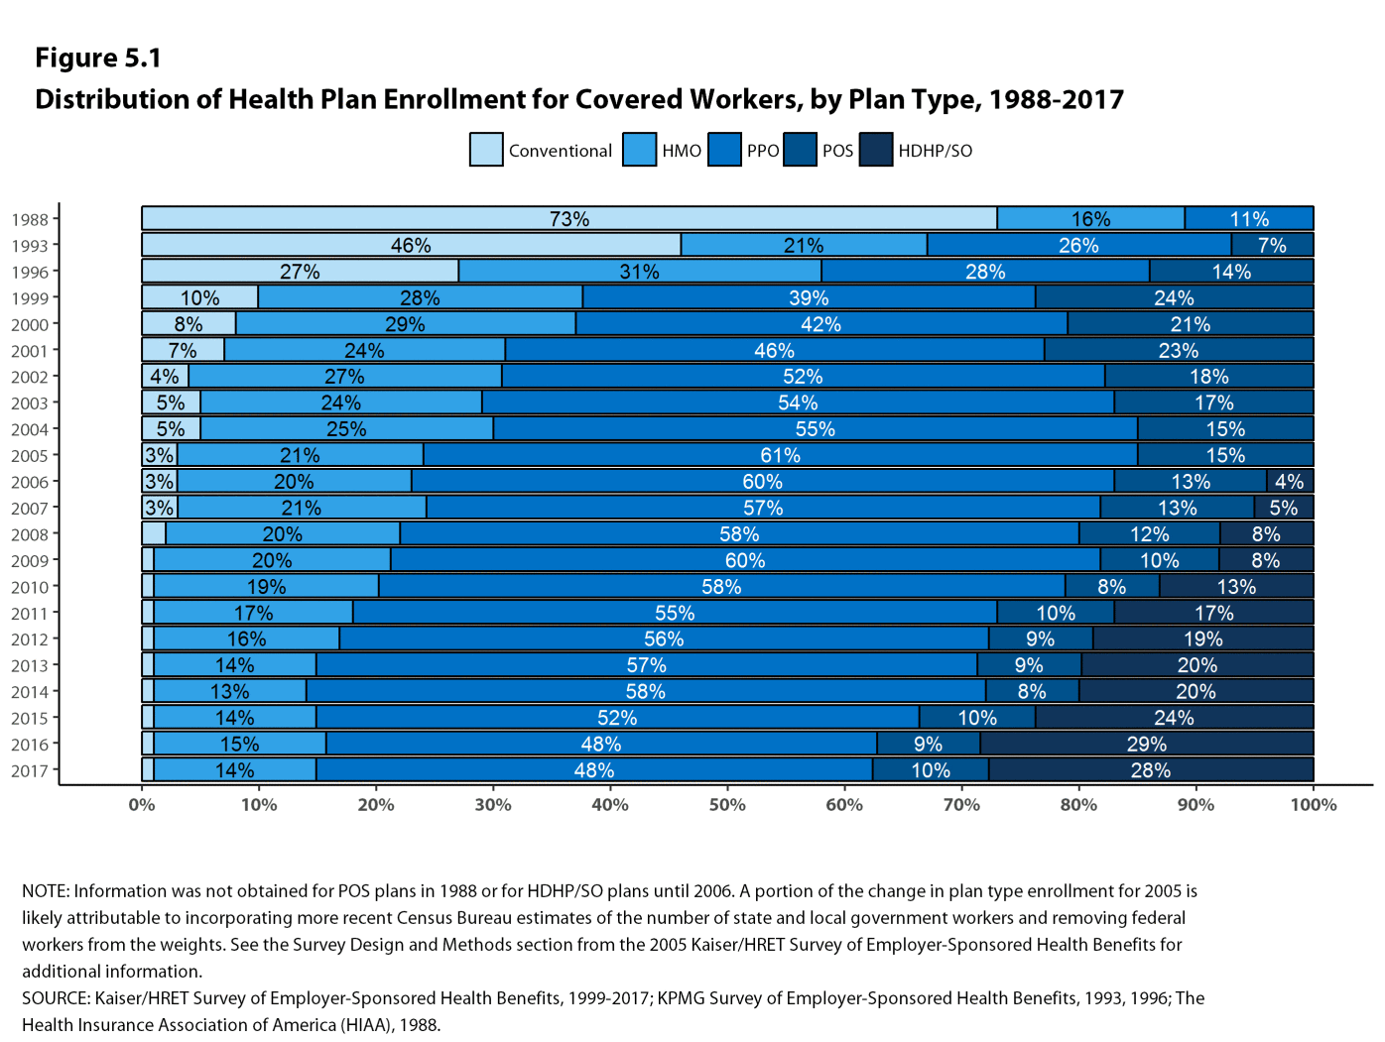
Notes:
High Deductible Health Plan (HDHP), sometimes paired with a Savings Option (SO) is not a separate “network type” — it’s a cost-sharing structure that can overlay an HMO, PPO, EPO, or POS.
Note: Conventional Plan is indemnity plan or fee-for-service plan, the traditional type of health insurance that existed before the HMOs, PPOs and other managed care models.

Slide 19
Evidence on High Deductible Health Plans (HDHPs)
💡 What’s a deductible?
It is the amount you pay out-of-pocket before your insurance starts to cover costs.
Study – What does a Deductible Do? The Impact of Cost-Sharing on Health Care Prices, Quantities, and Spending Dynamics (Brot-Goldberg et al., 2017, Quarterly Journal of Economics):
Natural experiment - One firm switched its employees from a zero cost-sharing plan → to a high-deductible plan.
Result: Health spending dropped by 12–14%.
What could be the reason?
Price shopping – people looked for cheaper options.
Using less care – people cut back on services overall.
Substituting care – people switched to lower-cost services.

Slide 20
Evidence on High Deductible Health Plans (HDHPs)
Study – What does a Deductible Do? The Impact of Cost-Sharing on Health Care Prices, Quantities, and Spending Dynamics (Brot-Goldberg et al., 2017, Quarterly Journal of Economics):
What did the authors find?
Spending reductions are entirely due to outright reduction in quantity.
i.e. people used less care – people cut back on services overall.
  No evidence of price shopping.
  Consumers reduce quantity of both potentially valuable care (preventive services) and potentially wasteful care (imaging services).
Reduction of 42% while under the deductible.

Slide 21
Summary: Key Points
Employer sponsored health insurance dominates private health insurance market
  Tax subsidies lead to more insurance, more care, and higher costs
Half are fully-insured and half self-insured
  Bigger employers are more likely to be self-insured
Employers are shifting toward more to defined contribution vs. defined benefit (e.g., comprehensive insurance)
Premiums continuing to increase
More people shifting to HDHP
Notes:
Employers prefer defined contribution because it gives them budget control and flexibility, while shifting rising cost risks onto employees. Employees, meanwhile, get more choice—but also more financial responsibility.
HDHPs are growing because they save employers money, offer employees lower premiums and HSA benefits,

Slide 22
Objective 2
Explain public insurance and how it differs from private insurance.

Slide 23
Public insurance

Slide 24
Public Insurance
Examples – Medicare (Federal, >65 + long-term disabilities), Medicaid (Federal/State, low income), Children’s Health Insurance Program (CHIP), Basic Health Programs, the Civilian Health and Medical Program’s of Veteran’s Affairs (CHAMPVA)
As always, for each program, we want to know:
Who is eligible?
What services are covered?
How is it financed?

Slide 25
Medicare
Established in 1965 to provide economic security to seniors (age 65+)
Expanded in 1972 to cover younger beneficiaries with permanent disabilities (e.g., ALS), including end stage renal disease
2020: covered over 61 million people in parts A and B
  2020 Traditional: 37.7 million
  2020 Medicare advantage (MA): 24.1 million
Covers individuals without regard to income or medical history.
  Not “Means Tested” - Medicare is like a membership earned through work and age, not based on financial need.
Four parts: A, B, C, and D
  Part A – Hospital and skilled nursing care
  Part B – Physician and outpatient hospital care
  Part C – Private Medicare – usually called Medicare Advantage
  Part D – Outpatient prescription drug coverage
Notes:
ALS stands for Amyotrophic Lateral Sclerosis
NB: A program is means tested if eligibility depends on your income or financial need (for example, Medicaid, SNAP/food stamps, or housing assistance).

Slide 26
Medicare Part A
What it covers:
Hospital stays 🏥 (inpatient care)
Skilled nursing facility care (after a hospital stay) 🩺
Hospice care ❤️
Short-term home health care (up to 100 days after a hospital stay) 🏡
How it is paid for:
Funded mostly through payroll taxes: 1.45% from you + 1.45% from your employer = 2.9% total.
Who gets it:
If you or your spouse worked and paid payroll taxes for 10 years or more, you’re automatically entitled to Part A with no premium.
If you worked fewer than 10 years, you can still get it — but you will pay a monthly premium.
Think of Part A as “hospital coverage you earn through years of work.”
Notes:
Hospice care is a special type of healthcare focused on providing comfort and support to people who are nearing the end of life, typically with a life expectancy of six months or less if the illness runs its normal course.

Slide 27
Medicare Part A
Medicare Part A: What You Pay (2021 Example):
Deductible: $1,484 (you pay this first)
Hospital Stays:
  Days 1–60 → $0 per day
  Days 61–90 → $371 per day
  Day 91 and beyond → $742 per day, but only for 60 “lifetime reserve days” (can use anytime in your life).
  After reserve days are gone → You pay the full cost of the hospital stay.

Slide 28
Medicare Part B
Supplementary Medical Insurance program helps pay for:
  Physician services
  Outpatient hospital care
  Preventive services, such as mammography screening
  Mental health services
  Home health visits (exceeding 100 visits per spell of illness)
  X-rays, diagnostic tests, durable medical equipment

Slide 29
Medicare Part B
How you get it:
If you are already receiving Social Security when you turn 65, you are automatically enrolled in Part B (unless you say no).
How it is paid for:
Funded by a mix of monthly premiums (paid by beneficiaries) and federal tax dollars.
Premiums are usually taken right out of your Social Security check.
What it costs (2021):
Standard monthly premium: $148.50 (higher if you have higher income).
Deductible: $201.
After that, Medicare pays 80% of covered services, and you pay the remaining 20% coinsurance.
Think of Part B as your coverage for doctor visits, tests, and outpatient care, paid through a monthly premium.

Slide 30
Medicare Part C (aka Medicare Advantage, aka Private Medicare)
What it is:
Private insurance plans that combine your Part A (hospital) and Part B (medical) benefits
These plans are approved and paid by Medicare but run by private companies.
Most plans are HMOs or PPOs, and many also include Part D (prescription drug coverage).
Who can join?:
You must already have Medicare Part A and Part B.
You must live in the plan’s service area.
Most people are eligible, but there are restrictions if you have End-Stage Renal Disease (ESRD)
Costs:
You still pay your Part B premium, and sometimes an extra premium to the private plan.
Cost sharing (copays, coinsurance, deductibles) varies by plan, but each has a maximum out-of-pocket limit, unlike traditional Medicare.
Notes:
PPO – Preferred Provider Organization

Slide 31
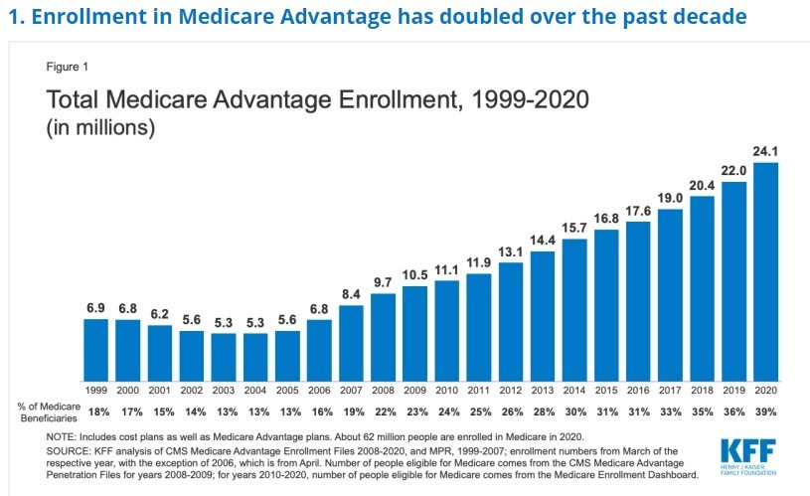
Notes:
PPO – Preferred Provider Organization

Slide 32
Medicare Part D – Prescription Drug Coverage
How it is funded:
Paid for through monthly premiums, federal tax dollars, and state contributions.
History:
Created by the Medicare Modernization Act of 2003, started in 2006.
How it works:
You can choose from two type of private plans
1. Stand-alone drug plans – added onto Traditional Medicare.
2. Medicare Advantage drug plans (HMOs, PPOs) – combine medical + drug coverage.
Enrollment rules:
Part D is voluntary, but if you do not sign up when first eligible (and do not have other credible drug coverage), you pay a late-enrollment penalty.
Open enrollment: Oct 15 – Dec 7 each year (Medicare Advantage has an extra Jan 1 – Mar 31 period).
After enrolling, you’re generally “locked in” until the next enrollment window.
NB: Plans have formularies (lists of covered drugs). Certain categories, like mental health medications, must always be covered.
Notes:
PPO – Preferred Provider Organization

Slide 33
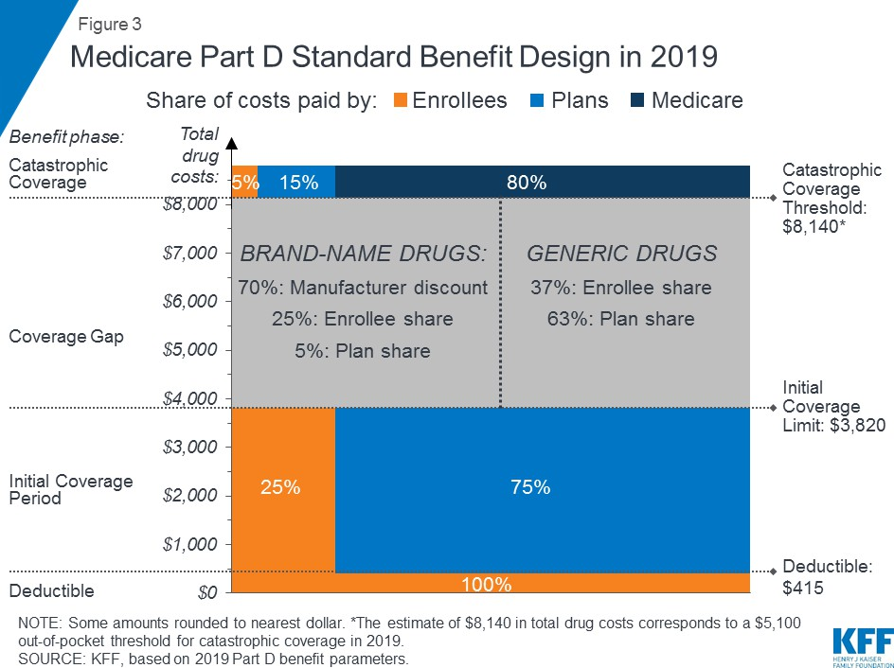
Notes:
PPO – Preferred Provider Organization

Slide 34
Gaps in Medicare benefits and out-of-pocket spending
Medicare has high cost-sharing requirements
Medicare coverage is limited in key areas
  No long-term care
  No hearing aids, eyeglasses, or dental care
Most beneficiaries have some additional insurance, aka “supplemental coverage”
  Hospitalization deductible
  Patient’s cost sharing (patients % responsibility)
  Some home care
Notes:
PPO – Preferred Provider Organization

Slide 35
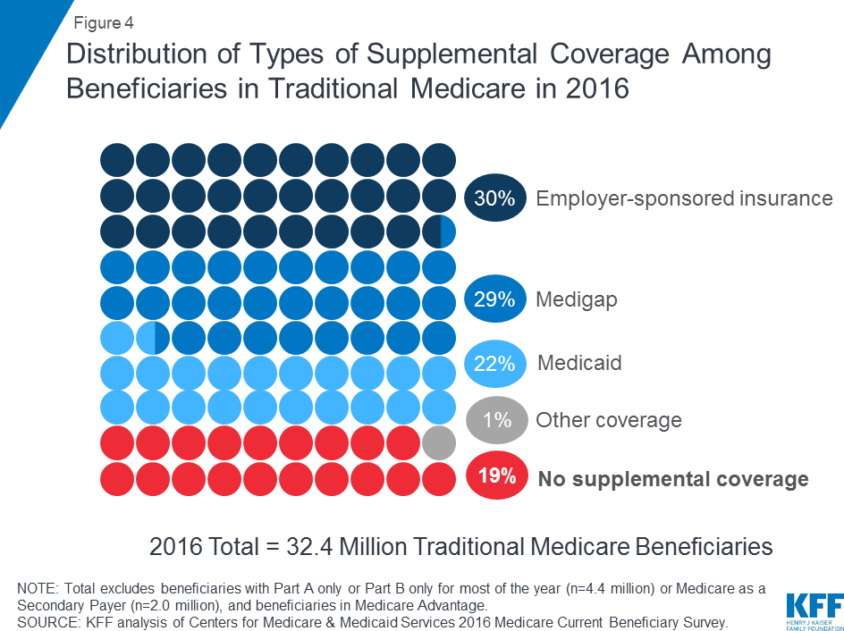
Notes:
PPO – Preferred Provider Organization

Slide 36
Medicare Summary
Medicare is complex and has 4 parts:
  Hospital (A)
  Physician services (B)
  Medicare Advantage (C = private A+B)
  Prescription drugs (D)
Covers elderly and disabled, and ESRD
Funded by general funds, payroll taxes, and premiums
Costs are large and increasing but not as much as private market
Target for reform
Notes:
ESRD – End Stage Renal Disease

Slide 37
Medicaid Overview
Enacted in 1965 as companion legislation to Medicare (added Title XIX of Social Security Act)
70.83 million enrolled in 2025 in 50 states + DC
Government insurance program for people whose income and resources are insufficient to pay for care
Eligibility – varies across states
  Low income? Children? Pregnant? Parents? Disabled? Senior citizen?
  Expanded as part of Affordable Care Act to include most low-income individuals (varies by state)
Covered services
  Includes mandatory services and gives states options for broader coverage
Financing
  Federal government matches states’ contributions (at rates ranging from 50-77% of total cost) to pay for care

Slide 38
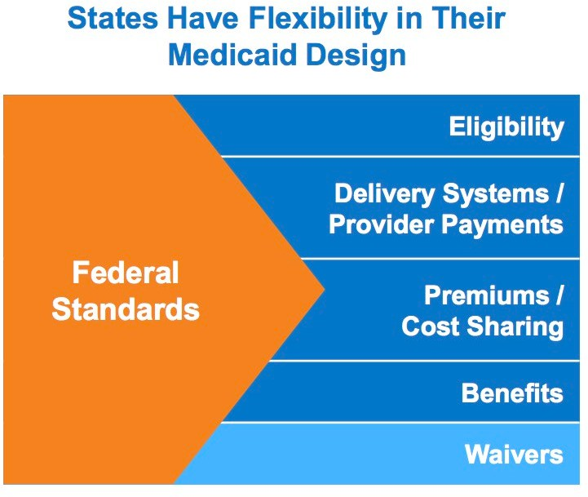
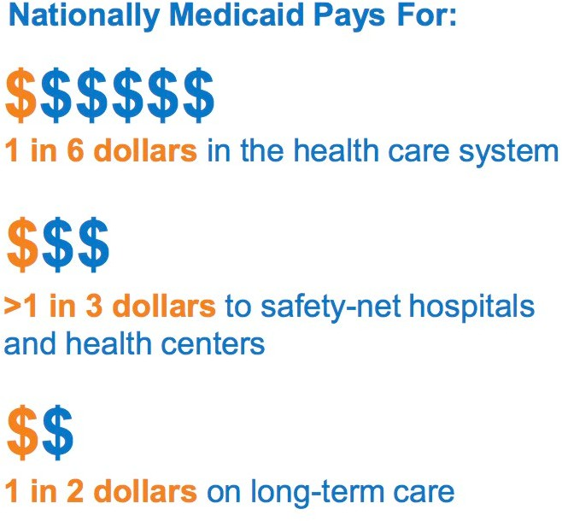

Slide 39
Medicaid Waivers
A Medicaid waiver is a provision in Medicaid law which allows the federal government to waive rules that usually apply to the Medicaid program
The intention is to allow individual states to accomplish certain goals, such as reducing costs, expanding coverage, or improving care for certain target groups such as the elderly or women who are pregnant
Thanks to these waivers, states can provide services to their residents that wouldn’t usually be covered by Medicaid
– For example, in-home care for people who would otherwise have to go into long-term institutional care.

Slide 40
Dual eligibles
Who are “Dual Eligibles”?
People who qualify for both Medicare and Medicaid.
About 12.2 million Americans in 2018.
Types of Dual Eligibles
Some get full benefits (Medicaid helps cover Medicare premiums and cost-sharing, plus extra services).
Others get partial benefits (Medicaid only helps with some Medicare costs).
In reality, there are 8 specific categories based on age, disability, income, and what benefits they qualify for.

Slide 41
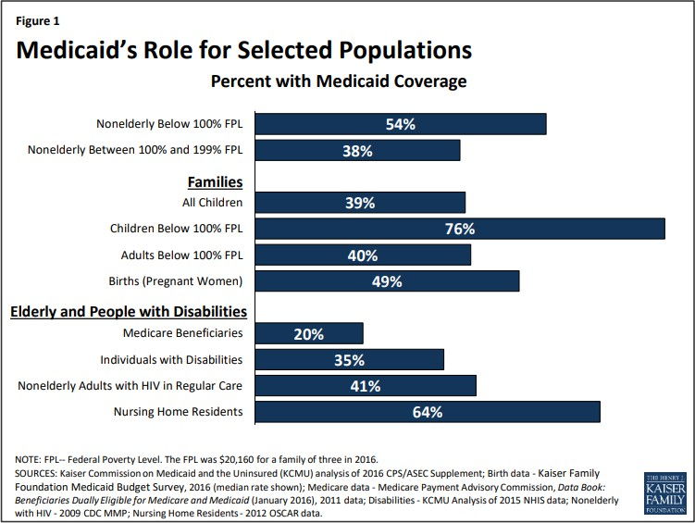

Slide 42
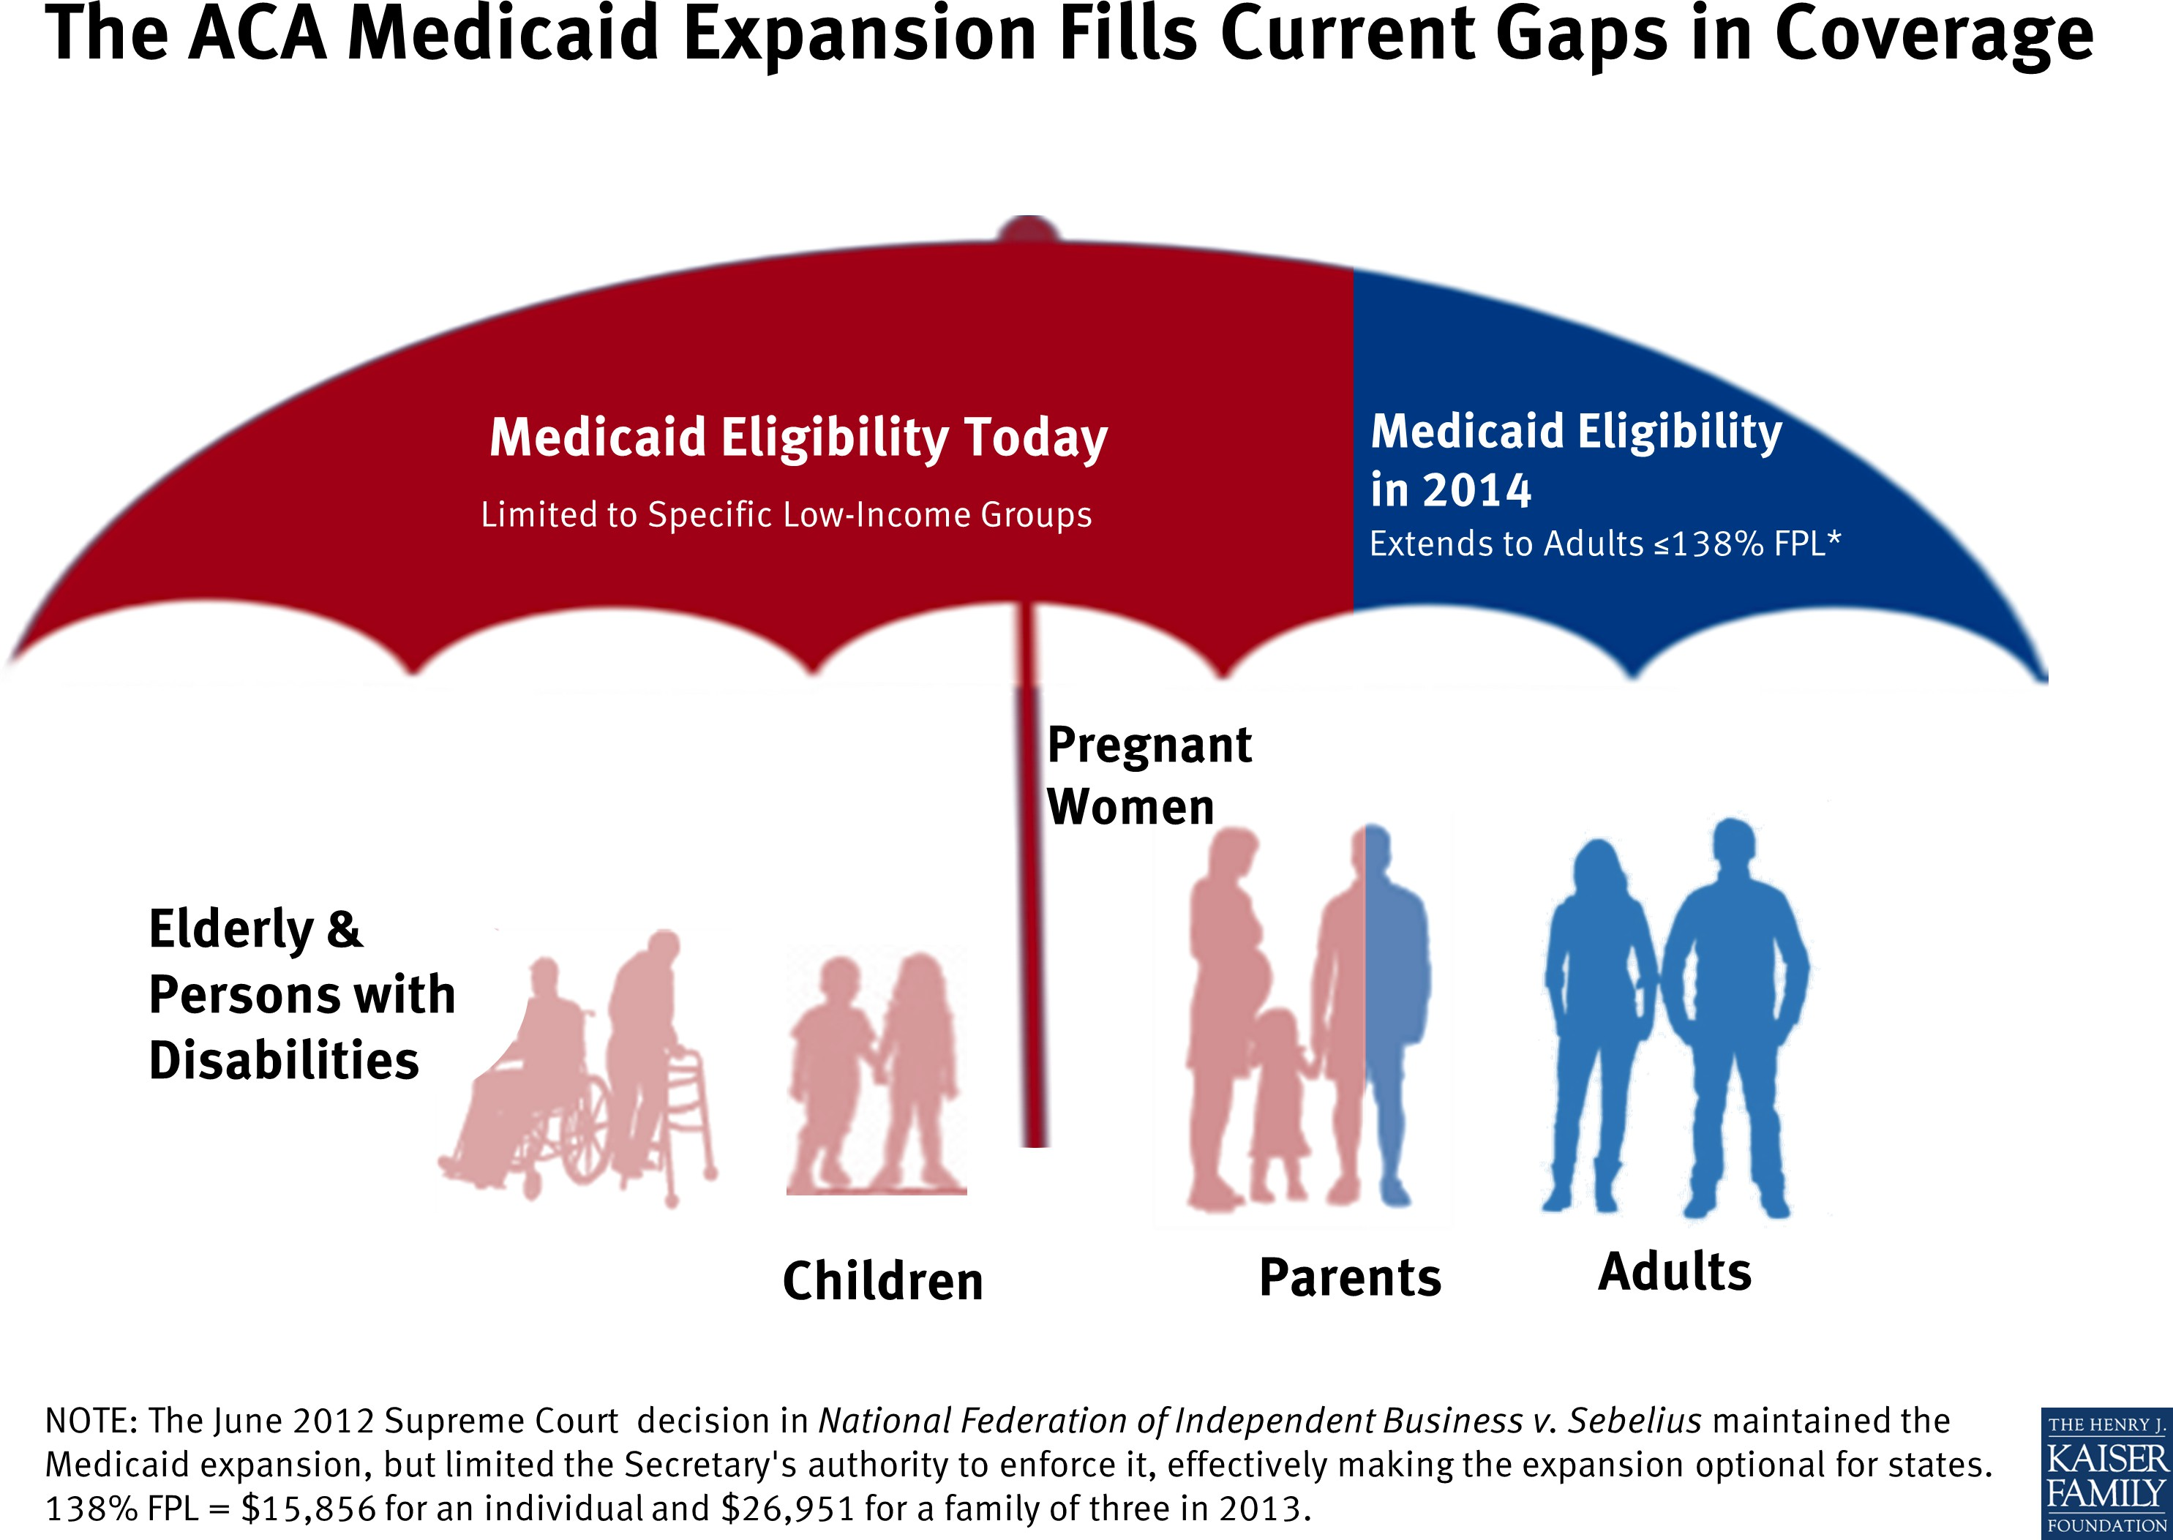
Notes:
Before the Affordable Care Act (ACA), a lot of low-income adults didn’t qualify for Medicaid, even though they couldn’t afford private insurance. The ACA’s Medicaid expansion (in states that adopted it) closed this gap by:
Allowing all adults with less than 138% of the Federal Poverty Level (FPL) to qualify.
Covering many people who were previously left out of the system.

Slide 43
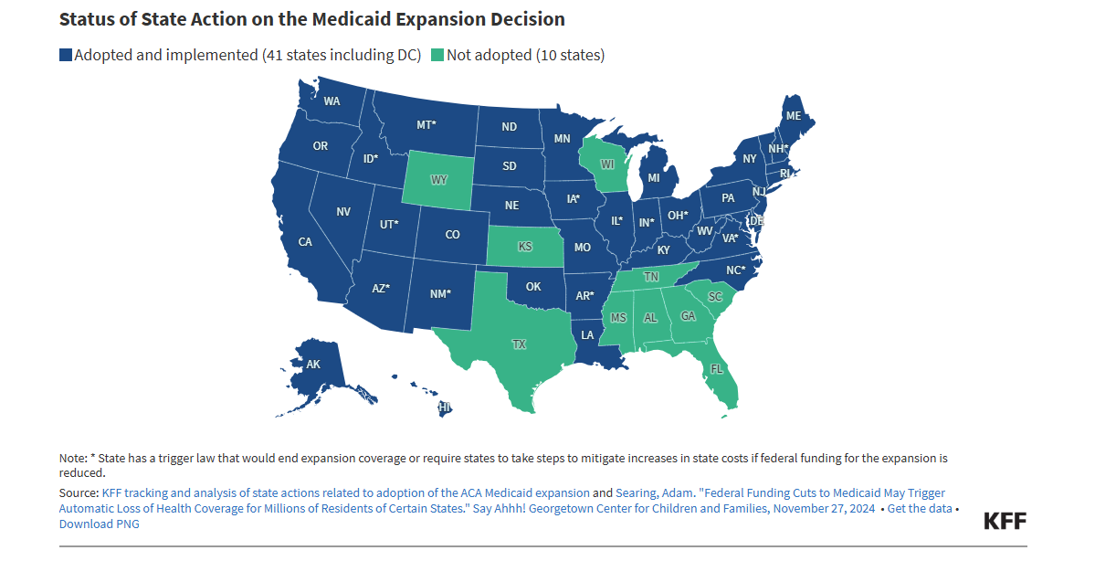
Notes:
Before the Affordable Care Act (ACA), a lot of low-income adults didn’t qualify for Medicaid, even though they couldn’t afford private insurance. The ACA’s Medicaid expansion (in states that adopted it) closed this gap by:
Allowing all adults with less than 138% of the Federal Poverty Level (FPL) to qualify.
Covering many people who were previously left out of the system.

Slide 44
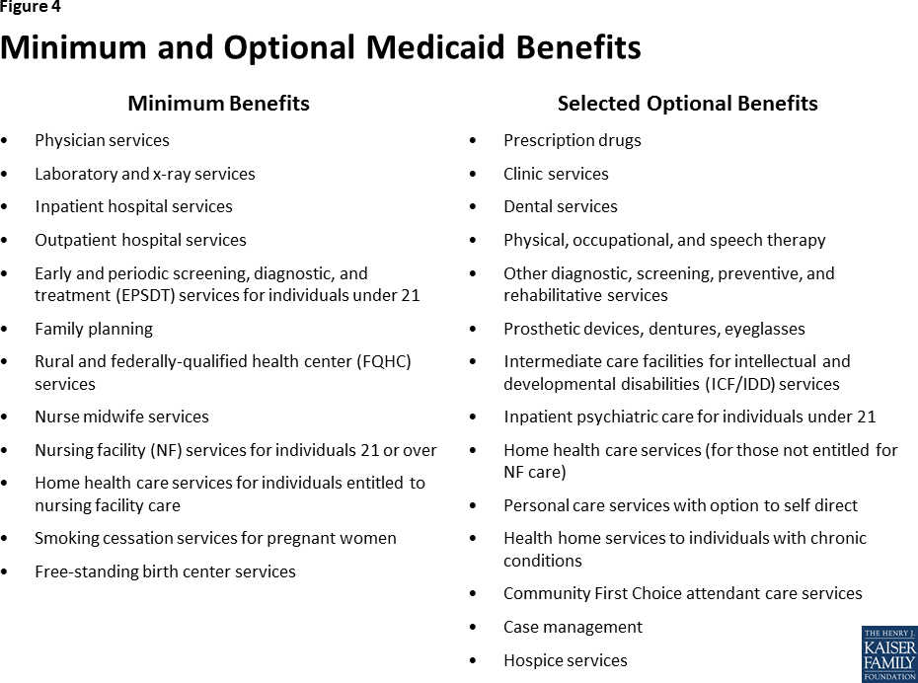
What services are covered?

Slide 45
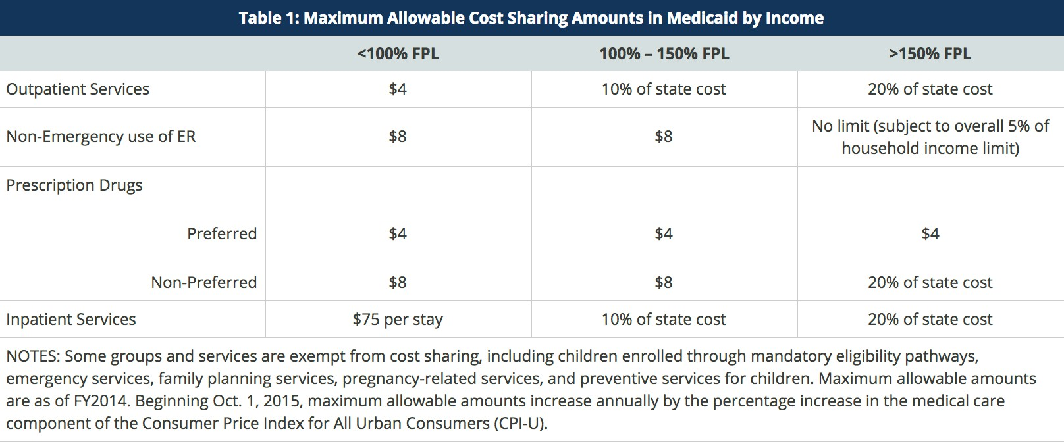
Medicaid cost sharing
States have flexibility to impose premiums and cost-sharing in Medicaid, up to maximum allowed amounts.
Cost-sharing cannot be charged for preventive services for children or emergency, family planning, and pregnancy-related services in Medicaid.

Slide 46
Medicaid Summary
Who it covers
Originally designed for children, pregnant women, and families with low incomes.
After the Affordable Care Act (ACA), many states expanded it to cover all low-income adults.
How it works
It’s a federal–state partnership: the federal government sets the rules, and states run the program.
Medicaid is also the main payer of long-term care (like nursing home stays).
Costs
Very limited cost sharing (small copays in some cases).
Challenges
Not all states expanded Medicaid under the ACA.
This leaves a “coverage gap”: some low-income adults earn too much for traditional Medicaid but not enough to afford private insurance.

Slide 47
Objective 3
Evaluate reimbursement issues.

Slide 48
Reimbursement issues

Slide 49
Reimbursement Issues Affecting Safety and Quality
How providers get paid matters for patient care.
Two main types of reimbursement: Retrospective vs. Prospective.
1. Retrospective reimbursement (pay after care):
Hospitals are reimbursed for costs after services are provided.
Formula: Payment = Workload × Average Cost per Case OR
          = Workload × No of services × fee per item of service
    Example: The more patients treated, or tests ordered, the higher the bill
Mode used depends on whether hospital is reimbursed on actual costs incurred or on a fee-for-service basis
Problem: May encourage more services, not always better care.

Slide 50
2. Prospective Reimbursement (pay before care)
Prospective reimbursement (pay in advance):
Payments are set ahead of time, not based on actual costs..
Through global budgeting or prospectively set cost per case.
Example of prospectively set cost per case is diagnosis-related groups (DRGs) pricing scheme introduced by Medicare in 1984 and later used in other countries.
Predicted effects of the DRG pricing:
    Cost shifting – moving costs to other services/payers.
    Patient shifting – preferring patients with simpler conditions.
    DRG creep – coding patients into higher-paying categories.
NB: Prospective systems encourage hospitals to control costs, but payers must monitor quality and fairness to protect patients

Slide 51
Pay-for-Performance (P4P)
What it is: A payment model that ties reimbursement to quality measures such as outcomes, safety, and patient satisfaction.
Goal: Reward providers for delivering better care and improving efficiency.
Examples: Hospital Readmission Reduction Program (HRRP) & Value-Based Purchasing (VBP).
Benefits: (1) Rewards high-quality, efficient care.; (2) Encourages prevention and safety improvements.
Challenges: (1) May unfairly penalize providers serving high-risk populations; (2) Focus on measurable metrics may overlook other aspects of care; (3) Risk of “gaming the system” (e.g., coding or documentation tricks).

Slide 52
EMTALA and Emergency Services
What it EMTALA?
EMTALA (Emergency Medical Treatment and Labor Act, 1986). Federal law requiring hospitals with ERs to stabilize and treat anyone in an emergency, regardless of insurance or ability to pay.
Impact on Safety & Quality
Protects patients from being denied emergency care (“patient dumping”).
Ensures access to lifesaving services, especially for the uninsured and vulnerable.
Challenges
No dedicated funding → hospitals often provide care without reimbursement.
Creates financial strain on safety-net hospitals.
May reduce resources for other services, affecting overall quality.
Burden falls unevenly → urban public hospitals handle most EMTALA cases.

Slide 53
Gamified knowledge check

