Slide 1
Scientific literacy & inquiry (SL&I)
Session 6: What do the data look like, and how are two things related?
Sonia Sharma, PhD Course Instructor

Slide 2
SLI Session | Date | Time Start | Time End | Topic | Instructor | Graded Assessments | USMLE Alignment
Session 1 | 07/29/26 | 1:00 PM | 2:30 PM | Special Topics in Research Part I - Behavioral Economics | Dr. Ekwunife | Active Learning | Epidemiology/population health: Survival Analysis Interpretation
Session 2 | 08/05/26 | 1:00 PM | 2:30 PM | Special Topics in Research Part II - Behavioral Economics | Dr. Ekwunife | Active Learning + UB Learns 3 Attempt Quiz | Epidemiology/population health: Survival Analysis Interpretation
Session 3 | 08/26/26 | 1:00 PM | 2:30 PM | Special Topics in Research Part I - Survival Analysis | Dr. Fraser | Active Learning | Epidemiology/population health: Survival Analysis Interpretation
Session 4 | 09/09/26 | 1:00 PM | 2:30 PM | Special Topics in Research Part II - Survival Analysis | Dr. Fraser | Active Learning + UB Learns 3 Attempt Quiz | Health care policy and economics
Session 5 | 10/07/26 | 1:00 PM | 2:30 PM | Biostats | Dr. Sharma | Active Learning | Distributions of Data; Correlations, Regression, Uses and Interpretation
Session 6 | 10/21/26 | 1:00 PM | 2:30 PM | Biostats | Dr. Sharma | Active Learning + UB Learns 3 Attempt Quiz | Distributions of Data; Correlations, Regression, Uses and Interpretation
Session 7 | 11/04/26 | 1:00 PM | 2:30 PM | Final exam |  | Final exam

Slide 3
Applied biostatistics part 2
What do the data look like, and how are two things related?

Slide 4
Clinical case
Ms. D, the 58-year-old with hypertension from Session 5, is back for her 3-month visit. BP 136/82 mmHg on lisinopril and amlodipine. She has two new questions.
1 · “My labs flagged something.”
Her annual panel of 20 tests is normal except ALT 44 U/L (reference 7–40), marked H. “Is something wrong with my liver?”
2 · “How much would cutting salt help?”
She eats about 5 g of sodium a day. She read that each extra gram raises blood pressure. “If I cut my salt in half, how much will my BP come down?”

Slide 5
Two new questions for every dataset
How are the data spread?
Is this one value unusual, or expected?
Tools: shape, mean vs. median, SD, the normal curve, z-scores, reference ranges
How are two things related?
When one goes up, what happens to the other, and by how much?
Tools: correlation (r, r²), regression slope (β), adjusted estimates, odds ratios
Session 5 asked whether a difference is real and whether it matters. Today's tools answer Ms. D's two questions.

Slide 6
Session 6 objectives
1
Describe a distribution's shape and choose the right summary (mean and SD vs. median and IQR)
2
Use the normal curve and z-scores to judge whether a value is unusual, and tell SD apart from SE
3
Interpret a correlation coefficient (direction, strength, r²) and name the ways r misleads
4
Interpret regression output: slope, adjusted vs. unadjusted estimates, R², odds ratios, and CIs against the null
5
Match the regression model to the outcome: linear, logistic, or Cox

Slide 7
Alignment of Session Learning Objectives
Session Objectives | Support for MEPO | Alignment with USMLE
Describe a distribution's shape and choose the right summary (mean and SD vs. median and IQR) Use the normal curve and z-scores to judge whether a value is unusual, and tell SD apart from SE Interpret a correlation coefficient (direction, strength, r²) and name the ways r misleads Interpret regression output: slope, adjusted vs. unadjusted estimates, R², odds ratios, and CIs against the null Match the regression model to the outcome: linear, logistic, or Cox | Knowledge for Practice 2.5 P1 Explain basic epidemiology, biostatistics, and prevention concepts and apply them to common clinical and public-health scenarios and experiences in classroom or simulated settings. | Biostatistics, Epidemiology/Population Health & Interpretation of the Medical Literature: distributions of data; correlation and regression, uses and interpretation

Slide 8
Warm-up
Three questions from Session 5
Individually by TopHat: no notes.

Slide 9
Warm-up 1
TopHat
Investigators compare the proportion of patients with at least one severe hypoglycemic episode over 12 months between insulin glargine and insulin degludec. Which test is most appropriate?
A. Two-sample t-test
B. Paired t-test
C. One-way ANOVA
D. Chi-square test
E. Pearson correlation

Slide 10
Warm-up 2
TopHat
An RCT reports a hazard ratio for death of 0.85 (95% CI 0.74–0.98) with a new heart-failure drug. Which statement is correct?
A. The result is not significant because the CI does not include 0
B. The drug prevents 85% of deaths
C. The drug is associated with a statistically significant 15% lower hazard of death
D. The p-value is greater than 0.05
E. 15% of patients in the drug arm died

Slide 11
Warm-up 3
TopHat
In 30,000 adults, a new statin lowered LDL 2 mg/dL more than generic atorvastatin (95% CI 1.2 to 2.8; p < 0.001). Lipid experts set the MCID at 10 mg/dL. The result is best described as:
A. Significant and clinically meaningful
B. Statistically significant but not clinically meaningful
C. Inconclusive
D. Convincingly negative
E. A Type I error

Slide 12
Mini-lecture A
What do the data look like?
Shape, the normal curve, SD vs. SE.

Slide 13
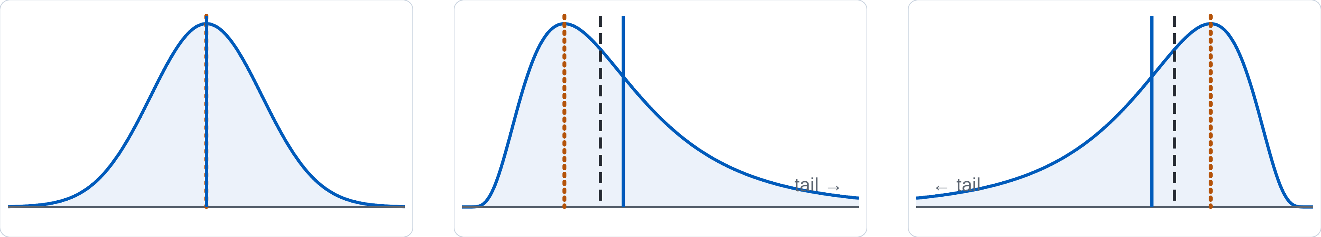
Shape decides the summary
Symmetric (normal)
Mean = median = mode
Positive (right) skew
Mode < median < mean · e.g., length of stay, triglycerides, CRP
Negative (left) skew
Mean < median < mode · e.g., age at death in high-income countries
Solid blue = mean · dashed = median · dotted orange = mode. The mean is pulled toward the tail. For skewed data, report the median and IQR.

Slide 14
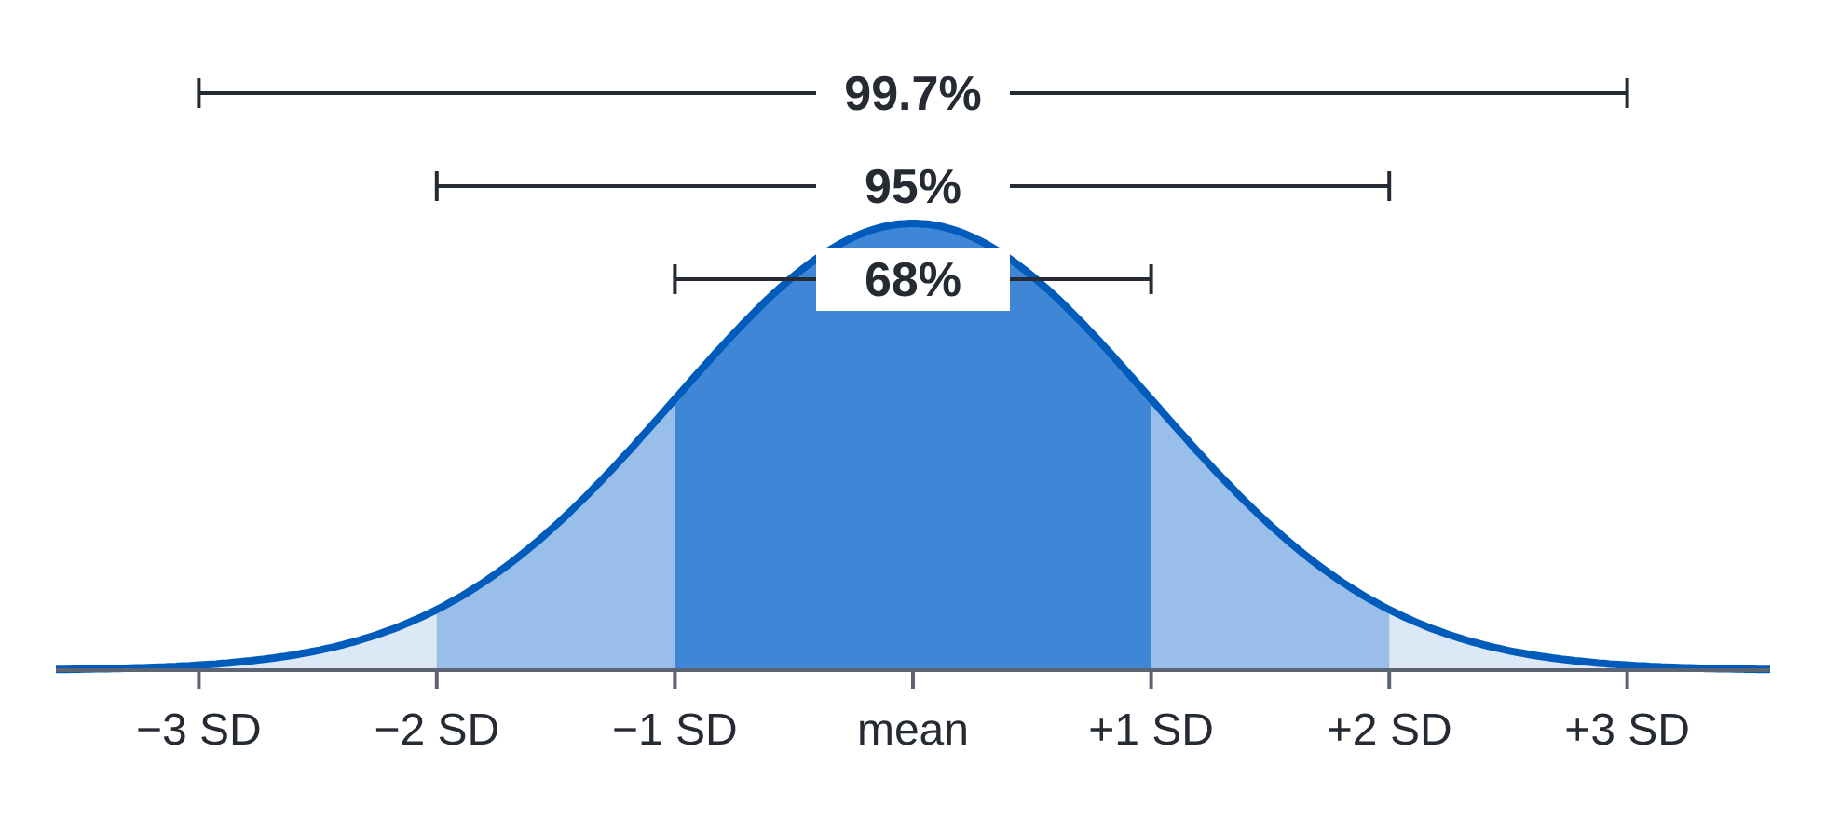
The normal curve: what counts as unusual
z-score
z = (value − mean) ÷ SD: how many SDs from the mean
Reference range
The central 95% of healthy people, about mean ± 2 SD. So 2.5% of healthy people fall above it and 2.5% below.

Slide 15
Back to Ms. D: one flag in 20 tests
5%
1 test: chance a healthy person is flagged
64%
20 tests: chance of at least one flag
36%
Chance all 20 are normal: 0.95²⁰ ≈ 0.36, so 1 − 0.36 ≈ 0.64
Same math as running many t-tests (Session 5, Q5). A single mildly abnormal value in a healthy person is often expected. Interpret it in context: the size of the deviation, symptoms, risk factors, and the trend on repeat testing.

Slide 16
SD vs. SE: patients vs. the estimate
Standard deviation (SD)
Spread of individual values. About 95% of patients lie within mean ± 2 SD. It does not shrink as n grows.
Standard error (SE)
Precision of the sample mean. SE = SD ÷ √n, and 95% CI ≈ mean ± 1.96 SE. It shrinks as n grows.
400 patients · mean SBP 136 mmHg · SD 15 | Range
Where about 95% of individual patients fall (± 2 SD) | ≈ 106 to 166 mmHg
95% CI for the mean: SE = 15 ÷ √400 = 0.75 | ≈ 134.5 to 137.5 mmHg
Ask: a paper shows mean ± SE error bars because they look tidier. What could a reader misjudge?

Slide 17
Check A1
TopHat
500 patients admitted with community-acquired pneumonia have a length of stay with mean 6.8 days, median 4 days, and mode 3 days. Which statement is correct?
A. The data are approximately normal, so the mean is the best summary
B. The data are negatively skewed; a few short stays pull the mean down
C. The data are positively skewed; a few long stays pull the mean up, so the median better describes a typical patient
D. The SD must be small
E. Mean, median, and mode must be equal in any large sample

Slide 18
Check A2
TopHat
Serum sodium in healthy adults is approximately normal, with mean 140 mEq/L and SD 2 mEq/L. A patient's sodium is 134 mEq/L.
What is the patient's z-score? Enter a number in TopHat.

Slide 19
Mini-lecture B
How are two things related?
Correlation: direction and strength of a straight line.

Slide 20
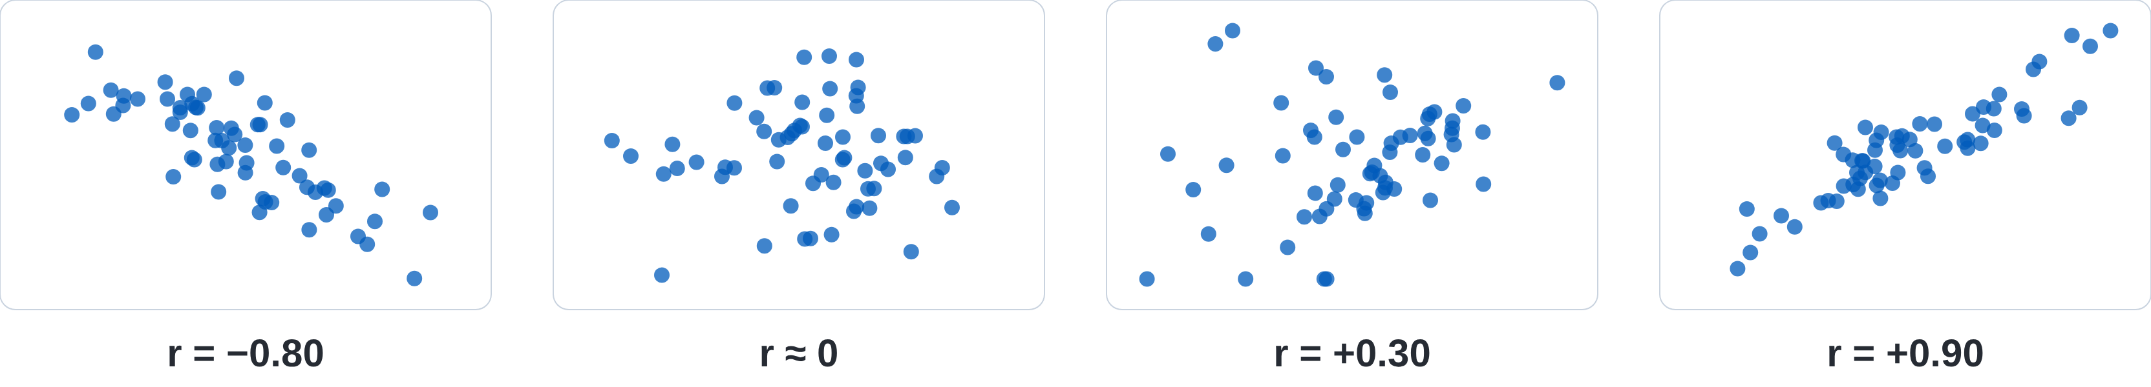
r runs from −1 to +1
Sign = direction
+ both rise together; − one rises as the other falls
Size = tightness
How closely points hug a straight line
r² = shared variation
r = 0.3 → r² = 0.09: 9% of the variation explained
Pearson r: two continuous, roughly normal variables. Spearman ρ: ranks; use it for ordinal or skewed data or when there are outliers.

Slide 21
Four ways r misleads
1 · Correlation is not causation
Coffee correlates with lung cancer because coffee drinkers were more likely to smoke. Confounding and reverse causation both produce r.
2 · r ≈ 0 does not mean no relationship
BMI and mortality are J-shaped: risk rises at both ends. r measures only straight-line fit.
3 · One outlier can make or break r
Always look at the scatterplot. Spearman's ρ resists outliers.
4 · r is not the slope
r says how tightly points hug the line, not how steep it is. For “how much,” you need regression.

Slide 22
Check B
TopHat
Among 250 adults with type 2 diabetes, weekly exercise minutes and HbA1c are correlated: r = −0.40 (p < 0.001). Which statement is correct?
A. Each additional hour of exercise lowers HbA1c by 0.40 percentage points
B. 40% of the variation in HbA1c is explained by exercise
C. About 16% of the variation in HbA1c is explained by its linear relationship with exercise
D. This is a weak positive relationship
E. Because p < 0.001, exercise causes lower HbA1c

Slide 23
Mini-lecture C
Regression: how much does one change with the other?

Slide 24
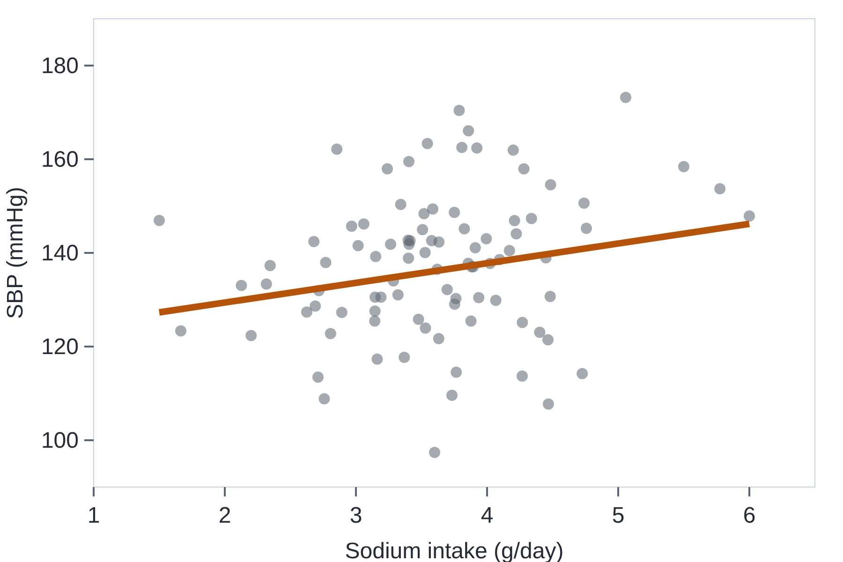
Linear regression: the slope is the answer
SBP = 121 + 4.2 × sodium
Slope β = 4.2: mean SBP is 4.2 mmHg higher per extra 1 g/day of sodium
Null for β is 0: a CI that excludes 0 means p < 0.05
R² = 0.06: sodium explains 6% of the variation in SBP (in simple regression, R² = r²)
Predict only inside the data (1.5–6 g/day): no extrapolation
Illustrative data

Slide 25
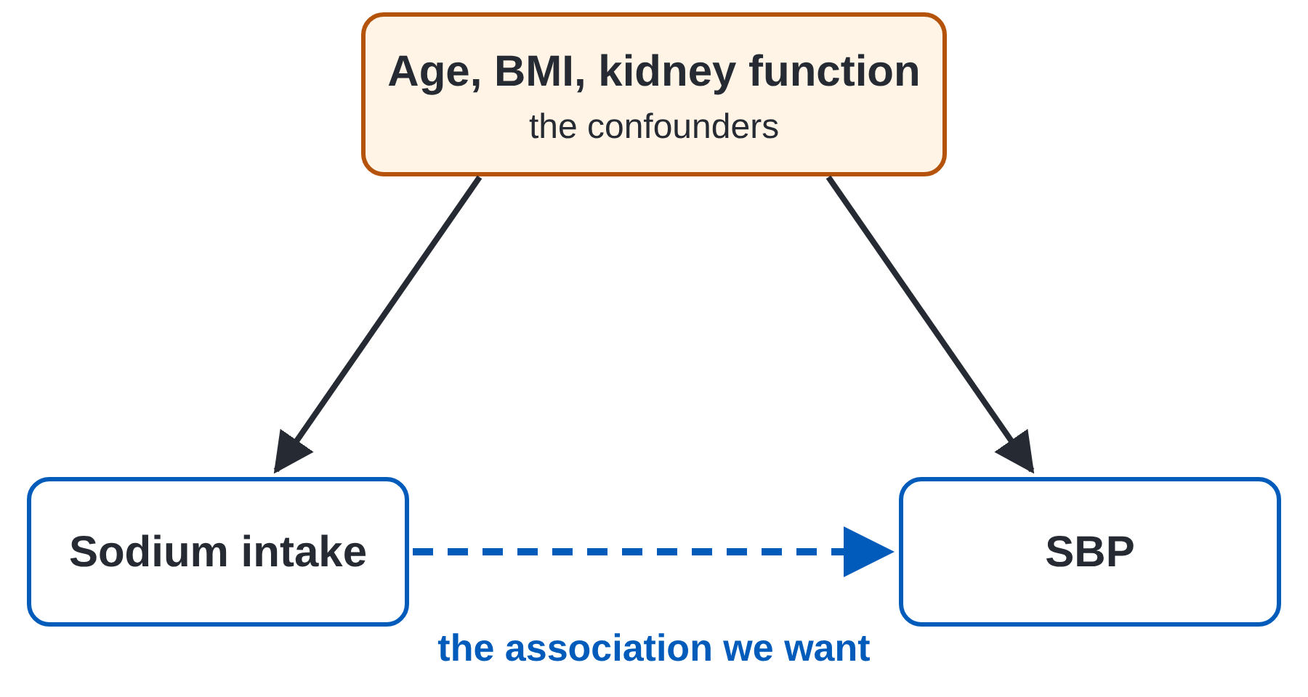
Adjusting for confounders
The unadjusted β mixes sodium's effect with everything that travels with sodium.
An adjusted β is the association holding the other variables constant.
If the crude and adjusted estimates differ substantially, the added variables were confounding.
Regression adjusts only for what was measured. Observational data cannot exclude residual confounding.

Slide 26
Match the model to the outcome
Outcome | Example | Model | Reports | Null
Continuous | SBP, HbA1c, LDL | Linear regression | β: difference in mean per unit | 0
Binary (yes/no) | Uncontrolled BP, 30-day readmission | Logistic regression | Odds ratio (OR) | 1
Time-to-event | Time to stroke or death, with censoring | Cox proportional hazards | Hazard ratio (HR) | 1
All three can include many predictors at once, so all three can report adjusted estimates. Cox regression is the survival analysis from Sessions 3–4.

Slide 27
Team application
The salt study
Read regression output; answer Ms. D.

Slide 28
The SALT-Check study (fictional)
Element | Detail
Design | Cross-sectional study of 2,400 adults with treated hypertension
Exposure | 24-hour urinary sodium: range 1.5–6.0 g/day; mean 3.6 g/day
Outcome 1 | Clinic SBP (mean 136 mmHg, SD 15) → linear regression
Outcome 2 | Uncontrolled BP, ≥ 140/90 mmHg (38% of participants) → logistic regression
Correlation | Sodium and SBP: r = 0.24 (p < 0.001)

Slide 29
Output A: linear regression for SBP
Predictor | Model 1: unadjusted β (95% CI) | Model 2: adjusted β (95% CI)
Sodium, per 1 g/day | 4.2 (3.5 to 4.9) | 2.1 (1.4 to 2.8)
Age, per 10 years | — | 4.8 (3.9 to 5.7)
BMI, per 5 kg/m² | — | 2.6 (1.7 to 3.5)
eGFR < 60 (yes vs. no) | — | 3.4 (1.2 to 5.6)
Physical activity, per 60 min/week | — | −0.3 (−0.9 to 0.3)
R² | 0.06 | 0.22

Slide 30
Your team's tasks
1
Interpret the adjusted sodium β in one sentence.
2
Why did the sodium β fall from 4.2 to 2.1? (poll)
3
What do you conclude about physical activity?
4
Sodium is clearly significant, yet R² = 0.06 in Model 1. How can both be true?
5
Ms. D eats 5 g/day. Predict her SBP difference at 2.5 g/day. Could you predict for 9 g/day? (team poll)
6
Interpret the two odds ratios in Output B. (team poll)
7
Stretch: Can you promise Ms. D that halving her salt will lower her BP by 5 mmHg?

Slide 31
Poll · Task 2
TopHat
The sodium coefficient fell from 4.2 mmHg (unadjusted) to 2.1 mmHg (adjusted for age, BMI, eGFR, and activity). What is the best explanation?
A. Model 1 was a Type I error
B. Age, BMI, and kidney function confounded the crude association
C. Adding variables always cuts coefficients in half
D. Sodium is not associated with SBP
E. The sample size fell in Model 2

Slide 32
Poll · Task 5
TopHat
Ms. D eats about 5 g of sodium a day. Using Model 2 (adjusted β = 2.1 mmHg per 1 g/day), how many mmHg lower would her SBP be predicted to be at 2.5 g/day?

Slide 33
Poll · Task 6 (Output B)
TopHat
Output B, logistic regression for uncontrolled BP, adjusted for all Model 2 variables. Sodium > 4 g/day vs. ≤ 4 g/day: aOR 1.35 (95% CI 1.12–1.63). Coffee ≥ 3 cups/day vs. fewer: aOR 0.92 (95% CI 0.74–1.14). Which statement is correct?
A. High sodium causes a 35% increase in uncontrolled BP
B. High sodium is associated with 35% higher odds of uncontrolled BP; the coffee estimate is not statistically significant
C. Both associations are statistically significant
D. Coffee lowers the odds of uncontrolled BP by 8%
E. The sodium OR is not significant because its CI does not include 0

Slide 34
Back to Ms. D
“My labs flagged something.”
With 20 tests, a healthy person has about a 64% chance of at least one flag. ALT 44 is just above the range: repeat it and look at the trend and the whole picture before ordering a workup.
“How much would cutting salt help?”
In this study, 2.5 g/day less sodium went with about 5 mmHg lower SBP, close to a meaningful change. It is an association, but randomized trials point the same way, so it is worth trying.

Slide 35
Start the quiz
UB Learns · 15 questions · 3 attempts
Open Note

