Slide 1
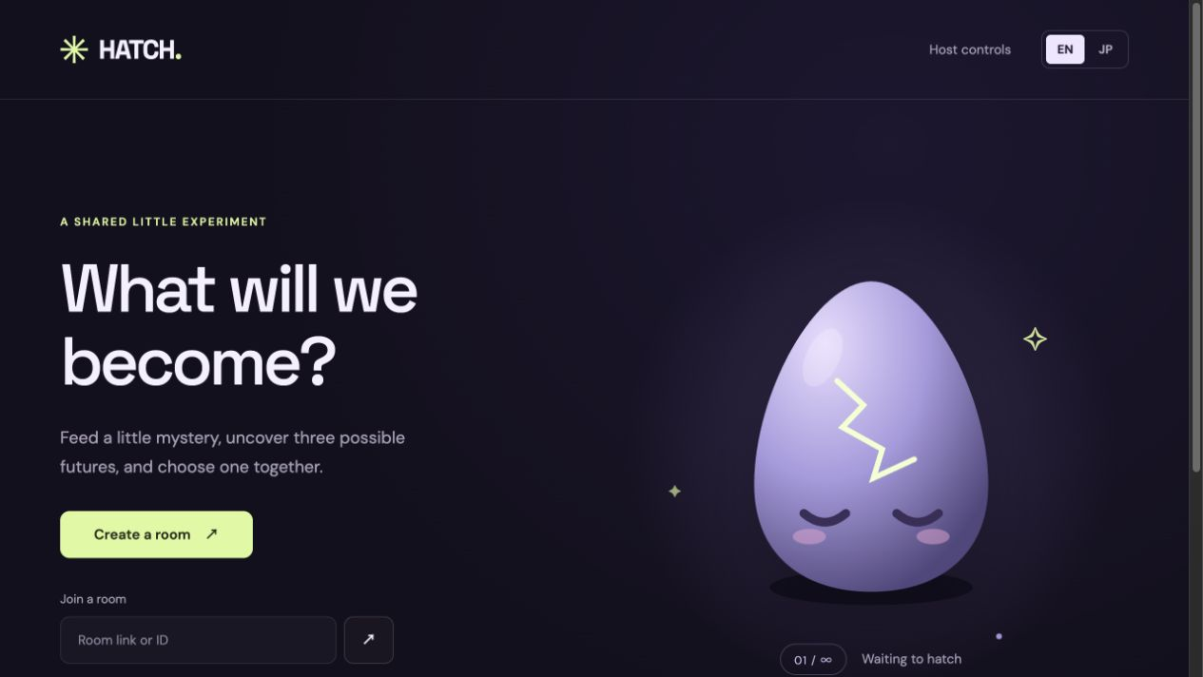
HATCH
A crowd creates one creature
Feed ingredients. Vote for one of three futures. Take your story home.
5–50 players · ≈3 minutes · no account
One shared prompt.
Every player adds a piece. The group decides what happens next.
1
The game in one screen
Notes:
Concept and app screenshot supplied by the user. Design targets: 5–50 players, approximately 3 minutes, no account.

Slide 2
The shared game
A short loop turns many small choices into one playable story.
01
Ingredient roles
Each player adds a piece
02
15s tapping
Shape the shared creature
03
Three futures
The group sees what could happen
04
Group vote
One direction wins
05
Final adventure
Everyone plays the result
06
Personal result
Each player takes a story home
One prompt → many ingredients → one future
Notes:
Gameplay flow based on the supplied product description.

Slide 3
Three services, three jobs
A simple architecture for a shared, generative game.
01
Neo4j
Contribution graph
Explains each player’s contribution
02
Nosana
Future render
Renders creature futures on GPU
03
Daytona
Live workspace
Runs and shares the app
Architecture roles shown here are design targets. Neo4j is verified; Nosana and Daytona remain work in progress.
3
How the pieces fit
Notes:
Role descriptions supplied by the user. Status caveat preserved on slide.

