Slide 1

Once Upon a Time:
Does Race Decide?
By: Gian-Carlo, Jaina, Jeffrey, Mayon, and Megan
Notes:
JM

Slide 2

Introduction:
Evolution of
Dating with Technology
Worldwide
Loneliness
Epidemic
Are Interracial
Couples Actually
a Rarity?
Notes:
JM

Slide 3

Research Question:
Can we predict a person’s categorical Yes/No decision using their self-reported racial preference—and how much do post-date ratings add?
Notes:
JM

Slide 4
Prior Work & Why This Dataset
This speed-dating dataset underlies published studies of gender (QJE, 2006) and racial preferences (Review of Economic Studies, 2008).
Prior Work
Our Contribution
Why This Dataset
Fisman et al. directly studied racial preferences and same-race choices.
Treat each Yes/No choice as a prediction problem using held-out participants.
Real decisions, race on both sides, a pre-event preference score, and post-date ratings.
Notes:
GC

Slide 5

The Data
6,865
43.2%
56.8%
14
Complete Decisions
Said
Yes
Majority-Baseline
Accuracy
Model Predictors
Cleaning Decisions: • Complete cases on outcome and all predictors • Correctly mapped race code 6 to “Other” • Retained 528 participants • Used iid only to control the split
Banned as Predictors: • Partner decision (dec_o) • Match flag (contains both decisions) • Like / probability-of-Yes restatements • Participant ID (iid)
Notes:
GC

Slide 6
Variables Used in the Models
One row is one participant’s Yes/No decision about one partner. iid identifies participants for splitting, but is never a predictor.
People & Outcome
Race Preference
Post-Date Ratings
dec: Yes/No outcome gender, age, race: decision-maker age_o, race_o: partner iid: split identifier only
samerace: same recorded race (0/1) imprace: importance of same-race dating (0–10) alignment = imprace × samerace
attr: attractiveness sinc: sincerity · intel: intelligence fun: fun · amb: ambition shar: shared interests

Slide 7

2
EDA
Who says yes, and to whom

Slide 8

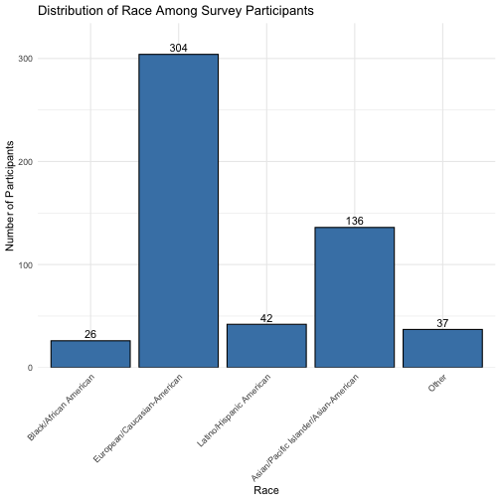
Demographics
545 participants · outputs/figures/eda/01_race_distribution.png
Notes:
May

Slide 9

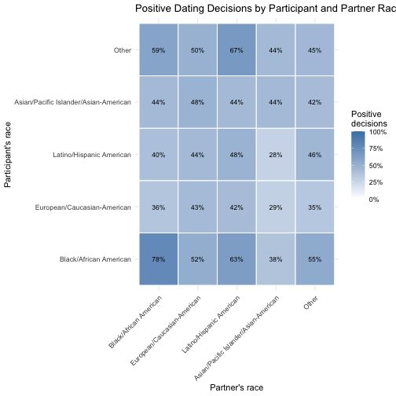
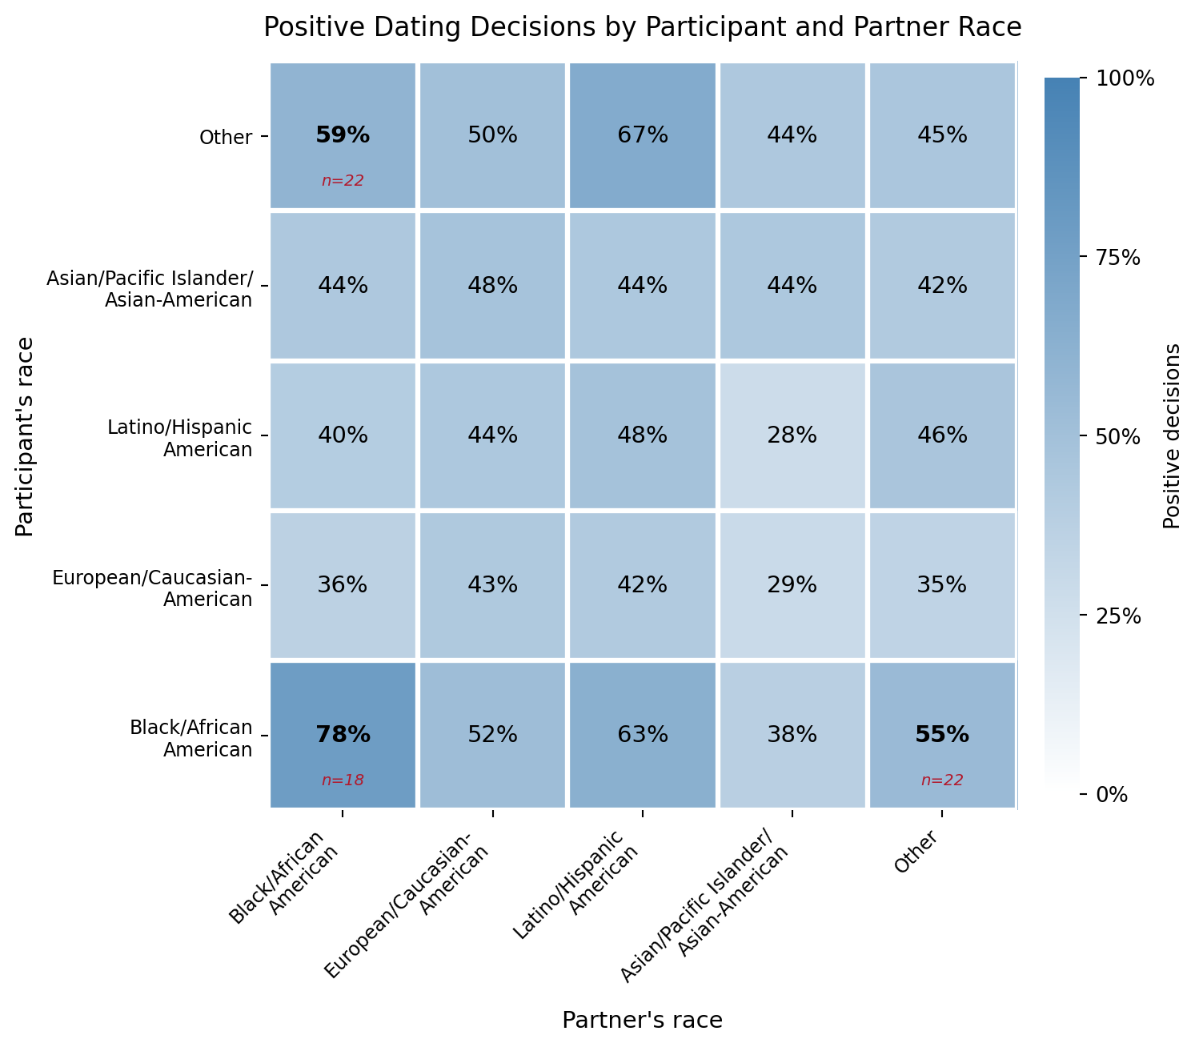
The Preference Matrix
Rows make the decision; columns are the partners · n = 8,242 observed decisions
Notes:
May

Slide 10
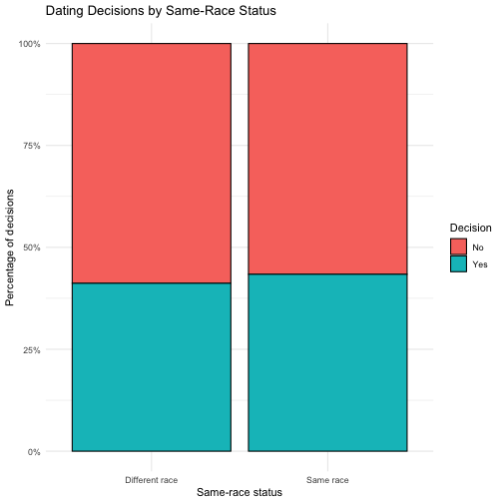
Does Same Race Matter?
43.4% same-race · 41.2% cross-race · descriptive association, not causation
Full EDA: n = 8,242 · modelling cohort: 45.1% vs 41.9%, χ² = 7.01, p = 0.008
Notes:
May

Slide 11
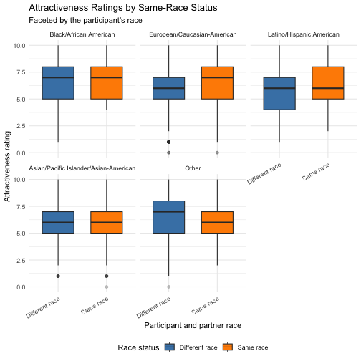
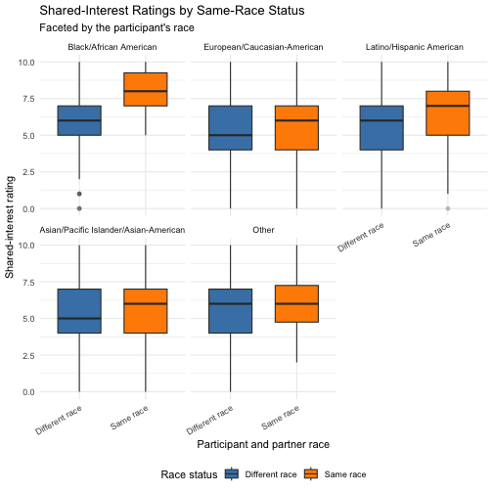
What Separates a Yes
Yes vs no: attractiveness 7.27 vs 5.35 · shared interests 6.44 vs 4.71
Post-date ratings are close to the outcome; they support prediction, not pre-date screening.
Notes:
May

Slide 12
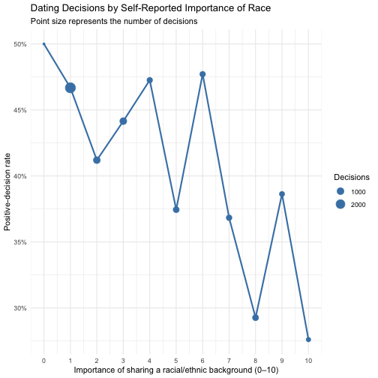
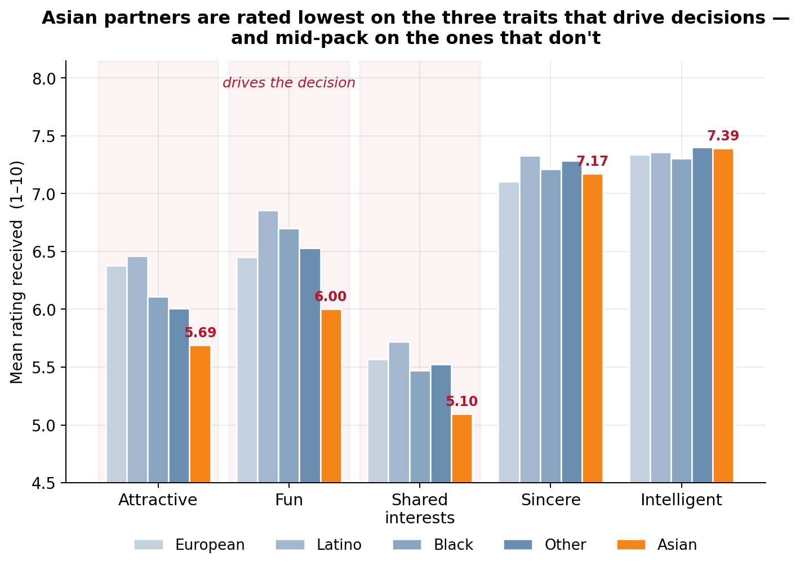
Stated Racial Preference
imprace is measured before the dates (0 = not important, 10 = very important) · the relationship is weak and non-monotonic
Notes:
May

Slide 13

3
The Models
Race-related benchmark + three full models · one held-out participant test set

Slide 14
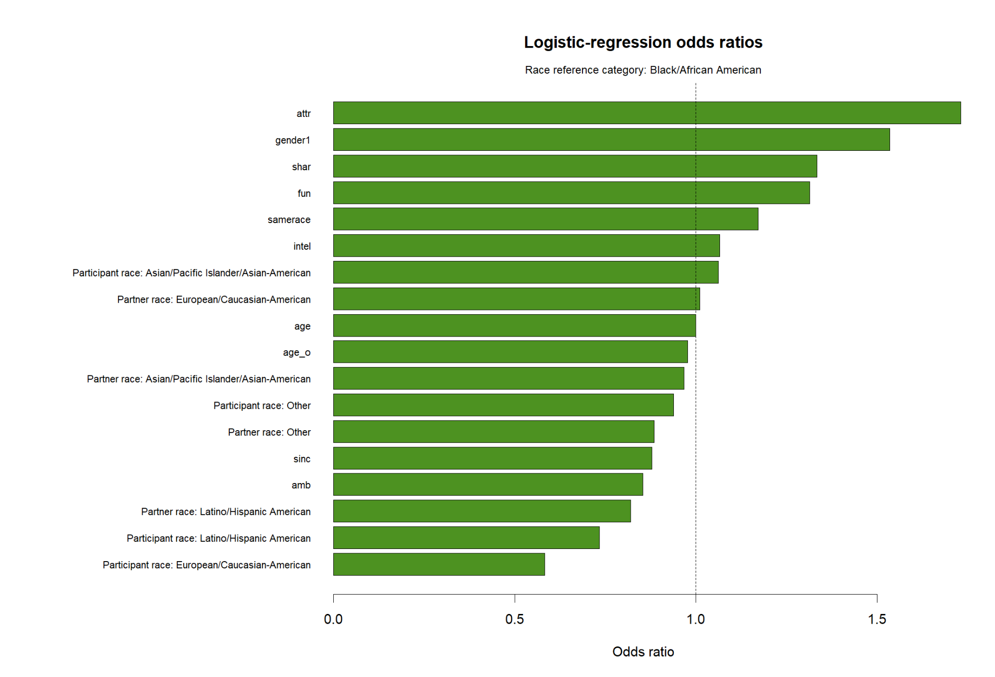
Training & Evaluation
Group Split by iid
Why Group the Split?
How We Judged Models
528 participants Train: 422 people 5,417 decisions Test: 106 people 1,448 decisions
Every decision from one person stays entirely in train or test. This prevents the model from learning a person in training and being tested on that same person.
Accuracy: overall correctness Recall: actual Yes found F1: precision–recall balance ROC-AUC: ranking across thresholds Calibration: probability reliability
Same complete-case cohort, participant split, 0.50 threshold, and metric function for every model
Notes:
Meg

Slide 15
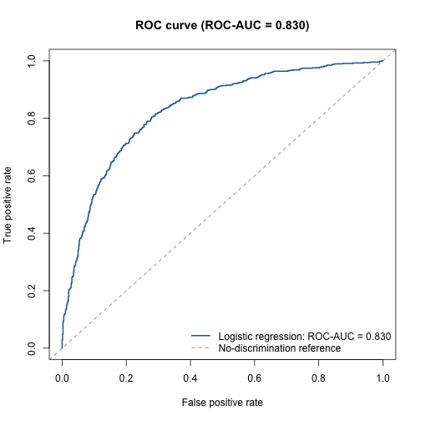
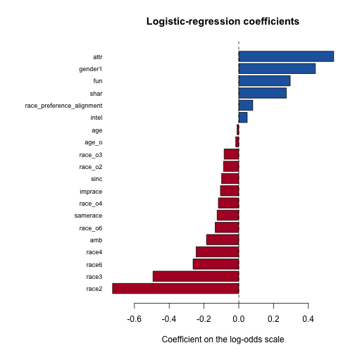
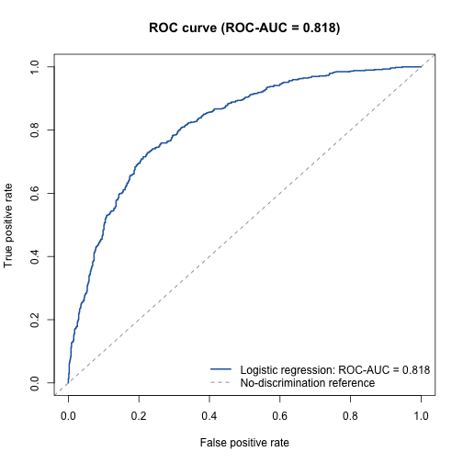
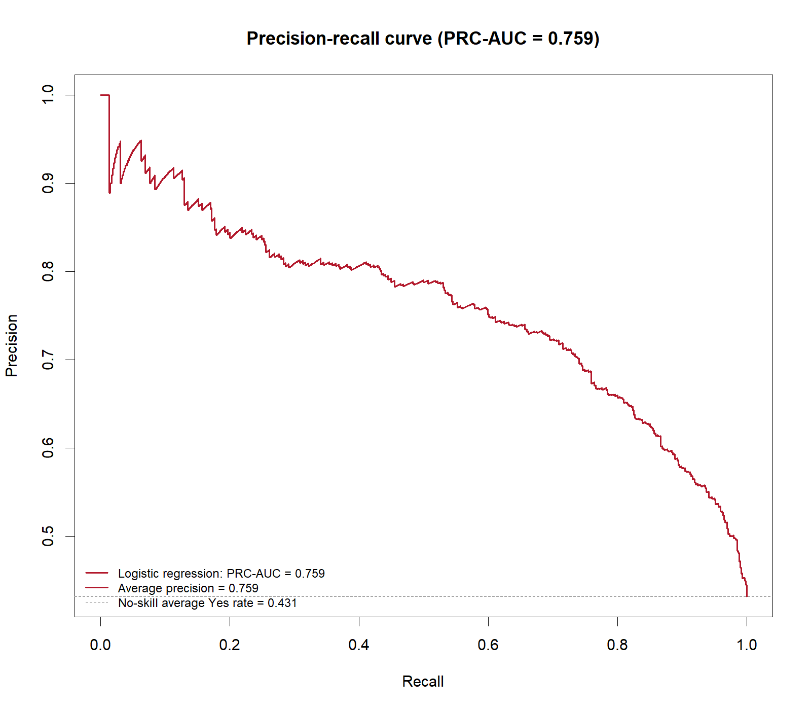
Logistic Regression
Accuracy 0.760 · F1 0.728 · ROC-AUC 0.830 best accuracy and F1; easiest to interpret
Common held-out participants · coefficients show conditional associations
Notes:
Meg

Slide 16
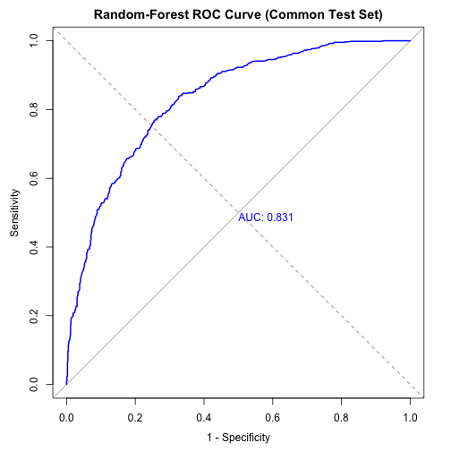
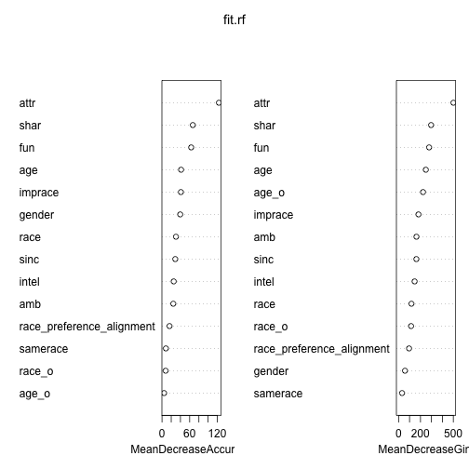
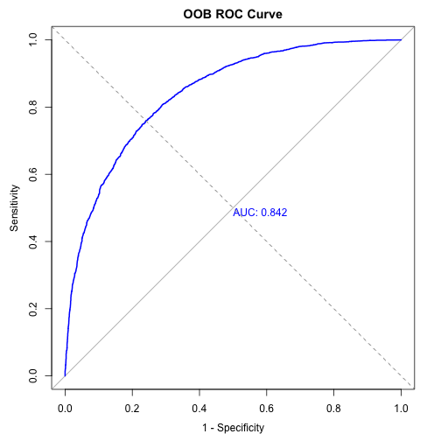
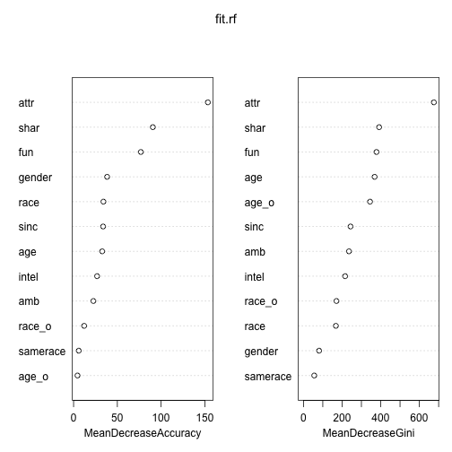
Random Forest
Accuracy 0.742 · F1 0.702 · ROC-AUC 0.831 highest AUC by only 0.001
Common held-out participants · OOB error retained only as a training diagnostic
Notes:
Jeff

Slide 17
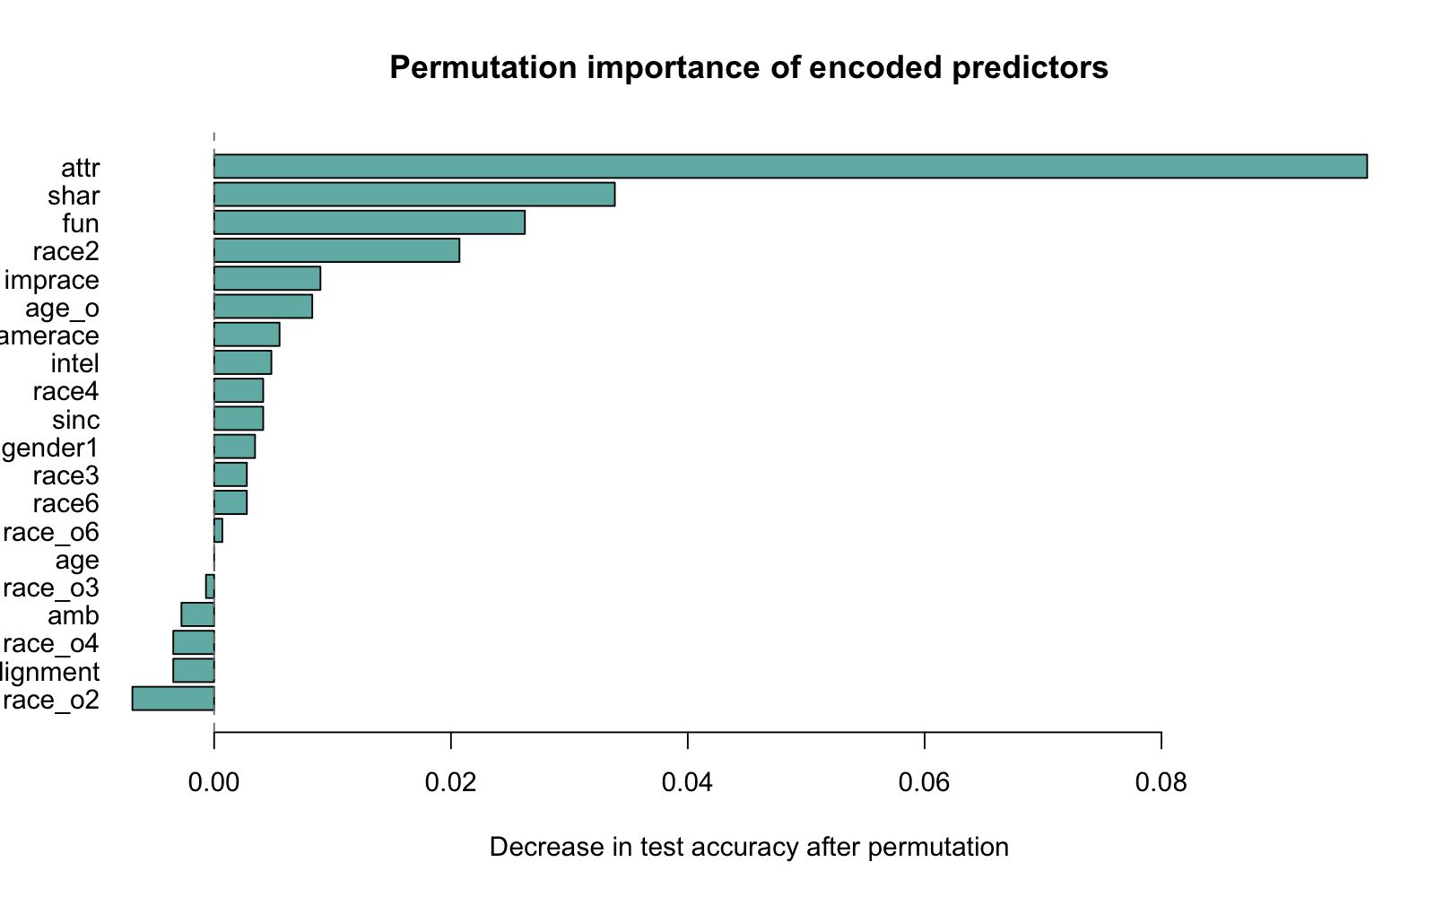
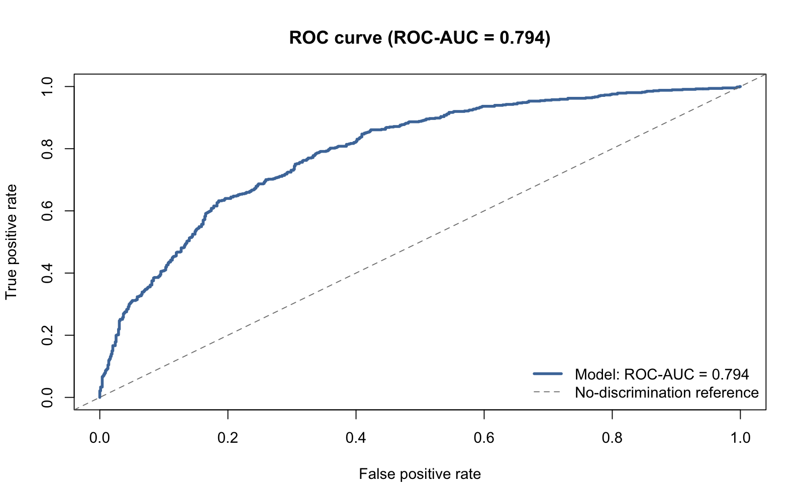
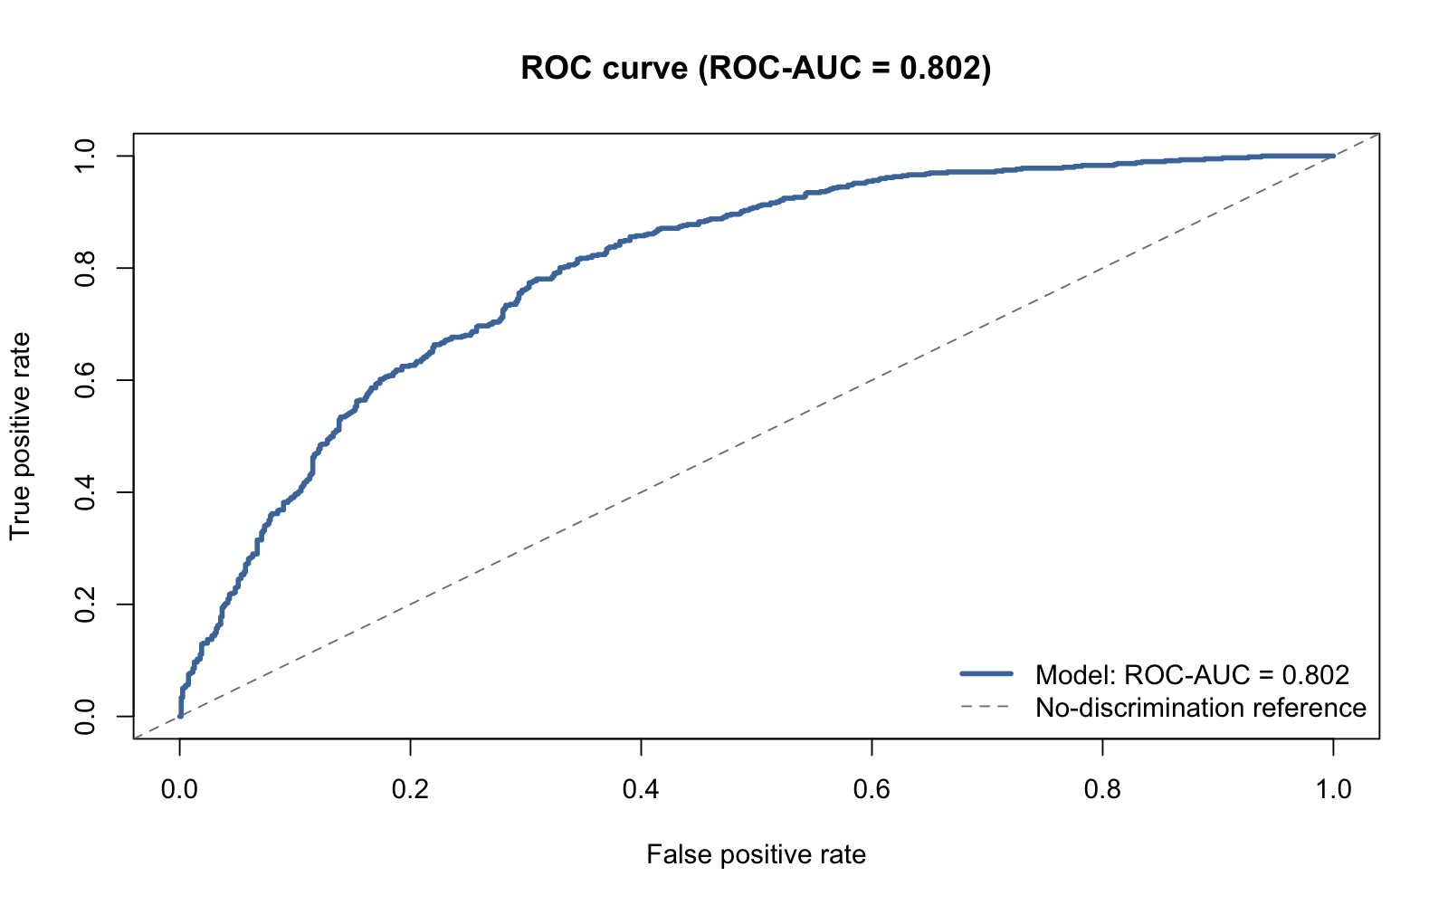
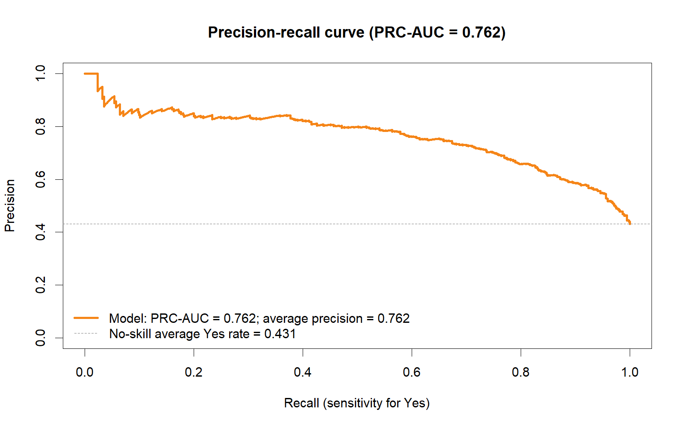
Neural Network
Accuracy 0.718 · F1 0.682 · ROC-AUC 0.794 added complexity did not improve prediction
Common held-out participants · permutation importance describes model reliance
Notes:
Meg

Slide 18
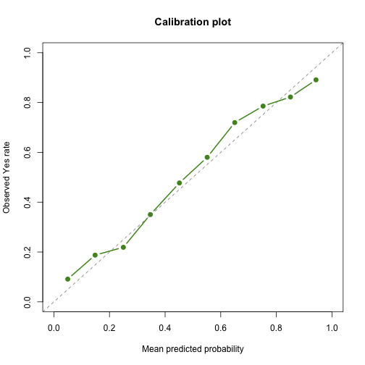
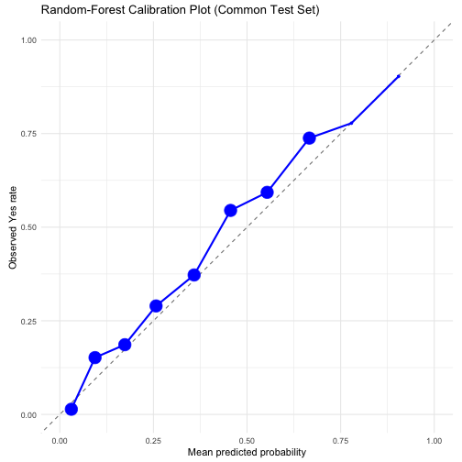
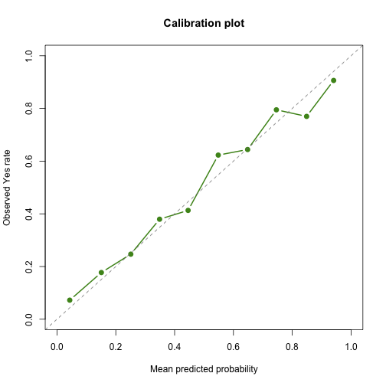
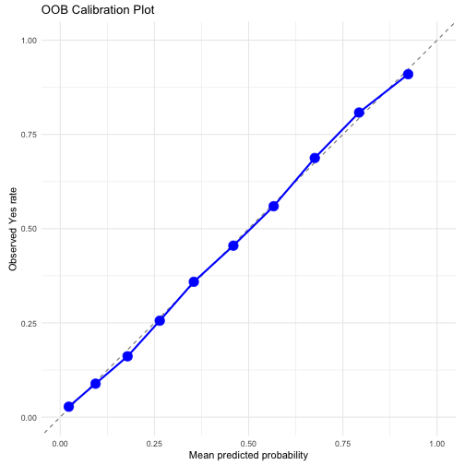
Are the Probabilities Honest?
Calibration asks: when a model predicts 70% Yes, do about 70% actually say Yes?
Closer to the diagonal is better · random-forest Brier score = 0.169 (lower is better)
Notes:
Jeff

Slide 19
Model Comparison
Model
Accuracy
F1
ROC-AUC
Race benchmark
0.588
0.380
0.601
Logistic regression
0.760
0.728
0.830
Neural network
0.718
0.682
0.794
Random forest
0.742
0.702
0.831
Logistic regression leads accuracy and F1; random forest leads ROC-AUC by 0.001.
All metrics use one function on the same 106 held-out participants (1,448 decisions).
Notes:
Jeff

Slide 20
4
Does Race Predict?
Putting a number on it

Slide 21
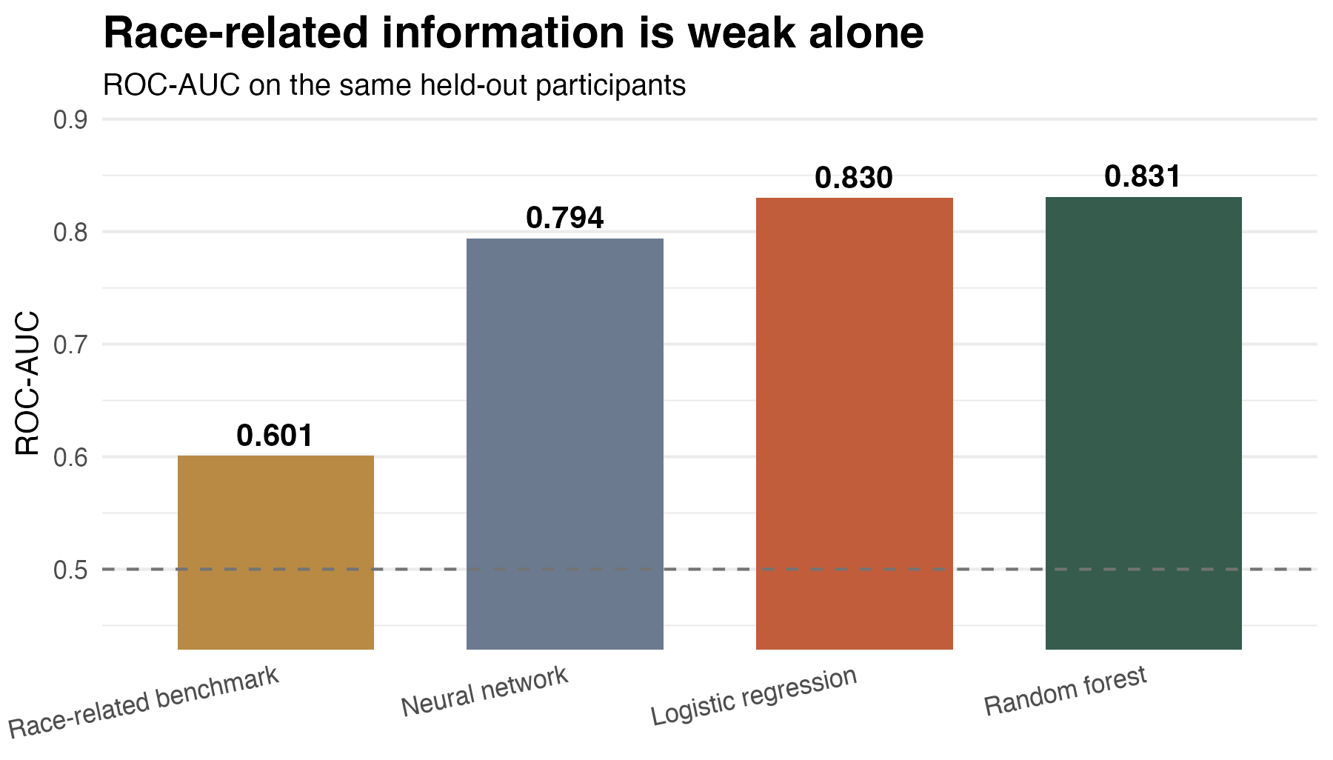
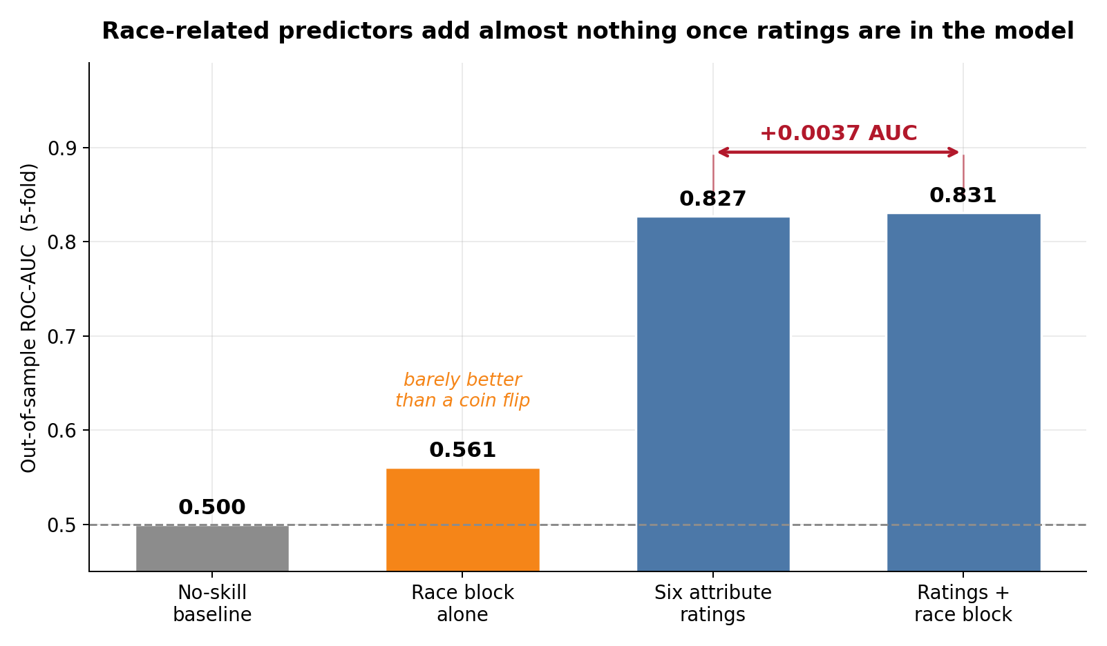
Race-Related Benchmark
Accuracy 0.588 · Recall 0.277 · ROC-AUC 0.601 better than chance, weak for individuals
Uses race + partner race + samerace + imprace + preference alignment only
Notes:
JM

Slide 22
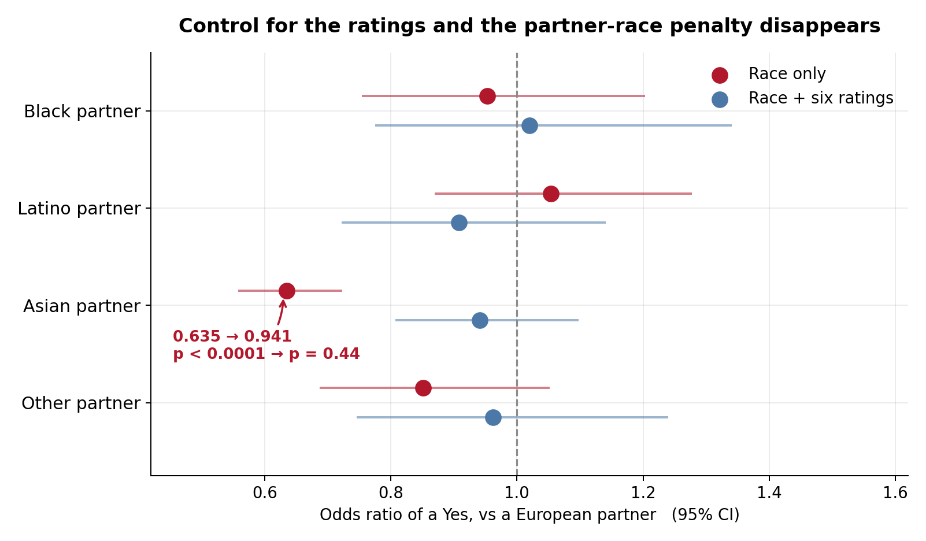
What the Models Mean
Attractiveness is strongest; fun and shared interests follow. Race-related effects are smaller.
Importance and coefficients describe model behavior—not causal effects.
Notes:
JM

Slide 23
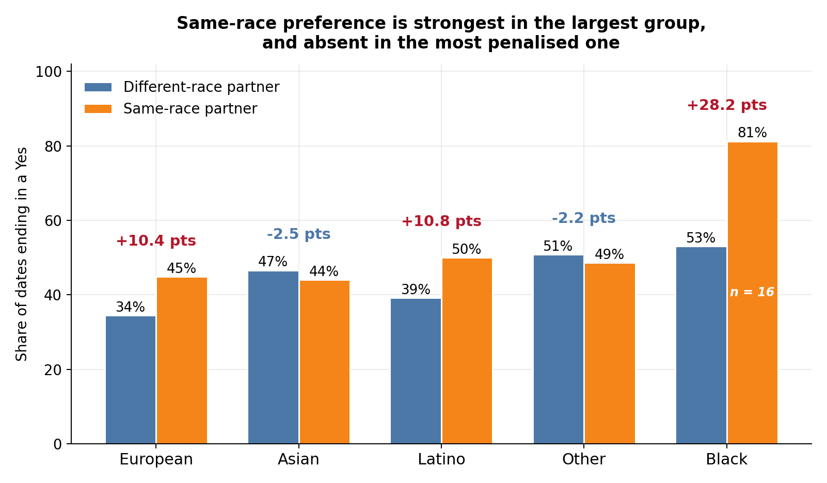
Bias Check
Unequal group sizes make subgroup error rates unstable; no fairness claim is made.
26 Black participants vs 304 European/Caucasian-American participants · future checks need participant-level bootstrap intervals
Notes:
JM

Slide 24
5
Conclusion
What we found · what we cannot claim

Slide 25
Conclusions and Predictions
01
The decision is predictable. Logistic regression reaches 76.0% accuracy; random forest reaches ROC-AUC 0.831.
02
Race-related information alone is weak. The restricted benchmark reaches ROC-AUC 0.601 and recall 0.277.
03
Post-date impressions carry most of the signal. Attractiveness, fun, and shared interests dominate the full models.
04
The result is predictive, not causal. It describes this historical experiment and is not a dating-app ranking rule.
Racial preference adds limited signal; interpersonal ratings explain far more predictive performance.
Notes:
GC

Slide 26

Validation / Application:
01
Participant Holdout
02
Fair Comparison
80/20 split by iid; no person appears in both partitions
Same cohort, predictors, threshold, and evaluator
03
Realistic Application
04
Next Validation
Post-date classification—not attraction before two people meet
Repeated group CV, wave holdout, and an external modern sample
Notes:
JM

Slide 27

Sources of Error & Bias:
Historical Columbia Volunteer Sample
Subjective Post-Date Ratings
Four Minutes, Not a Relationship
Coarse, Imbalanced Race Categories
Complete Cases + One Split
dec is stated interest, not an actual relationship. Post-date ratings are close to the outcome; prediction and mediation are not causation.
Notes:
Meg

Slide 28

AI Usage
Codex
Cursor
Claude
Analysis and validation updates
Brainstorming ideas
Finding candidate datasets
PowerPoint revisions
Citation compilation
Slideshow outline
AI assisted coding, debugging, sourcing, and presentation editing; the team selected the research question and interpretation.
Notes:
May

Slide 29
Citations & Data Sources
PAPER
ANALYSIS CODE
Fisman, Iyengar, Kamenica & Simonson (2006). Gender Differences in Mate Selection. QJE 121(2), 673–697.
github.com/mayonm/z0-v2 — final.Rmd creates the shared cohort, participant split, models, metrics, and figures.
DATA
PRIOR WORK
Speed Dating Experiment and variable key — Columbia Business School, 21 waves, 2002–2004. data/Speed_Dating_Data.csv.
Fisman, Iyengar, Kamenica & Simonson (2008). Racial Preferences in Dating. Review of Economic Studies 75(1), 117–132. DOI: 10.1111/j.1467-937X.2007.00465.x
CONTEXT
SOFTWARE
Pew Research Center. (2020, August 20). Nearly half of U.S. adults say dating has gotten harder for most people in the last 10 years.
R with randomForest, nnet, pROC, glm, ggplot2 and dplyr.
CONTEXT
TEMPLATE
Pew Research Center. (2017, May 18). Intermarriage in the U.S. 50 years after Loving v. Virginia.
Template by Slidesgo, icons by Flaticon, illustrations by Freepik. Fonts: Grenze and Barlow Semi Condensed.

Slide 30

Thank you!
Gian-Carlo · Jaina · Jeffrey · Mayon · Megan
Questions?

