Slide 1
AN UNDERGRADUATE PROJECT PROPOSAL
ON
“PERFORMANCE EVALUATION OF STEGANOGRAPHIC APPROACHES TO DIGITAL IMAGES”
BY
OLOLADE ABIODUN EMMANUEL 0635
AYODELE MOLOLUWA OLAMILEKAN 0558
OLAYINKA OLUWASEGUN ENIOLA 0633
SUPERVISED BY
DR. OLUKOYA
DEPARTMENT OF COMPUTER
BAMIDELE OLUMILUA UNIVERSITY OF SCIENCE EDUCATION AND TECHNOLOGY IKERE EKITI

Slide 2
1.1 Background to the Study
Web clients sometimes need to send, store, or retrieve information (data) globally from any geographical location through the internet (Hadipour et al, 2020). This has helped to carry out or initiate transactions between different parties without physical contact at lower price. However, over the decades there has been a rise in the challenges facing the web space due to data vulnerabilities. This allow unauthorized people to have access to data sent through the web. A well-known method for doing this is to change the data into an alternate structure (steganography) (zaidan et al, 2019). Using this method means data can be seen simply by the people who know how to return it to its unique structure. A technique for securing data is known as encryption but while encryption focuses on transforming data into unreadable forms, its presence is still detectable which could make it a target for attacks (Allteef et al, 2019). Encryption, coupled with steganography conceals the existence of information, adding an extra layer of security by hiding data within other objects, such as images or text. This dual approach can address some of encryption’s visibility limitations (Hadipour et al., 2020). The old craft of concealing messages with the goal that they are not detectable. No replacement or permutation was utilized. The secret message is plain, however clueless to the reader (Kaur, 2016)

Slide 3
1.2 Problem Statement
With the recent rise of progress in using digital communications for the university and its research institutes, the institutes and their research work is at risk of exposures pandering them to prospects of leaks. To secure research data, we must look into cryptography, the method of concealing data in the digital domain. Cryptography methods of steganography allow encoders to hide information within other media — for instance images — to ensure anonymity of a research and its object as well as authenticity of the data while in transit. According to Manohar, (2020) steganography is the method in which significant data including, content or data is concealed in a media that is open to other individuals; this gives steganography a power of hiding critical details. Such encryption is especially useful for researchers dealing with IP or unpublished data, as is the case with IP-bearing research questions or unpublished data, where even using encryption, it may prove ineffective against interception and tampering. In addition, Simmons et al. (2023) assessment of inferential attack on a stega database schemes the interface based to the DCT-domain, hence more importance is always required to enhance stenographic schemes particularly to the collaborative research networks where secure communication is considered necessary.

Slide 4
1.3 AIM AND OBJECTIVE
This study's main aim is to conduct performance evaluation on the stenographic techniques least significant bit and discrete wavelet transform using PSNR (Peak to signal ratio) and MSE (Mean square error).
The specific objectives of this project are to:
Design a Least significant bit (LSB) and Discrete cosine transform (DCT) algorithm to hide the existence of data
Implement steganography images based on Least Significant Bit (LSB) and Discrete cosine transform techniques (DCT)
Evaluate stenographic approaches using Peak square-to-noise ratio (PSNR) and Mean square
Error (MSE)

Slide 5
1.4 SCOPE OF THE STUDY
This research focuses on evaluating steganography techniques used in hiding data or information. By investigating the performance of stenographic techniques that work specifically for *digital images. It reviews and provides comparative accuracy of two famous algorithms: Least Significant Bit (LSB) and Discrete cosine Transform (DCT). This research will focus on developing and implementing these techniques and evaluate them using PSNR and MSE. The study does not investigate other types of stenographic techniques, such as those used in audio or video files, nor does it assess their effectiveness within real-world attack scenarios or advanced security systems. Also, the research is purely performance oriented and does not cover any cryptographic or legal aspects of steganography. Focusing on only digital images and 'how to measure' opens up the field of study to a practical understanding/ improvement of both techniques.

Slide 6
1.5 LITERATURE REVIEW
Steganography,(the art of hiding messages), has been used since the early times as an ancient means of covert communication, the science of hidden writing is known as steganography but its workable forms date back on centuries.
Its earliest documented use dates back to histiaeus, a Greek ruler under Persian empire. Histiaeus’s method is chronicled by Herodotus, which describes how he got one of his slaves shaved and engraved a hidden message on the scalp, then let the hair regrow and sent the slave to deliver the secret note. This clever technique allowed histiaeus to secretly spur revolt against the Persians in Miletus (cox et al., 2018; teaching London computing, 2023) Another early form of steganography consisted of wax in wooden tablets. Scribbling’s were carved into the wood beneath the layer of wax, which was then re-coated to look unwritten on. A well-known classical method for doing this was used by demaratus, a Greek exile in Persia, to inform Sparta of an approaching Persian invasion (teaching London computing, 2023).
During the 20th century, stenographic methods progressed extensively — particularly during world war two. German forces invented microdots (very small images or text that can be reduced to the size of a full stop) and used them to insert messages into papers. This allowed data to be hidden in microfiche (making it very difficult to perceive by outsiders) (cox et al., 2018)
Steganography, now in the digital age, experienced a major leap forward in the 1990s. Techniques such as embedding information into digital images, videos, and audio files became prevalent, made possible by the advent of computer technology (Wikipedia, 2023)
Such landmark events show us how steganography transitioned from basic physical methods to complex digital methods, demonstrating humanity's never-ending quest for privacy.

Slide 7
1.6 RELATED WORKS
Kundra (2018) discussed different image Steganography techniques, and their comparison was discussed so that one can choose the best method for hiding the secret information. Different proposed techniques in the literature have been discussed, and some of the techniques result in high-quality images while others are more secure. By analyzing all the techniques, the study found that the performance of the Hash-LSB would be more secure than other techniques as earlier discussed, Hash-LSB is the combination of two technologies, one from cryptography and another from steganography. Moreover, the RSA algorithm is so secure that no one can easily break it.
Albarbarawi (2020) discussed an efficient and secure method of hiding secret messages in a color image. RGB color image is used to hold a secret message. It divides the message into three sub-messages and generates three random private keys: red, green and blue, where each sub-message has to be hidden. This method was targeted to increase security and minimize embedding and extracting time by hiding short messages within a color image. However, the distortion of the image has been found due to the increasing size of the secret message.
Rajendran et al (2019). Also presented a new symmetric key-based image-hiding technique. This technique generates pseudo-random keys using a One Dimensional (1-D) logistic map. Those keys are used for randomly choosing the pixel position of the cover image to hide the secret image. The experimental results of this technique showed that it has the better visual quality and less distortion than other techniques, but it has yet to consider for a color image.

Slide 8
1.7 Steganography Domains and Techniques
Throughout the past years, numerous written pieces of literature have discussed on information hiding, but two data hiding methods were created until this point: spatial domain and frequency domain. Because the media considered in this written literature are image outlines, this study will focus on using digital images for the discussions.
The supposed spatial domain refers to how the secret is blended directly into the distributed pixels (areas), while in the frequency domain, it is vital to change the host-image first utilizing a frequency-oriented mechanism (Hussain et.al, 2018).
STEGANOGRAPHY
SPATIAL DOMAIN
FRECUENCY DOMAIN
LSB
DCT
DWT

Slide 9
1.8 Research Methodology
The comparison of the Spatial domain technique with the Frequency domain technique has been proposed to break down which technique is safer by having a high Peak Signal to Noise Ratio (PSNR) and Mean square error (MSE), following the processes in the (fig 2) we are aware that the objective of steganography is to protect communications from an eavesdropper, stenographic techniques works to hide the presence of the actual message from any observer. The Least Significant Bit will be compared with the discrete wavelet transform to arrive at a high-security and advanced method. The performance of the two methods will be measured utilizing the Peak Signal to Noise Ratio (PSNR) and mean square error (MSE).

Slide 10
1.9 Architecture of the Proposed Method
DATA
COLLECTION
EMBEDMENT OF DATA
ALGORITHMS
PHASE 1
PHASE 2
LSB
DWT
DCT
EVALUATION METRICS
PSMR
MSE
PERFORMANCE
EVALUATION

Slide 11
2.1 Data Collection
To perform this study there are data required to implement a standard and reliable performance evaluation in steganography the data collected for this study includes:
Bitmap image:
A bitmap is an image file format used to store the digital images. The word bitmap means map of bits. They are used to create realistic graphics and images, it uses lossy compression algorithm but it doesn’t lose any image information.
JPEG:
Just like bitmap Joint photographic experts group (jpeg) is also used to store digital image the main difference would be that it uses lossy compression algorithm so it loses some image information.
Different bitmap (BMP) cover images with 256x256 and 512x512 resolutions for least significant bit (LSB) and discrete cosine transform (DCT) techniques are utilized in the experimentations. The evaluation parameters of these techniques are based on MSE (mean square error) and PSNR (peak-to-square noise ratio).
Text are embedded into the images in architechtural phases which are highlighted below

Slide 12
2.2 Embedment of Data
This is a summary of how the process of this research will be carried out it would happen in two different phas
Phase One
In the main stage, the secret message is embedded in the BMP cover image using Least Significant Bit's embedding algorithm. Then, the stego image is sent by the sender to the recipient at that point. Next, the Receiver extracts hidden information from the BMP stego image using the Least Significant Bit is removing algorithm.
Phase two
In the subsequent stage, the BMP cover image is changed to JPEG, and the secret message is embedded in the JPEG cover image by utilizing the discrete cosine transform's embedding algorithm. Then, at that point, the JPEG stego image is changed to a BMP stego image and sent by the sender to the Receiver, where the Receiver concentrates on extracting the information from the JPEG stego picture by converting back the BMP stego image into JPEG stego picture. Afterwards, he/she utilizes the discrete cosine transform's extracting algorithm.
Both BMP stego images created from the two algorithms will use Peak Signal to Noise Ratio (PSNR). And Mean Square Error (MSE).
The algorithm used to perform this are explained in the next phase

Slide 13
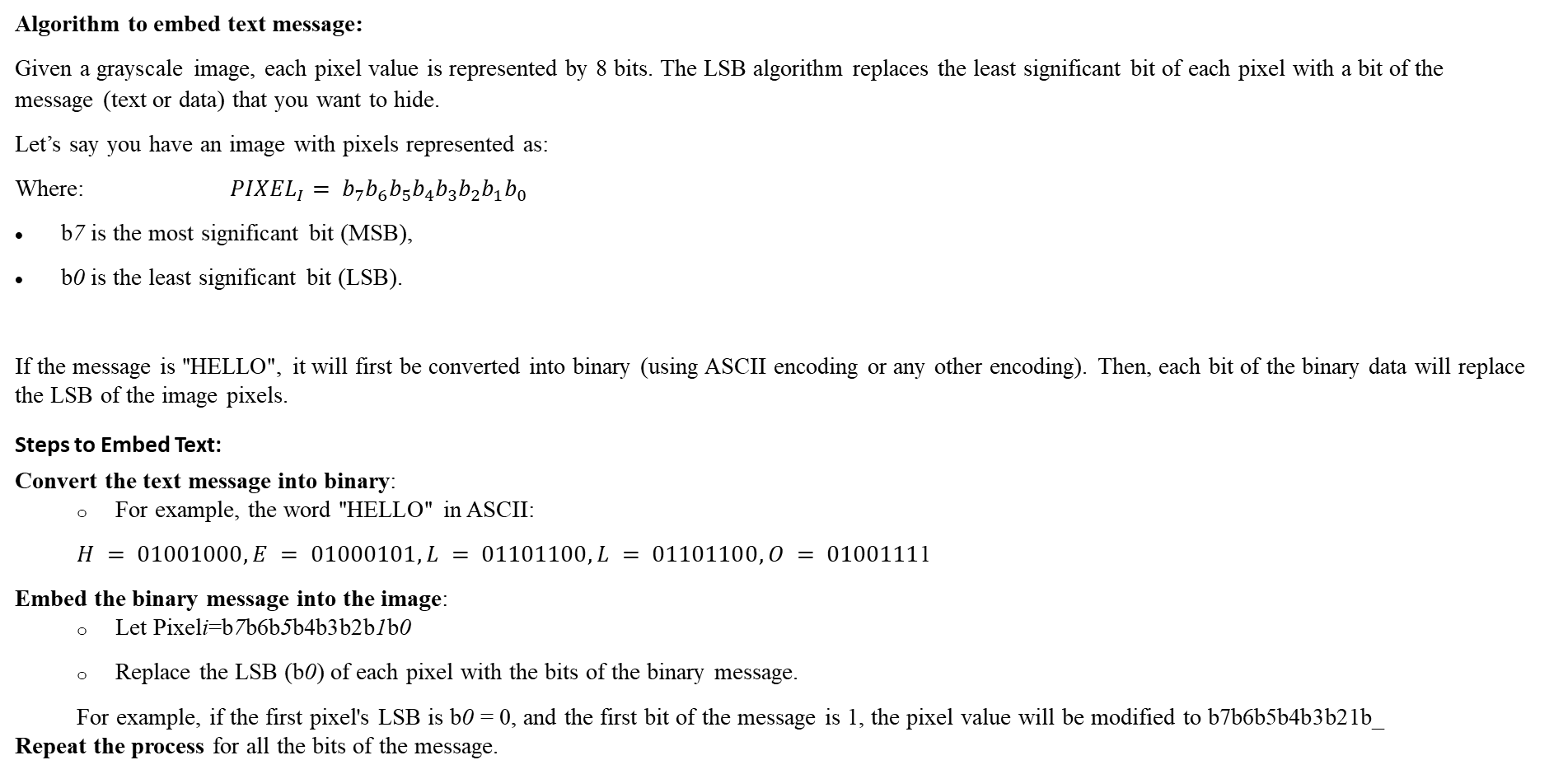
2.3 LSB ALGORITHM
Algorithm to embed text message:
Given a grayscale image, each pixel value is represented by 8 bits. The LSB algorithm replaces the least significant bit of each pixel with a bit of the message (text or data) that you want to hide.
Let’s say you have an image with pixels represented as:
Where: ${PIXEL}_{I}= b_{7}b_{6}b_{5}b_{4}b_{3}b_{2}b_{1}b_{0}$
b7​ is the most significant bit (MSB),
b0 is the least significant bit (LSB).
If the message is "HELLO", it will first be converted into binary (using ASCII encoding or any other encoding). Then, each bit of the binary data will replace the LSB of the image pixels.
Steps to Embed Text:
Convert the text message into binary:
For example, the word "HELLO" in ASCII:
$H = 01001000, E = 01000101, L = 01101100, L = 01101100,O = 0100111$1
Embed the binary message into the image:
Let Pixeli=b7b6b5b4b3b2b1b0
Replace the LSB (b0) of each pixel with the bits of the binary message.
For example, if the first pixel's LSB is b0 = 0, and the first bit of the message is 1, the pixel value will be modified to b7b6b5b4b3b21b_
Repeat the process for all the bits of the message.

Slide 14
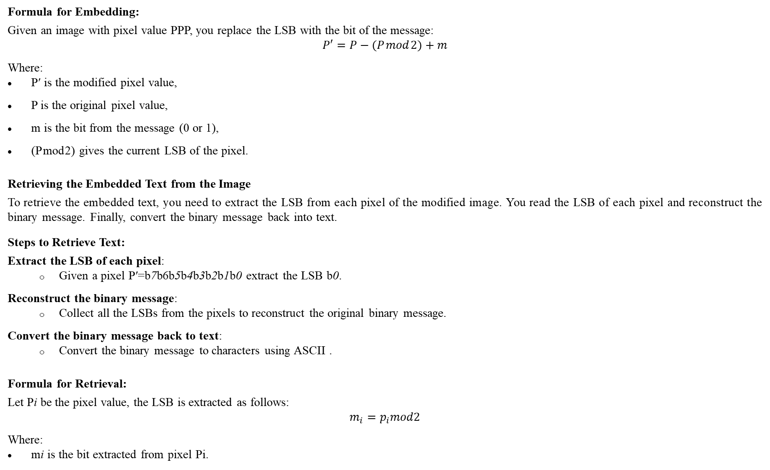
Formula for Embedding:
Given an image with pixel value PPP, you replace the LSB with the bit of the message:
$$P′=P−(P mod 2)+m$$
Where:
P′ is the modified pixel value,
P is the original pixel value,
m is the bit from the message (0 or 1),
(P mod 2) gives the current LSB of the pixel.
Retrieving the Embedded Text from the Image
To retrieve the embedded text, you need to extract the LSB from each pixel of the modified image. You read the LSB of each pixel and reconstruct the binary message. Finally, convert the binary message back into text.
Steps to Retrieve Text:
Extract the LSB of each pixel:
Given a pixel P′=b7b6b5b4b3b2b1b0 extract the LSB b0.
Reconstruct the binary message:
Collect all the LSBs from the pixels to reconstruct the original binary message.
Convert the binary message back to text:
Convert the binary message to characters using ASCII .
Formula for Retrieval:
Let Pi be the pixel value, the LSB is extracted as follows:
$$m_{i}=p_{i}mod2$$
Where:
mi is the bit extracted from pixel Pi​.

Slide 15
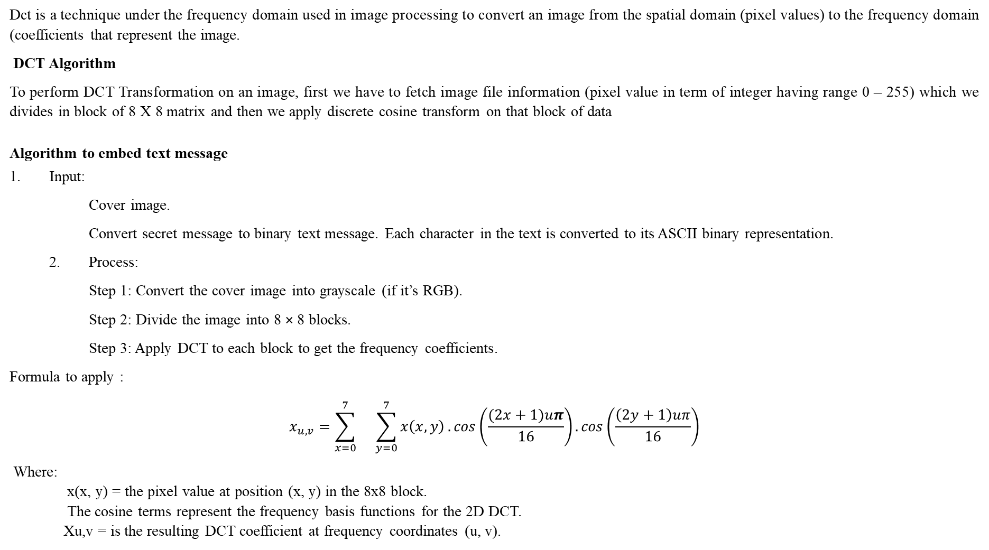
2.4 Discrete Cosine Transform Technique
Dct is a technique under the frequency domain used in image processing to convert an image from the spatial domain (pixel values) to the frequency domain (coefficients that represent the image.
DCT Algorithm
To perform DCT Transformation on an image, first we have to fetch image file information (pixel value in term of integer having range 0 – 255) which we divides in block of 8 X 8 matrix and then we apply discrete cosine transform on that block of data
Algorithm to embed text message
1. Input:
Cover image.
Convert secret message to binary text message. Each character in the text is converted to its ASCII binary representation.
2. Process:
Step 1: Convert the cover image into grayscale (if it’s RGB).
Step 2: Divide the image into 8 × 8 blocks.
Step 3: Apply DCT to each block to get the frequency coefficients.
Formula to apply :
$$x_{u,v}=\sum_{x=0}^{7}{}\sum_{y=0}^{7}{x\left(x, y\right)}.cos\left(\frac{(2x+1)uπ}{16}\right). cos\left(\frac{\left(2y+1\right)uπ}{16}\right)$$
Where:
x(x, y) = the pixel value at position (x, y) in the 8x8 block.
The cosine terms represent the frequency basis functions for the 2D DCT.
Xu,v​ = is the resulting DCT coefficient at frequency coordinates (u, v).

Slide 16
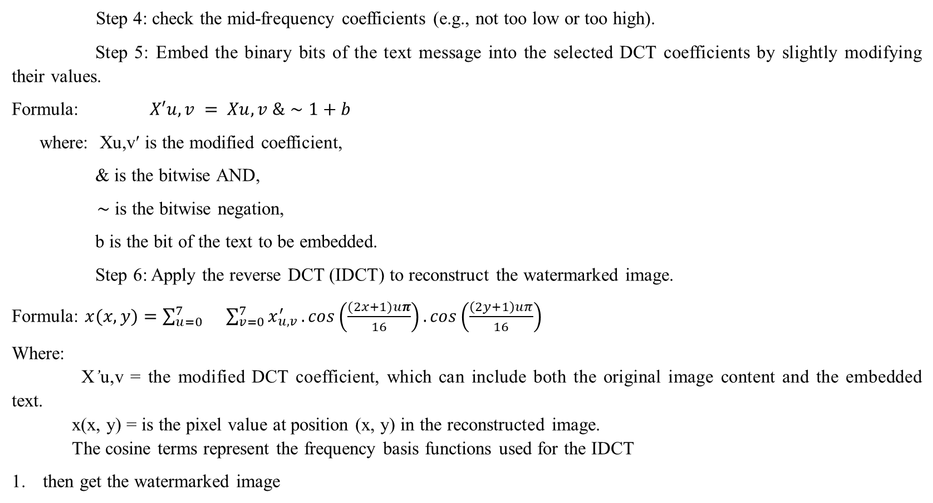
Step 4: check the mid-frequency coefficients (e.g., not too low or too high).
Step 5: Embed the binary bits of the text message into the selected DCT coefficients by slightly modifying their values.
Formula: $X′u,v ​= Xu,v ​\&∼1+b$
where: Xu,v′​ is the modified coefficient,
& is the bitwise AND,
∼ is the bitwise negation,
b is the bit of the text to be embedded.
Step 6: Apply the reverse DCT (IDCT) to reconstruct the watermarked image.
Formula: $x(x,y)=\sum_{u=0}^{7}{}\sum_{v=0}^{7}{x_{u,v}^{′}}.cos\left(\frac{(2x+1)uπ}{16}\right). cos\left(\frac{\left(2y+1\right)uπ}{16}\right)$
Where:
X’u,v = the modified DCT coefficient, which can include both the original image content and the embedded text.
x(x, y) = is the pixel value at position (x, y) in the reconstructed image.
The cosine terms represent the frequency basis functions used for the IDCT
then get the watermarked image

Slide 17
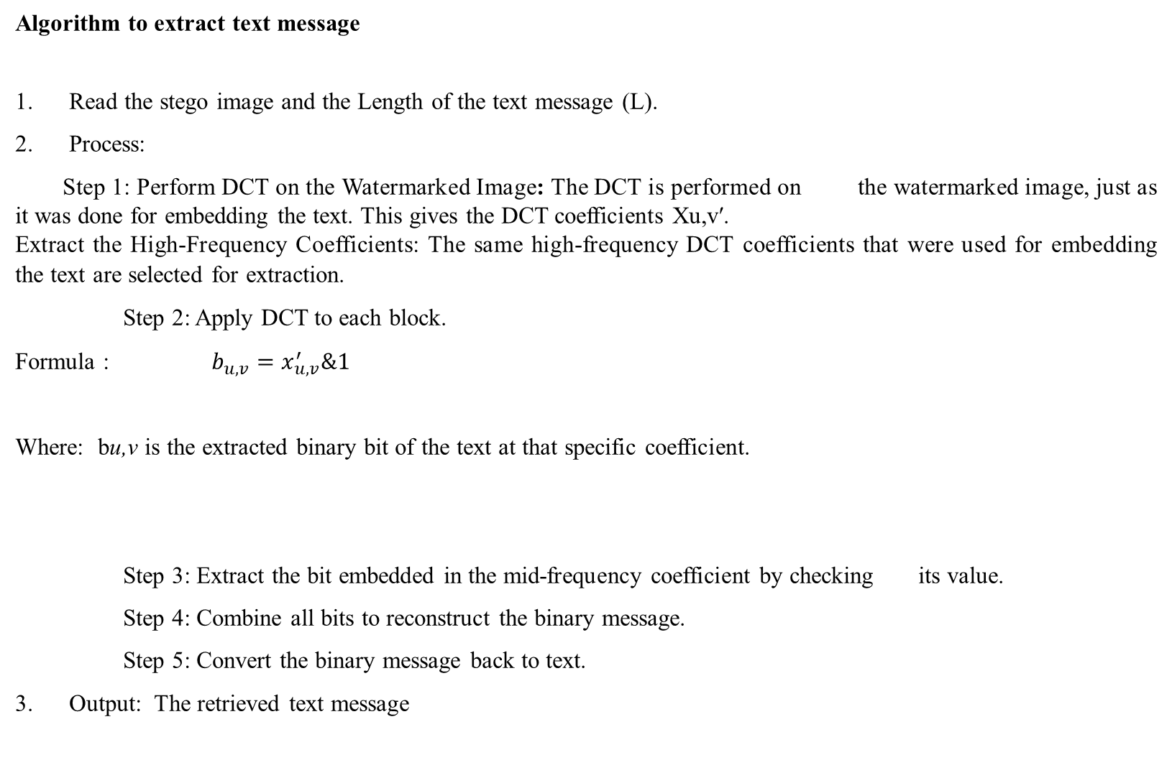
Algorithm to extract text message
1. Read the stego image and the Length of the text message (L).
2. Process:
Step 1: Perform DCT on the Watermarked Image: The DCT is performed on the watermarked image, just as it was done for embedding the text. This gives the DCT coefficients Xu,v′​.
Extract the High-Frequency Coefficients: The same high-frequency DCT coefficients that were used for embedding the text are selected for extraction.
Step 2: Apply DCT to each block.
Formula : $b_{u,v}=x_{u,v}^{′}​\&1$
Where: bu,v​ is the extracted binary bit of the text at that specific coefficient.
Step 3: Extract the bit embedded in the mid-frequency coefficient by checking its value.
Step 4: Combine all bits to reconstruct the binary message.
Step 5: Convert the binary message back to text.
3. Output: The retrieved text message

Slide 18
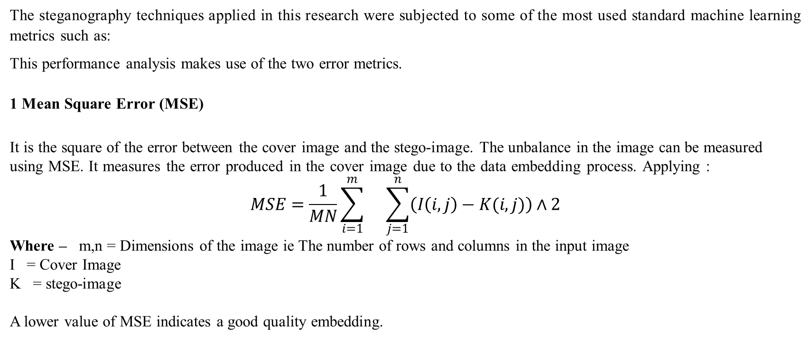
2.5 PERFORMANCE EVALUATION METRICS
The steganography techniques applied in this research were subjected to some of the most used standard machine learning metrics such as:
This performance analysis makes use of the two error metrics.
1 Mean Square Error (MSE)
It is the square of the error between the cover image and the stego-image. The unbalance in the image can be measured using MSE. It measures the error produced in the cover image due to the data embedding process. Applying :
$$MSE=\frac{1}{MN}\sum_{i=1}^{m}{}\sum_{j=1}^{n}{\left(I\left(i,j\right)−K(i, j)\right)}∧2$$
Where – m,n = Dimensions of the image ie The number of rows and columns in the input image
I = Cover Image
K = stego-image
A lower value of MSE indicates a good quality embedding.

Slide 19
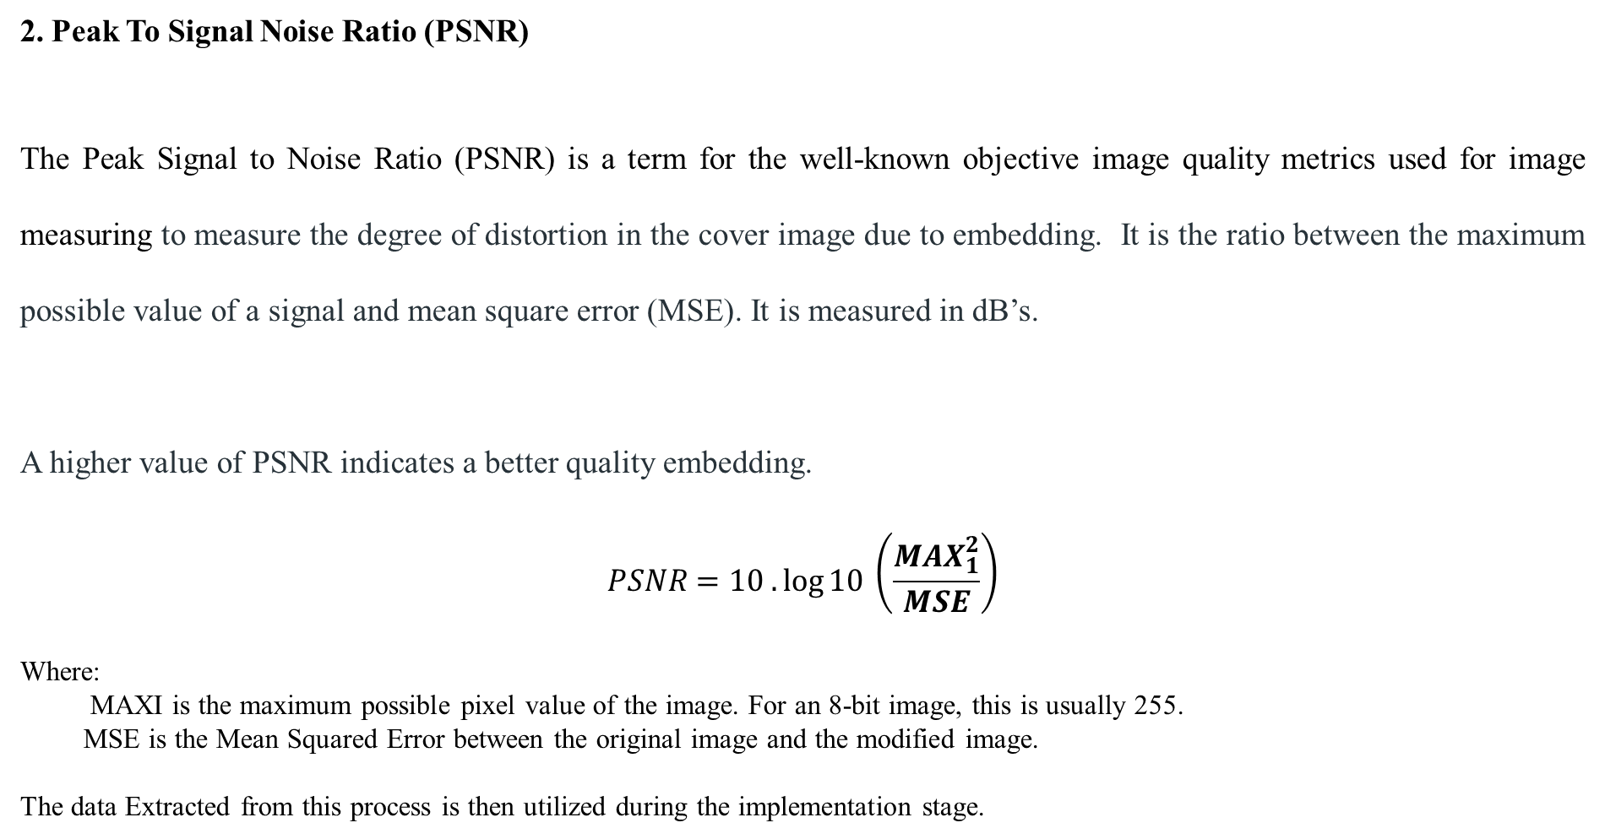
2. Peak To Signal Noise Ratio (PSNR)
The Peak Signal to Noise Ratio (PSNR) is a term for the well-known objective image quality metrics used for image measuring to measure the degree of distortion in the cover image due to embedding. It is the ratio between the maximum possible value of a signal and mean square error (MSE). It is measured in dB’s.
A higher value of PSNR indicates a better quality embedding.
$$PSNR=10 .\log{10}​\left(\frac{{MAX}_{1}^{2}}{MSE}\right)$$
Where:
MAXI​ is the maximum possible pixel value of the image. For an 8-bit image, this is usually 255.
MSE is the Mean Squared Error between the original image and the modified image.
The data Extracted from this process is then utilized during the implementation stage.

Slide 20
Different bitmap (BMP) cover images with 256x256 and 512x512 resolutions for least significant bit (LSB) and discrete cosine transform (DCT) techniques are utilized in the experimentations. The evaluation parameters of these techniques are based on MSE (mean square error) and PSNR (peak-to-square noise ratio).
We have used Python 3.6.1 for the project. We used pillow (PIL) for Spatial domain transformations like LSB and OpenCV for Frequency domain transformations like DCT and DWT implementations.
We are hiding text inside a carrier image (cover image) and making that stego to be decoded later and get the hidden text back. We stored MSE and PSNR (dB) for LSB, DCT, and DWT and stored them in an excel spreadsheet.

Slide 21
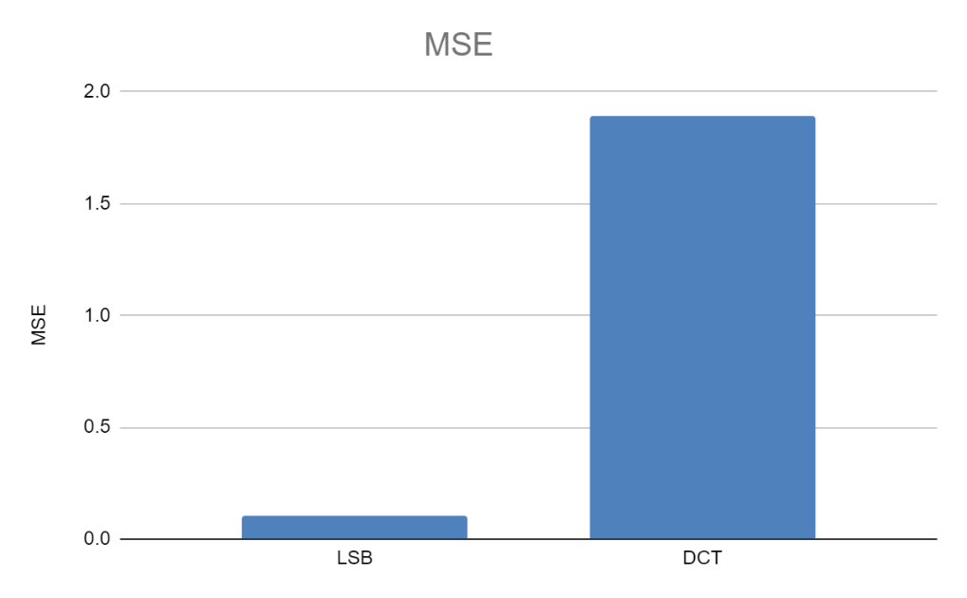
2.6 Project Evaluation Results
The result of our project's implementation using python and the following the steps in the proposed architecture is shown in the Lenna image:
For Lenna.png | MSE | PSNR
Original vs LSB | 0.103221893310547 | 57.9930854017019
Original vs DCT | 1888.07461929321 | 15.3706120665433
The MSE and PSNR for the original cover image following LSB and DCT transformation are shown in the above table.
MSE COMPARISON
FIGURE 8: MSE COMPARISON
The MSE for LSB and DCT is displayed in the above chart. It shows that DCT has a significantly higher mean square error than LSB, therefore it is more durable and has a higher payload capacity.

Slide 22
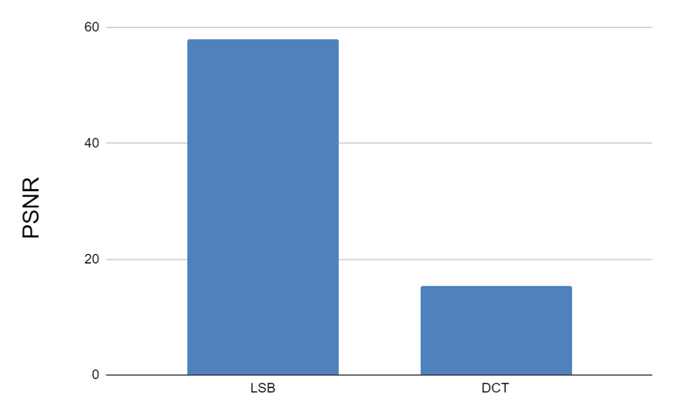
PSNR evaluation results
Peak Signal-to-Noise Ratio (PSNR) is a measure of the quality of an image, comparing an original image with a modified or compressed version. It tells us how much "noise" (unwanted changes) has been introduced into the image.
The PSNR for LSB and DCT can be seen in the chart. Peak Signal to noise ratio for LSB is significantly higher than DCT
High PSNR = Means less noise and better quality.
Low PSNR = Means more noise and poorer quality.
Therefore if PSNR for LSB (Least Significant Bit) is higher than for DCT (Discrete Cosine Transform). This means that the LSB algorithm introduces less noise into the image compared to the DCT method, resulting in better quality.
-But If two images are identical, the noise is zero, so the *Mean Squared Error (MSE)* is zero. Since PSNR is inversely related to MSE, a perfect match (MSE = 0) makes PSNR infinitely high, representing no noise at all.

Slide 23
2.7 Discussion
PSNR: DCT has a lower PSNR than LSB, indicating lower image quality, but this also means higher robustness in the image embedded with dct algorithm.
MSE: DCT has a higher MSE than LSB, indicating lower reconstruction accuracy, but this also means higher payload capacity
Invisibility: LSB has a lower level of invisibility than DCT, as the changes made by the LSB method are more visible to the human eye.
Payload Capacity: LSB has a higher payload capacity than DCT, as it can embed more secret data in the image pixel values.
Robustness: DCT is more robust than LSB, as the high-frequency coefficients used by the DCT method are less affected by image processing operations
Method | LSB | DCT
PSNR | High | Low
MSE | Low | High
Robustness | Low | High
Invisibility | Low | High
Payload Capacity | High | Low

Slide 24
The watermark is inserted in the DWT and DCT domain of a picture in a multi-resolution way. First, an original image and watermark are converted to the wavelet domain in the DWT domain, and the watermark is then embedded. To ensure that the embedded watermark is undetectable and to increase the robustness of the confidential data, the DCT system also uses visual masking. Once the watermark has been removed from the watermarked image during decoding, key performance metrics, including peak signal to mean noise ratio (PSNR) and correlation, are computed.
Various attacks have been made on the watermarked image to demonstrate the robustness of the used technique. In each instance, PSNR and correlation have been computed.

Slide 25
2.8 CONCLUSION
This study goes into great detail regarding using the LSB and DCT algorithms in steganography. For use in steganography, the LSB and DCT are implemented. The performance evaluation of the LSB and DCT approaches is successfully finished in this experiment, and the experimental findings are discussed. For the LSB and DCT algorithms, the MSE and PSNR values are compared. The PSNR value displays the image quality following data embedding.
According to the experiment’s findings, the LSB has a higher PSNR than the other two algorithms due to its minimal impact on image quality. However, the DCT algorithm is more robust and better suited for situations where imperceptibility and resistance to compression is critical
As a result, the experiment concludes that the DCT algorithm is superior to the LSB and DWT-based algorithms for using steganography
Although DCT is preferred in this study the other algorithms have their strengths but according to the objectives of this study it is concluded that the DCT algorithm demonstrated the best performance for steganographic applications in digital images. Its robustness and ability to embed data effectively while maintaining a good balance between imperceptibility and resistance to compression make it the most suitable approach for this study's goals.

Slide 26
2.9 RECOMMENDATION
In terms of recommendations for performance evaluation of stenographic approaches to digital images, the following can be considered:
Choose appropriate error metrics: The choice of error metrics is crucial for evaluating the performance of the stenographic approach. PSNR and MSE are two commonly used metrics, but other metrics such as structural similarity index (SSIM) may also be considered depending on the specific requirements of the application.
Consider a wide range of test images: To accurately evaluate the performance of the stenographic approach, it is important to consider a wide range of test images that cover different image types, resolutions, and compression levels.
Consider the impact of image compression: Image compression can significantly impact the performance of the stenographic method. To accurately evaluate the performance of the approach, it is important to consider the impact of image compression and evaluate the performance of the stenographic method under different compression levels.

Slide 27
3.1 FUTURE WORKS
There are several directions for future works on performance evaluation of stenographic approaches to digital images:
Development of new error metrics: The development of new error metrics that can better evaluate the performance of stenographic approaches, particularly in terms of preserving the visual quality of the image and hiding the hidden data, can be an area of future work.
Integration of deep learning methods: The integration of deep learning methods, such as Convolutional Neural Networks (CNNs), into stenographic approaches can be a promising area of future work. The performance of these methods can be evaluated and compared against existing approaches.
Evaluation of performance under new attacks: The evaluation of the performance of stenographic approaches under new and emerging attacks, such as adversarial attacks and AI-based image forensics, can be an area of future work.

Slide 28
REFERENCES
L. K. Tyagi, A. Gupta and A. Mohamed, "Unveiling the Invisible an In-Depth Analysis of Text Steganography Techniques, Challenges, and Advancement," 2023 3rd International Conference on Technological Advancements in Computational Sciences (ICTACS), Tashkent, Uzbekistan, 2023
Amid.a.jalab, a.a zaidan, b.b zaidan, “new design for information hiding with in steganography using distortion techniques”, international journal of engineering and technology (ijet)), vol 2, no. 1, issn: 1793-8236, feb (2019), singapore.
Histiaeus And Steganography | Teaching London Computing: A Resource Hub From Cas London & Cs4fn(Https://Teachinglondoncomputing.Org/Histiaeus/).
A. Hadipour and R. Afifi (2020) , "Advantages and disadvantages of using cryptography in steganography," 2020 17th International ISC Conference on Information Security and Cryptology (ISCISC), Tehran, Iran, 2020, pp. 88-94.
Abd Allteef, S. K. (2019). Proposed Steganography Method to Hide Image Data in Wave File. Journal of Babylon University, 18(1–2), 360-367.
ALabaichi, A., Al-Dabbas, M. A. A. A. K., and Salih, A. (2020). Image steganography using least significant bit and secret map techniques. International journal of electrical and computer engineering (2088-8708), 10(1).
Anumol, V. B., Thejus, P., and Namboothiri, L. V. (2022, May). Enhanced Security In Medical Image Steganography-A Hybrid Approach Using Spatial And Transform Domain. In 2022 Second International Conference on Interdisciplinary Cyber Physical Systems (ICPS) (pp. 197-202).
Chandran, S., and Bhattacharyya, K. (2015, January). Notice of Removal: Performance analysis of LSB, DCT, and DWT for digital watermarking application using steganography. In 2015 International Conference on Electrical, Electronics, Signals, Communication and Optimization (EESCO) (pp. 1-5). IEEE.

Slide 29

APPRECIATION

