Slide 1

Enhancing Local Attractions for Youth (post-secondary students)
The City of Kingston actively promotes the attraction and engagement of citizens and visitors by promoting Kingston's rich history, culture, talent, and scenery. We have an opportunity to better integrate our community's large post-secondary student demographic by developing events, programming, and initiatives that appeal to its interests. How can we make Kingston a better place to live and play for a younger demographic?

Slide 2
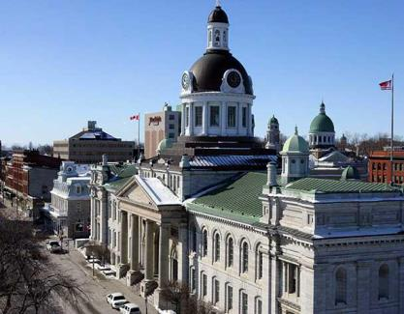
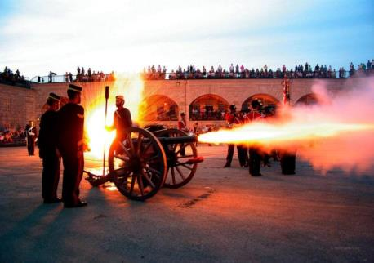
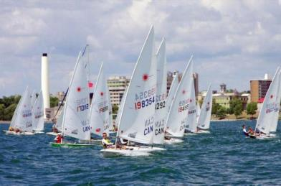
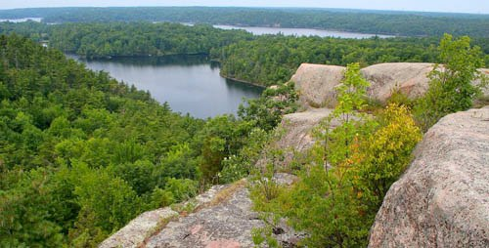

Slide 3

Kingston’s “One Voice” Campaign

Slide 4
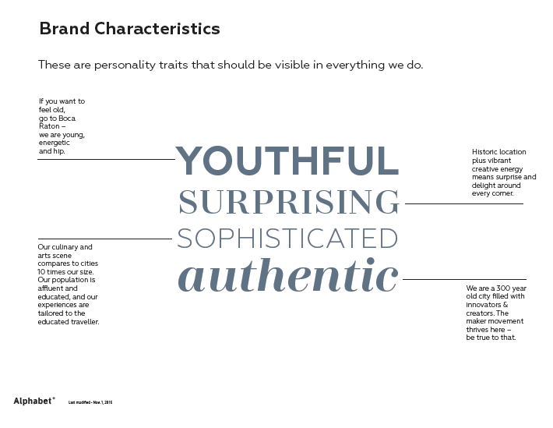

Slide 5
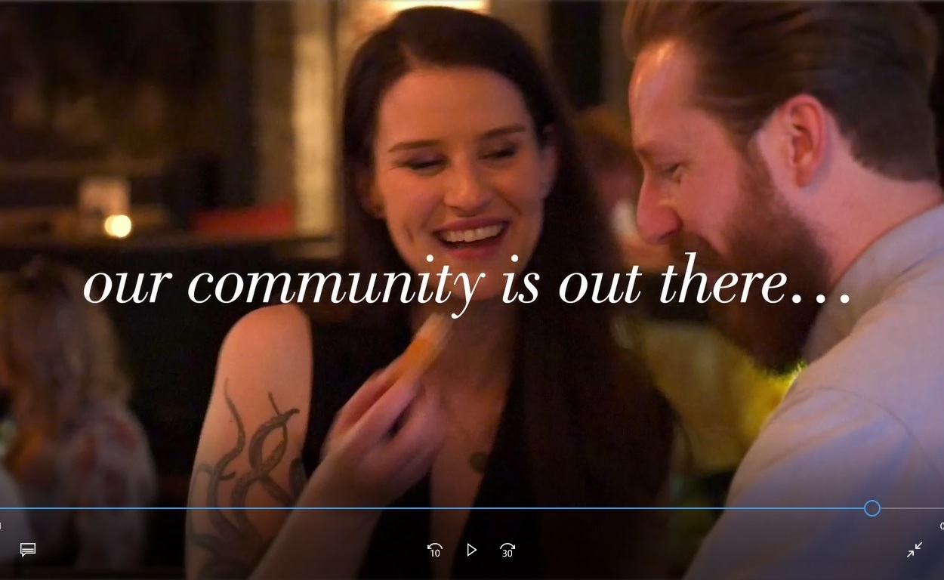
Re-targetting Plan

Slide 6
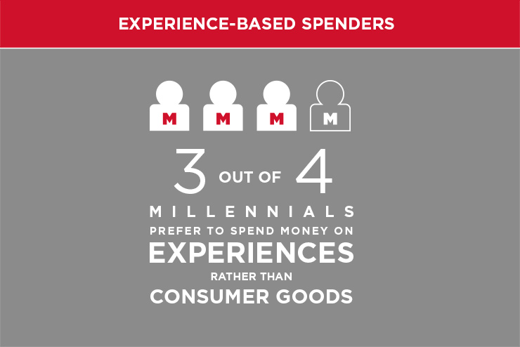

Slide 7
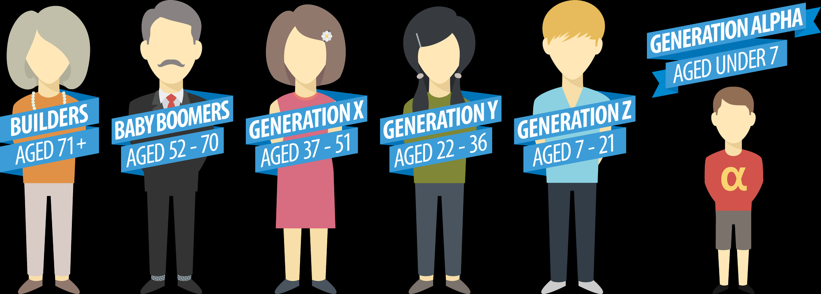
Today’s Demographics
https://nuwco.com/how-to-teach-gen-z-to-be-collaborative-innovative-and-responsive/

Slide 8
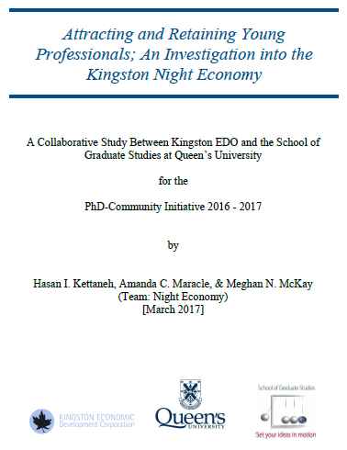
http://business.kingstoncanada.com/en/resourcesGeneral/Innovation_Kingston/Attracting-and-Retaining-Young-Professionals-2.pdf

Slide 9
Survey Findings
270 young professionals (average age 26.05 years, student and non-students, most with a post-secondary education, and without children) captured a representative sample of young professionals in Kingston.
Current opinions of Kingston were mixed, and highlighted the perception that Kingston is a “student town” (32.6%) with many bars/pubs (34.2%).
Student migration appeared dependant on available employment options (66.1%), and access to more services/activities (27.1%) often offered by larger cities.
Ratings indicated dissatisfaction with the informal evening social scene (60.9%), entertainment (83%), shopping (69.2%), public transit (76.9%), and late night food options (69.2%) all offered during the night-time in downtown Kingston.
Engagement ratings indicated interest in a 24hr café/coffee/tea shop (64.2%), a night-time market/bazaar (72.2%), evening shopping (63.5%), a night-time cultural fusion festival (81.4%), eating downtown after 11pm (70.6%), and use of public transit after 11pm (63.8%).
Additional requests included; more venues for shopping and casual social interaction (32.1%), more (and better diversity of) public events (27.5%), better access to arts, culture, and cinema options (15.6%), and better evening/weekend transit service (15.6%).

Slide 10
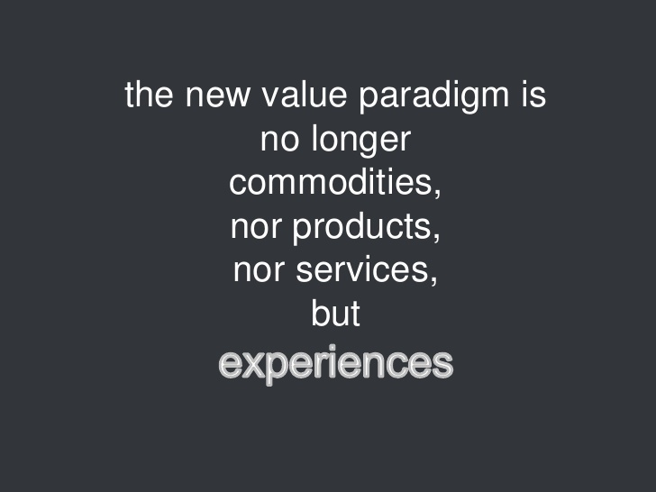

Slide 11
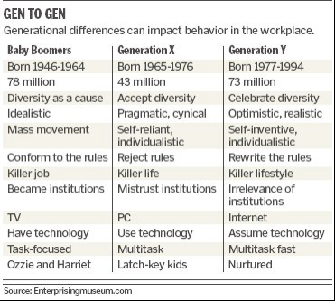
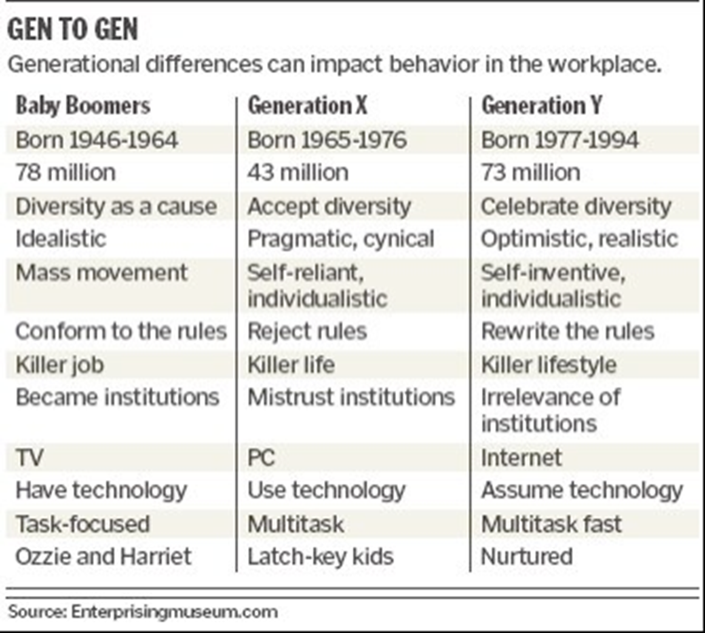

Slide 12


Slide 13
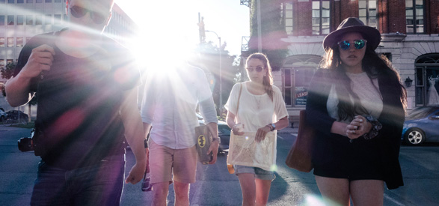
The Sweet Spot
Now, how to make Kingston a better place to live and play ...

Slide 14
Potential Resources
Attracting and Retaining Young Professionals: An Investigation into the Kingston Night Economy
Kingston Culture Plan
Y2K, Kingston Youth Strategy
Tourism Kingston/Kingston Accommodation Partners
Kingston Economic Development
Kingston Strategic Plan
Kingston Demographic Data
Canada Census Data
Environics Data
Soul of the Community, Knight Foundation
https://www.hipstorytours.com/
http://www.juvenisfestival.ca/
http://thekickandpush.com/
https://www.tettcentre.org/
http://musicfly.ca/
http://www.kingstonist.com/
http://www.visitkingston.ca/
http://www.kingstonlife.ca/
https://www.pps.org/
https://museumhack.com/
https://www.citylab.com/design/2012/03/guide-tactical-urbanism/1387/
https://improveverywhere.com/
http://www.cityrepair.org/
http://parkingday.org/

