Slide 1
MIVA OPEN UNIVERSITY · SCHOOL OF COMPUTING
DESIGN AND IMPLEMENTATION OF A DETERMINISTIC
FAILURE-MODE GUARDRAIL SYSTEM FOR AI-GENERATED
SOFTWARE USING MODEL CONTEXT PROTOCOL
2023/C/SENG/0351
OLUWAMAYOWA KALEJAIYE
Supervisor: Ijegwa Acheme, Ph.D · July, 2026

Slide 2
01 · PROBLEM
Agents write code that runs — not code that survives
▸ Coding agents learn from tutorials, which never show the failure.
▸ Benchmarks score correctness on exercised paths — never resilience.
▸ Ambiguous outcomes (charged? lost?) become double charges and lost work.
▸ No deterministic, evidence-backed guardrails reach agents as tools.
A payment handler that passes every test and double-charges on retry is a success under every standard metric.
Failures — Final Year Project Defence
02 / 11
Notes:
Open with the double-charge story: provider charges, response is lost, handler retries blindly. Say: benchmarks never test this path. Pause, then the gap line.

Slide 3
02 · AIM
Build the checking layer benchmarks never built
▸ Aim: design, implement, and evaluate deterministic failure-mode guardrails for AI-generated software.
▸ 1. Investigate failure modes and existing guardrail approaches.
▸ 2. Design an invariant-based guardrail framework.
▸ 3. Develop it as a Model Context Protocol server.
▸ 4. Implement a deterministic evaluation harness.
▸ 5. Evaluate through proxy and blind agent studies.
Failures — Final Year Project Defence
03 / 11
Notes:
Read the aim once, slowly. Walk the five objectives quickly; each maps to a chapter and to a results table later.

Slide 4
03 · LITERATURE
Everything exists except the connection
▸ Correctness benchmarks (HumanEval, SWE-bench) never score resilience.
▸ Pattern-selection DSS compare technologies — they never check generated code.
▸ Resilience canons catalogue controls as knowledge, not as checks.
▸ Gap: nobody connects deterministic guardrails to the agents producing the code.
Done A, B, C — but none done D. Therefore propose E.
Failures — Final Year Project Defence
04 / 11
Notes:
Name the three prior strands in one breath each. Land on the gap formula: done A/B/C, none done D, therefore propose E.

Slide 5
04 · METHOD
Build the artefact, then measure it
▸ Design Science Research: build, then evaluate — not surveys, not opinion.
▸ Agile: rules, tools, and harness co-evolved through iterations.
▸ Data: 17 matched pairs + 6 proxy + 6 adversarial cases.
▸ Instrument: one harness, ten criteria, frozen prompts and manifests.
17
matched pairs
10
scored criteria
6+6
scenarios + adversarial
3
commercial agents
Failures — Final Year Project Defence
05 / 11
Notes:
If asked why not surveys: opinions about resilience are a poor substitute for measured findings on code. Say that only if pushed.

Slide 6
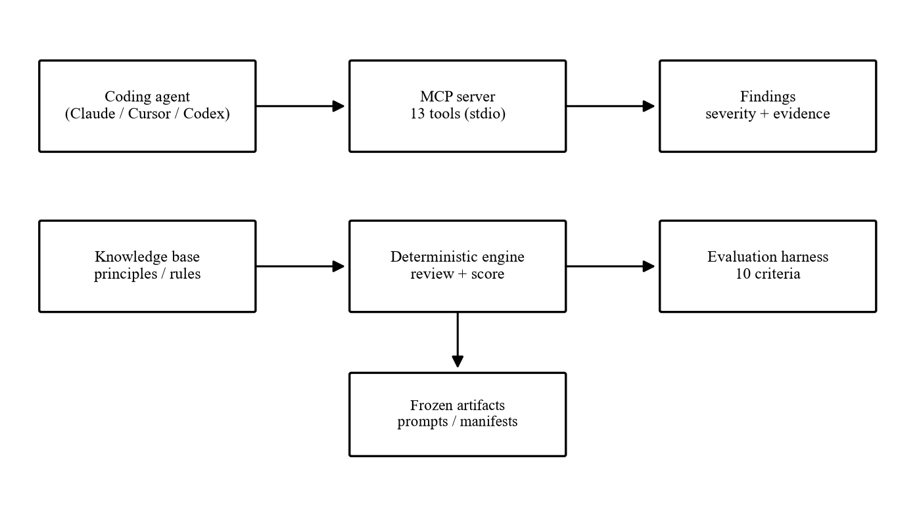
05 · SYSTEM
One server, any agent, zero token cost
▸ Knowledge base: 11 principles, 10 rule families, versioned JSON.
▸ Deterministic engine: review and score — never hallucinates.
▸ 13 MCP tools: any compliant agent calls them; findings carry evidence.
Failures — Final Year Project Defence
06 / 11
Notes:
Walk left to right across the diagram. Emphasise: one server, any agent; the check costs nothing and never varies.

Slide 7
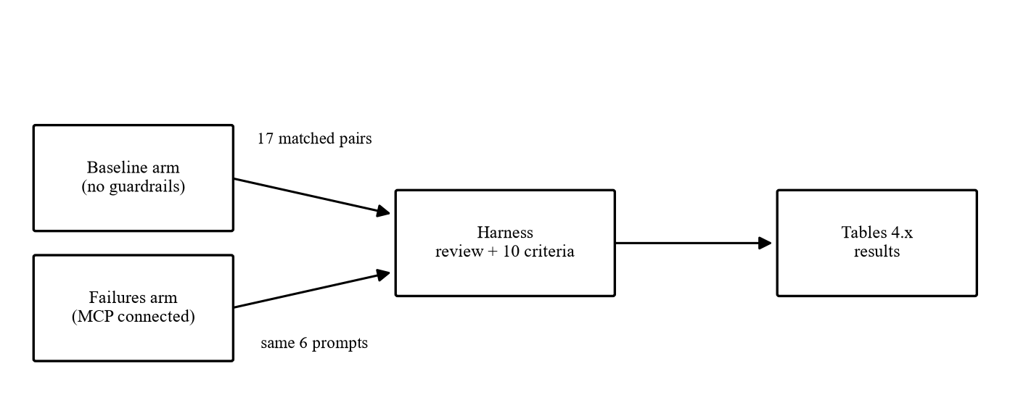
06 · EVALUATION
One variable changed, everything else frozen
▸ Same 6 prompts, two arms: baseline vs guardrails connected.
▸ Claude, Cursor, Codex — 17 matched pairs, no per-agent tuning.
▸ Frozen prompt hashes, manifests, commits — fully reproducible.
Failures — Final Year Project Defence
07 / 11
Notes:
Stress the single manipulated variable: the only difference between arms is whether the server was connected.

Slide 8
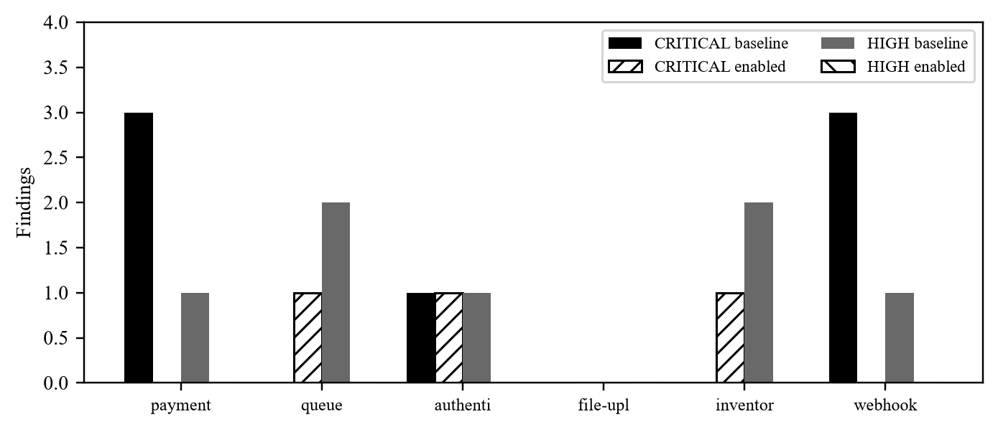
07 · RESULTS I
The instrument sees improvement where it exists
▸ CRITICAL 7 → 3, HIGH 7 → 0 across six scenarios.
▸ Payment and webhook: 3 → 0 CRITICAL each.
▸ Architecture 1.0 throughout — nothing bought with infrastructure.
This qualifies the harness — so trust it on the blind study next.
Failures — Final Year Project Defence
08 / 11
Notes:
This slide qualifies the instrument: the harness sees improvement where improvement exists, so trust it on the blind study next.

Slide 9
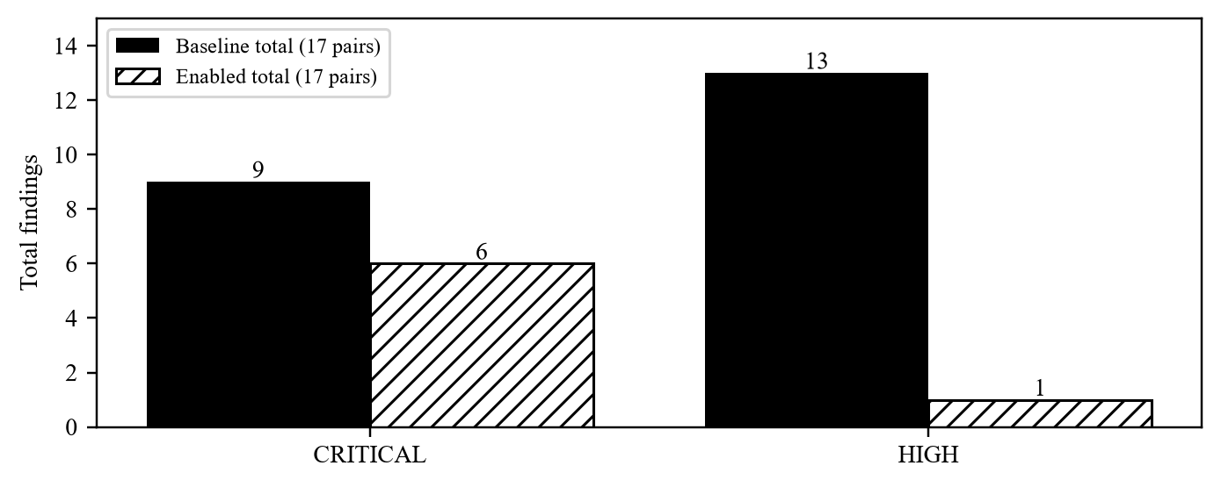
08 · RESULTS II
Consistent direction across all three agents
▸ 16 of 17 pairs improved on at least one criterion.
▸ HIGH findings never rose — and fell 13 → 1 overall.
▸ Adversarial probe: 4 of 6 flagged at CRITICAL; limits documented.
Direction holds per agent: 6/6, 5/5, 5/6 — no single model carries it.
Failures — Final Year Project Defence
09 / 11
Notes:
The headline slide. Say the three numbers slowly. If asked about the regressions: one is the documented upsert false positive, the rest are the tool catching unsafe retries the agent added.

Slide 10
09 · DISCUSSION
Three lessons, five objectives met
▸ Checks beat judges: deterministic output cannot hallucinate.
▸ Early beats late: plan review reshaped designs; code review patched them.
▸ More code is the mechanism: +39% volume is pending records and reconciliation — the resilience itself.
Objective | Evidence | Met
1 Investigate | Ch. 2, Table 2.1 | Yes
2 Design | Ch. 3, Figs 3.1–3.2 | Yes
3 Develop | Ch. 4, server + tools | Yes
4 Harness | Ch. 3–4, 10 criteria | Yes
5 Evaluate | Tables 4.2–4.4 | Yes
Failures — Final Year Project Defence
10 / 11
Notes:
Three lessons, one breath each. The objectives table is in the report; here just assert the mapping confidently.

Slide 11
10 · CONCLUSION
A cheap, reproducible floor for resilience practice
▸ Deterministic guardrails measurably improve agent-generated resilience.
▸ Recommend: review plans before code; ship checks as tools, not judges.
▸ Next: AST-level rules, enforced tool use, live-provider testing.
github.com/mayowa-kalejaiye/Failures
doi.org/10.5281/zenodo.22966362
failures-mcp on PyPI
Thank you.
Failures — Final Year Project Defence
11 / 11
Notes:
End on the artifact: code, paper, DOI all public. Then stop talking and take questions. If asked about limits, go straight to the adversarial boundary — owning it is the strongest move.

