Slide 1
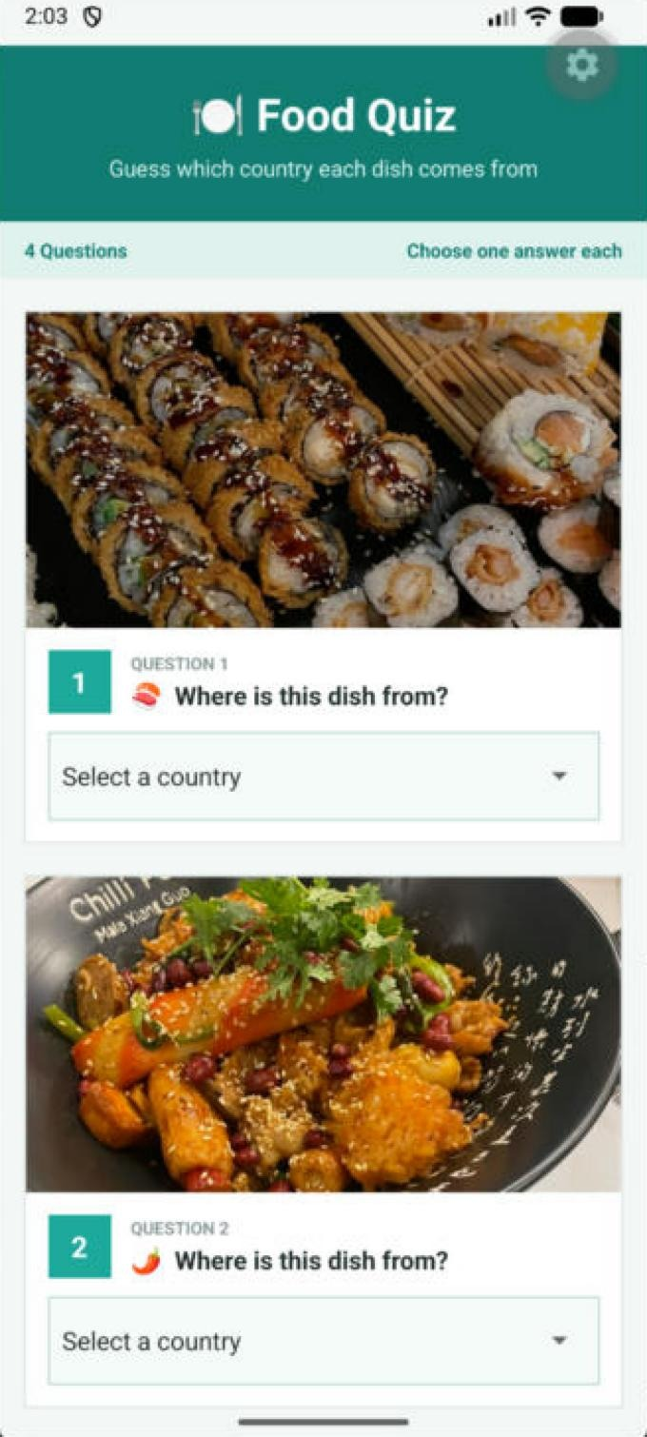
Food Quiz
C346 | EXERCISE 5
Code and app output, side by side. Restyled with React Native StyleSheet and Flexbox.
May Poe Khitt(25038034)
Notes:
Hi, this is my Food Quiz app for Exercise 5. I restyled it using StyleSheet and Flexbox. In this video I will show each part of the code beside what it does in the app.

Slide 2

The header
PART 1 | APP.JS LINES 42-45 AND 121-126
App.js
<View style={styles.headerBox}>
<Text style={styles.header}>Food Quiz</Text>
<Text style={styles.subHeader}>Guess...</Text>
</View>
headerBox: {
backgroundColor: '#127C74',
padding: 24,
marginTop: 30,
alignItems: 'center',
},
In the app
The teal box at the top. alignItems: 'center' puts the title and subtitle in the middle, and padding gives them space around the edges.
Notes:
This View uses the headerBox style. In the StyleSheet I gave it a teal backgroundColor and padding. alignItems: 'center' centres the title and subtitle, as you can see here in the app.

Slide 3

The info bar
PART 2 | APP.JS LINES 47-50 AND 137-146
App.js (shortened)
<View style={styles.infoBar}>
<Text style={styles.infoText}>4 Questions</Text>
<Text style={styles.infoText}>Choose...</Text>
</View>
infoBar: {
flexDirection: 'row',
justifyContent: 'space-between',
backgroundColor: '#E1F2F0',
paddingLeft: 16,
// ... more padding and margin
},
In the app
flexDirection: 'row' puts the two texts side by side. justifyContent: 'space-between' pushes “4 Questions” to the left and “Choose one answer each” to the right.
Notes:
The info bar uses flexDirection: 'row', which places the two texts side by side. justifyContent: 'space-between' pushes '4 Questions' to the left and 'Choose one answer each' to the right.

Slide 4
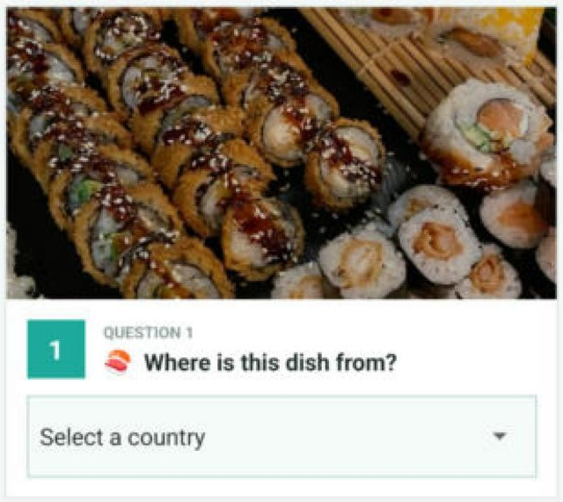
The question card
PART 3 | APP.JS LINES 5-8 AND 152-163
App.js (shortened)
const Question = ({ number, image, ... }) => {
<View style={styles.card}>
<Image source={image} style={styles.image} />
// ... question and picker
card: {
backgroundColor: 'white',
borderWidth: 1,
borderColor: '#DDE5E5',
marginLeft: 16, marginRight: 16,
marginBottom: 20,
},
image: { width: '100%', height: 200 },
In the app
One reusable Question component. Each card has a white background, a border and margins to separate it. width: '100%' makes the photo fill the card.
Notes:
I made a reusable Question component, so all four questions share the same layout. Each question is wrapped in a card with a white background, a border and margins, so the questions are separated. The image has width: '100%' so it fills the card's width.

Slide 5
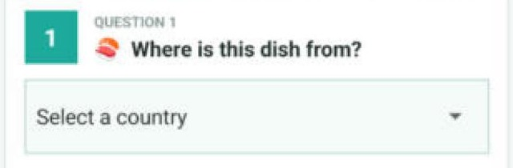
Number box beside the question
PART 4 | APP.JS LINES 11-19 AND 167-187
App.js (shortened)
<View style={styles.questionRow}>
<View style={styles.numberBox}>
<Text style={styles.number}>{number}</Text>
</View>
<View style={styles.questionTextBox}> ...
</View>
questionRow: { flexDirection: 'row', ... },
numberBox: {
width: 40, height: 40,
justifyContent: 'center',
alignItems: 'center', },
questionTextBox: { flex: 1, marginLeft: 12 },
In the app
flexDirection: 'row' puts the number box beside the question. justifyContent and alignItems: 'center' centre the number in its box. flex: 1 lets the text fill the rest of the row.
Notes:
questionRow uses flexDirection: 'row' to place the number box beside the question. In numberBox, justifyContent and alignItems: 'center' centre the number inside the box. questionTextBox has flex: 1, so the text takes up the remaining space.

Slide 6
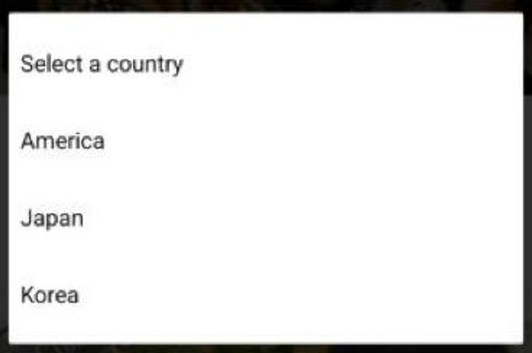
The answer dropdown
PART 5 | APP.JS LINES 21-28 AND 199-203
App.js
<View style={styles.pickerBox}>
<Picker selectedValue={value}
onValueChange={onValueChange}>
<Picker.Item label='Select a country' value='' />
<Picker.Item label={opt1} value={opt1} />
<Picker.Item label={opt2} value={opt2} />
<Picker.Item label={opt3} value={opt3} />
</Picker>
</View>
pickerBox: {
borderWidth: 1, borderColor: '#B8D8D5',
backgroundColor: '#F7FBFB', },
In the app
Tapping the box opens the three country choices. The border and light background make pickerBox look like an input field.
Notes:
The Picker sits inside pickerBox, which has a border and a light background so it looks like an input field. When I tap it, it shows the three options I passed in as opt1, opt2 and opt3.

Slide 7
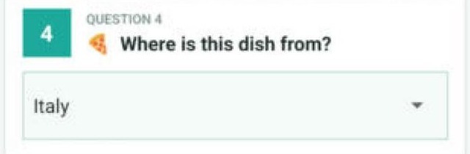
Saving each answer
PART 6 | APP.JS LINES 35-38 AND 82-90
App.js (shortened)
const [ans1, setAns1] = useState('');
const [ans2, setAns2] = useState('');
const [ans3, setAns3] = useState('');
const [ans4, setAns4] = useState('');
<Question
number="4"
image={require('./assets/pizza.jpg')}
value={ans4}
onValueChange={(value) => setAns4(value)}
opt1="France" opt2="Italy" opt3="Spain"
/>
In the app
When I pick “Italy”, onValueChange calls setAns4, so the answer is saved in state and stays shown in the box.
Notes:
Each answer is saved with useState, in ans1 to ans4. When I pick an option, onValueChange calls the setter, for example setAns4, so the chosen answer is stored and shown in the box. I reuse the same Question component four times and only change the image and options.

Slide 8
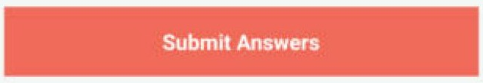
The submit button
PART 7 | APP.JS LINES 92-109 AND 207-219
App.js (shortened)
<TouchableOpacity
style={styles.button}
onPress={() => { /* next slide */ }}>
<Text style={styles.buttonText}>
Submit Answers
</Text>
</TouchableOpacity>
button: {
backgroundColor: '#F26B5B',
padding: 16,
alignItems: 'center',
},
buttonText: { fontSize: 17, fontWeight: 'bold' },
In the app
A coral backgroundColor makes the button stand out from the teal theme. alignItems: 'center' centres the bold white text inside it.
Notes:
At the bottom is the submit button, a TouchableOpacity. I styled it with a coral backgroundColor so it stands out from the teal theme, and alignItems: 'center' centres the white text.

Slide 9

Checking the score
PART 8 | APP.JS LINES 95-105
App.js, inside onPress
let score = 0;
if (ans1 == 'Japan') { score = score + 1; }
if (ans2 == 'China') { score = score + 1; }
if (ans3 == 'Myanmar') { score = score + 1; }
if (ans4 == 'Italy') { score = score + 1; }
let msg = 'You can do better next time.';
if (score == 4) { msg = 'Well done! ...'; }
else if (score >= 2) { msg = 'Not bad!'; }
Alert.alert('Your Result', 'You have '
+ score + ' correct answers! ' + msg);
In the app
Each correct answer adds 1. With all four right, Alert.alert shows “4 correct answers” and the food expert message.
Notes:
When the button is pressed, this code checks each answer and adds 1 to the score for each correct one. Then it picks a message based on the score and shows the result with Alert.alert. I answered Japan, China, Myanmar and Italy, so I got 4 out of 4.

Slide 10
StyleSheet and Flexbox used
SUMMARY
Property | Used in | What it does
flexDirection: 'row' | infoBar, questionRow | Places items side by side
justifyContent: 'space-between' | infoBar | Pushes text to both ends
alignItems / justifyContent: 'center' | headerBox, numberBox, button | Centres the content
flex: 1 | container, questionTextBox | Fills the remaining space
width: '100%' | image | Photo fills the card width
colours, borders, padding, margins | card, pickerBox, button | Teal theme and separated cards
Notes:
To sum up, I used flexDirection, justifyContent, alignItems and flex for the layout, and colours, borders, padding and margins in the StyleSheet for the look. Compared to my original plain version, the app now has a clear colour theme, separated cards and a proper Flexbox layout. Thank you for watching.

