Slide 1
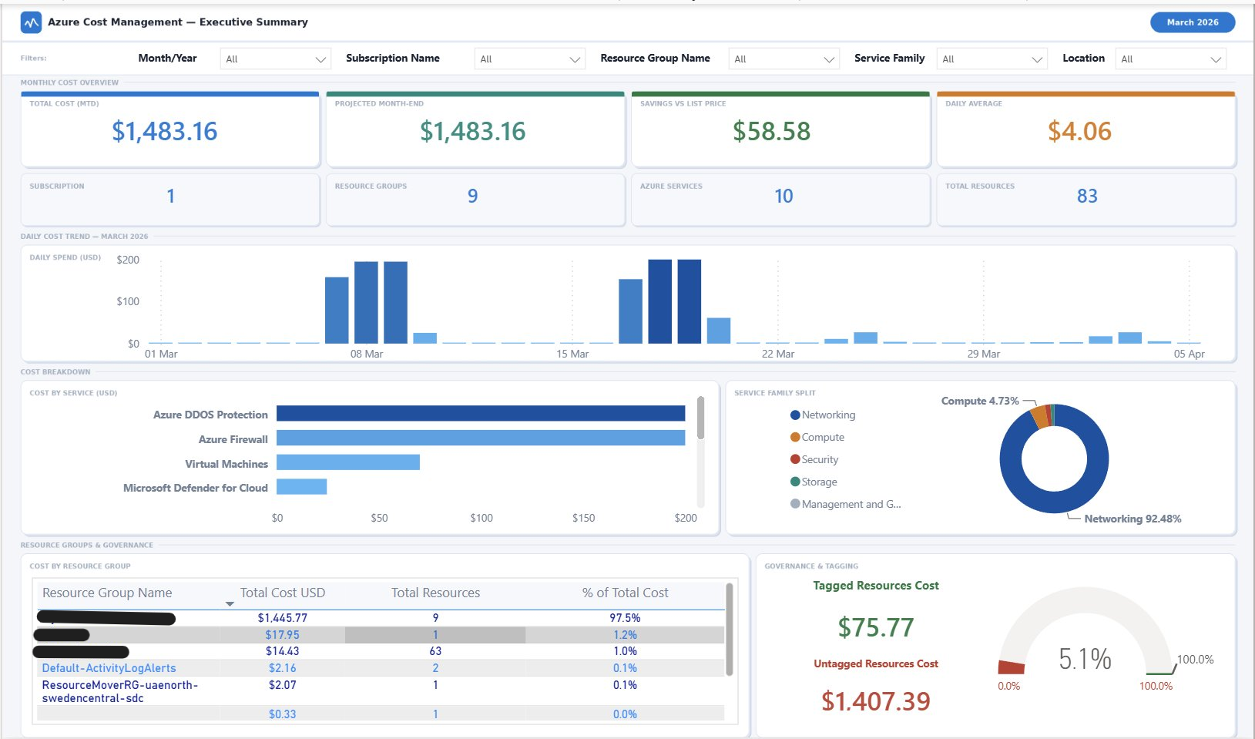

PROJECT KICKOFF
Azure FinOps Cockpit
A drop-in Power BI accelerator that turns raw Azure Cost Management exports into boardroom-ready FinOps insight — no middleware, no SaaS, no code.
Where did the money go?
Executive Summary — spend by subscription, service, region & trend
Are we leaking money?
Tags & Governance — tag coverage and cost-center attribution gaps
Are we paying retail?
FinOps Optimization — reservation & savings-plan coverage vs. on-demand
Page 1 of 3 — Executive Summary (out-of-the-box)
68
3
<30 min
$0
pre-built DAX measures
report pages, 62 visuals
from export to insight
SaaS or middleware cost

Slide 2







Architecture Review
Blob-direct ingestion — no data warehouse, no ETL service between the export and the report.
Azure Cost Management
Azure Blob Storage
Power BI Desktop / Service
Scheduled daily export (month-to-date)
Classic MCA + FOCUS 1.0 formats
CSV or CSV.GZ output
writes CSV
Container: cost-analysis/
One file per billing period
manifest.json excluded by the query
Blob Data Reader
Power Query: 9-step M pipeline
Wide-and-flat Vertipaq model
68 measures · 13 relationships
3 report pages, refreshed daily
Key design decisions
Dual fact tables
Wide-and-flat model
Daily refresh cadence
Zero middleware
Classic MCA and FOCUS 1.0 read the same files — deploy today, A/B compare, migrate to pure FOCUS later.
Dimensions live on the cost rows; only tags get a table (Dim-tags), since tag keys are unbounded.
Dataset refresh scheduled 1–2 h after the Azure export lands; runs on existing Pro/PPU capacity.
Power Query reads blobs directly with Storage Blob Data Reader — no Synapse, Databricks, or Fabric required.

Slide 3




GETTING AROUND THE REPOSITORY
Navigating the IP
Repository map
Deploy in five steps
powerbi/
Azure_Cost_Management_Template.pbit (open this) · dax/all-measures.dax (paste-ready) · queries-templete/ generic M files + queries-original/ reference
1
Configure the daily export in Cost Management (Classic + FOCUS) to a blob container
2
Open Azure_Cost_Management_Template.pbit in Power BI Desktop
docs/
Ten numbered guides: overview → prerequisites → quickstart → architecture → data model → Power Query line-by-line → DAX reference → customization → deployment → troubleshooting
3
Enter the two prompts: BlobAccountUrl and ContainerName
azure-setup/
setup-azure-exports.md — portal, Azure CLI and Bicep walkthroughs for the upstream Cost Management export
Sign in with an account holding Storage Blob Data Reader
4
5
Refresh — all three dashboards populate; publish & schedule
assets/
architecture.svg for reuse in decks & docs, plus previews of all three dashboard pages
Read first: 03-quickstart · 04-architecture · 07-dax-measures · 08-customization License: MIT — fork it, rebrand it, ship it as your own IP.

