Slide 1

Integrated Development Project « Smart Virtual Classroom »
Elaborated by :
Habbachi Maysa
Harrath Ali
Ghazouani Neji
Fajraoui Khaled

Slide 2

Introduction
1
Project Context
2
Outline
Problematic
3
Study of the existing
4
Proposed Solution
5
Functional & Non Functional Requirement
6
Prototypes
7

Slide 3
Introduction
Quote
1

Slide 4


Project context
.Help students and teachers communicate,
collaborate, organize and manage assignments
.To create advancement in education systems.
To make better learning and understanding
To encourage informal learning
2

Slide 5

Problematic
the main difficulty in education these days is that sometimes education needs to be done remotely or the perfect example is the times of a pandemic online learning is a good way of solving that
3

Slide 6


Study of the existing
Microsoft teams
Google classroom
-There is no option to upload files/videos/voice messages in google meet
-No automated quizzes and tests.
-You can’t keep track of the attendence list of the students in google meet
5

Slide 7

Proposed Solution
6

Slide 8

Solution
We will try to create a web application in which students can perform the peer evaluation and training so they improve their performance on assessed work.
Dash boarding & Reporting: Our platform
provides users with high traceability
while setting up detailed dashboards and
reports.
7

Slide 9

Added Value
Our application will create a community for students
to interact and network in order to help each other and provide
the best solution to support the learning experience for them
9

Slide 10

Identification of Actors
Administrator
Student
Teacher
8

Slide 11


Functional requirements
We distinguished these Modules that our application will provide
User Management:
-Authentication
-Check history record
-Apply for registration
Peer Evaluation:
-Review other student's work
-Give feedback
Training:
-Apply for a course's workshop
9

Slide 12
Non-functional requirements
Security
Maintainability
Use-ability
10

Slide 13
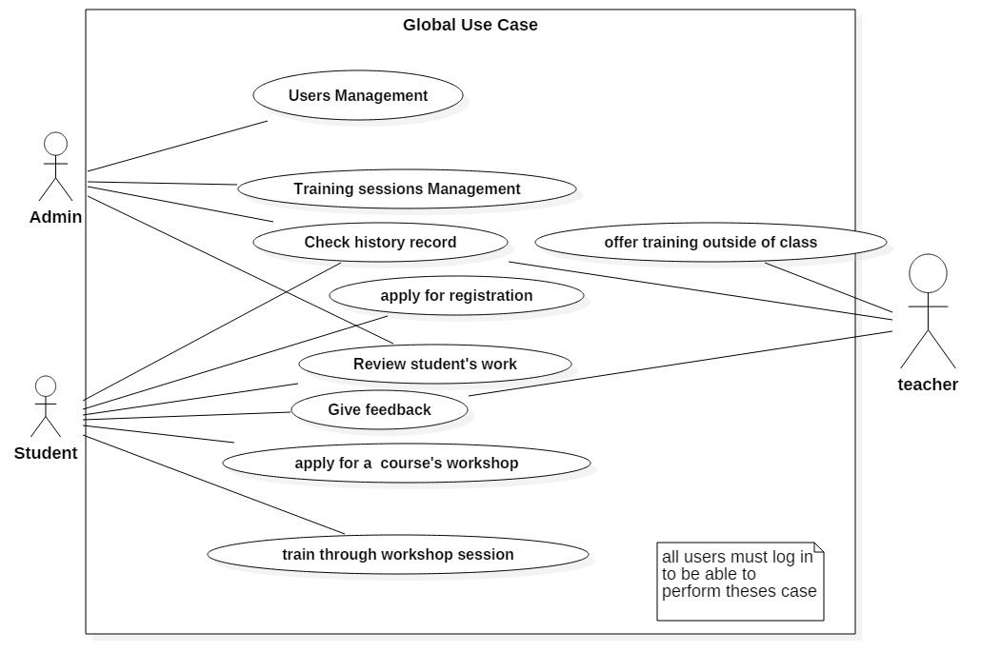
Global use-case diagram
11

Slide 14




Used Technologies
12

Slide 15
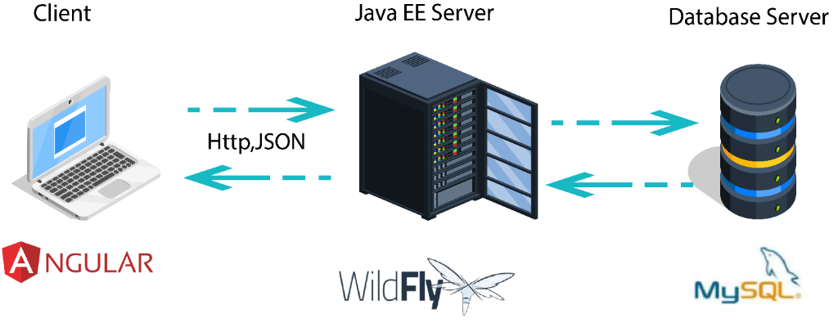
Global architecture: Physical architecture
Sed ut perspiciatis unde omnis.
13

Slide 16
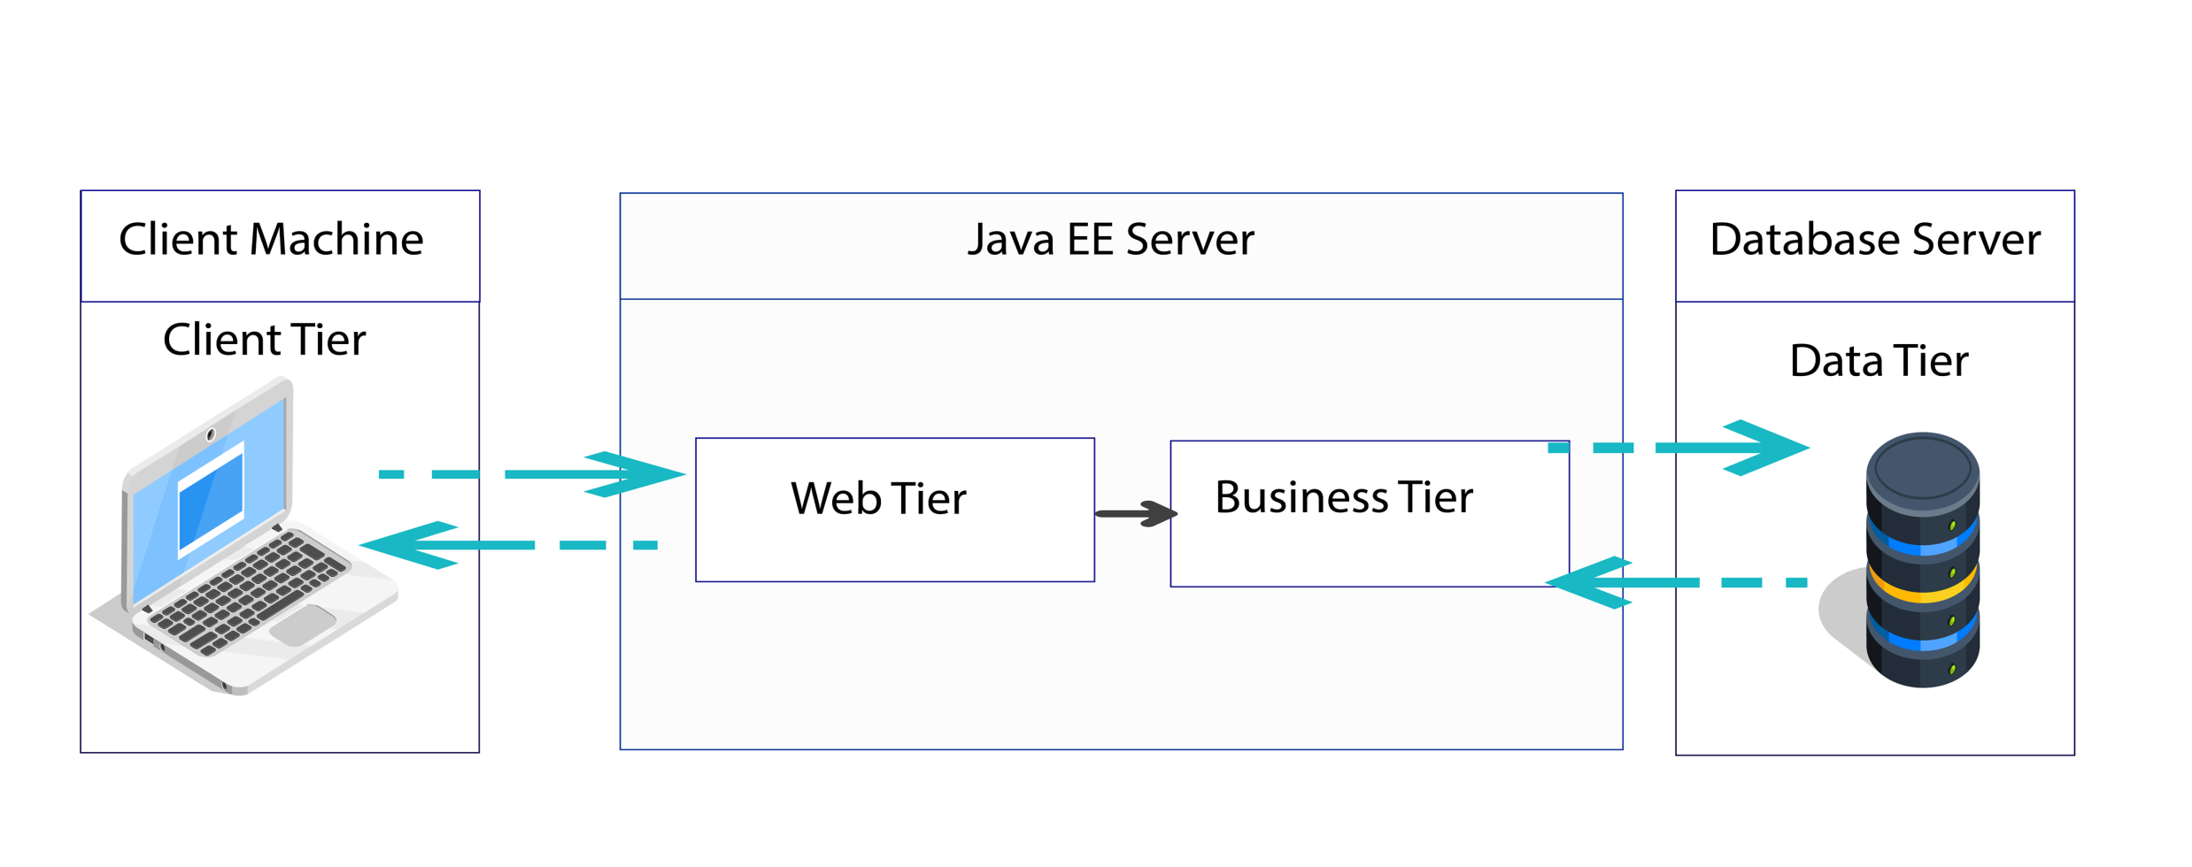
Global architecture: Logical architecture
14

Slide 17
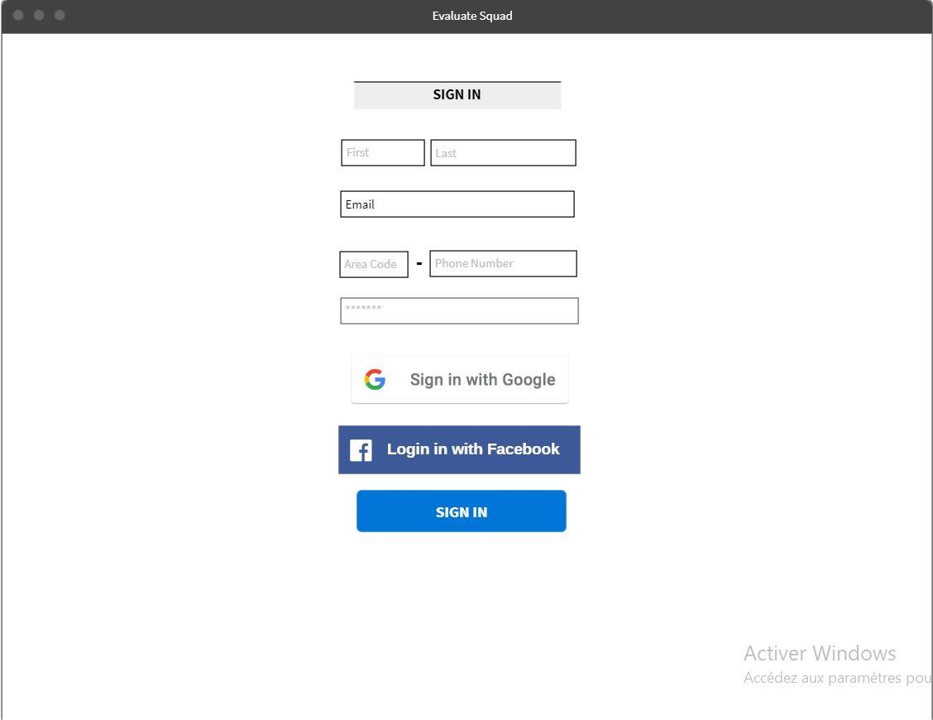
Prototypes
15

Slide 18
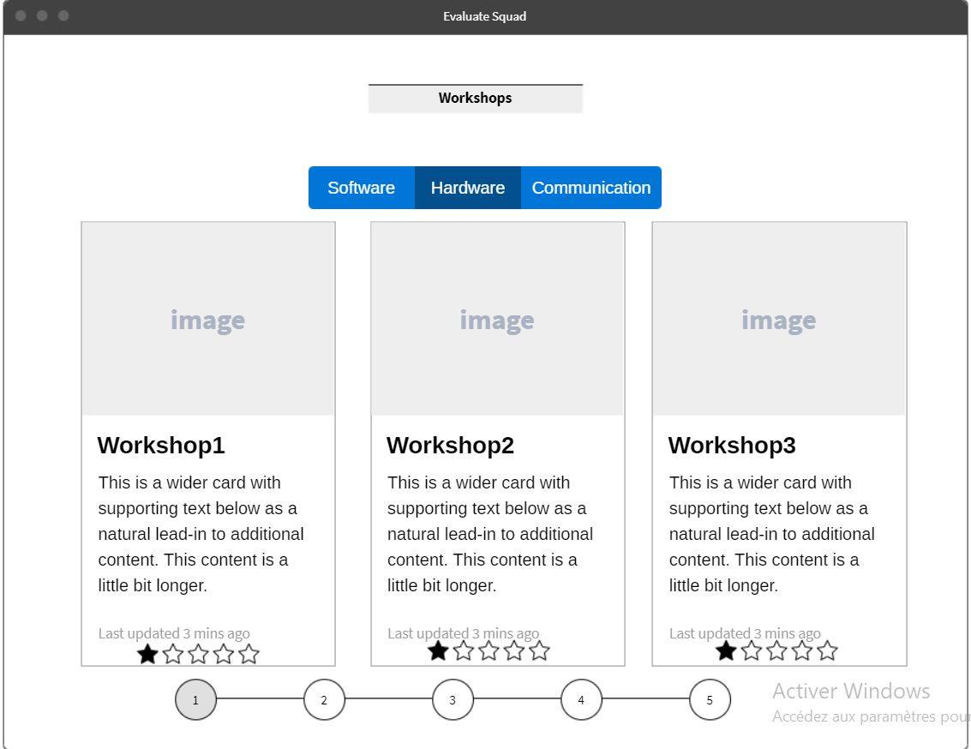
Prototypes
16

Slide 19
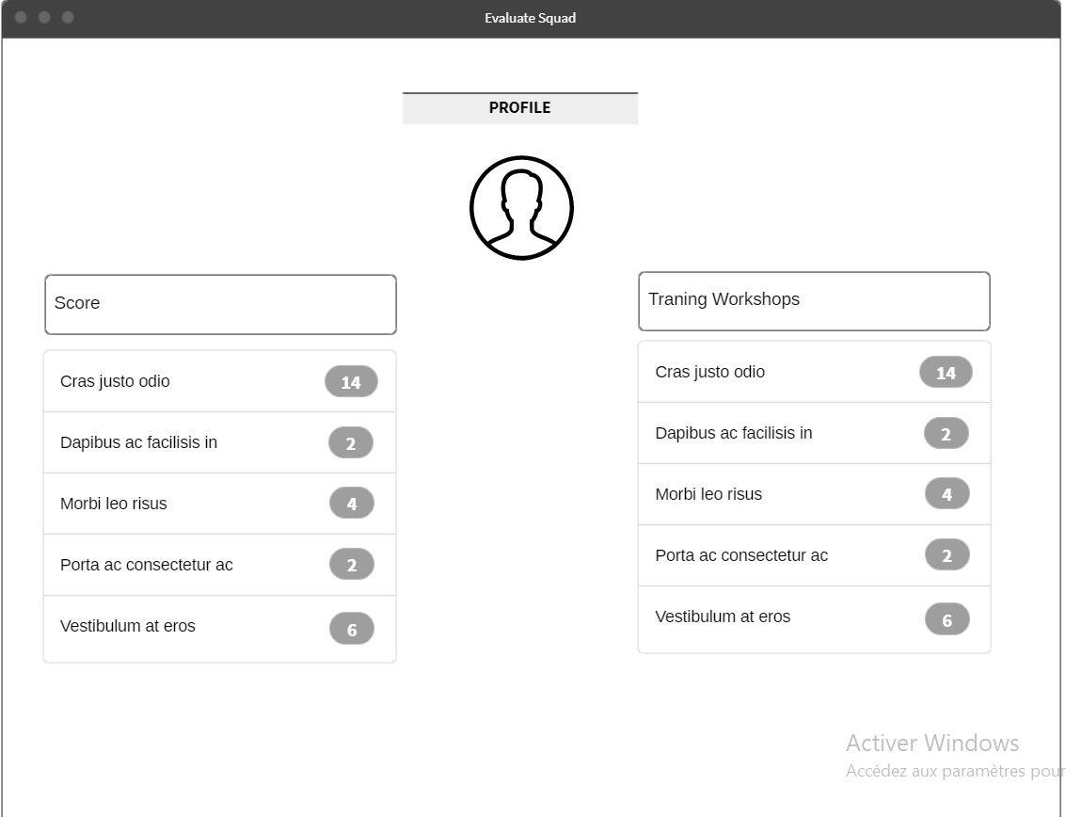
Prototypes
17

Slide 20
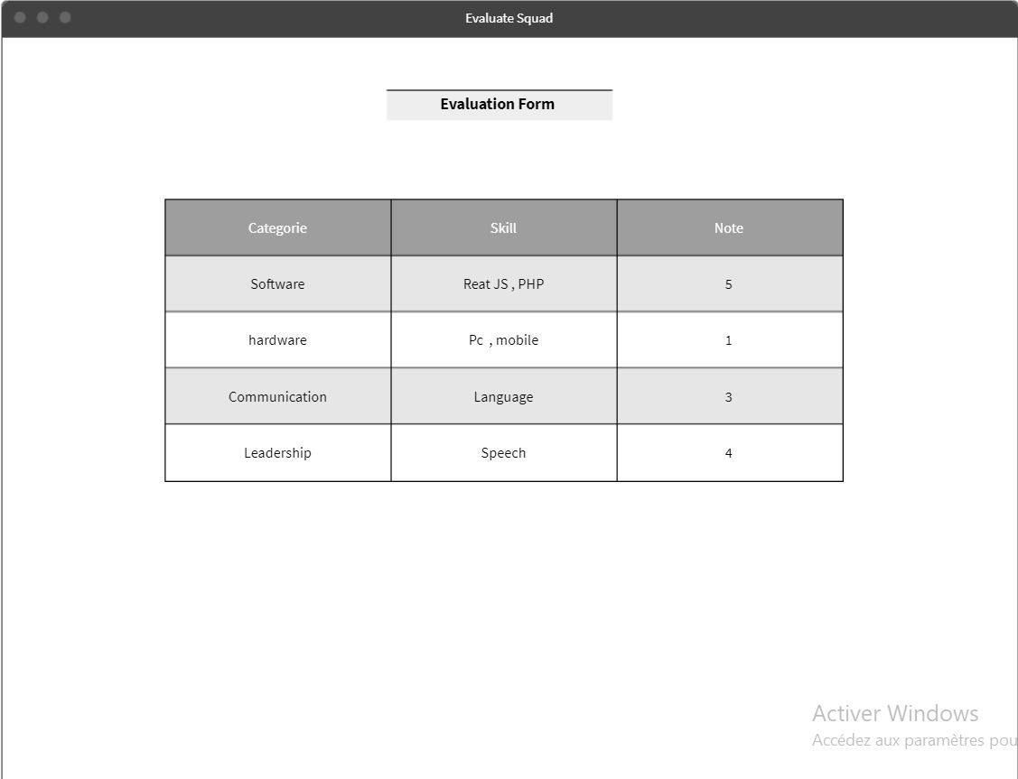
Prototype
18

Slide 21
Thank You For Your
Attention

