Slide 1
Brain Tumor Classification: Results Analysis
Deep Learning cnn Model Evaluation and Analysis

Slide 2
Why is this project important?
Automate the detection and classification of brain tumors from MRI images significantly improves diagnostic accuracy and speed. Early and accurate tumor identification is crucial for effective treatment planning, potentially saving lives and reducing the burden on healthcare systems. The following model can assist radiologists and healthcare professionals by providing a reliable, fast, and cost-effective tool for diagnosing brain tumors.

Slide 3
Data Source
This dataset is taken from Kaggle at: https://www.kaggle.com/datasets/masoudnickparvar/brain-tumor-mri-dataset
It contains MRI images of the brain, categorized into four classes:
Glioma: A type of tumor that originates in the glial cells of the brain.
Meningioma: A tumor that arises from the meninges, the layers of tissue that cover the brain and spinal cord.
Pituitary Tumor: A tumor that occurs in the pituitary gland located at the base of the brain.
No Tumor: Images without any tumor.
This dataset contains 1311 images of brain tumors that are used to test the model.

Slide 4
Data Preparation(cleaning & preprocessing)
The images were resized to a consistent dimension of 128x128 pixels.
The pixel values were normalized (scaled to the range [0, 1]).
Many duplicate images where deleted (426 images).
The dataset was divided into training and test sets (80% for training, 20% for testing).
Labels were one-hot encoded for multi-class classification.

Slide 5
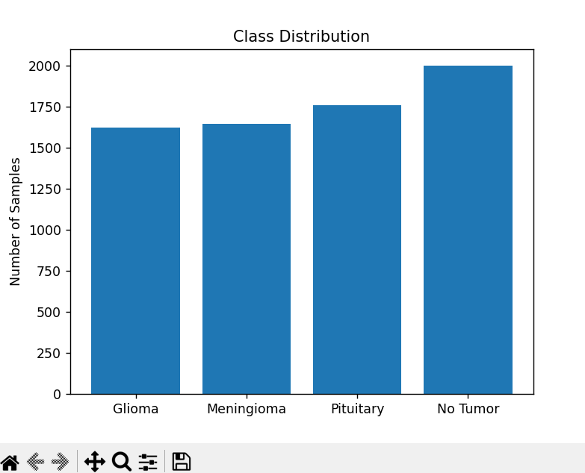
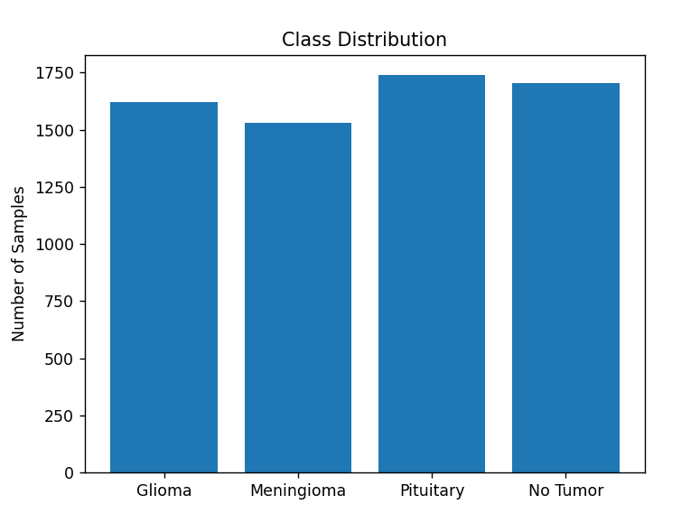
Class distribution
Originally
After cleaning

Slide 6
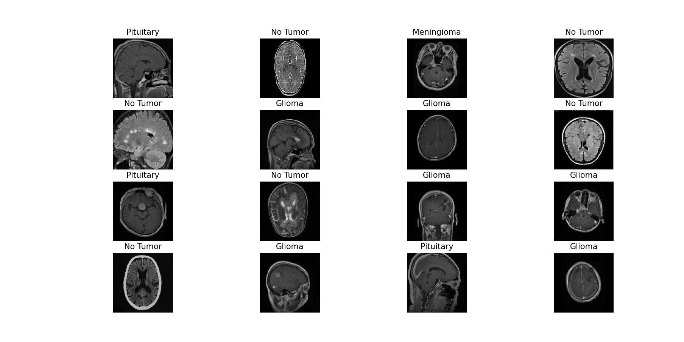
Sample data

Slide 7

Model: Convolutional Neural Network (CNN)
This model follows a typical CNN model architecture.
Input Layer
Convolutional Layers (Conv2D)
Max-Pooling Layers (MaxPooling2D)
Flatten Layer
Dense Layer
Dropout Layer
Output Layer
Key Characteristics:
Total Parameters: 3,305,156 parameters (trainable) to learn the weights during training.
Loss Function: Categorical cross-entropy (for multi-class classification).
Optimizer: Adam optimizer (commonly used for its efficiency and good performance).
Activation Function: ReLU for hidden layers, softmax for the output layer to handle multi-class classification.
The model is trained with 10 epochs.

Slide 8
Training Performance
Initial Training Accuracy: 56.83% (Epoch 1).
Final Training Accuracy: 97.93% (Epoch 10).
Training Loss: Reduced from 0.9771 to 0.0589.
Steady convergence without sudden jumps.
Indicates a well-tuned learning process.

Slide 9
Validation Performance
Initial Validation Accuracy: 81.06%% (Epoch 1).
Final Validation Accuracy: 94.41% (Epoch 10).
Validation Loss: Reduced from 0.5164 to 0.1660.
Consistent improvement with minimal overfitting.
Validation closely matches training performance.

Slide 10
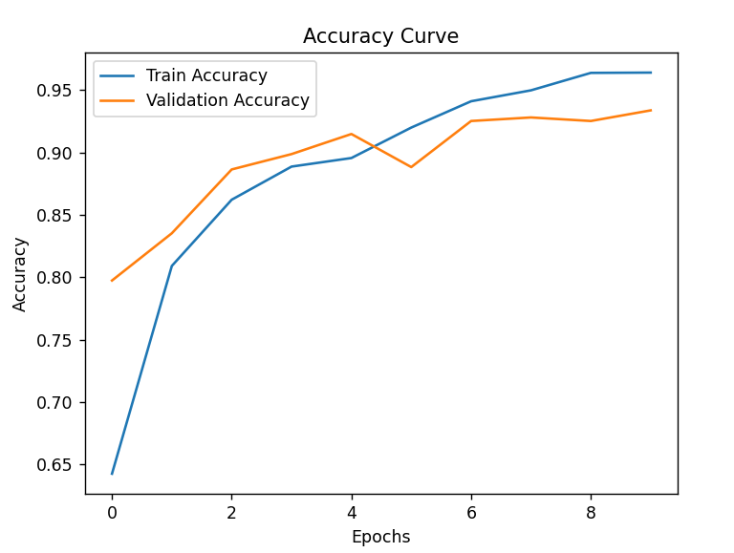
Validation & training Accuracy Curve

Slide 11
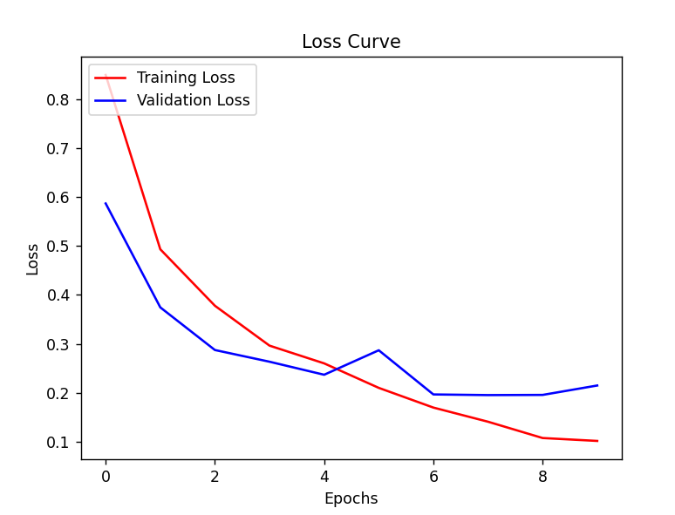
Training & Validation loss Curve

Slide 12
4. Test Results
Test Accuracy: 94.24%.
Test Loss: 0.1849.
Model generalizes well to unseen data, making good predictions on new data.

Slide 13
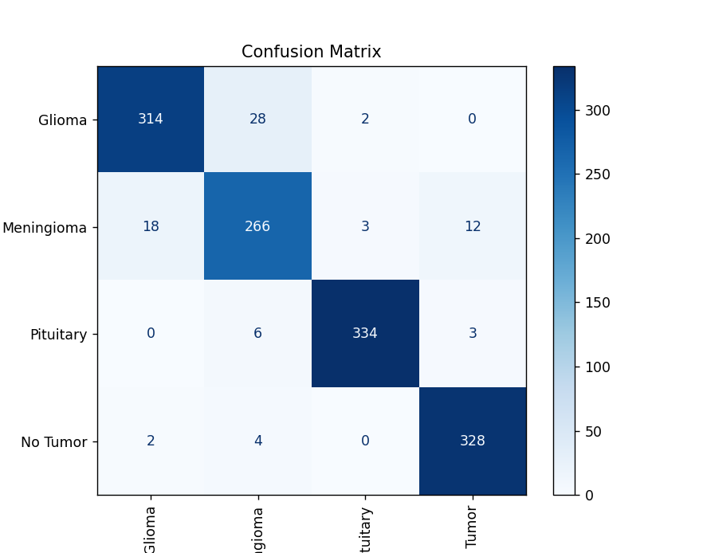
Confusion Matrix

Slide 14
Strengths
High accuracy: Over 94% on validation and test sets.
Balanced generalization with minimal overfitting.
Converges quickly within 10 epochs.
Efficient and effective for multi-class classification.

Slide 15
Limitations
Limited improvement in validation accuracy after Epoch 6.
Potential class imbalance or noise in dataset.
Heavy reliance on fully connected layers. Dense layers dominate parameter count (~3.2M).

Slide 16
Recommendations
Use data augmentation (rotation, flipping, etc.).
Perform Experiment with pre-trained models (e.g., VGG16, ResNet).
hyperparameter tuning (learning rate, batch size).
Balance classes

