Slide 1







Client processes query
GraphQL query
Requests data
Requête
Réponse
UI
Requête
+
Réponse
Serveur LDAP
Requête
Réponse
Updates UI
Sends result

Slide 2
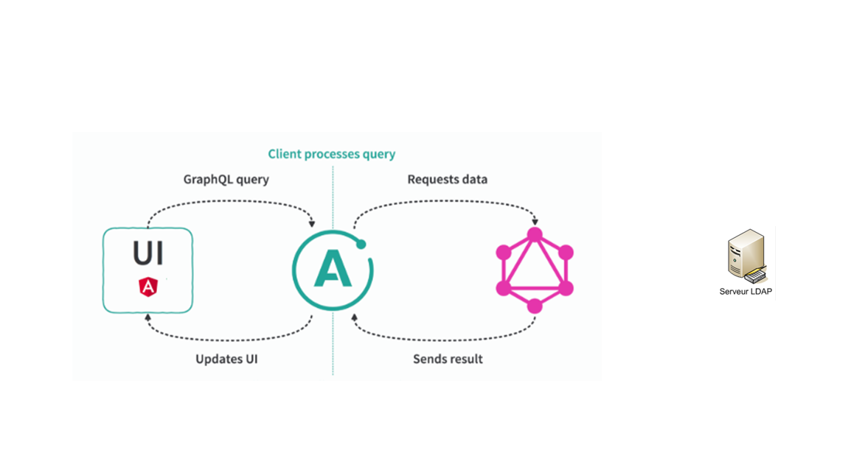
Client processes query
GraphQL query
Requests data
Request
Response
UI
Request
+
Response
Serveur LDAP
Request
Request
Updates UI
Sends result

