Slide 1
Yelp api | machine learning predictions
Hamza sakr Marcus mcbride mayssa maring David arreguin

Slide 2
Code used:
Leaflet.Js
Pandas / python
Random forest
Yelp api

Slide 3
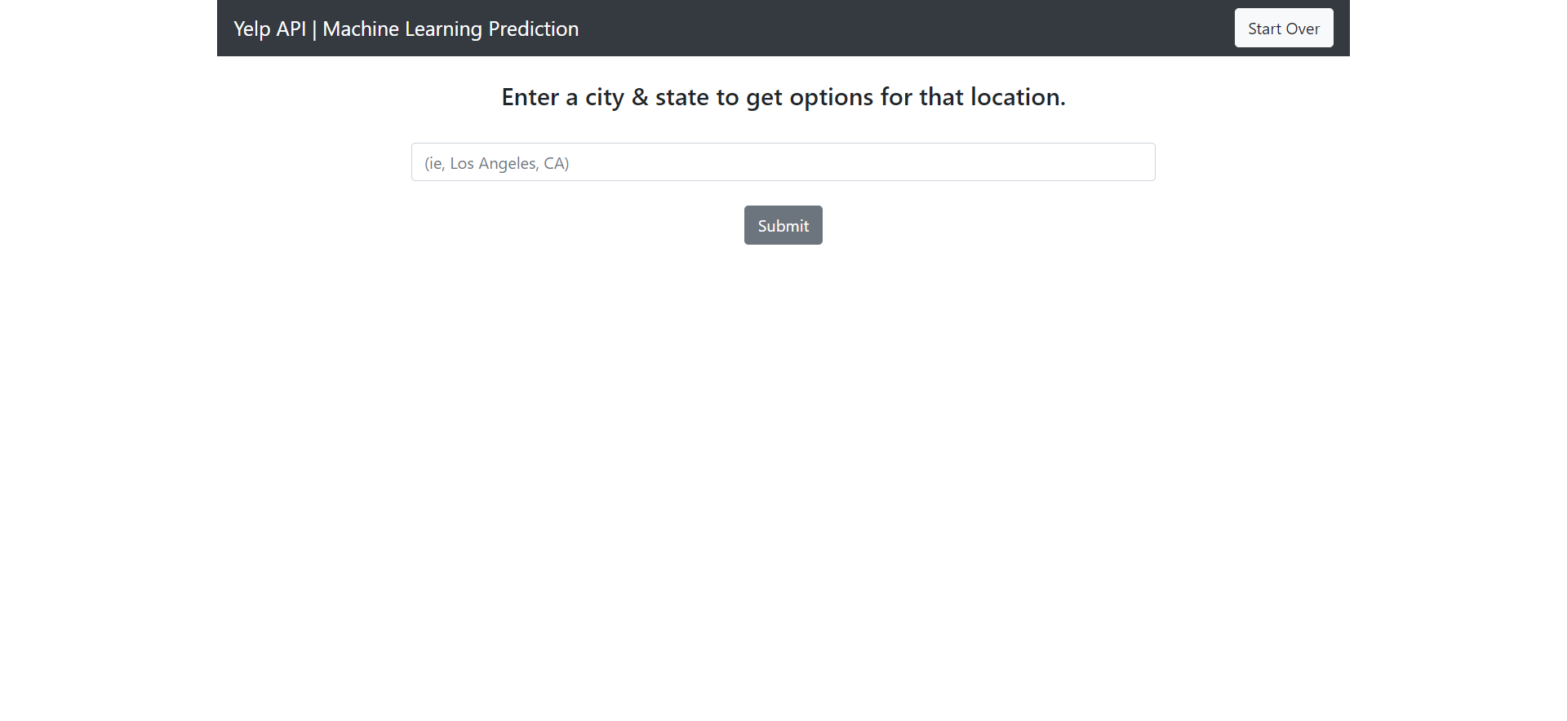
Main landing page where the user inputs a city to search by

Slide 4

Display while api search is being performed

Slide 5
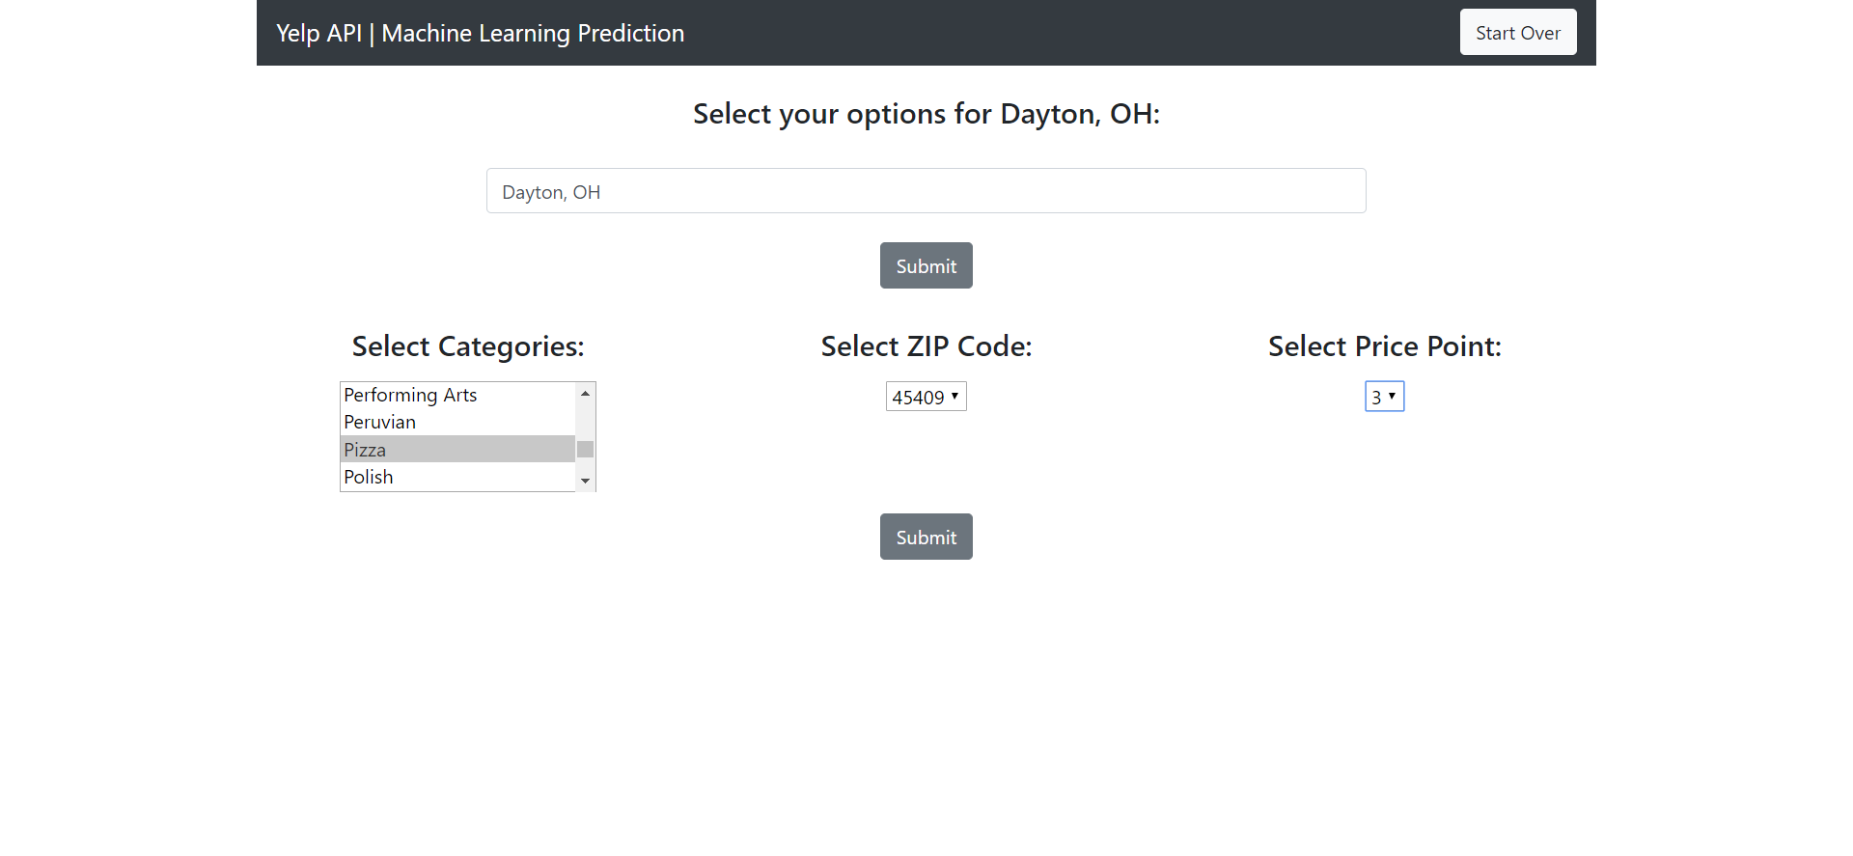
User selections are added dynamically after the api call is complete

Slide 6
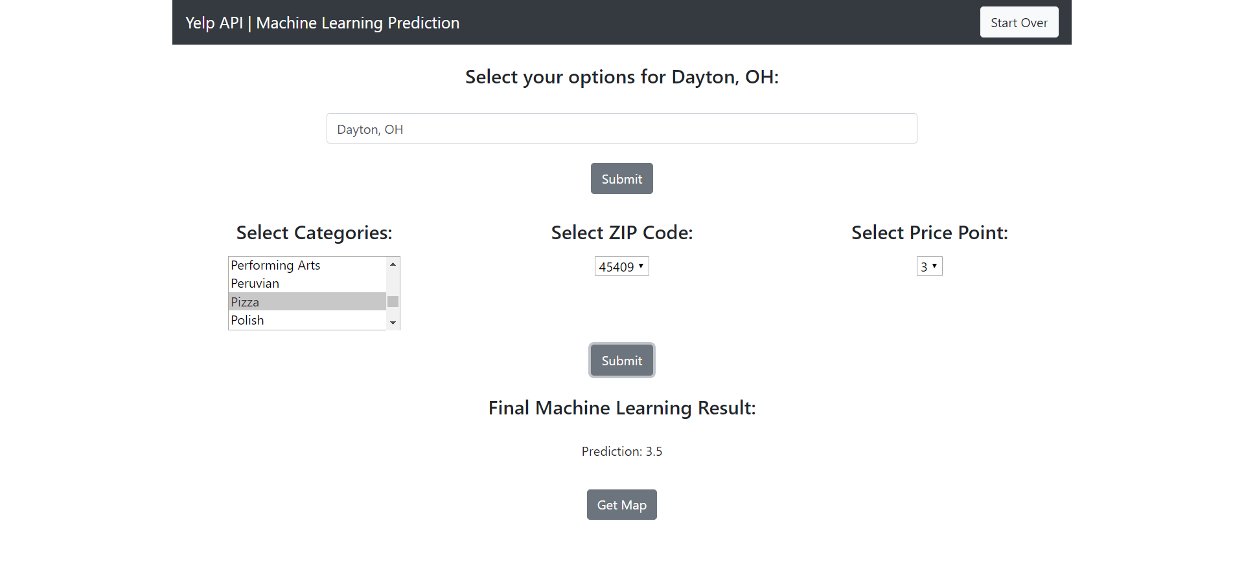
Once the user options have been sent the final machine learning result is added dynamically along with a button to view the corresponding leaflet map

Slide 7
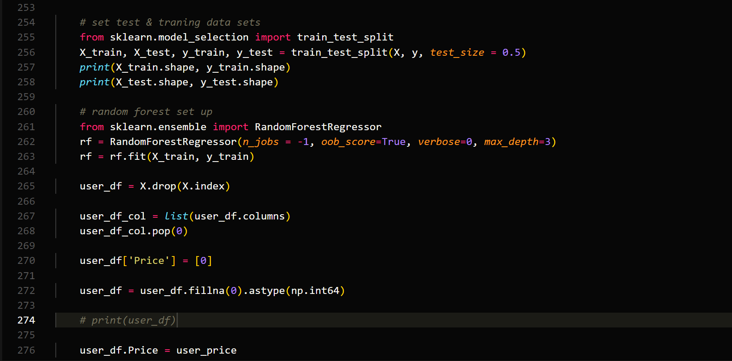
MACHINE LEARNING SET UP CODE

Slide 8
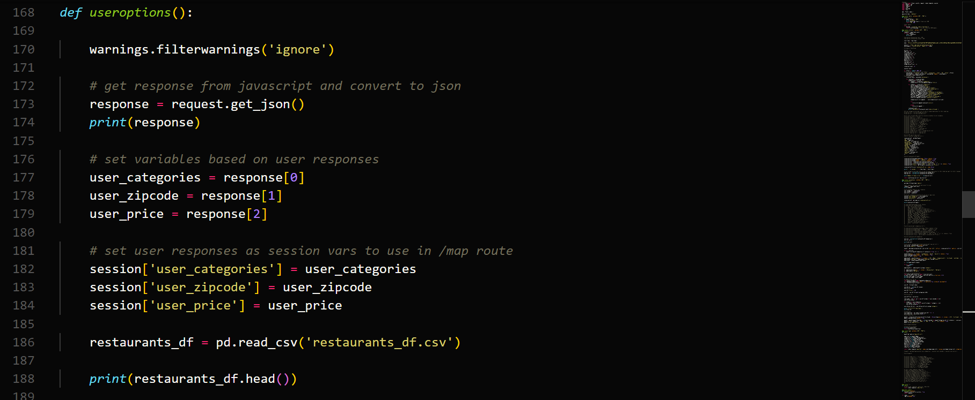
PYTHON SESSION VARIABLES WHICH ALLOW YOU TO ACCESS VALUES ACROSS ROUTES

Slide 9
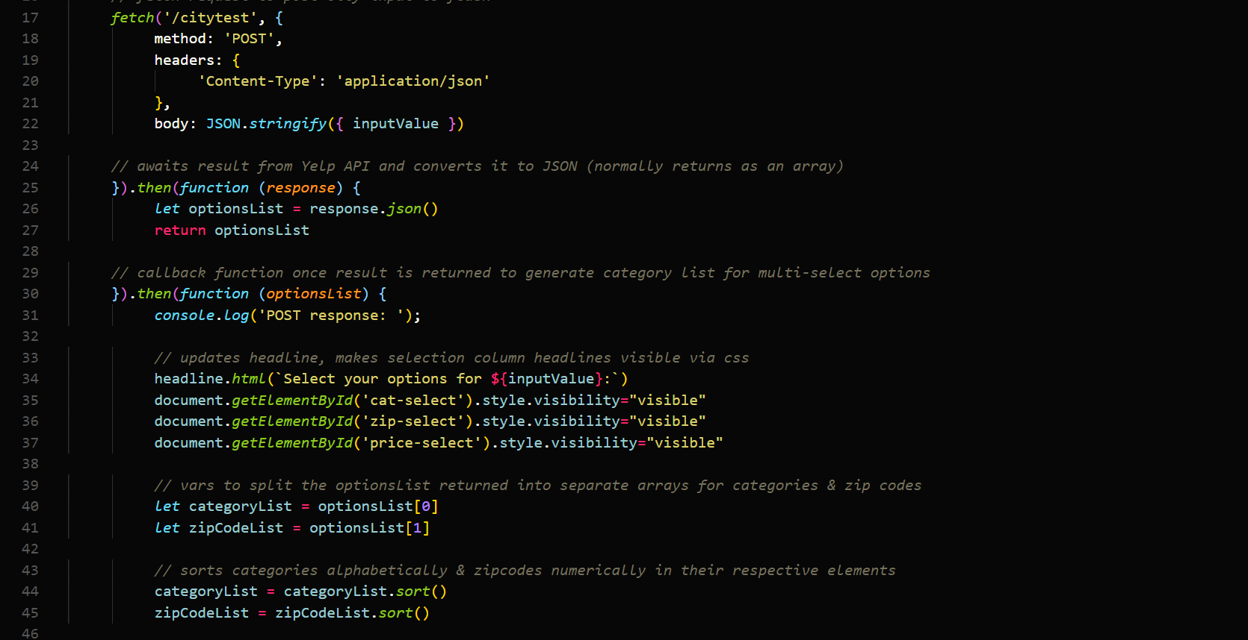
FETCH API (JAVASCRIPT) ALLOWS YOU TO SEND/RECEIVE DATA BETWEEN ENDPOINTS

Slide 10
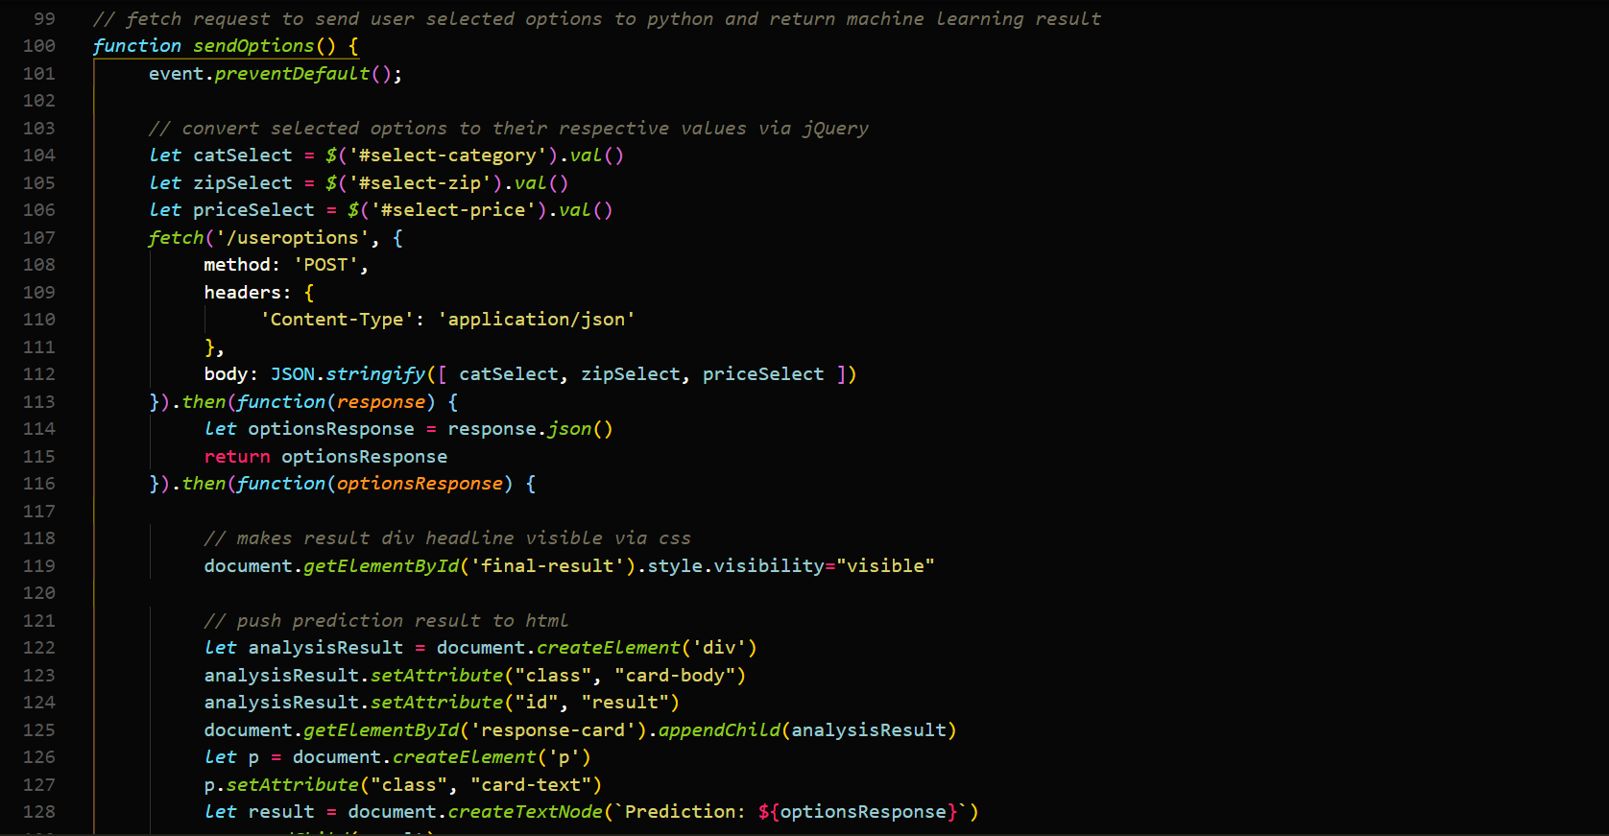
Sample fetch api code which dynamically adds html elements as a result

Slide 11
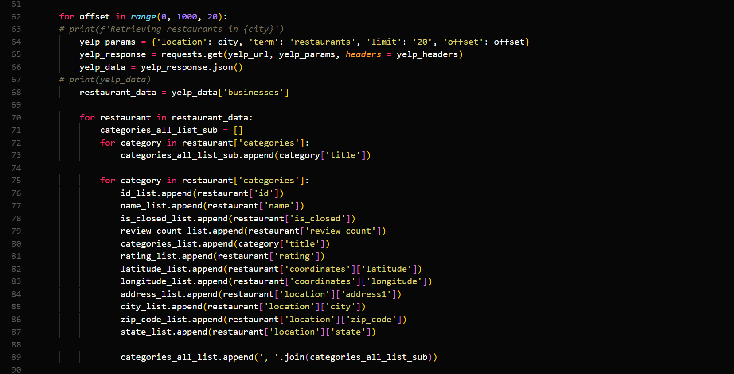
Flask / python code

Slide 12
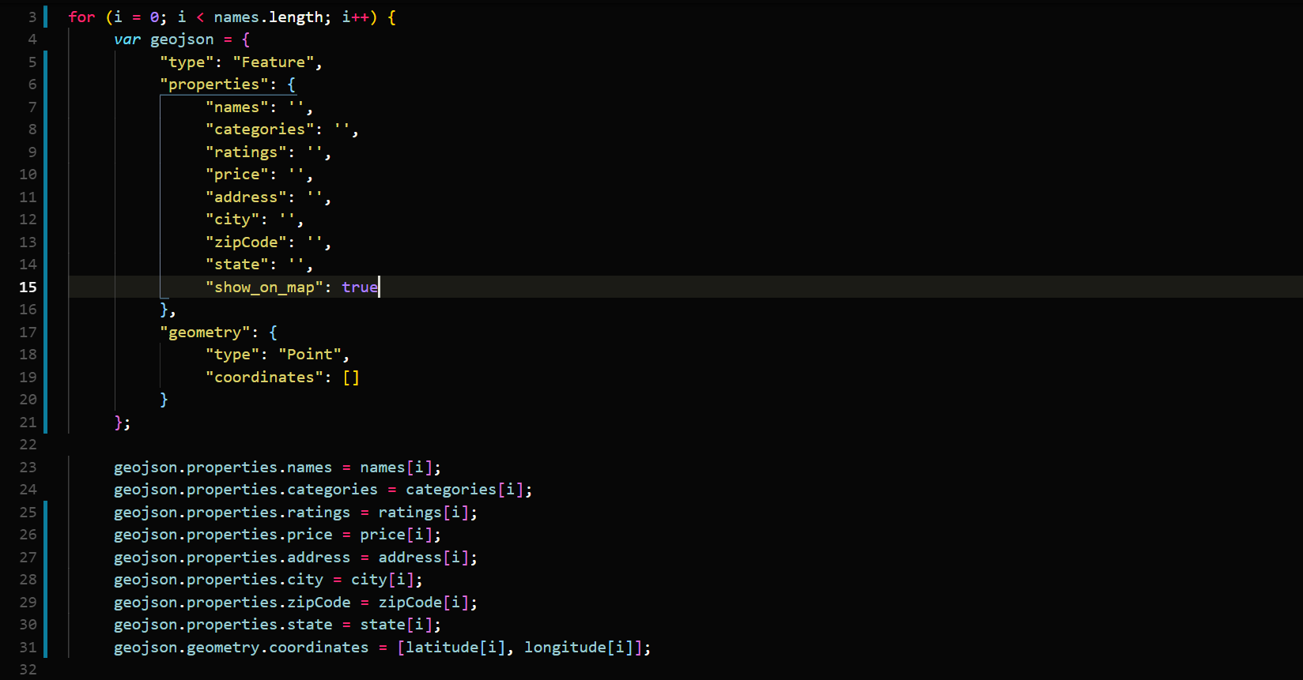
GEOJSON / LEAFLET CODE

Slide 13
Questions / comments

