Slide 1

Customer Shopping Behavior Analysis
Uncovering insights from 3,900 transactions to guide strategic business decisions.

Slide 2
Dataset at a Glance
3,900
18
Transactions
Columns
Rows in dataset
Features tracked
37
$59.76
Missing Values
Avg. Purchase
Review Rating only
Mean spend per order

Slide 3
Key Features Tracked
Demographics
Purchase Details
Shopping Behavior
Age, Gender, Location, Subscription Status
Item, Category, Amount, Season, Size, Color
Discount, Promo Code, Frequency, Review Rating, Shipping

Slide 4

Data Preparation in Python
01
Load & Explore
Imported via pandas; df.info() & .describe()
02
Clean Missing Data
Imputed Review Rating using category medians
03
Feature Engineering
Created age_group & purchase_frequency_days
04
Database Integration
Loaded cleaned DataFrame into PostgreSQL

Slide 5
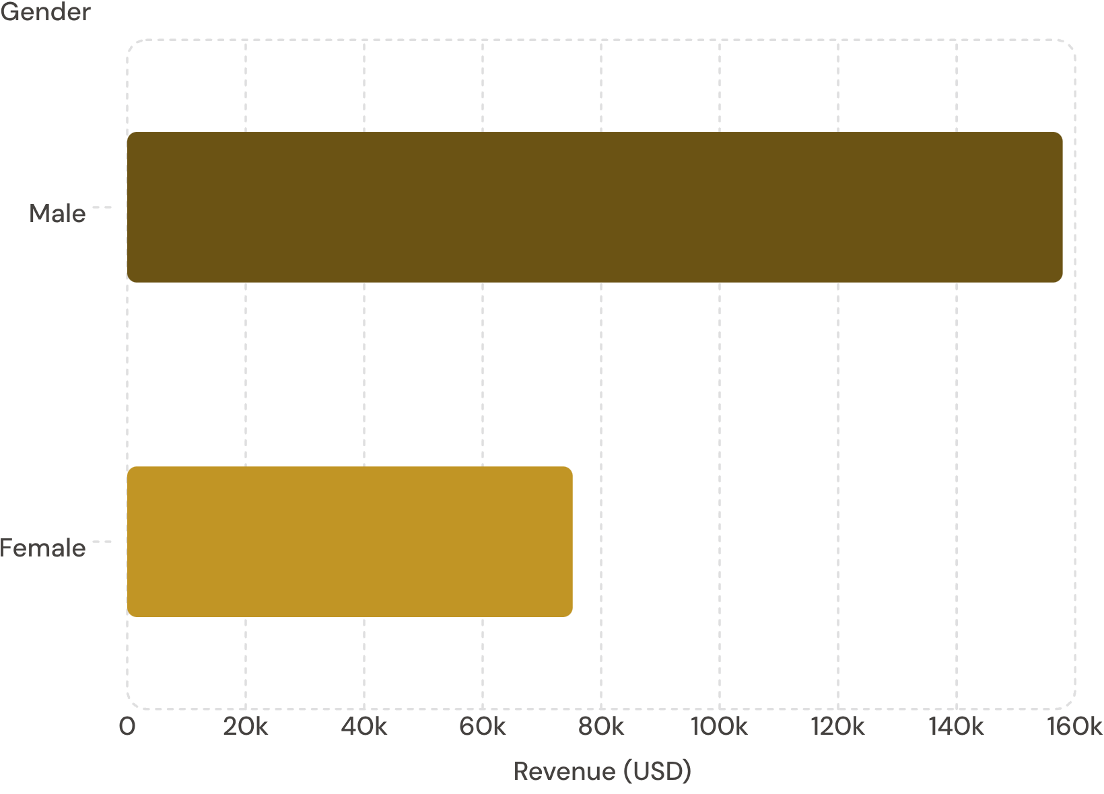
Revenue by Gender
Key Insight
Male customers generated 2.1× more revenue than female customers.
Male: $157,890
Female: $75,191

Slide 6
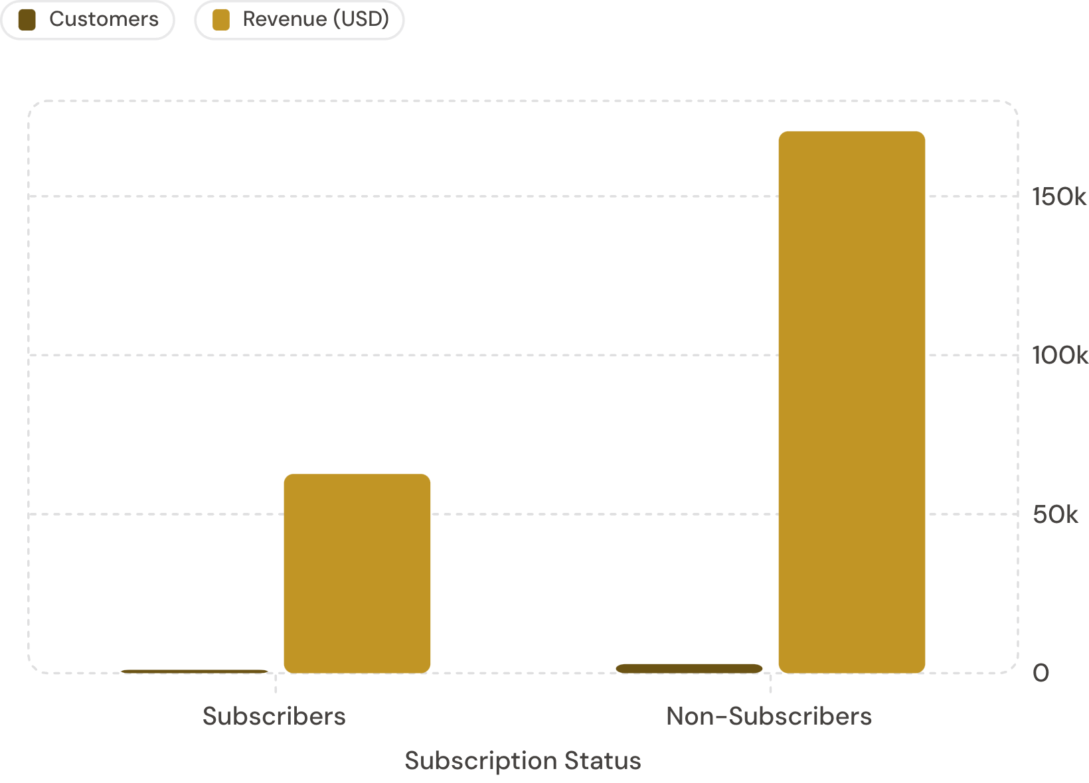
Subscriber vs. Non-Subscriber
Key Insight
Non-subscribers drive 73% of total revenue despite similar avg. spend.
Avg spend: ~$59.50 (both groups)
Only 27% are subscribers

Slide 7
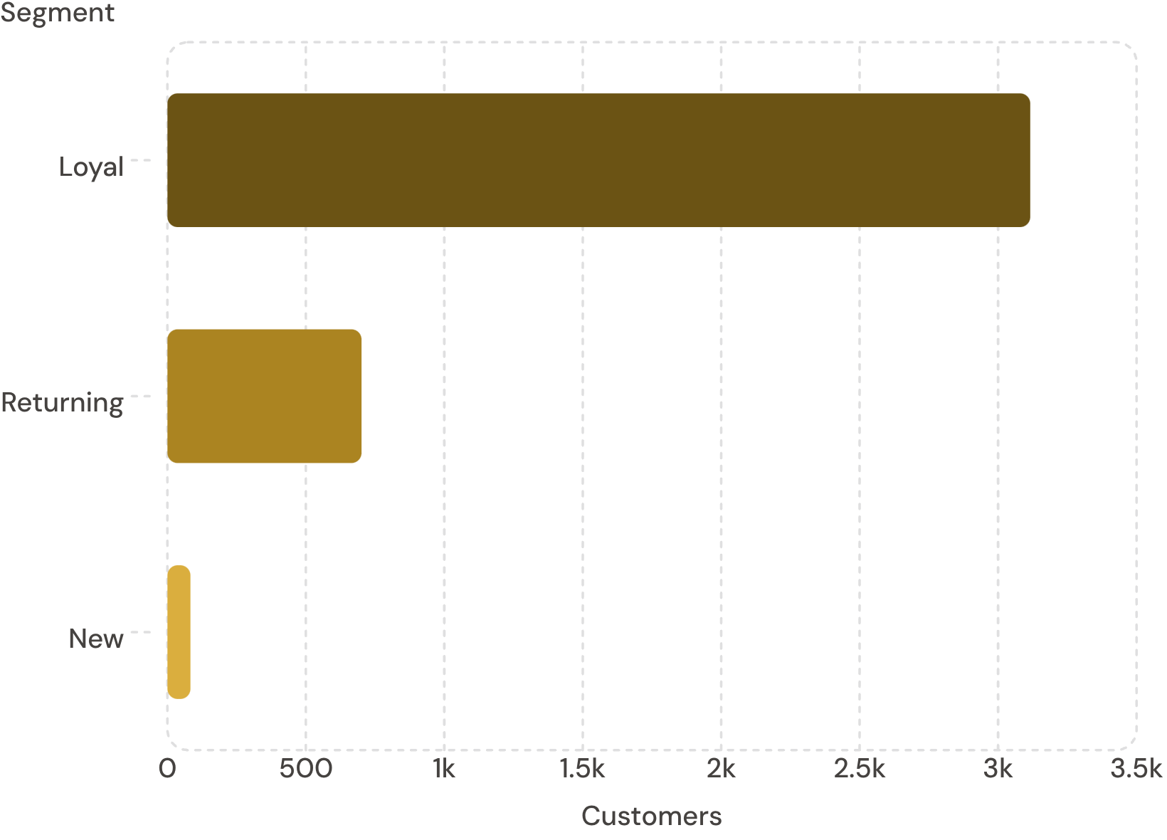
Customer Segmentation & Top Products
Customer Segments
Top-Rated Products
Item
Avg Rating
Gloves
3.86
Sandals
3.84
Boots
3.82
Hat
3.80
Skirt
3.78

Slide 8
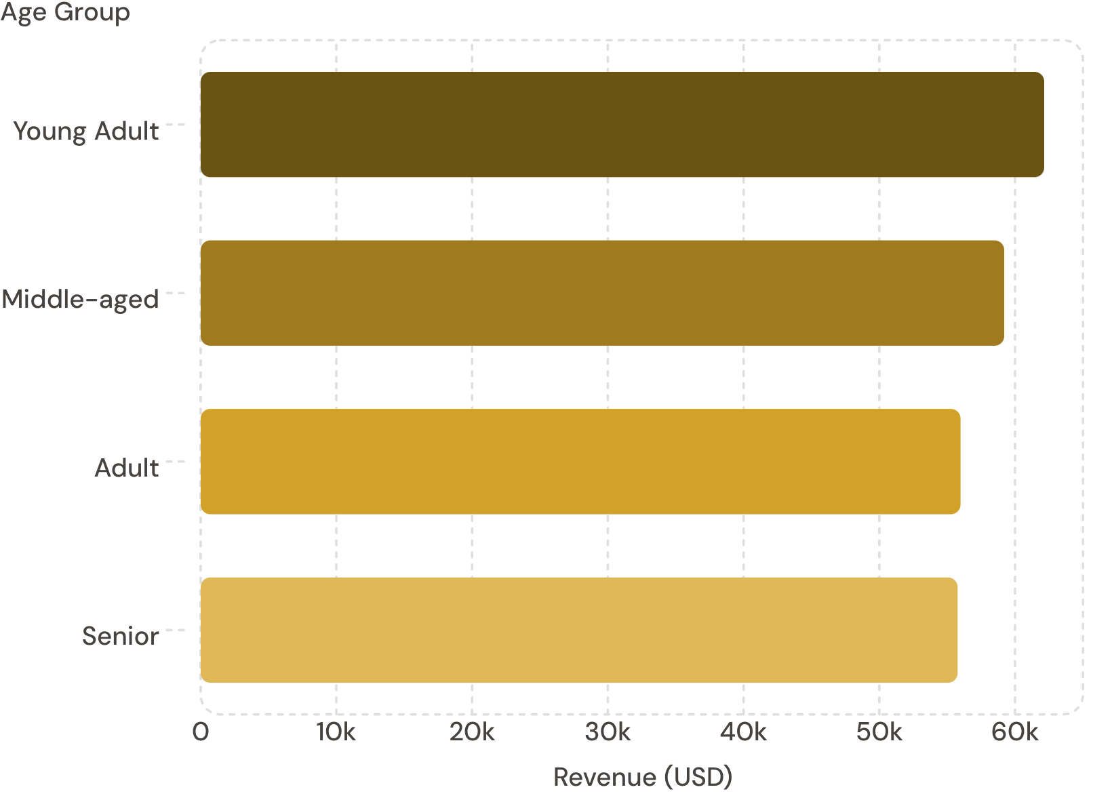
Revenue by Age Group
Key Insight
Revenue is relatively balanced across age groups — Young Adults lead slightly.
Young Adult: $62,143
Senior: $55,763

Slide 9

Power BI Dashboard
3.9K Customers
Total tracked
$59.76 Avg.
Purchase amount
3.75 Avg.
Review rating
73% Non-Subscribers
Largest segment

Slide 10




Business Recommendations
Boost Subscriptions
Loyalty Programs
Promote exclusive subscriber benefits
Reward repeat buyers to grow the Loyal segment
Review Discount Policy
Targeted Marketing
Balance sales boosts with margin control
Focus on high-revenue age groups & express-shipping users

