Slide 1
Machine Learning AI

Slide 2
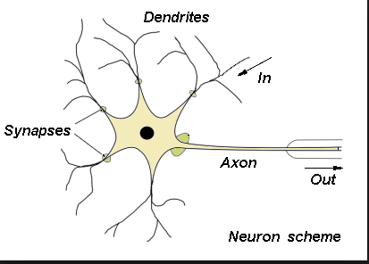
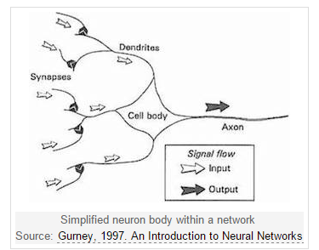
The Brain Stuff

Slide 3
Agenda/Not Brain Stuff
Score function(Linear vs Non-Linear)
Loss function(SVM)
Back propagation
Stochastic Gradient Descent(SGD)
Computer Vision
Convolution Neural Network
Architecture (CNN, RNN, LSTM)
Toolkits
Demo (Classification, Detection)
Apply it to solve business problem

Slide 4
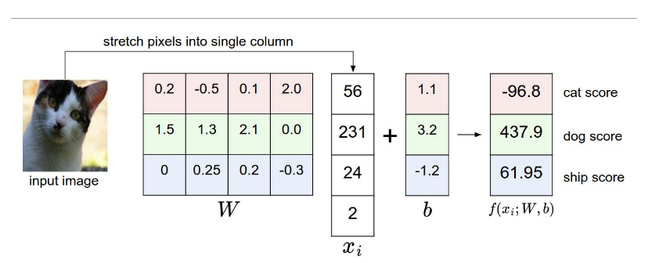
Score Function
maps the raw data to class scores

Slide 5
Loss Function
Quantifies the agreement between the predicted scores and the ground truth labels

Slide 6
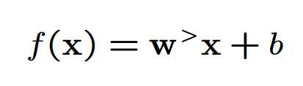
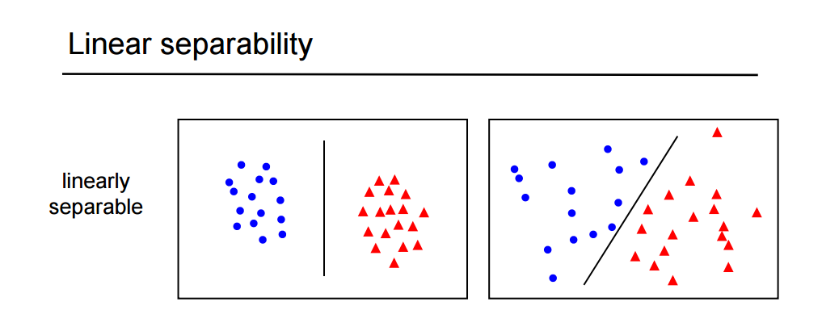
Linear

Slide 7
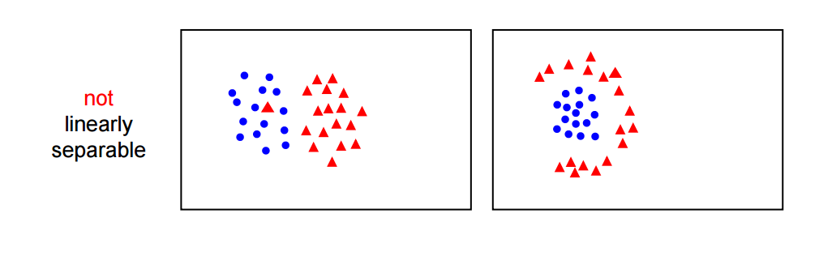
Non Linear

Slide 8
Classification Demo
Linear classifier
http://vision.stanford.edu/teaching/cs231n/linear-classify-demo/
Non-Linear
http://cs.stanford.edu/people/karpathy/convnetjs/demo/classify2d.html

Slide 9


