Slide 1

Angular 2
A development platform for building mobile and desktop web applications

Slide 2
Version
RC5 is being used for this DEMO

Slide 3
Prerequisite
Node.js
NPM

Slide 4
What we cover today
Modules
Components
Pipes
Services
Dependency Injection
Http
RxJS, observerable
Routing

Slide 5
Technologies for this demo
Angular2 libs
Typescript
System.js (module loader, CommonJS, AMD and ES2015 modules)
RxJs (reactive extension, observable)

Slide 6
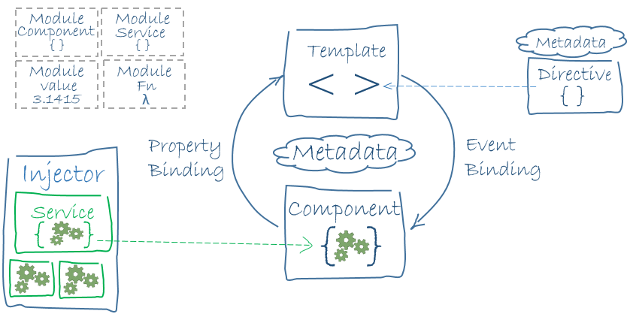
Architecture

Slide 7
Modules
Help organize an application into cohesive blocks of functionality
Angular itself is split into separate Angular Modules(Core, Browser, Http and Form etc)
Every Angular application has at least one module, AppModule by conversion
Module can import other mudules
A class that with @NgModule anotation/attribute

Slide 8
Components
Encapsulate the template, data and behavior of a view
At least one component
Can contain other components
A class with @Component anotation/attribute
Decouple from DOM
Because of the decoupling, it becomes unit testable

Slide 9
Components
App Component
Navigation Bar Component
Side Bar Component
Component A
Component C
Component B

Slide 10
Binding
Component and DOM are decoupled
Unlike jquery $(‘#txtUal’).text(‘46012345678’)
Component class itself update the DOM via binding

Slide 11
Binding
DOM
<span>{{ual}}</span>
Component
ual : string
Bind
DOM is updated whenever the ual is updated
DOM
<input type="text“ [(ngModel)]=“ual">
Component
ual : string
Bind
Two way binding

Slide 12
Pipes
Pipes transform displayed values within a template
<p>Transaction Date {{ txDate | date }}</p>

Slide 13
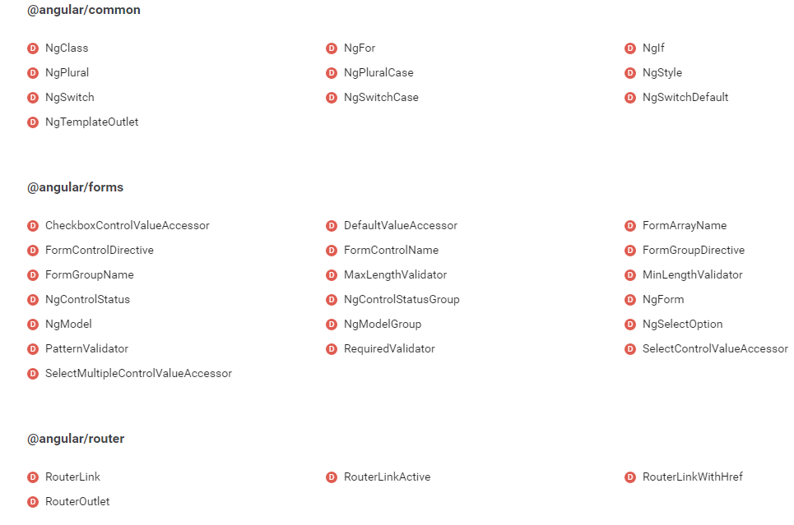
Directives

Slide 14
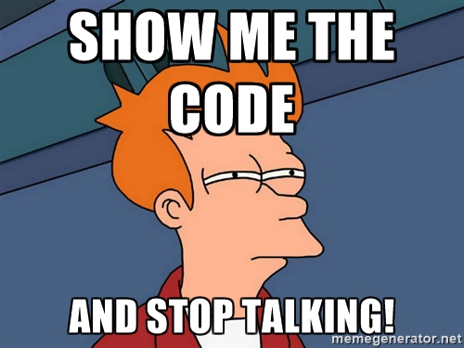

Slide 15
Services
Reusable codes that can be shared
Multi components can use the same service
NOTE: It is quite different from Angular 1’s Service

Slide 16
Dependency Injection
Hierarchical Dependency Injection system
Inject in module level means instance per module
Inject in component means instance per component
Parallel with the components tree

Slide 17
Dependency Injection
Component A
Injector A
Component B
Injector B
Component C
Injector C
Component C
Injector C
Component C
Injector C

Slide 18
Let’s go back to the code

Slide 19
Http
A separate module in Angular 2
Instead of returning a Promise, it returns Observable
Why? Before answering, let’s have a look at what is Observable

Slide 20
What is a observable
An observable is a stream of events that we can process with array-like operators

Slide 21
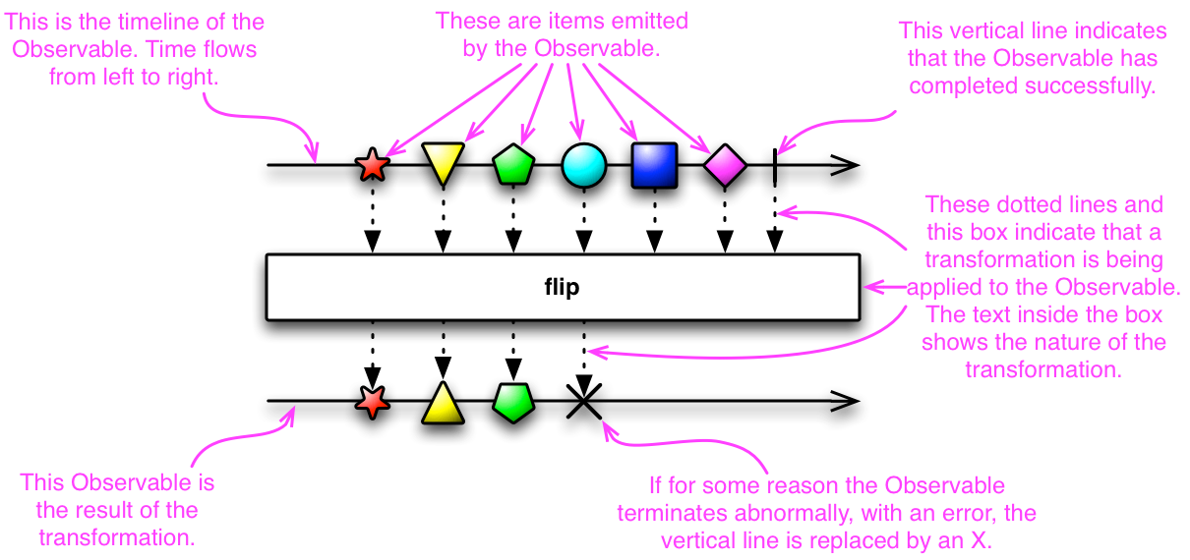
What is Observable
http://reactivex.io/documentation/observable.html

Slide 22
Why Observable not Promise
Promise is good for single one and done pattern but not good for the following
Request -> Cancel -> New Request
Request -> Logic -> Request
Filter junk traffic to the server

Slide 23
RxJs
An API for asynchronous programming with observable streams
Provides a list of operators to manage the observable, e.g. debounceTime, distinctUntilChanged etc

Slide 24
Observable Demo
Observable that to filter odd number
A textbox will send request to server to get data for text changed event

Slide 25
Routing
Setup a route table
Route a path to a component

Slide 26


