Slide 1


Medical Data Analysis in Edge Computing Environment
By
MAYUKH ROY (A91005219090)
HRITHIK RUDRA (A91005219102)
SHUBHADEEP MAITY (A91005219106)
SUBJECT: Major Project (ETMJ100)
Course: B. TECH (CSE) Batch: 2019-23

Slide 2
Abstract
For our project, we have mainly used Machine learning concepts in Edge computing environment to detect diseases in Medical domain.
The detection of Pulmonary Embolism (PE) - a critical condition where a blood clot obstructs a pulmonary artery, leading to impaired blood flow to the lungs – has been taken into consideration for our project work.
This study proposes an innovative approach employing VGG16 and XGBOOST models to categorize CTPA images as either 'PE' (images with emboli) or 'No PE' (images without emboli).
We utilize a Kaggle dataset containing over 1000 images categorized accordingly.
Edge computing involves processing data in proximity to its origin, minimizing latency and enabling real-time decision-making.
By deploying our VGG16 and XGBOOST models on edge devices such as local servers or within healthcare facilities, we enhance the speed and reliability of CTPA image classification.

Slide 3
Introduction
The topics of discussion for our project :-
Edge Computing
Pulmonary Embolism
VGG-16
XGBOOST

Slide 4

Edge Computing
Edge computing is a way of bringing the power of computing closer to where it's needed, rather than relying on far-away data centers or the cloud. It means performing tasks like processing data and storing information on devices that are right there, at the "edge" of the network.
Edge computing is all about making things more efficient, faster, and reliable by having computing power closer to where it's needed, rather than relying solely on distant servers.
Edge computing involves processing data in proximity to its origin, minimizing latency and enabling real-time decision-making. By deploying our VGG16 and XGBOOST models on edge devices such as local servers or within healthcare facilities, we enhance the speed and reliability of CTPA image classification. This advancement facilitates prompt diagnosis by doctors, enabling timely medical interventions and potentially saving lives.

Slide 5
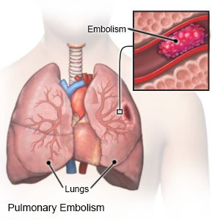
What is PULMONARY EMBOLISM?
Pulmonary embolism is a blockage in one of the pulmonary arteries in our lungs. In most cases, pulmonary embolism is caused by blood clots that travel to the lungs from deep veins in the legs or, rarely, from veins in other parts of the body (deep vein thrombosis).
Since the clots block blood flow to the lungs, pulmonary embolism can be life-threatening. Computed tomography pulmonary angiography (CTPA) is used for diagnosing this embolism.

Slide 6
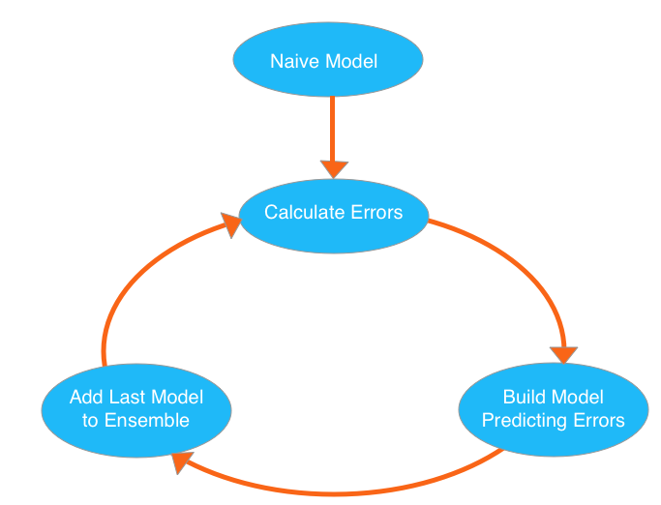
What is VGG16 and XGBOOST ?
VGG16
is a convolutional neural network (CNN) architecture that was developed by the Visual Geometry Group (VGG) at the University of Oxford. It is a deep neural network that consists of 16 layers and was introduced in the paper "Very Deep Convolutional Networks for Large-Scale Image Recognition" by Karen Simonyan and Andrew Zisserman in 2014. VGG16 achieved excellent results on the ImageNet Large Scale Visual Recognition Challenge (ILSVRC) in 2014 and has since become a popular model for image classification tasks.
XGBOOST
XGBOOST (Extreme Gradient Boosting) is a popular machine learning algorithm for supervised learning tasks, particularly for classification and regression problems. It is a gradient boosting framework that uses a set of decision tree-based models for ensemble learning.

Slide 7
NOVELTY
The project aims to leverage the pre-trained VGG16 model and combine it with XGBoost for medical image classification.
This combination of deep learning and boosting techniques can potentially enhance the accuracy and performance of the classification model.
Furthermore, the use of grayscale images, feature extraction, and the XGBoost algorithm contribute to the novelty of the approach.

Slide 8
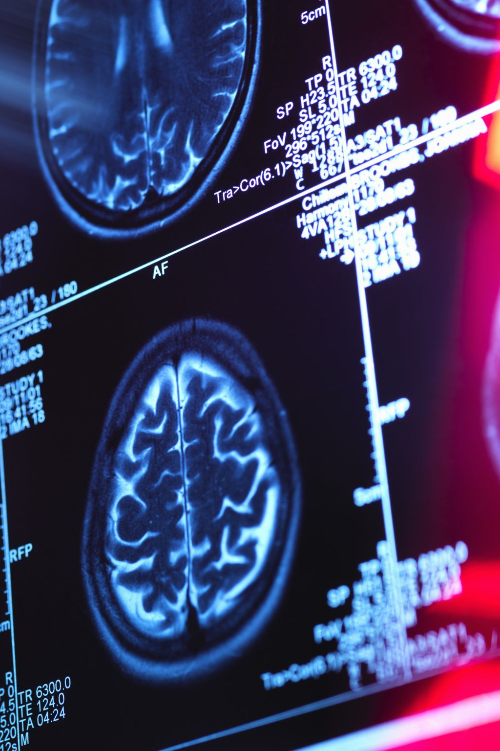
Proposed Approach
Use a Dataset which contains CT scan images of human chests
Build a XGBOOST model in combination with VGG16 to classify the CT scan images into two classes “PE” and “No PE” (Here “PE” is an acronym for “Pulmonary Embolism”)
To evaluate the model using metrics like Precision, Recall and F1-score.

Slide 9

DATASET DESCRIPTION
The Dataset mainly contains images of Chest CT Scans from which we must predict the existence and characteristics of Pulmonary Embolism.
We will be requiring Training and Test images for our work. In this dataset, the images are grouped in directories by study and series.

Slide 10
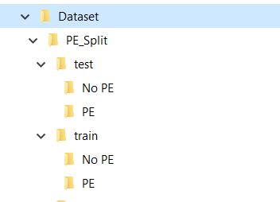
The following folders contain: -
Test: all test images, i.e. , metadata Has total 210 images (105 in “No PE” and 105 in “PE”)
Train: all training images Has total 1664 images (832 in “No PE” and 832 in “PE”)
Dataset Used : RSNA(Radiology Society of North America) STR(Society of Thoracic Radiology) Pulmonary Embolism Detection
Source of the Dataset : Kaggle

Slide 11
METHODOLOGY
Our task is to classify the CTPA(Computed Tomography pulmonary angiography)
images as “PE” and “No PE” classes.
The methodology of our project is divided into two parts
VGG 16 MODEL
(For extracting information from the image)
XGBOOST MODEL
(For Classifying images based on their characteristics)

Slide 12
STEPS INVOLVED IN OUR METHODOLOGY
The methodology aims to classify Pulmonary Embolism CTPA scans correctly into “PE” and “No PE”, with each Train and Test splits PE and No PE images.
Resize all images to 256
Convert RGB images to Gray-scale
Normalize pixel values to between 0 and 1
Load VGG16 model without classifier /fully connected layers
Use features from Convolutional network for XGBOOST to classify images
Evaluate the performance of the model

Slide 13
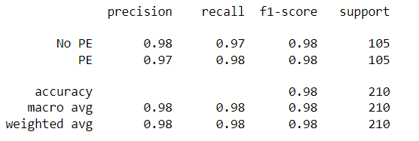
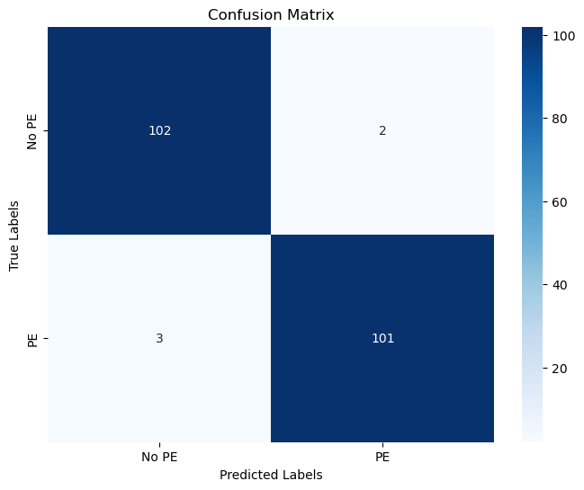
RESULT
So, at the end, here is the classification report that has been generated after the predictions from the algorithm.
Accuracy of 97.61% (approx. 98%) has been achieved.
For The "PE" class, the sensitivity is observed to be 98%.
For the "No PE" class it is seen to be 97%.

Slide 14
FUTURE SCOPE
The future scope of this project can be quite promising, as medical imaging and healthcare continue to evolve with advancements in technology.
Improved accuracy: As deep learning algorithms and models continue to advance, there is scope for enhancing the accuracy of medical image classification.
Integration with healthcare systems: Integration with existing healthcare systems and electronic health records (EHRs) can enable seamless access to medical image classification results and facilitate better patient management and treatment planning.
Expansion to other medical conditions: The project can be expanded to classify images related to various other medical conditions, which would contribute to a broader range of applications in healthcare.
Real-time image analysis: The project can be optimized to perform image classification in real-time, allowing for immediate analysis and decision-making during medical procedures or emergencies.
Collaboration with medical experts: Collaborating with medical professionals and researchers can provide valuable insights and feedback for further improvement of the project.

Slide 15

CONCLUSION
So, the VGG16 model combined with XGBOOST has successfully classified the CTPA images into two classes, and through this classification, we get to know which image has detected Pulmonary Embolism.
This model will be very much helpful for medical diagnosis using predictions from image detection.
It can identify clots in an image and generates high quality segmentation mask for each instance.

Slide 16
References
X. Yang, “A Two-Stage Convolutional Neural Network for Pulmonary Embolism Detection from CTPA Images,” IEEE Access, vol.7, (2019).
“Pulmonary Embolism imaging and outcomes,” AJR American Journal of Roentgenology, (2012).
S. J. S. D. Yadav, “Convolutional neural network based medical image classification for disease diagnosis,” Vols. J Big Data 6, 113 , (2019).
S. J. S. Yadav, “ Deep convolutional neural network based medical image classification for disease diagnosis,” Vols. J Big Data 6, 113, (2019).
The RSNA Pulmonary Embolism CT Dataset, (2021).
Mukherje, D. and Anand, A., 2023. On edge deep learning implementation: approach to achieve 5G. Multimedia Tools and Applications, 82(8), pp.12229-12243.
Mukherje, Dhritiman, and Aman Anand. "On edge deep learning implementation: approach to achieve 5G." Multimedia Tools and Applications 82, no. 8 (2023): 12229-12243.

Slide 17
Role of Each Group Member
Shubhadeep Maity – Finding suitable models for our project(Xgboost and VGG-16), Coding, Methodology, Presentation
Mayukh Roy – Finding best dataset, Coding, Methodology and Report
Hrithik Rudra – Finding various research papers related to medical domain and going through them, Coding
THANK
YOU

