Slide 1

RCC INSTITUTE OF INFORMATION TECHNOLOGY
A Unit of RCC Institute of Technology, an autonomous Society of Department of Higher Education, Govt. of West Bengal.
Estd. in 1999
Department of Computer Science & Engineering
Rock, Paper, Scissor using Python
By Mayukh Ghosh
CSE2019/104
11700119023
Python Project

Slide 2
I would like to express my special sincere thanks of gratitude to my teacher Mr. Swapan Shakhari and Mr. Souvik Majumdar, who gave me this golden opportunity to do this wonderful project of Python.
Sir also helped me with the doubts regarding the project. I came to know about so many new things, I am really thankful to him as this project has given me a boost to my knowledge and exposed me to a variety of new aspects of Python language.
I would also like to thank our principal sir Prof. Anirban Mukherjee and our HOD sir Mr. Rajib Saha who have decided to include the project in the curriculum and gave me a chance to work under their guidance for this project.
Secondly, I would also like to thank my friends who helped me a lot in finalizing this project with the limited time frame.
MAYUKH GHOSH
11700119023
ACKNOWLEDGEMENT:

Slide 3
Introduction:
My project is a simple GUI based python game Rock, Paper and Scissor. It was made extensively with the help of Tkinter module in Python which allowed me to create many widgets such as buttons, entry boxes, add colours and add a pop-up window.
This is a very basic game which we have all played in our childhood days, I tried to implement this as a real time game against the computer using the python.
The basic rules of the dames are if both computer and user choose same rock & rock, paper & paper, scissor & scissor there is no score and a tie in game. When user choose rock and computer choose scissor then user wins and vice versa. Again, when computer choose paper and user choose scissor computer wins and vice versa, when user choose rock and computer choose paper user wins and vice versa, when computer choose rock and user choose scissor computer wins and vice versa.
A standard Python interface to the Tk GUI toolkit shipped with Python. In addition, Python with tkinter outputs the fastest and easiest way to create GUI applications. Creating a GUI using tkinter is an easy task.
I created this game so that everybody can play and remember their childhood days.

Slide 4
Abstract
I have created three button each for rock, paper, scissor. These buttons given to the user to select their choice for one time and the computer gives its own choice. The two choices one of the user and the other of the computer are matched and the score is individually given as output.
The scoreboard using box is given as the text computer score and the player score are given as well as the choices are shown as many times as the button is pressed.

Slide 5
Methodology:
Tkinter Programming:
Tkinter is Python's de-facto standard GUI (Graphical User Interface) package. Python when combined with Tkinter provides a fast and easy way to create GUI applications. Tkinter provides a powerful object-oriented interface to the Tk GUI toolkit.
Creating a GUI application using Tkinter is an easy task. All we need to do is perform the following steps –
1.Import the Tkinter module.
2.Create the GUI application main window.
3.Add one or more of the above-mentioned widgets to the GUI application.
4.Enter the main event loop to take action against each event triggered by the user.

Slide 6
About the Code:
I have imported Tkinter module and then created scr widget window. I set the background color and the geometry of the buttons. I’ve also imported random and message box for displaying and randomizing the computer picks of rock scissor or paper.
I’ve assigned certain global variables for storing the score of computers and the user. There are other variables for storing the choice of user and the choice of computer for comparison.
There are several if-elif-else statements which correspond to the condition when the user and the computer choices need to be compared to assign a score.
Finally, the two scores need to be compared to check who reaches the final value 10 first.
The first to reach 10 points will win the game. Otherwise, the loop will keep running. To terminate the loop, we use the destroy () function.
I’ve tried to change the colors: foreground, background and active background to distinguish each function separately. I’ve also tried to change the fonts, size, geometry and other features available in the Tkinter module of Python. At the end, main loop () ensures that our program keeps running unless closed by the user.

Slide 7
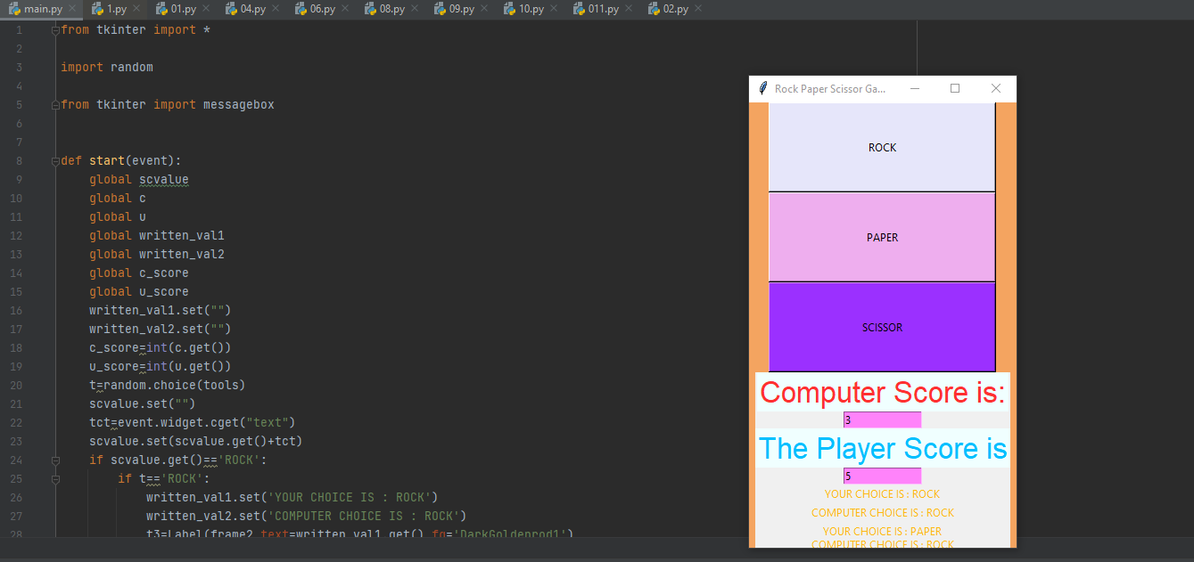
Output:

Slide 8
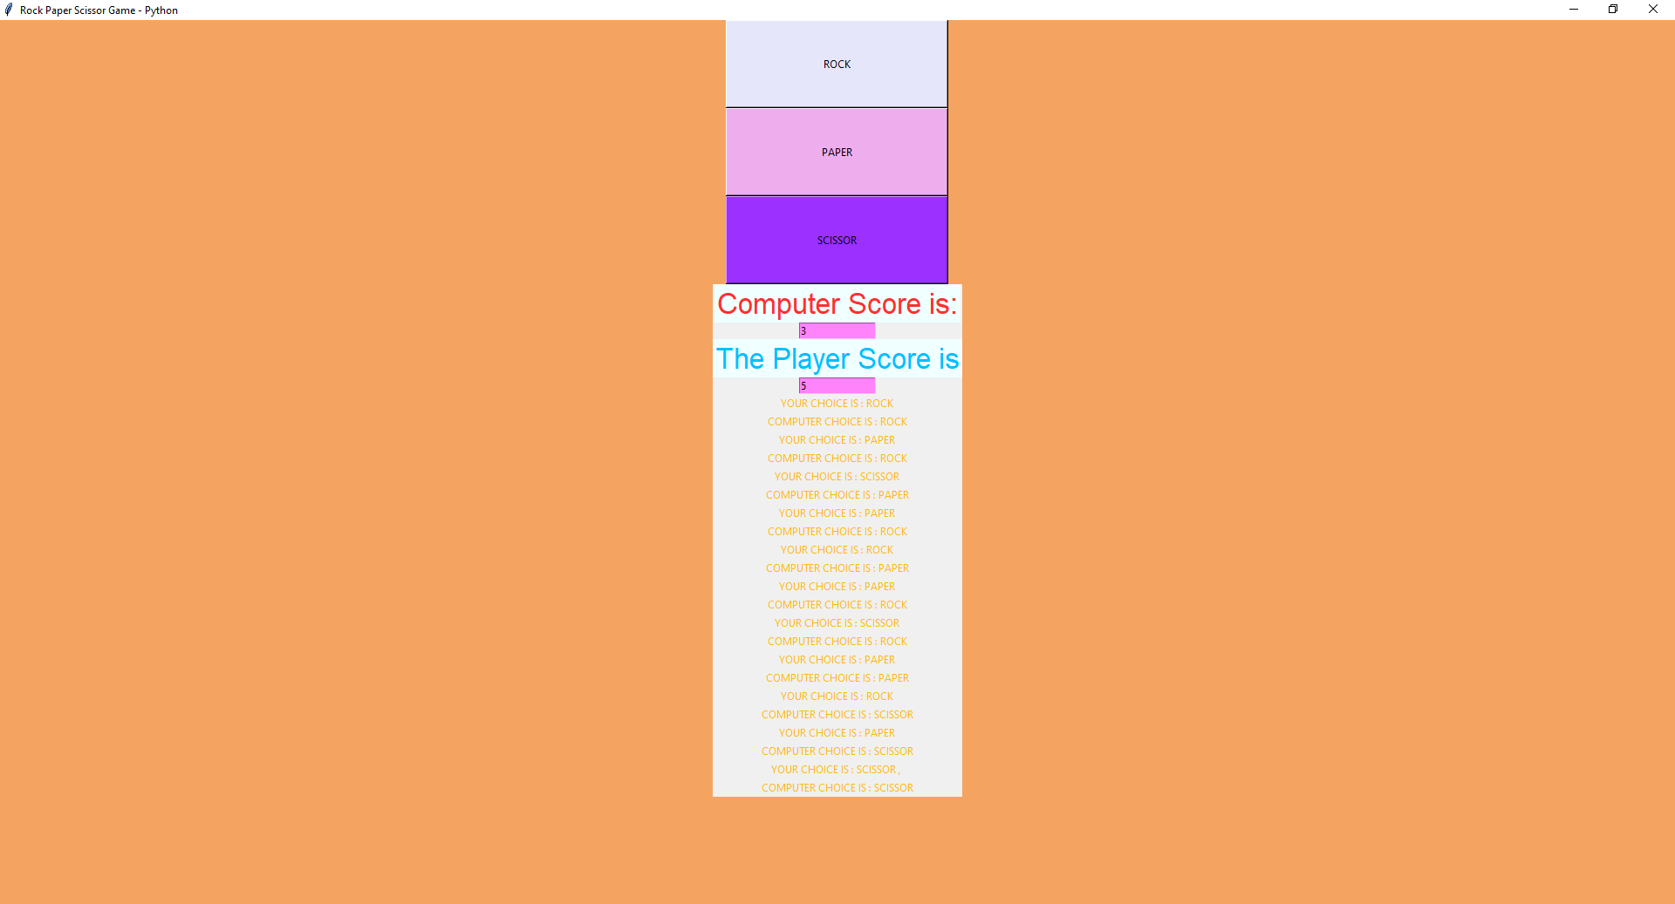

Slide 9
CONCLUSION
The project has made effective use of Tkinter modules like Tk and StringVar. It has also made use of some very efficient library packages in python made us present our project in a very appealing way.
This project helped me learn a lot about other modules of python outside of the B Tech syllabus and helped me explore Tkinter and graphical based modules.
I would like to express my kind gratitude to all my teachers who have helped me to complete this project and last but not least to my friends who assisted me all the time where I felt any problem.
I would like to do some more projects like this in the near future if the time permits for me after completing my studies.
Future Scopes:
This game can be used by others to develop some more basic games like golf, copter, etc. which needs some more lines of code.
Also, this can lead the way to certain heavy graphical games.

Slide 10

References:
[1]https://www.tutorialspoint.com/python/python_gui_programming.htm
[2] https://www.javatpoint.com/python-tkinter
[3] https://www.geeksforgeeks.org/python-tkinter-tutorial/?ref=lbp
[4] https://www.youtube.com/channel/UC59K-uG2A5ogwIrHw4bmlEg
[5] https://www.google.com/
[6] https://www.youtube.com/

