Slide 1
Stanselearn
Django E-Learning Website Platform
Empowering Education Through Technology

Slide 2
Project Overview
🚀 Project: Stanselearn
👨‍💻 Developer: Mayukh (GitHub: mayukh2912)
🔗 Repository: GitHub - mayukh2912
📚 A comprehensive Django-based Learning Management System
🎯 Designed for modern educational institutions and online learning
⚡ Built with scalability, security, and user experience in mind

Slide 3
Technology Stack - Backend
🐍 Framework: Django 4.x
🔧 Language: Python 3.x
📦 Key Packages:
• Django REST Framework - API development
• Django ORM - Database management
• Django Authentication - User management
• Pillow - Image processing
• Django Admin - Administrative interface

Slide 4
Technology Stack - Frontend & Database
🎨 Frontend Technologies:
• HTML5 - Structure and semantics
• CSS3 - Styling and animations
• JavaScript - Interactive functionality
• Bootstrap 5 - Responsive framework
• jQuery - DOM manipulation
🗄️ Database Options:
• SQLite (Development) (Development)
• PostgreSQL, MySQL, Oracle (Production)

Slide 5
System Architecture
🏗️ Design Pattern: MVT (Model-View-Template)
📱 Core Components:
• Models: Database layer for courses, users, assessments
• Views: Business logic and request handling
• Templates: User interface presentation layer
• URLs: URL routing and navigation
• Forms: Data input validation and processing
• Admin: Administrative interface customization

Slide 6
User Management System
User Registration & Authentication
Role-based Access Control
Profile Management
Social Login Integration
🔐 Security Features:
• Password encryption and hashing
• Session management
• CSRF protection
• SQL injection prevention

Slide 7
Course Management System
Course Creation & Publishing
Content Management System
Video, Text & Document Upload
Course Categories & Tags
Course Pricing & Enrollment
📊 Additional Capabilities:
• Bulk course operations
• Course analytics and insights
• Content versioning
• SEO-friendly URLs

Slide 8
Interactive Learning Features
Interactive Course Dashboard
Progress Tracking
Quiz & Assessment System
Certificate Generation
Discussion Forums
Bookmarks & Notes
🎯 Enhanced Learning Experience:
• Responsive design for all devices
• Offline content download
• Multi-language support potential
• Accessibility compliance

Slide 9
User Roles: Students
👨‍🎓 Student Capabilities:
Browse and enroll in courses
Access course materials
Track learning progress
Take quizzes and assessments
Participate in discussions
Download certificates
📱 Student Dashboard Features:
• Personalized course recommendations
• Learning calendar and reminders
• Social learning communities

Slide 10
User Roles: Instructors
👨‍🏫 Instructor Capabilities:
Create and manage courses
Upload multimedia content
Create assessments and quizzes
Monitor student progress
Communicate with students
Generate course analytics
📈 Instructor Tools:
• Advanced content editor
• Student performance insights
• Automated grading system

Slide 11
User Roles: Administrators
👨‍💼 Administrator Capabilities:
Manage all users and roles
Oversee platform operations
Access comprehensive analytics
Manage system settings
Content moderation
Technical maintenance
🛠️ System Administration:
• Database backup and recovery
• Security monitoring
• Performance optimization

Slide 12
Benefits for Institutions
🏫 For Educational Institutions:
Cost-effective e-learning solution
Scalable architecture
Easy content management
Comprehensive reporting
Custom branding options
💡 Strategic Advantages:
• Reduced operational costs
• Enhanced student engagement
• Data-driven decision making
• Global reach capabilities

Slide 13
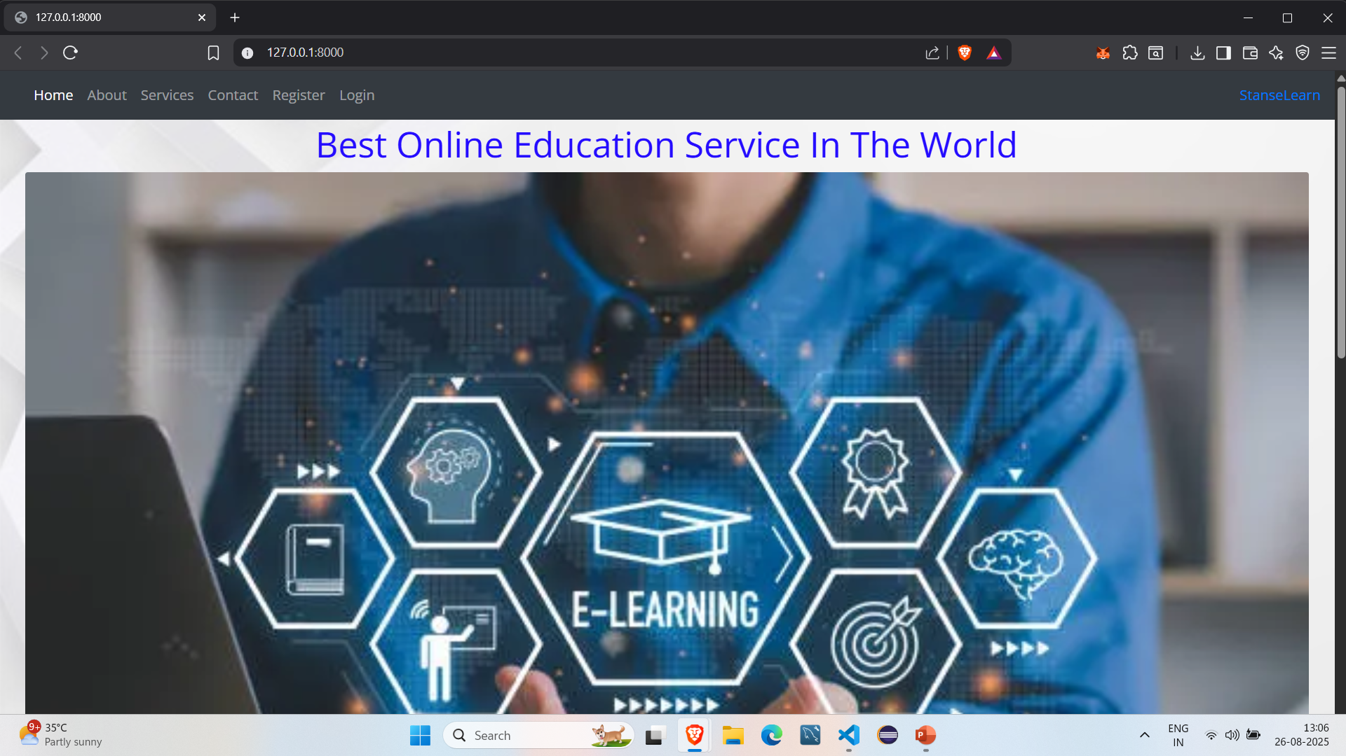
Technical Implementation
🔧 Implementation Excellence:
Secure authentication system
RESTful API endpoints
Responsive web design
File upload management
Email notification system
Search and filtering capabilities
Payment integration ready
Multi-language support potential
⚡ Performance Optimizations:
• Caching mechanisms
• Database query optimization
• CDN integration ready

Slide 14
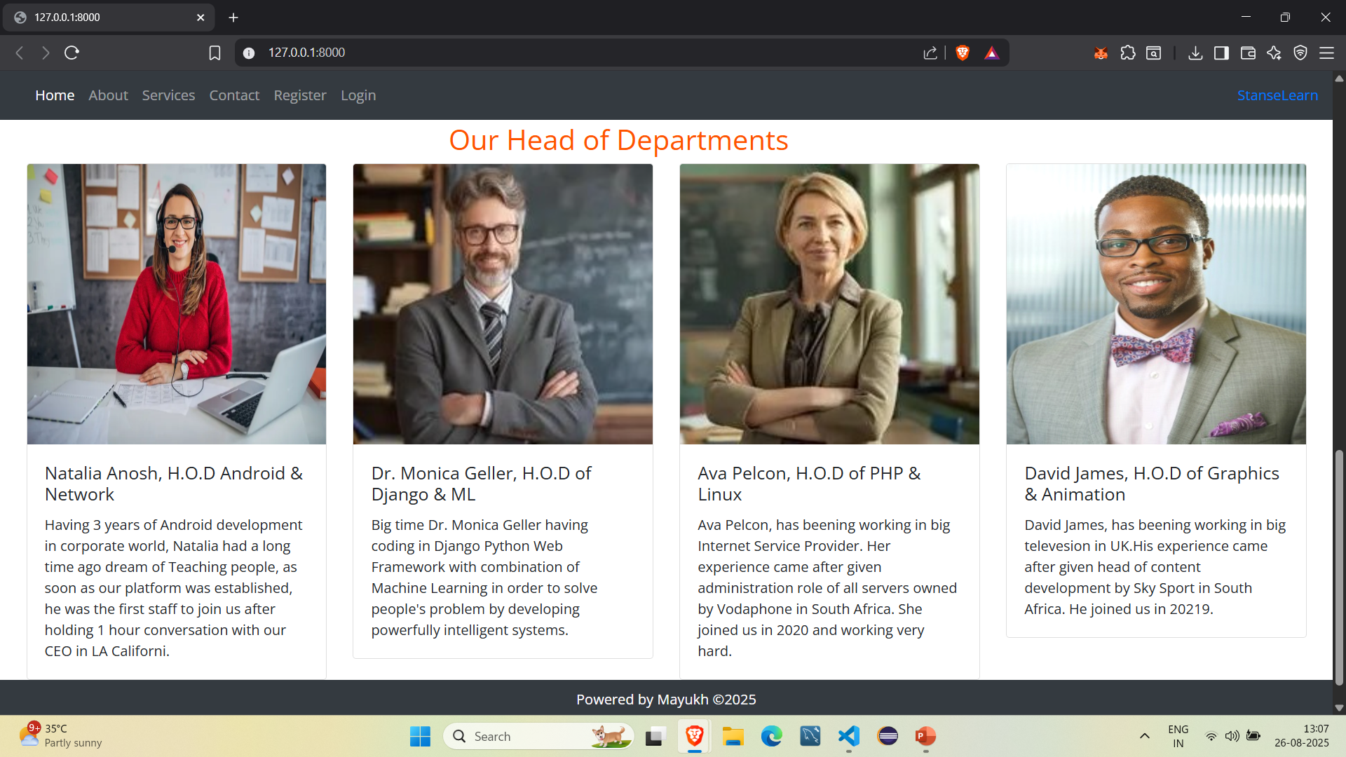
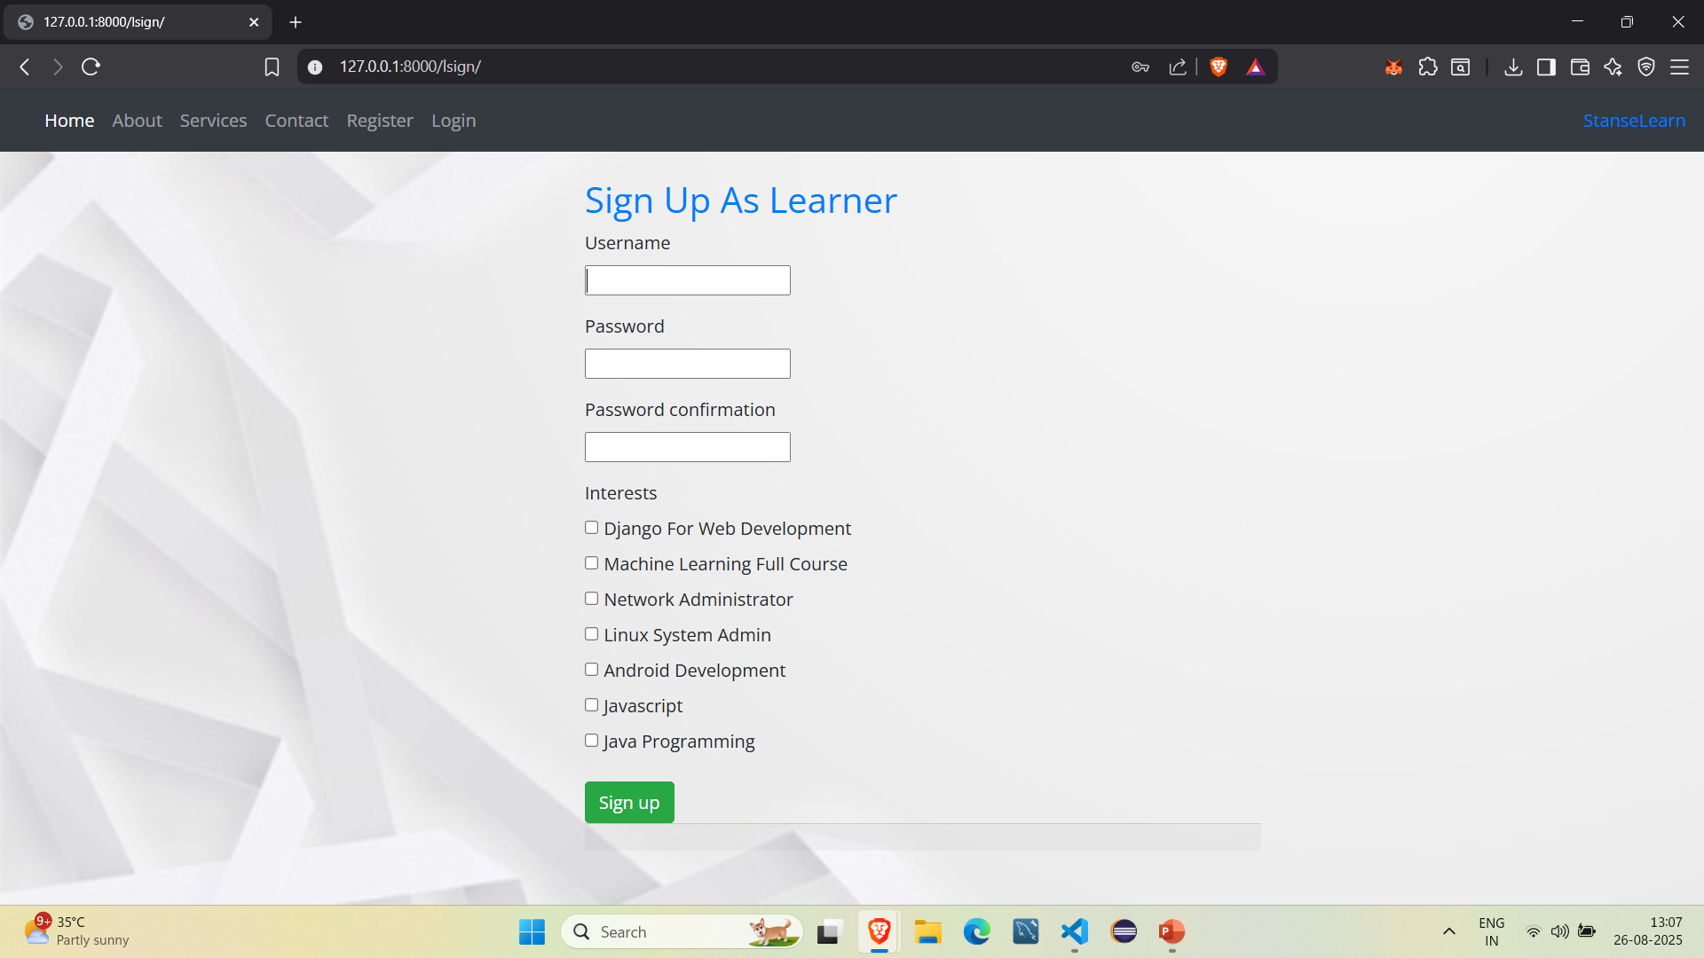
Output

Slide 15
Future Enhancements
🚀 Future Roadmap:
Mobile application development
AI-powered course recommendations
Video conferencing integration
Advanced analytics dashboard
Gamification features
Blockchain certificates
🔮 Vision 2026:
• Industry 4.0 integration
• Advanced AI tutoring systems

Slide 16
Why Choose Stanselearn?
✅ Open Source & Customizable
✅ Industry-Standard Technology Stack
✅ Scalable Architecture Design
✅ Comprehensive Feature Set
✅ Security & Privacy Focused
✅ Mobile-First Responsive Design
✅ SEO & Performance Optimized
✅ Active Development & Support
🎯 Perfect for educational institutions, corporate training,
and online course creators!

Slide 17
Getting Started
🚀 Quick Start Guide:
1️⃣ Clone the Repository:
git clone https://github.com/mayukh2912/Stanselearn_Django_E_Learning-Website.git
2️⃣ Install Dependencies:
pip install -r requirements.txt
3️⃣ Setup Database:
python manage.py migrate
4️⃣ Create Superuser:
python manage.py createsuperuser
5️⃣ Run Development Server:
python manage.py runserver

Slide 18
Thank You!
🙏 Thank You for Your Attention!
📞 Connect with the Developer:
🐙 GitHub: github.com/mayukh2912
📧 Project Repository: Stanselearn_Django_E_Learning-Website
🤝 Contributions Welcome:
• Bug reports and feature requests
• Code contributions and improvements
• Documentation enhancements
• Community feedback and suggestions
🚀 Let's revolutionize education together with Stanselearn!

