Slide 1

PROJECT AEGIS
Transitioning to Dynamic Agentic Defense
Securing Market Leadership in the Era of Mythos-Class AI Threats
QUALYS | CONFIDENTIAL
1 / 15

Slide 2

EXECUTIVE SUMMARY
We shift from 'Showing a Map' to 'Operating a Guardian' that autonomously prunes attack surfaces.
THE PROBLEM
Static, manual security maps risks in weeks that attackers exploit in minutes.
THE CATALYST
Mythos-class AI lets adversaries automate Attack Path discovery at zero cost.
THE SOLUTION
Dynamic Agentic Experience (DAE) for Attack Path — autonomous, real-time defense.
THE VALUE
90% reduction in MTTR. First-mover advantage in the Autonomous Security category.
2 / 15

Slide 3

THE STRATEGIC CATALYST
The 'Mythos' Inflection Point
< 15 min
45 days
Shadow API → Domain Admin
time for AI-automated attack
Average human triage-to-patch cycle
We are bringing a knife to a machine-gun fight
CONCLUSION
Models like Claude Mythos can reason across codebases to find 0-days and chain them into Attack Paths autonomously. Adversaries are no longer individuals — they are Attack Factories. Survival in 2027 requires machine-scale defense to counter machine-scale offense.
3 / 15

Slide 4

THE PROBLEM STATEMENT
The Decay of Static Attack Paths
DIAGNOSTIC, NOT SURGICAL
DATA SILOS
REMEDIATION FATIGUE
Current AP tools tell you you're sick but don't perform the surgery. They are dashboards, not agents.
ETM finds external assets but doesn't 'know' the identity risk in AD until a human connects the dots manually.
70% of critical paths identified in Q1 remain unpatched in Q3. Human bottleneck creates compounding risk.
70% of critical paths from Q1 remain unpatched in Q3
4 / 15

Slide 5



THE SOLUTION
The Three DAE Pillars
01
02
03
MAPPING AGENT
SIMULATION AGENT
REMEDIATION AGENT
Continuous
Predictive
Actionable
Real-time ingestion of ETM, Cloud, and Identity signals. Keeps the path graph alive 24/7.
Red Team AI that finds routes to crown jewels. Reasons like a Mythos-class attacker to identify choke points.
Goal-oriented pruning via TruConfirm identity challenges and autonomous virtual patches.
5 / 15

Slide 6

COMPETITIVE LANDSCAPE
Our 'Blue Ocean'
INCUMBENTS
QUALYS DAE
Wiz • Tenable • Palo Alto
Autonomous Resilience • Auto-Pilot
Focus on 'Comprehensive Visibility.'
They are Better Maps — showing more data, more dashboards, more alerts. But they still require humans to interpret and act.
Native TruConfirm integration lets us 'break' paths using Identity as a physical circuit breaker — a capability competitors lack.
We move from Vulnerability Management Tool to Business Continuity Partner.
MARKET POSITION SHIFT: Vulnerability Management Tool → Business Continuity Partner
6 / 15

Slide 7

THE VISION DEMO
Neutralizing the Mythos Path in < 60 seconds
External Recon → Shadow API → RCE → Container Escape → Domain Admin
STEP 1
Mythos-agent finds an undocumented Shadow API on UAT Dev server. Plans RCE via Struts CVE-2023-50164 to jump to host.
AI PROBES
STEP 2
Mapping Agent detects probe. Simulation Agent recognizes Toxic Combination: UAT host has cached Kerberos ticket for Domain Admin.
DAE REASONS
STEP 3
Action A: Virtual patch on Shadow API endpoint instantly. Action B: TruConfirm out-of-band challenge for the admin account.
DAE INTERCEPTS
RESULT: Path collapsed in < 60 seconds. Analyst receives a Resolution Summary, not an Emergency Alert.
7 / 15

Slide 8
Let me show you what this looks like.
LIVE DEMO
8 / 15

Slide 9

LIVE DEMO CONTRAST
Manual dashboard vs. Agent DAE
BEFORE: MANUAL DASHBOARD
AFTER: AGENT DAE
ManualDashboard.js
AgentDaeChat.js
Static table of discovered paths
Conversational AI greets + maps live
Manual 'Trigger Simulation' button
Mapping agent auto-discovers topology
Raw alert with no remediation logic
Simulation agent traverses, flags PCS 9.9
Manual 'Deploy Fixes' — no validation
Remediation agent deploys WAF + MFA
No PCS scoring or re-verification
Auto re-validates: PCS drops to 7.7
One toggle. Same data. Completely different operational paradigm.
One toggle. Same data. Completely different operational paradigm.
9 / 15
9 / 15

Slide 10

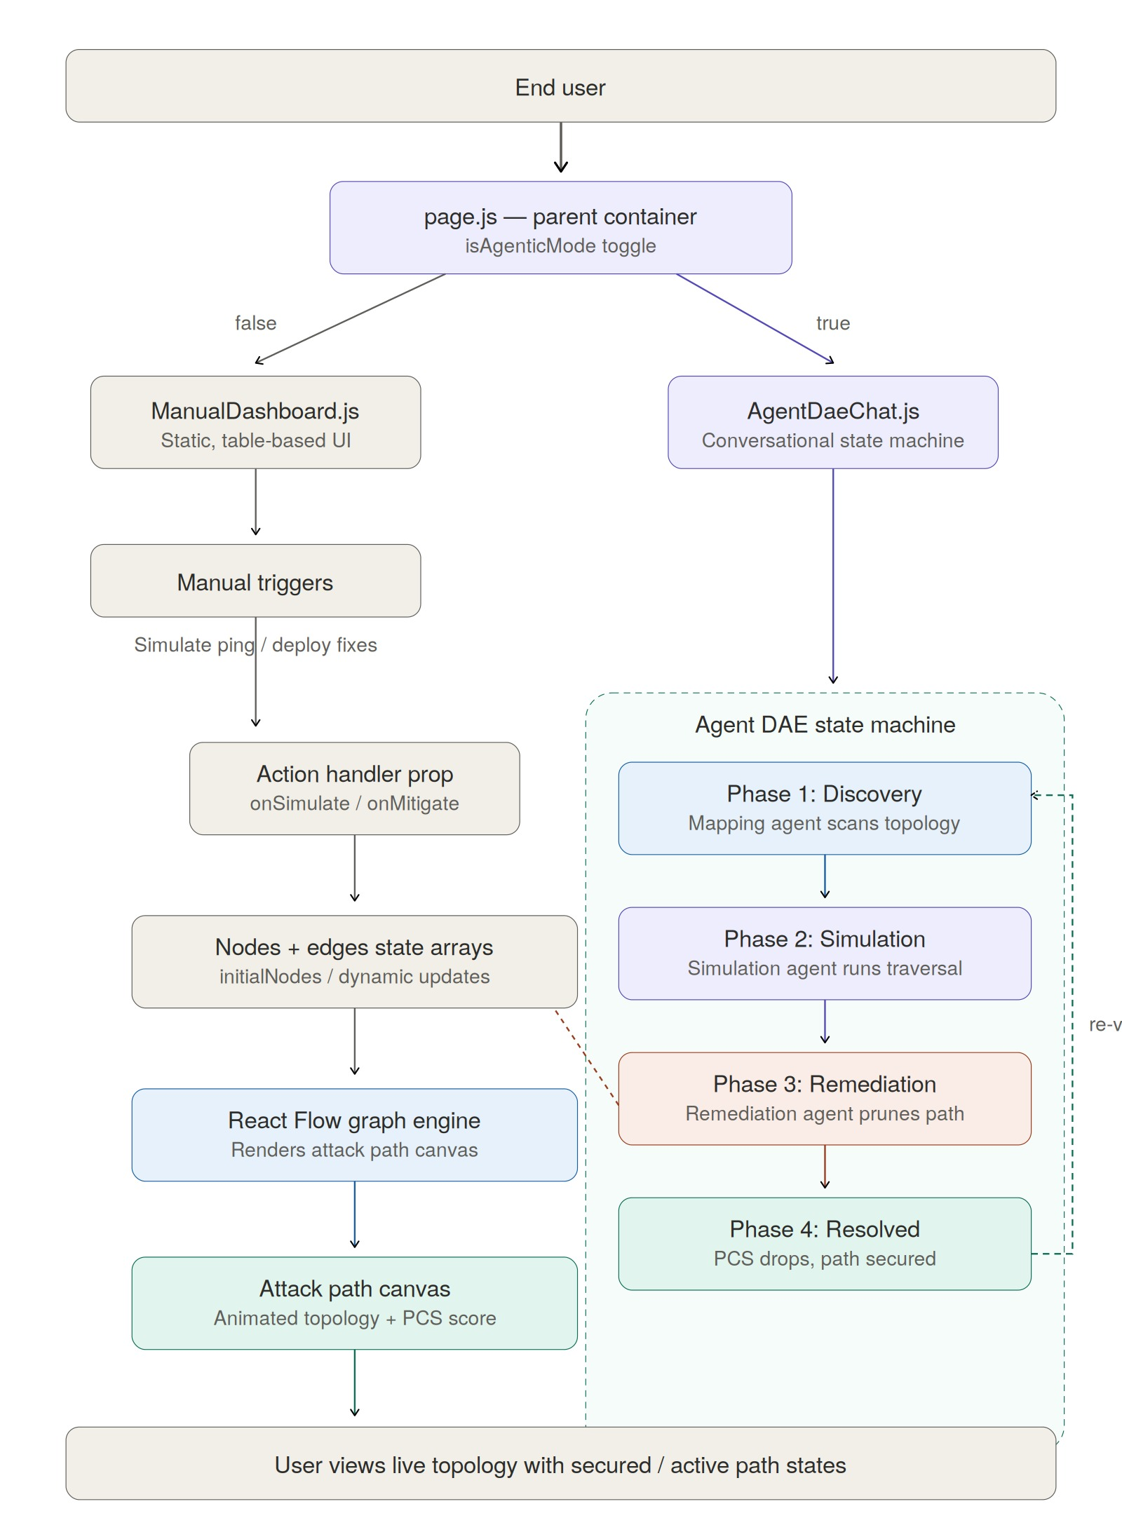
DEMO ARCHITECTURE
How the prototype is wired
Next.js + React Flow + Modular agent state machine | github.com/mayukhg/dae-attack-path-demo
10 / 15

Slide 11

DEMO vs. PRODUCTION
DEMO vs. PRODUCTION
What you just saw vs. what we will build
DEMO SIMULATES
PRODUCTION WILL DO
PRODUCTION WILL DO
Local state machine (scripted phases)
LLM-powered reasoning (Claude / ExPRT.AI)
LLM-powered reasoning (Claude / ExPRT.AI)
Hardcoded node/edge topology data
Live ETM + CSAM + VMDR telemetry
Live ETM + CSAM + VMDR telemetry
Chat-driven agent with static responses
TruConfirm identity circuit breakers
TruConfirm identity circuit breakers
PCS scoring from preset values
A2A agent orchestration protocols
A2A agent orchestration protocols
Single-path demo scenario
Multi-path, real-time graph at scale
Multi-path, real-time graph at scale
The demo proves the interaction model. Project Aegis builds the intelligence behind it.
The demo proves the interaction model. Project Aegis builds the intelligence behind it.
11 / 15
11 / 15

Slide 12

OPERATIONAL ARCHITECTURE
Leveraging Our Rails
FOUNDATION
Leverage Qualys ETM for the surface map and TruConfirm for identity enforcement. We don't start from scratch.
THE 'BRAIN'
Agent Orchestration Layer — a specialized LLM-based controller that translates Security Goals into Product Actions.
A2A PROTOCOLS
Standardized bus for internal tools to communicate intent and context without human middleware.
12 / 15

Slide 13

THE ECONOMIC CASE
Why Autonomous Remediation Pays for Itself
COST OF INACTION
RETURN ON DAE
$4.4M
Avg. cost of a single Domain Admin compromise (IBM Data Breach Report)
90%
MTTR reduction — remediation in minutes, not weeks
45 days
Mean time to remediate — every day is an open exposure window
85%
Fewer human-hours per incident, freeing SOC for strategic work
70%
Of critical paths from Q1 remain unpatched in Q3, compounding liability
10x
Asset volume handled by existing team, zero headcount growth
NET ECONOMIC IMPACT
$4.4M
85%
10x
Avoided per Domain
Admin breach
OpEx savings on
incident response
Capacity multiplier
zero headcount add
13 / 15

Slide 14

GO-TO-MARKET STRATEGY
'Stop Mapping. Start Defending.'
TARGET PERSONA
PRODUCT-LED GROWTH
The "Overwhelmed CISO" — too many tools, not enough people. Needs autonomous reduction, not more dashboards.
Free Path Simulation shows prospects exactly how a Mythos-class attacker would compromise them in minutes.
CHANNEL STRATEGY
PREMIUM TIER
Position DAE as core intelligence for MSSP partners, enabling "Autonomous SOC-as-a-Service."
DAE as new Premium tier for ETM/VMDR, projected incremental ARR in Year 1.
14 / 15

Slide 15

THE CALL TO ACTION
The Attack Factories are already here. We cannot 'wait and see.'
1
Approve seed funding for the Proof of Concept
2
Authorize the Tiger Team headcount (8 engineers)
3
Review the Prototype at the next Strategic Review Board
The future of security is not a dashboard. It is an agent. Let's build it.
15 / 15

