Slide 1
PRODUCT BUILDER CASE STUDY
From Protocol to Product
Turning the Qualys MCP server into a Risk Copilot
qualys-cli-mcp
16 tools · 12 modules
one governance layer
Mayukh · github.com/mayukhg/qualys-mcp-app

Slide 2
THE THESIS
A protocol is not a product.
A protocol is not a product.
pip install qualys-cli-mcp takes ninety seconds. Everything that makes it usable by a security team happens after.
CAPABILITY · 16 tools, 12 modules, one governance layer
THE PRODUCT WORK · this deck
OUTCOME · a running, governed, auditable risk copilot
02 / 23

Slide 3
WHY THIS MCP SERVER
What the server actually is
LLM
qualys-cli-mcp
qualys-cli
Qualys Cloud
Claude, GPT, Llama — speaks MCP, holds no credentials
Validates argv, redacts secrets, enforces policy, writes the audit log
Auth, retries, the actual Qualys API calls
VM · PC · PM · WAS · TotalCloud · CS · CSAM · Cloud Agent
›
›
›
The server never touches Qualys directly. It wraps an existing CLI and puts a governance layer in front of it — which is precisely why it can be productised rather than demoed.
03 / 23

Slide 4
WHY THIS MCP SERVER
Three unlocks
01
02
03
One thread, twelve modules
No API client to build
Guardrails in the box
Natural language replaces hand-built QQL across VM, PC, PM, WAS, TotalCloud, Container Security, CSAM and Cloud Agent.
Sixteen typed tools plus a generic passthrough. The integration cost of a cross-module workflow collapses to a config entry.
Argv validation, keyring credentials, module allowlist, read-only mode, append-only JSONL audit — shipped, not bolted on.
04 / 23

Slide 5
WHY THIS MCP SERVER
Capability was never the blocker
Security teams have not pointed LLMs at security data for three reasons. This server answers all three.
CREDENTIALS
BLAST RADIUS
PROVENANCE
“Who holds the keys?”
“What can it break?”
“Prove what it did.”
Secrets sit in the OS keyring. They are never passed to the model, and they are redacted out of tool output.
DENY_WRITE forces read-only. ALLOWED_MODULES bounds the session to the modules you name.
Every tool call lands in an append-only JSONL log with actor, module, mode and timestamp.
This is the part most MCP demos never touch — and the only part an enterprise buyer actually asks about.
05 / 23

Slide 6
THE SOLUTION SPACE
Eleven doors
Every use case the server supports. Listing them is the easy half.
Query & triage
Decision support
Distribution
Platform
Conversational VM triage
Policy Compliance posture Q&A
WAS findings summarisation
Cloud misconfiguration review
Container image risk gate
CSAM risk-ranking lookups
Cloud Agent coverage checks
Patch prioritisation across VM + PM
Copilot inside Claude Desktop / IDE
Governed read-only self-service reporting
Custom security tooling built on qualys_cli() and qualys_cli_help()
06 / 23

Slide 7
THE SOLUTION SPACE
How I cut eleven to one
Four criteria, stated before the scoring — not reverse-engineered from the answer.
CANDIDATE | NEEDS A CROSS-MODULE JOIN | EXERCISES THE GOVERNANCE LAYER | REPLACES A RECURRING RITUAL | HAS A SECOND AUDIENCE
Conversational VM triage | ○ | ○ | ○ | ○
Patch prioritisation | ● | ○ | ○ | ○
Container / cloud misconfig review | ○ | ○ | ○ | ○
Governed self-service reporting | ○ | ● | ○ | ●
Unified Cross-Domain Risk Copilot | ● | ● | ● | ●
The winner is the only candidate that needs a join no single Qualys screen gives you, exercises the guardrails that are the actual moat, replaces a named ritual (the Monday leadership report), and ships with a second audience already in it.
07 / 23

Slide 8
DEEP DIVE
The problem, in the customer's words
01
02
“Nothing tells us what to fix first.”
“We join it by hand.”
Hosts, cloud resources, containers and web apps each rank separately. There is no single list.
An analyst opens six modules to answer one question about one asset. Every week.
03
04
“The Monday report is a spreadsheet.”
“Engineering wants answers, not access.”
Defensible to leadership, provable to nobody. No record of what was pulled, or when.
Managers need to know how risky their estate is — without a Qualys seat or write permissions.
08 / 23

Slide 9
DEEP DIVE
Requirements, mapped to tools
The decomposition is the design. Every business question resolves to a named tool and a named module.
BUSINESS NEED | MCP TOOL | MODULE
What are our riskiest assets right now? | Asset risk-ranking / inventory | CSAM
What is wrong with them, and how bad is it? | Detection + host queries + KB lookup | VM
Is a failing control compounding the risk? | Posture assessment | PC
Is it an internet-facing app with findings? | Findings list | WAS
Is it cloud-hosted and misconfigured? | Connector + CDR data | TotalCloud
Does it run vulnerable container images? | Image vulnerability scan | CS
Is a fix already in flight? | Job + patch listings | PM
Are we even watching this asset? | Agent inventory | Cloud Agent
Anything the curated tools miss | qualys_cli() + qualys_cli_help() | Generic
Safe self-service, provable to auditors | DENY_WRITE + ALLOWED_MODULES + AUDIT_LOG | Governance
09 / 23

Slide 10
DEEP DIVE
The weekly workflow
1 · Identify
2 · Explain
3 · Compound
4 · Branch
Rank the top assets — CSAM
Turn CVE IDs into a narrative — VM + KB
Flag controls that make it worse — PC
Follow the asset type — WAS / TC / CS
5 · Blind spots
6 · Fix
7 · Gap-fill
8 · Report
Name what we cannot see — CA
In flight, or needs a job? — PM
The bespoke ask — qualys_cli()
One ranked list, one exec summary
Eight modules, one narrative. This is a join — not eight queries printed next to each other.
10 / 23

Slide 11
DEEP DIVE
The copilot reports what it cannot see.
The copilot reports what it cannot see.
Two of the five assets in the demo tenant have no Cloud Agent — an internet-facing VPN gateway and a production database in eu-west-1. Every risk score on them is an underestimate. The copilot says so out loud instead of ranking them politely low.
Most tools report findings
This one reports the absence of findings
A coverage gap is a finding, not a blank row
11 / 23

Slide 12
DEEP DIVE
Governance is the packaging, not the fine print
Analyst
Manager · self-service
the Monday risk sweep
“how risky is my team's estate?”
MODULES
All 8 in scope
MODULES
CSAM, VM, WAS only
SAME
COPILOT
MODE
Read-only (DENY_WRITE=1)
MODE
Read-only (DENY_WRITE=1)
EVIDENCE
Full cross-module chain
EVIDENCE
Restricted modules hidden and labelled
AUDIT
Every call, JSONL
AUDIT
Every call, JSONL
Same copilot. Two products. The difference is two environment variables — and, as the next slide shows, the server actually enforces them.
12 / 23

Slide 13
PROOF
Same app. Same backend. Two rails.
Analyst
CSAM VM PC WAS TC CS PM CA
Manager · self-service
CSAM VM WAS · 5 locked
1
Stay on the default profile
1
Switch profiles
no call · 8/8 modules, read-only
POST /api/session {profile:"manager"}
2
Ask for the ranked risk list
2
Workbench refreshes
POST /api/chat → csam.risk_ranking
same scores — CSAM ranking stays open
3
Scan the ranking
prod-checkout-web-01 · 96 · CRITICAL
3
Expand the same asset
4
Expand the top asset
GET /api/assets/…/evidence · 2/5 visible
GET /api/assets/…/evidence · 5/5 visible
4
Ask why it's risky
5
Ask a cross-module follow-up
POST /api/chat → module VM
POST /api/chat → module CA
5
Ask about patches anyway
6
Try a write command anyway
POST /api/chat → module PM denied
POST /api/qualys-cli → 403 blocked
7
Open the audit log
6
Open the audit log
GET /api/audit
GET /api/audit · CSAM / VM / WAS only
Leaves with a cross-module remediation picture — and a defensible trail of how it was built.
Leaves with enough visibility to self-serve — and a paper trail proving the boundary held.
The ranking is never restricted — only the supporting detail underneath it. A manager can see that an asset scores 96; they cannot see the compliance failure or the patch job behind it. That was a decision, not a limitation.
13 / 23

Slide 14
PROOF
The guardrail, executed
I tried to make it do the wrong thing. The server said no — and then wrote down that I asked.
$ curl -X POST localhost:5050/api/qualys-cli \
-d '{"command":"pm patch apply --job Q3-log4j-remediation"}'
HTTP/1.1 403 Forbidden
{
"output": "blocked: 'pm patch apply ...' looks like a
The model did not refuse. The server refused. That is the difference between a control and a hope.
DENY_WRITE applies to every profile, including the Analyst's — there is no privileged path around it.
The denial is audited, not just blocked. An auditor can see what was attempted, not only what succeeded.
write operation and QUALYS_MCP_DENY_WRITE=1 is
enforced for this session."
}
# and in the audit log, one line later:
{"ts":"2026-07-14T07:17:18Z", "tool":"qualys_cli",
"module":"GENERIC", "mode":"read-only",
"result":"denied"}
14 / 23

Slide 15
DEEP DIVE
What changes
 | TODAY | WITH THE COPILOT
Ranking across domains | Six modules, joined by hand | One ranked list
Time to the Monday report | Hours of spreadsheet work | One conversation
Provenance | None | Timestamped JSONL, per tool call
Coverage gaps | Invisible | Named as a first-class finding
Audience | Analysts with Qualys seats | Plus engineering managers, read-only
Directional. No live tenant data was used — these are the claims the prototype exists to test, not measured results.
15 / 23

Slide 16
THE SURFACE
Three principles I designed to
Each one is provable in the screenshots that follow.
01
02
03
Never assert. Cite.
Governance in the chrome.
One surface, two personas.
Every claim carries the module that produced it. There are no naked answers anywhere in the interface.
Read-only, the module allowlist and the audit count live in the header — not in a config file nobody opens.
The same screen, re-scoped. Restriction is a designed state, not an error state.
16 / 23

Slide 17
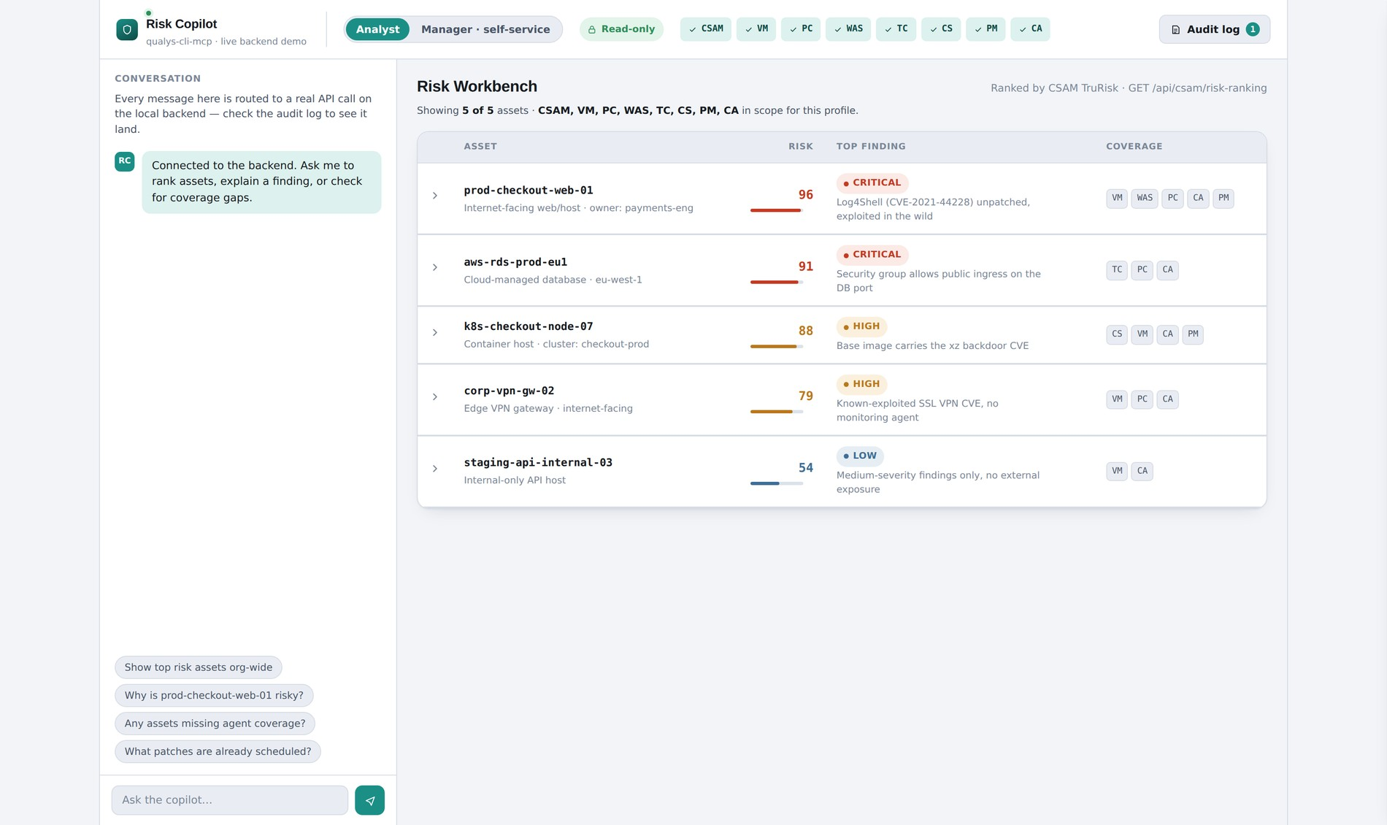
THE SURFACE
The whole product in one frame
Conversation on the left. Ranked evidence on the right. The governance contract across the top.
The header states the contract before you ask anything: read-only, 8 of 8 modules in scope, and a live audit counter.
This is a running app — a Node server enforcing the policy, not a styled mockup.
17 / 23

Slide 18
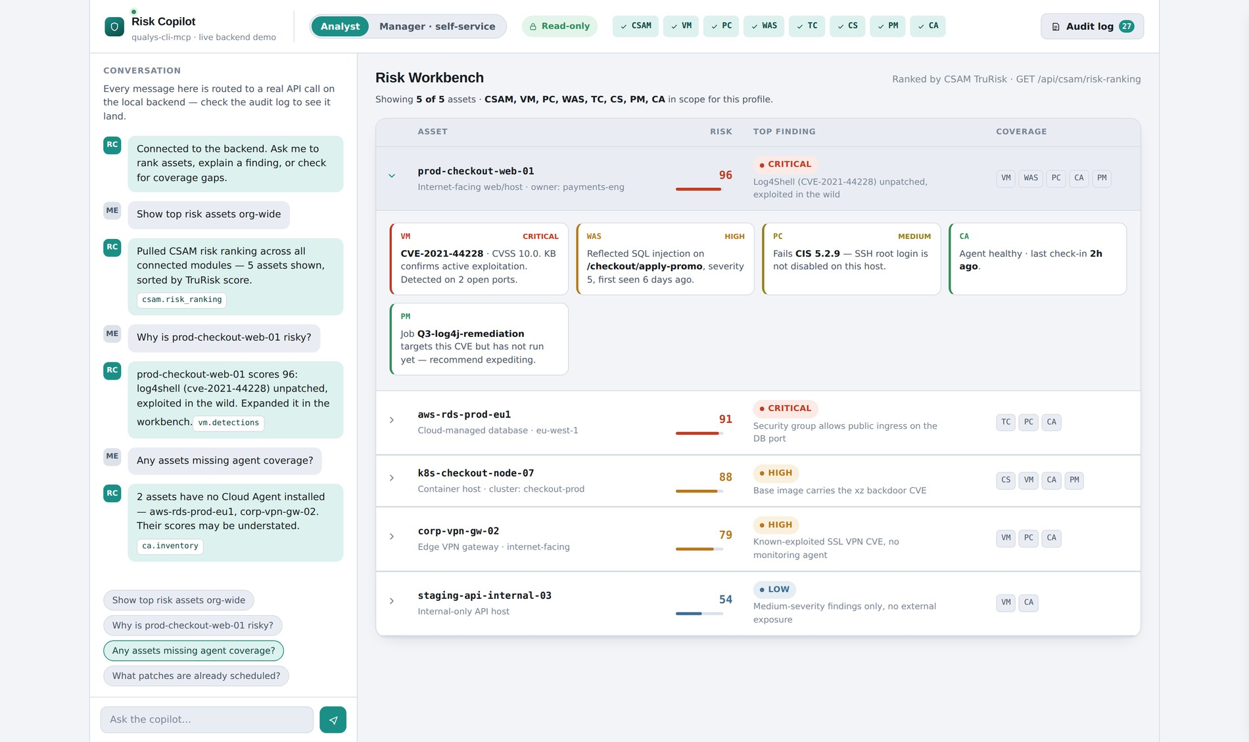
THE SURFACE
The conversation carries its receipts
Every answer is stamped with the tools that produced it.
“Show top risk assets org-wide” resolves to csam.risk_ranking.
“Why is prod-checkout-web-01 risky?” resolves to vm.detections · pc.posture.
“Any assets missing agent coverage?” resolves to ca.inventory.
An analyst can defend the answer without trusting the model.
18 / 23

Slide 19
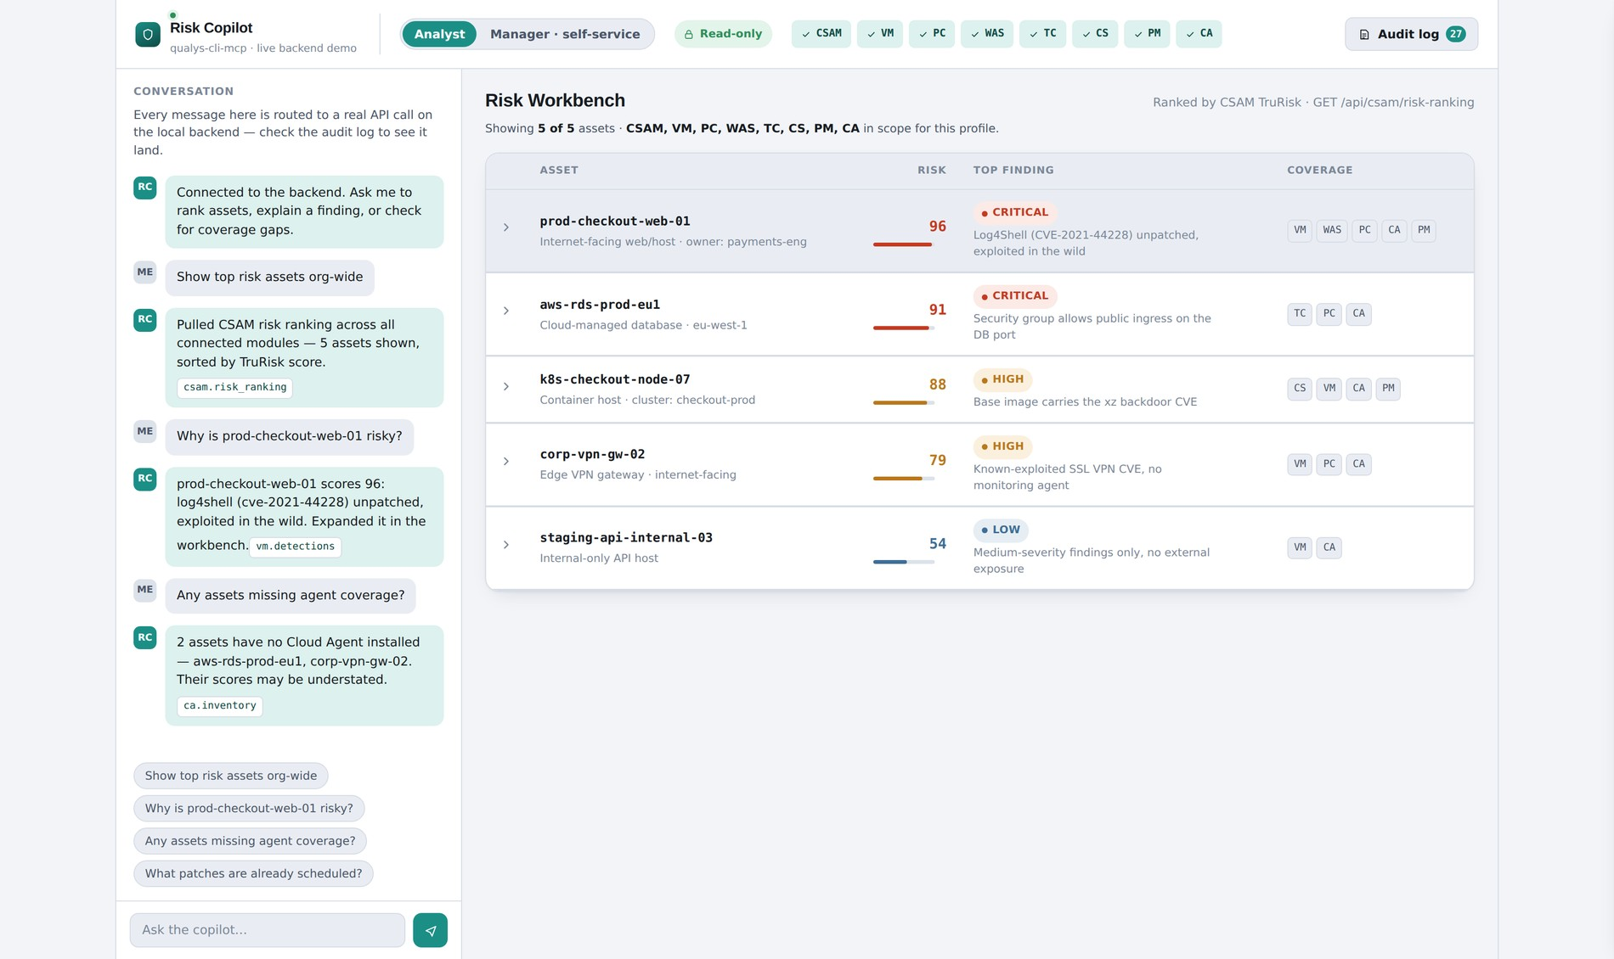
THE SURFACE
One asset. Five modules. One story.
Expand prod-checkout-web-01 (TruRisk 96) and all five evidence cards render — 5/5 visible, because every module they live in is inside the Analyst allowlist.
VM — Log4Shell, CVSS 10.0, KB confirms active exploitation.
WAS — reflected SQL injection on /checkout/apply-promo.
PC — fails CIS 5.2.9, SSH root login is enabled.
CA — agent healthy, so this score can be trusted.
PM — a remediation job exists and has not run. Expedite it.
19 / 23

Slide 20
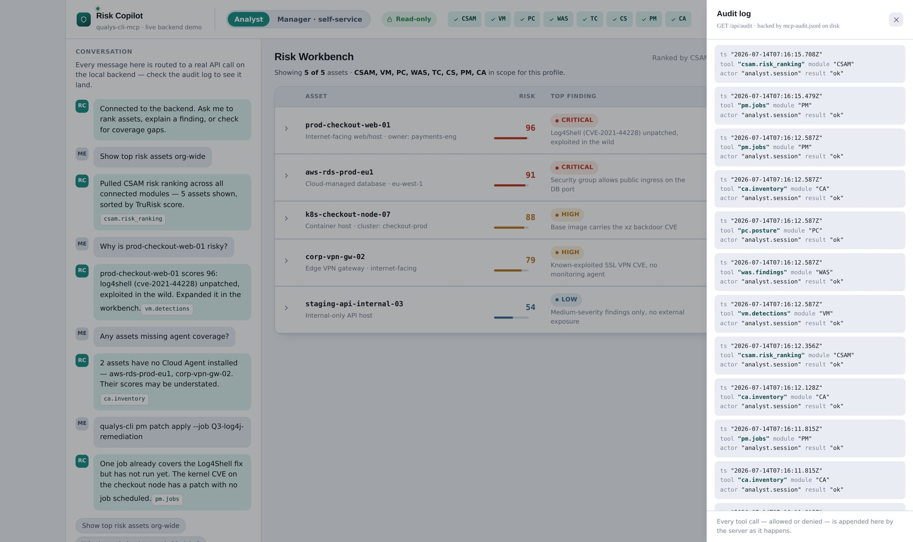
THE SURFACE
The audit log proves the negative
Append-only JSONL: timestamp, tool, module, actor, mode, result. Written for every call — including the ones that were denied.
Most audit logs record what happened. This one lets you prove what didn't.
The Manager's trail is visibly shorter than the Analyst's — evidence that the session never touched PC, TC, CS, PM or CA, without taking anyone's word for it.
That is the difference between compliance theatre and a control.
20 / 23

Slide 21
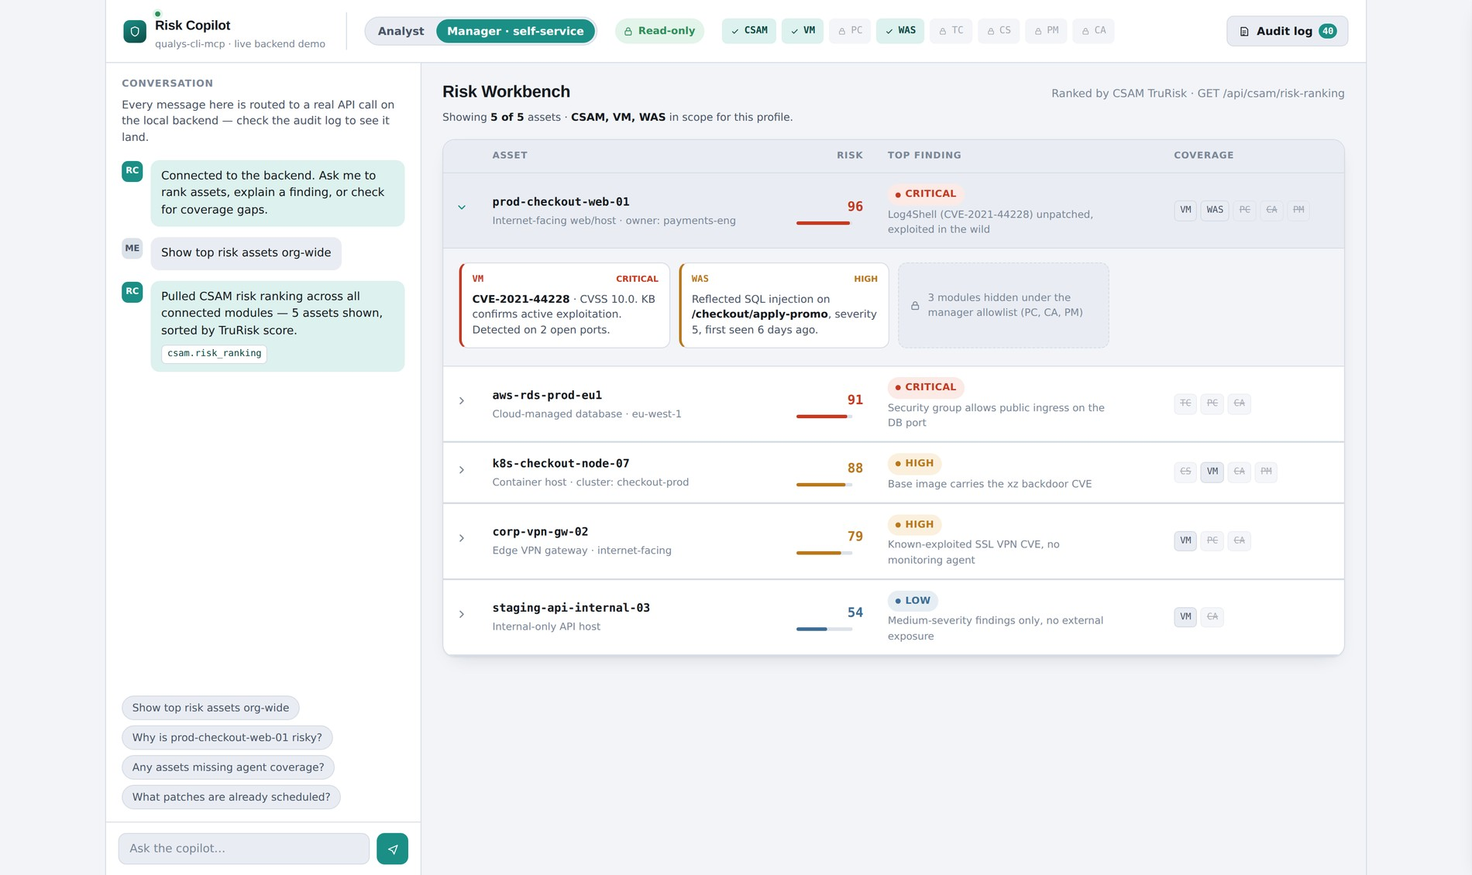
THE SURFACE
The same product, re-scoped
Manager profile, same asset, same endpoint: 2 of 5 evidence cards render. The server decides, not the stylesheet.
The banner names exactly what hid: “3 modules hidden under the manager allowlist (PC, CA, PM).” Nothing is silently dropped.
Ask about patches anyway and the copilot says PM is out of scope — the restriction surfaces in the conversation, not in a log the manager will never read.
Restriction is a designed state, not an error state.
21 / 23

Slide 22
HOW I BUILT IT
The loop
01
02
03
Read the spec — all 16 tools, all 12 modules
Map tools to business needs, not to features
Cut eleven to one, on criteria stated first
04
05
06
Design the workflow as a join, not a query list
Build the surface until the guardrails actually run
Pressure-test the guardrails as a persona, not a setting
Honest scope: this is a running application — a Node server that enforces the allowlist, rejects writes, and writes its own audit log. What it does not have is a live Qualys tenant behind it. Production needs a real MCP session against real data, a latency and cost budget, and an eval harness for hallucination on risk claims. Naming the gap accurately is part of the job.
22 / 23

Slide 23
WHAT'S NEXT
The server was the raw material. The product was the judgment.
v1 — the Monday ritual
v2 — scheduled run, delivered to Slack
v3 — write path with approval gating
v4 — an ETM consumption channel
Eleven doors. One opened. Made safe enough to walk through.
github.com/mayukhg/qualys-mcp-app
23 / 23

