Slide 1
01 · THE PROBLEM
Nobody can answer “what do we fix first?”
Not a data problem. Qualys already holds the data — it just holds it eight screens apart. What is missing is the join.
01
02
No single ranked list
Six modules, one question
Hosts, cloud resources, containers and web apps each rank on their own. The join happens in a human head, or it does not happen.
To judge one asset, an analyst opens VM, PC, WAS, TotalCloud, Container Security and Cloud Agent — before Patch Management can even be consulted.
03
04
A report nobody can prove
Blind spots rank as “low”
The weekly leadership pack is a spreadsheet. Defensible to the board, provable to no one. No record of what was pulled, or when.
An asset with no agent has no findings. Today that reads as safe. It is the opposite of safe.
Evidence, made concrete: in the prototype's demo tenant, 2 of the 5 top-risk assets carry no Cloud Agent — an internet-facing VPN gateway and a production database in eu-west-1. Every risk score on them is an underestimate, and nothing in the stack currently says so out loud.
01 / 05

Slide 2
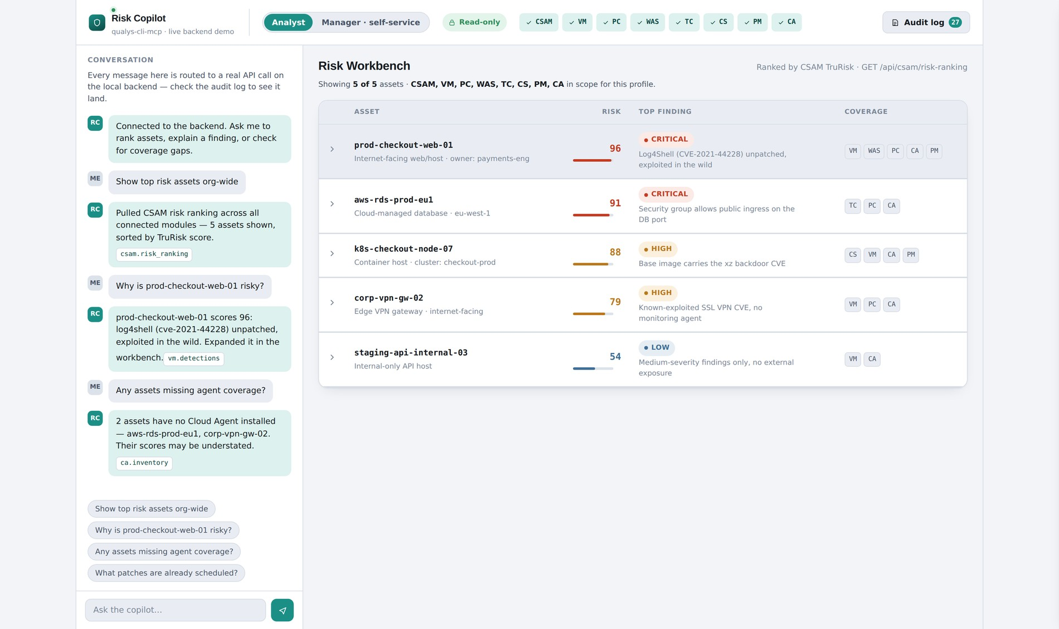
02 · THE SOLUTION
One conversation. Eight modules. One ranked answer.
Ask in plain language. The copilot calls CSAM, VM, PC, WAS, TotalCloud, CS, PM and CA — then shows its work.
A running app on the qualys-cli-mcp contract: read-only enforced server-side, module-allowlisted, every call written to an append-only audit log.
Expand prod-checkout-web-01 (TruRisk 96) and the chain unfolds — VM finds Log4Shell, WAS finds SQL injection on the checkout path, PC finds SSH root login enabled, PM says the fix job exists and has not run.
Send a write command through the passthrough and it returns 403 — then logs that you tried. The guardrail runs; it is not drawn.
02 / 05

Slide 3
03 · THE OPPORTUNITY
Sized in the units we actually have
Reach and effort are countable today. Revenue is not — and I would rather name what it would take to price it than invent a number.
THE JOIN
THE REACH
THE CHANNEL
8 modules → 1 list
A second audience, already built
Zero new surfaces to sell
A ritual that runs 52 times a year stops being a spreadsheet exercise. Illustrative model: ~4 analyst-hours × 52 weeks ≈ 200 hours a year, per team, reclaimed — arithmetic on a stated assumption, not a measurement.
A read-only, module-allowlisted profile puts risk answers in front of engineering managers who will never hold a Qualys seat. The capability ships today; sizing the seat count needs one design partner's headcount.
MCP is a consumption channel, not a product. The copilot lands inside Claude Desktop, an IDE or a chat client the customer already lives in — extending ETM's reach without extending its surface area.
No live tenant sits behind this yet — the data is local. But the governance layer is executable, not illustrated: the allowlist restricts, the write is rejected, the audit log records both. Every figure above is either counted from the server's own spec or labelled as a model.
03 / 05

Slide 4
04 · WHY NOW / WHY QUALYS
The guardrails are the differentiation
WHY NOW
WHY QUALYS
WHY THIS SHAPE
The server exists, and it is early
We own the layer everyone else bolts on
Chat is table stakes. The join is not.
qualys-cli-mcp is at 0.1.2, Beta, MIT-licensed, maintained by Qualys. MCP is becoming the default way agents reach enterprise systems. The window to define what a governed security copilot looks like is open, and it will not stay open.
Credential redaction, argv validation, module allowlisting, read-only enforcement and append-only JSONL audit ship inside the server. That is not a feature list — it is the reason a CISO lets a model near this data at all.
Anyone can wire an LLM to a vulnerability feed. Correlating eight modules into one defensible narrative, with the evidence trail attached, is a platform move — and a point tool cannot answer it.
04 / 05

Slide 5
05 · THE ASK
What I need to ship it
01 · A tenant
02 · One engineer
03 · A design partner
04 · Six weeks
A read-only sandbox with DENY_WRITE=1 and real or anonymised data across all eight modules.
One backend engineer, part-time, to swap the local data layer for live qualys-cli calls.
One customer to run the Monday ritual for four weeks and tell us what the report is missing.
Then a go / no-go, judged on one question: did the ranked list change what got fixed first?
The running application, the persona walkthrough and this deck were built without any of the above. That is the point — the expensive part was the judgment, not the budget.
05 / 05

