Slide 1

JANATA SHIKSHANA SAMITI’S
SHRI MANJUNATESHWARA INSTITUTE
OF UG AND PG STUDIES, DHARWAD
Project Title-AgroBoost-Sai Agro Fertilizers
Presented by: Mayur Desai (Reg No: U02BF22S0160)
Project Guide: Miss. Yashoda Patil
Notes:
We designed this template so that each member of the project team has a set of slides with its own theme where he/she can present their research. Members, here’s how you add a new slide to just your set:
Mark where you want to add the slide: Select an existing one in the Thumbnails pane, click the New Slide button, then choose a layout.
The new slide gets the same theme as the previous one you selected.
Careful! Don’t annoy your fellow presenters by accidentally changing their themes. That can happen if you choose a theme Variant from the Design tab, which changes all of the slides in your presentation to that look.

Slide 2
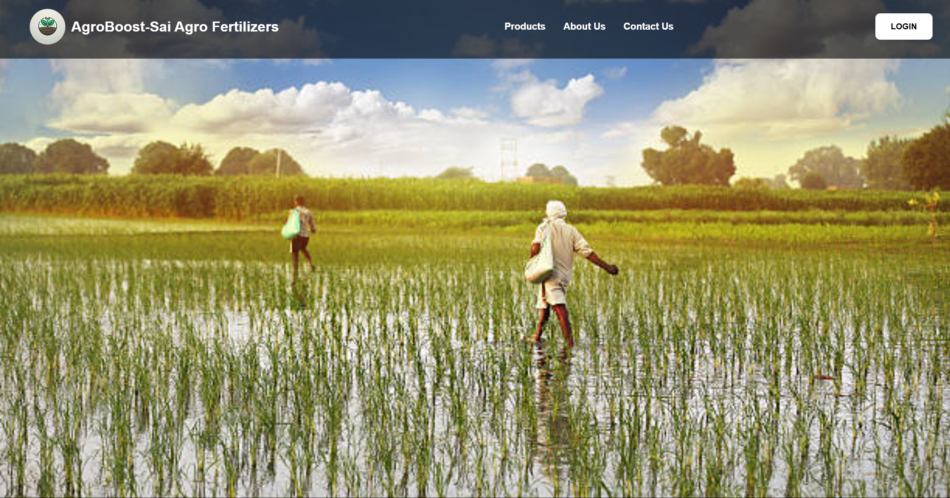
AGROBOOST-SAI AGRO FERTILIZERS
Notes:
We designed this template so that each member of the project team has a set of slides with its own theme where he/she can present their research. Members, here’s how you add a new slide to just your set:
Mark where you want to add the slide: Select an existing one in the Thumbnails pane, click the New Slide button, then choose a layout.
The new slide gets the same theme as the previous one you selected.
Careful! Don’t annoy your fellow presenters by accidentally changing their themes. That can happen if you choose a theme Variant from the Design tab, which changes all of the slides in your presentation to that look.

Slide 3

CONTENTS
Introduction
Objectives
System Modules
Tools and Techniques
Process Logic
Database Structure
Features
Screenshots
Testing
Limitations
Scope
Conclusion

Slide 4
Introduction
AgroBoost-Sai Agro Fertilizers is a web-based e-commerce platform developed for a client to manage and streamline agricultural product sales. The system allows the admin to add, update, and delete product details, as well as manage customer information and orders. It offers a user-friendly interface for customers to browse products and place orders efficiently. The platform centralizes inventory, billing, and user management, helping reduce manual effort and improve accuracy. Designed for scalability and real-world usability, AgroBoost supports digital transformation in the agricultural sector.

Slide 5





Objectives: Core Goals
Our platform aims to enhance agricultural sales efficiency.
Order and Transaction Management
Role-based Dashboards
Streamlines order processing.
Provides tailored views.
Centralized Management
Sales and Stock Reporting
Integrates inventory, billing, and users.
Generates insightful reports.

Slide 6
System Modules: Admin and User Views
AgroBoost operates through two distinct modules, each tailored to specific user roles.
Admin Module
User Module
  User management
Registration/login
  Product management
Product browsing
  Stock updates
Order placement
  Report viewing
Bill viewing

Slide 7





Tools and Technologies:
AgroBoost is built using a robust stack of development tools and technologies.
Frontend
Backend
HTML, CSS, JavaScript ensure a responsive user interface.
PHP powers server-side logic and database interactions.
Development Tools
Database
VS Code and PhpMyAdmin facilitate efficient development.
MySQL manages all product and user data.

Slide 8
Process Logic
Input Process Output
Login and Registration
Adding Products
Product Details
Order Details
Login Status
Listed Products
Product Summary
Order Summary
AgroBoost-Sai
Agro Fertilizers

Slide 9
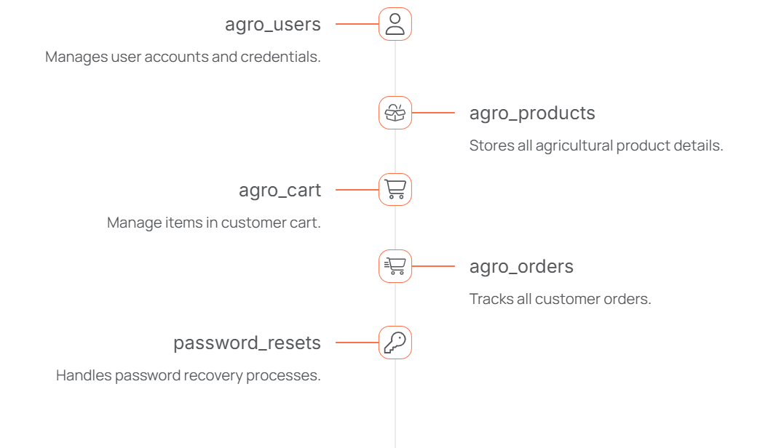
Database Structure

Slide 10

Features: Enhanced Functionality
1.
CAPTCHA Security
Ensures secure login and registration processes.
2.
Role-Based Access
Redirects users to dashboards based on their roles.
3.
Product Management
Admin can add, update, and delete products easily.
4.
Secure Profiles
Includes password hashing and profile updates.

Slide 11
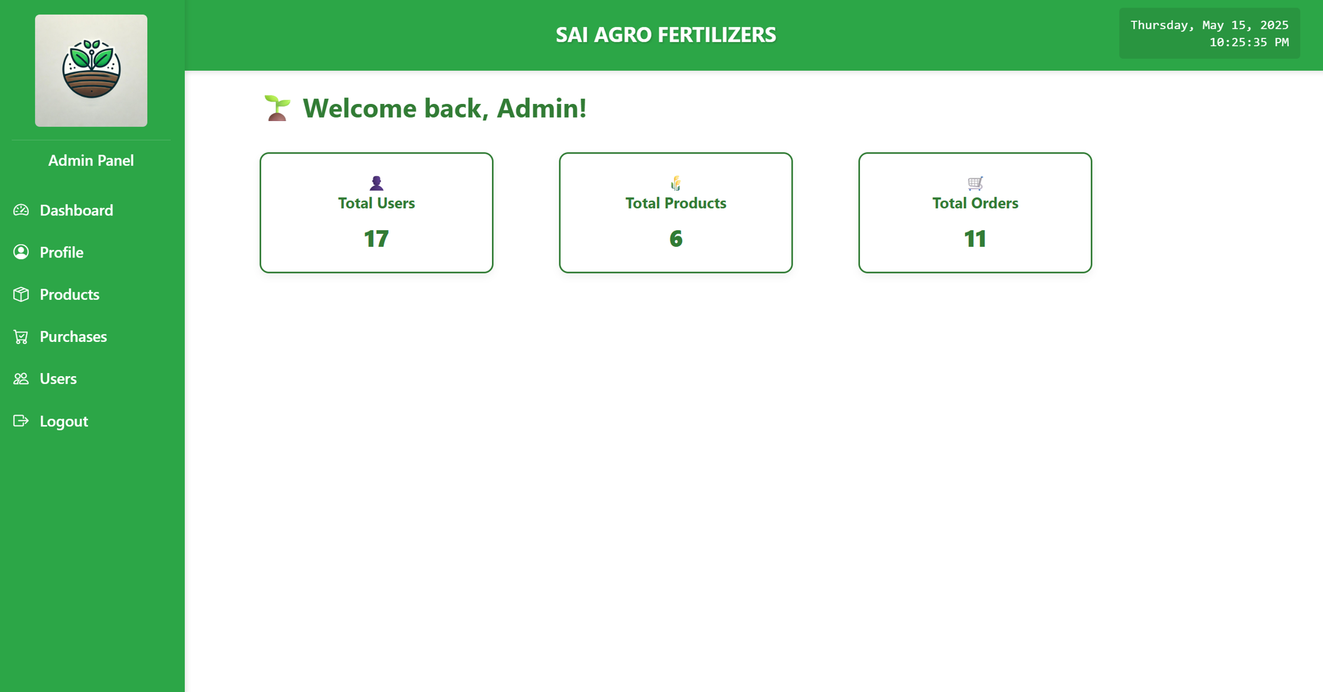
Admin Dashboard

Slide 12
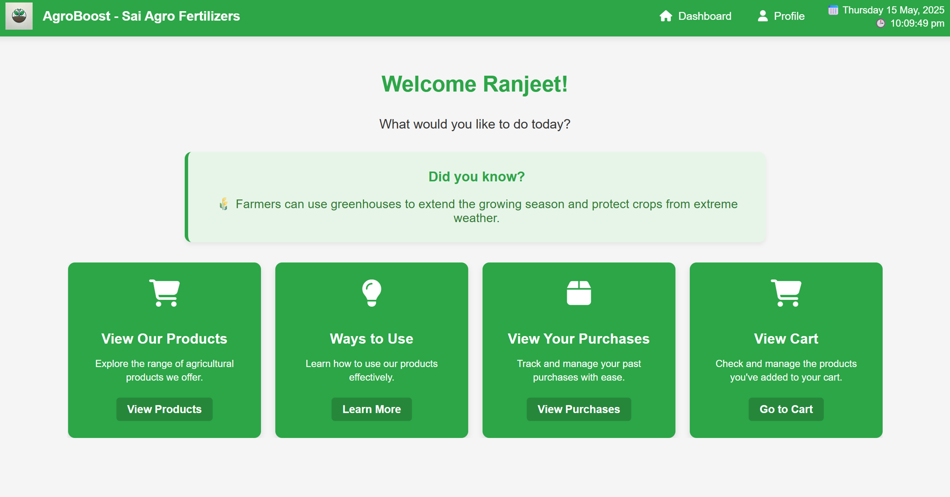
Customer Dashboard

Slide 13

Testing-Rigorous Quality Assurance
1.
Unit Testing
3.
Integration Testing
Individual component verification
Module interaction validation
2.
System Testing
4.
Validation Checks
End-to-end functionality checks
CAPTCHA and form integrity
All major bugs have been resolved, ensuring a stable and reliable platform.

Slide 14

Current Project Limitations
No Live Order Tracking
Customer order status updates unavailable
Quantity Restriction
Product order quantity limited per transaction
No Delivery Service
Customers must pick up orders
No Mobile App
Platform not accessible via dedicated mobile app

Slide 15

Scope-Expanding Project Horizons
New Employee Module
Streamline internal user management
Online Payment Method
Enable secure digital transactions
Enhanced Analytics
Improve reporting and data insights

Slide 16
CONCLUSION
AgroBoost is a client-based agricultural e-commerce platform designed to streamline product and user management for small-scale vendors and provide a simple ordering system for customers. Built using PHP, MySQL, HTML, CSS, and JavaScript, the system allows the client (admin) to add, delete, and update products, manage users, and track and update orders efficiently. Customers can browse available products, place orders online, and then visit the shop with necessary documents for pickup, ensuring transparency and verification. This project successfully blends functionality with simplicity, offering a secure and manageable system for real-world agricultural commerce needs. Future enhancements may include digital payment integration, live order tracking, and farmer-specific logins to scale operations further.

Slide 17
Thank You…

