Slide 1

MyAnimeList

Slide 2
Introduction
MyAnimeList is a professional-grade web application that caters to the needs of anime enthusiasts worldwide.
By offering the ability to create and showcase anime profiles, it provides users with a platform to share their preferences with friends and the larger community.
With its usage, users can easily discover new anime titles and share their ratings and reviews with others.
This user-friendly and precise web application is an ideal solution for anyone seeking to explore the world of anime.

Slide 3
Why is it Implemented?
This web application offers a high degree of flexibility to administrators, enabling them to effectively manage the primary anime database.
It offers comprehensive services to end-users, allowing them to effortlessly access the database and enrich it with additional information.

Slide 4
How is it Implemented?
Entities
AnimeDb
UserDb

Slide 5
Functions in MyAnimeList
AnimeDb
Add: Add a new anime to the database
Update: Update an existing anime in the database
View: View all anime in the database
Delete: Remove an anime from the database

Slide 6
Functions in MyAnimeList
UserDb
Add anime to database with extra fields.
Update anime status (watching, completed, plan to watch, dropped).
View all anime in the database.
Delete an anime from the database.

Slide 7
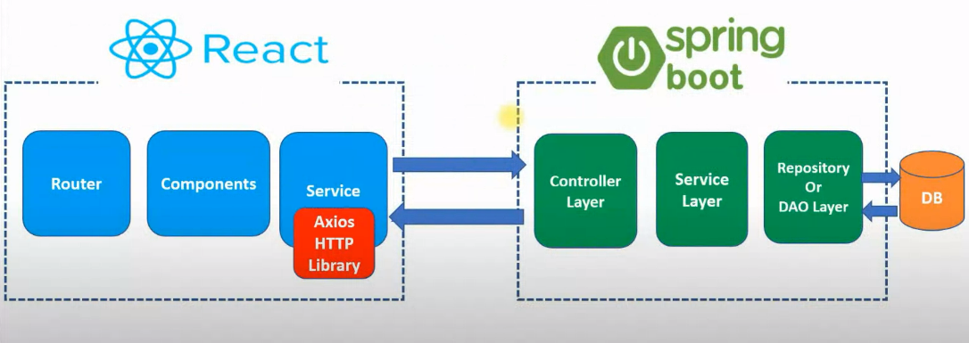
ARCHITECTURE

Slide 8
Design prototype
result table = MyAnimeList
id | anime_name | mal_rating | ranking | total_episodes | eps_progress | user_rating | status
1 | Attack on Titan | 8.52 | 5 | 75 | 10 | 9.5 | WTCG
2 | Naruto | 8.19 | 18 | 220 | 220 | 8.5 | CMPL
3 | One Piece | 8.54 | 2 | 965 | 300 | 7 | DRPD
4 | Demon Slayer | 8.39 | 7 | 26 | 26 | 8 | PTW
5 | Fullmetal Alchemist | 9.23 | 1 | 51 | 51 | 9 | CMPL
entity1 = AnimeDb |  |  |  |  |  | entity2 = USERdb
id | anime_name | mal_rating | ranking | total_episodes |  | id | eps_progress | user_rating | status
1 | Attack on Titan | 8.52 | 5 | 75 |  | 1 | 10 | 9.5 | WTCG
2 | Naruto | 8.19 | 18 | 220 |  | 2 | 220 | 8.5 | CMPL
3 | One Piece | 8.54 | 2 | 965 |  | 3 | 300 | 7 | DRPD
4 | Demon Slayer | 8.39 | 7 | 26 |  | 4 | 26 | 8 | PTW
5 | Fullmetal Alchemist | 9.23 | 1 | 51 |  | 5 | 51 | 9 | CMPL

Slide 9

TOOLs USED

Slide 10
CONCLUSION
With the surging popularity of anime, its fanbase has been rapidly expanding, prompting the need for diverse avenues to satiate their ever-growing appetite for entertainment.
This platform presents anime recommendations and showcases them in a well-structured manner, providing comprehensive information and easy access to reviews.

