Slide 1
Bluemix Hackathon
Providentia Application
Mayur Mahale
Sagar Rivankar
Niranjan Kachhawa

Slide 2
Business Requirement and solution
Business Requirement:
Often when we need to plan our vacation comprising of making an itinerary, we end up googling about the places we plan to visit, consulting several travel agencies and friends to come up with the final detailed plan for our vacation, this ends up being a daunting task for the person who has taken the initiative to do it.
Solution : Travelpedia is a complete travel planning application, that will simplify vacation planning. Thinking on how to reach ? When is the right time to visit a place ? Confused about where to stay ? Searching for tourist attractions & things to do? Travelpedia is THE answer!
A sophisticated application that assimilates all aspects of planning a vacation, Travelpedia is a one stop solution to all holiday planning needs.

Slide 3
Initial scope
Scope :
End to End planning of a vacation/ holiday, including the travel, accommodation & sites(places) to visit.
Recommendation of the ‘optimum’ route for visits(if vacation spans multiple locations).
Suggesting the best tourist attractions(at any place), once the route is finalised. Along with providing expert opinions & reviews about the destination.
Hints at the best time of the year to visit any location(helps in narrowing down the destination choice during any time of the year).
Recommending the best hotels, filtered by custom user preferences(budget & quality), along with expert reviews.

Slide 4
Use cases
User authentication
A user can create his account.
On successful registration he gets an email notification.
User can create a personalized trip
A user must specify his origin, destination and waypoints(max 4 supported).
A user must specify the start and end date of the trip.
User can create an itinerary
A user can view the accommodations available at a location and select one according to his preference based on the budget and the rating.
A user can view the tourist attractions at a particular location and choose the ones he/she plans to visit.
A user can decide on what is the best time to visit a particular place based on the climate preview provided.
A user can see and select the best restaurant available to have a lavish lunch/dinner
Trip summary
A user can see the preview of the itinerary created by him.
A user can either modify or finalize the itinerary.
Share the trip
A user can share the trip created with the community.
Destination search
An unregistered user can search for a particular destination, which provides details like: location info, the best time to visit, user reviews and write a review.

Slide 5
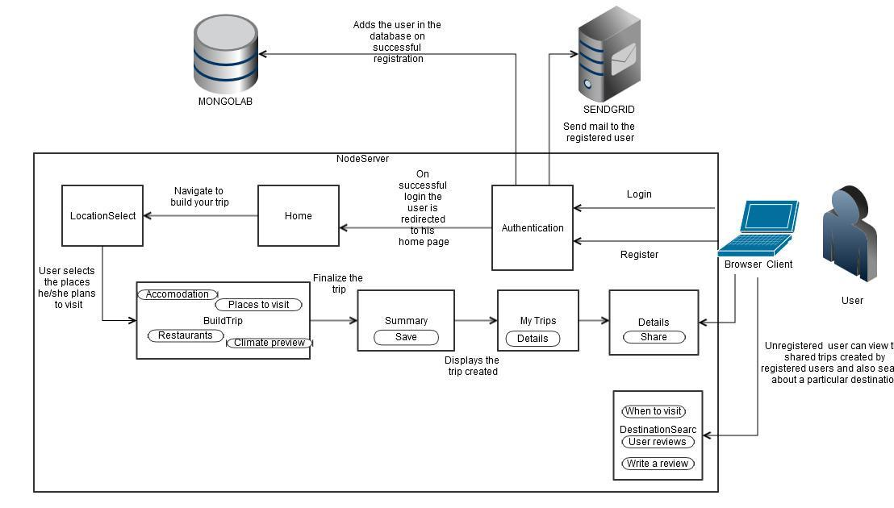
Block diagram

Slide 6
Technologies used
Bluemix Technologies(and rationale behind using them)
Node.js sdk (high performance, fast, npm, active dev community)
MongoLab (schema-less, scalable, no join’s)
SendGrid (email service)
Non-Bluemix Technologies
Mongoose (use the mongodb service)
Bootstrap (responsive UI)
Google Maps Javascript V3 APIs (places library)
Passport.js (Node.js authentication module)
Express.js (Provides node.js middleware)
Weather.com apis (live weather information, with forecast)

Slide 7
How our idea is unique and how can we market it
How is it unique?
Assimilates all aspects of travel planning in one application.
Build your custom holiday trip, handpick individual places.
Support your decision with reviews.
Get all necessary details about any destination at one place.
Places to stay, places to visit, places to eat, when to go ? We answer.
Share your trip with the public community.
Take it to market ?
Current application -- Prototype.
Enhancements:
Integrate with 3rd party apis (with business justification)
Localize destination information for more accuracy
Upcoming trip reminder

Slide 8
Bluemix product experience
Bluemix is a remarkable product.
The notable features include:
Scalability.
Flexibility.
Multi platform support.
Progressive development approach.
Efficient devops services.
Collaborative development.

Slide 9
Working with Rational Team Concert
Installing Eclipse and the Rational Team Concert plug-in
Rational Team Concert requires Eclipse 4.3.2. If you don't have Eclipse 4.3.2, download and install Eclipse 4.3.2 from Eclipse.org.
In Eclipse, go to Help > Install New Software
In the Install window, complete the following steps:
In the Work with field, enter https://jazz.net/downloads/rational-team-concert/5.0/5.0/p2
Press Enter to load the contents of the update site.
Select the Rational Team Concert Client Feature check box.
Select the Group items by category check box
Click Next.
Click on Next. Review the license terms and if you agree to the terms, accept them.
Click Finish to install the plug-in.
If you receive a security warning message, click OK.
If you are required to restart Eclipse, click Yes.
Continued..

Slide 10

Connecting to your DevOps Services projects from Eclipse
You have two options to connect to your projects from Rational Team Concert:
Connect with the Manage JazzHub Projects tool
Accept a Team Invitation
Option 1: Connect with the Manage JazzHub Projects tool
In Eclipse, go to Window > Show View > Team Artifacts.
Click the JazzHub icon to launch the Manage JazzHub
In the Manage JazzHub Projects window, enter your Jazz ID and IBM ID password for authentication to DevOps Services.
Select the DevOps Services projects you want to connect to and click Finish.
Option 2: Accept a Team Invitation
Browse to your project page on DevOps Services.
Click Configure eclipse client on the right side of the project page.
Copy the text for the project invitation.
In Eclipse, go to File > Accept Team Invitation
Paste the copied invitation text, and click Finish.
Enter your Jazz ID and IBM ID password for authentication to DevOps Services.
Now you have connected to your DevOps Services project in Eclipse. Click the Team Artifacts tab and see the new Repository Connection and Project Area
Continued…

Slide 11
Loading code into Eclipse from Jazz SCM
If your project is in a Jazz SCM repository, follow these steps to create a new Repository Workspace and load your components into Eclipse.
In Eclipse, go to Window > Show View > Team Artifacts.
Expand your Project Area to see the Source Control folder.
Select the Source Control folder, right-click, and select New > Repository Workspace
Select the stream you want to flow to. Click Next.
Specify a new name for your repository workspace. Add the word Eclipse in the name. Click Finish.
The tool continues with additional steps. Select Find and load Eclipse projects to load all of the projects from the components in the new repository workspace into your local Eclipse. Click Next.
Select the Eclipse projects to be loaded into your local Eclipse. Click Finish.
If you are working on an existing project with code, click the Package or Project Explorer tab to browse the loaded files, open a file, and edit code.
For more info visit: https://hub.jazz.net/tutorials/clients#working_with_rational_team_concert

Slide 12
Thank You.

