Slide 1
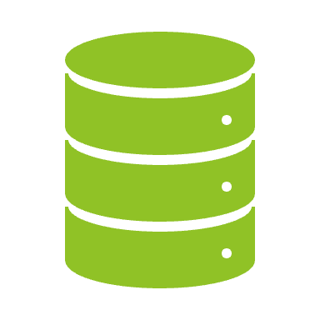
Database Management Tools
By: Mayur Tikar (Data Analyst)
Company: DataSpace

Slide 2

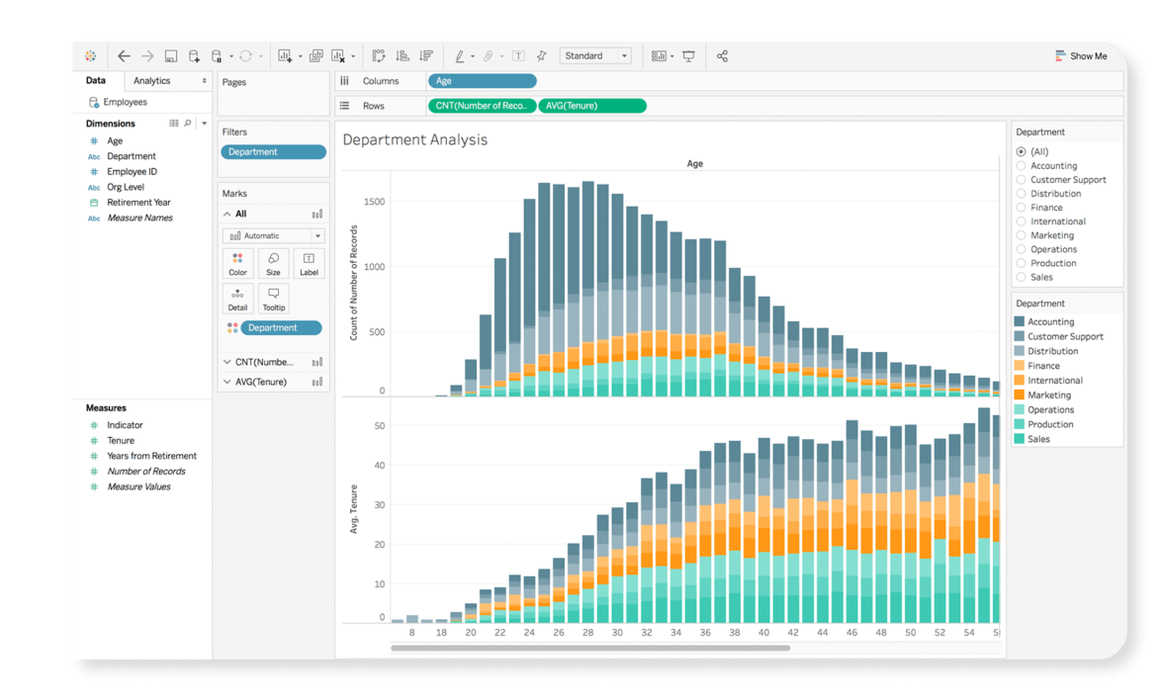
Tableau is visual analytics platform to explore and manage data, to perform analysis and discover trends and patterns, share insights and make data-driven decisions.

Slide 3
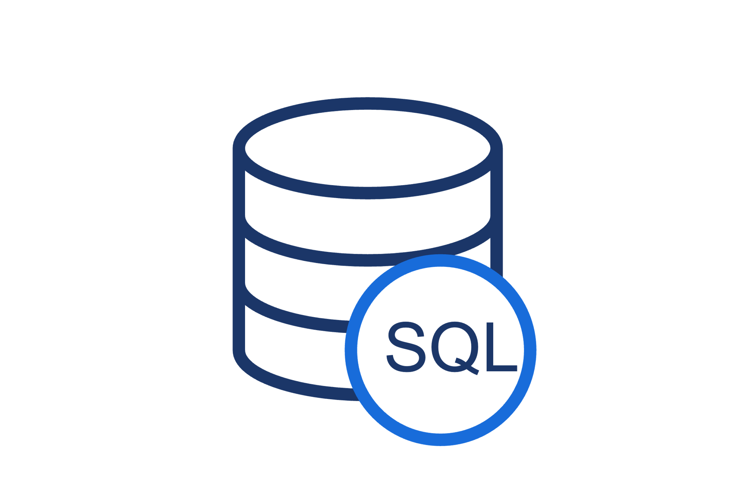
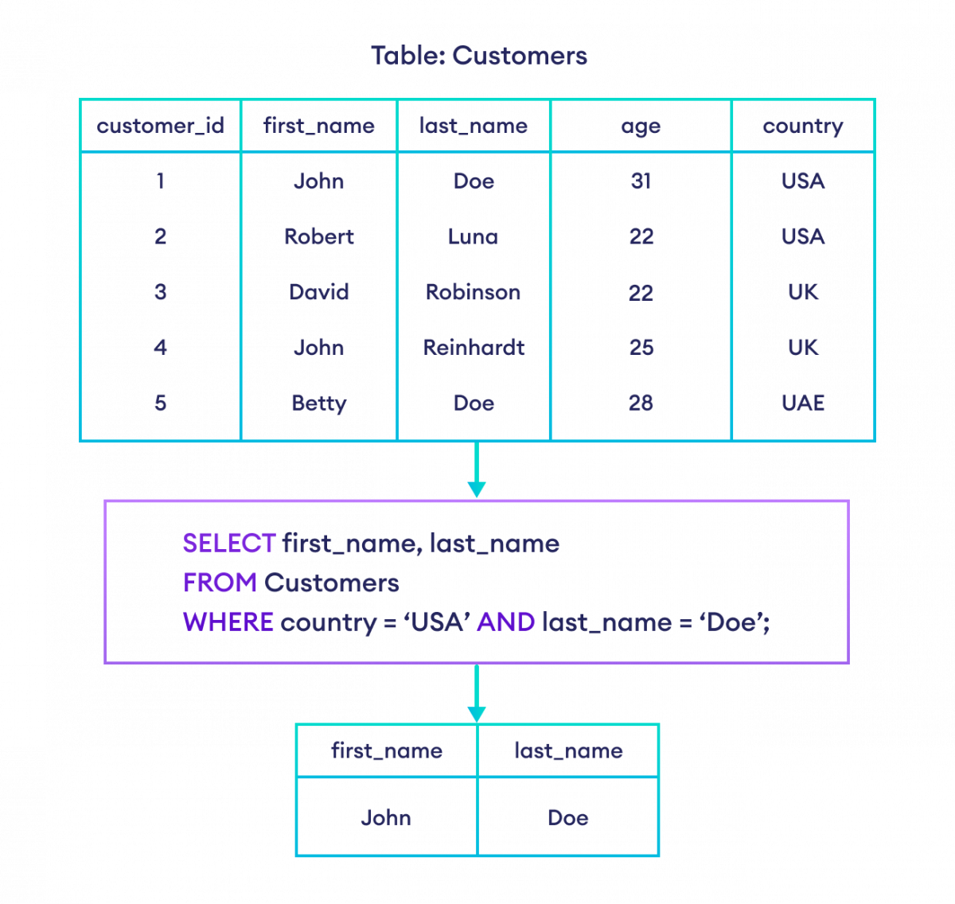
Databases and SQL
Databases are organised, structured files that store information. These database has Fields as columns and Records as rows.
Structured Query Language (SQL) is a programming language for storing and processing information in a relational database.
A relational database stores information in tabular form, with rows and columns representing different data attributes and the various relationships between data values.
SQL statements are used to store, update, remove, search, and retrieve information from the database.

Slide 4

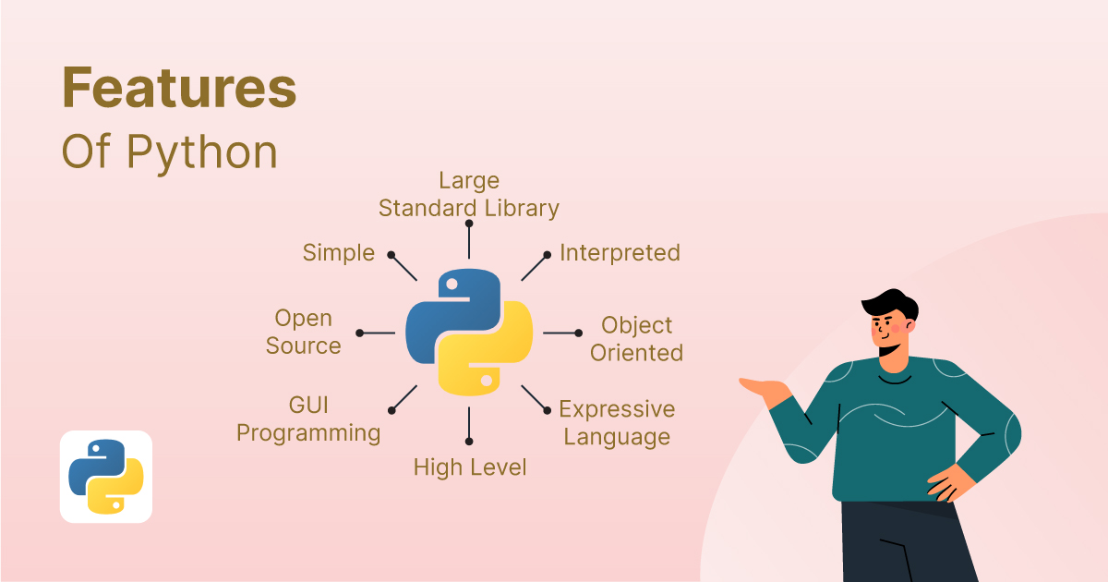

Slide 5
Data Lifecycle
Creation
(Extract, Query, Collect)
Archive
(Monitor, Delete)
Storage
(Transform, Oraganise, Clean)
Visualise
(Reports, Share)
Usage
(Analyse, summarise, create data models)

Slide 6
Data Lifecycle
Each stage of data lifecycle has to go through several supporting disciplines like Requirements, Security, Ethics, Tools and Quality.
If we look at our spreadsheet, it has gone through Storage, Usage, and Visualise.
Data has been provided to us and we have processed the data, performed analysis, and created charts to show our results that will help the business to grow.
Further we can collect data from databases directly from system, load and preprocess the data using Python, visualise data by creating dashboard on Tableau and archive, reuse or delete the data after certain period of time.

Slide 7
Thank you.

