Slide 1

Eco-Cart
Group Members - Mayur Patil (220343120057)
Aniket Pachore (220343120067)
Yash Patil (220343120118)
Bharat Sonar (220343120023)
Project Guide – Mrs. Harshita Maheshwari

Slide 2
Contents
Introduction
Choice of topic
Proposed System
Methodology
Proposed System Model
Proposed Approach
Screenshot
System Requirements
Applications
Advantages & Limitations
Conclusion
Future Scopes
References

Slide 3
Choice of Topic
Promotes Customers to use more eco-friendly products.
Easy & Fast
Product Differentiation

Slide 4
Proposed System
AIM:
Eco-Cart is an eco-friendly and fair trade online shop.
Well-designed and distinguished collection of products that serves different purposes under one roof.

Slide 5
Methodology
The objective is to create a web site that can perform the following:-
Test web applications with HTTP servers (Tomcat).
Create an application capable of creating, retrieving, updating, and deleting (CRUD) client data. The application will consist of a simple Spring Boot RESTful API and a user interface (UI) implemented with the React JavaScript library.
Read the data logically into Seller, Customer and Admin.
Creating a local database.

Slide 6
Proposed System Model
There are three main modules:
Admin Seller Customer
1 Home 1 Home 1 Home
2 Admin Login 2 Seller Login 2 Add Product to Cart
3 Admin Profile 3 Seller Profile 3 View Cart
4 View, Delete Seller 4 Add Products 4 View, Edit Profile
5 View Customer 5 View, Edit, Delete Product. 5 View My Orders
6 View All Orders 6 Log Out 6 Log Out
7 Logout

Slide 7
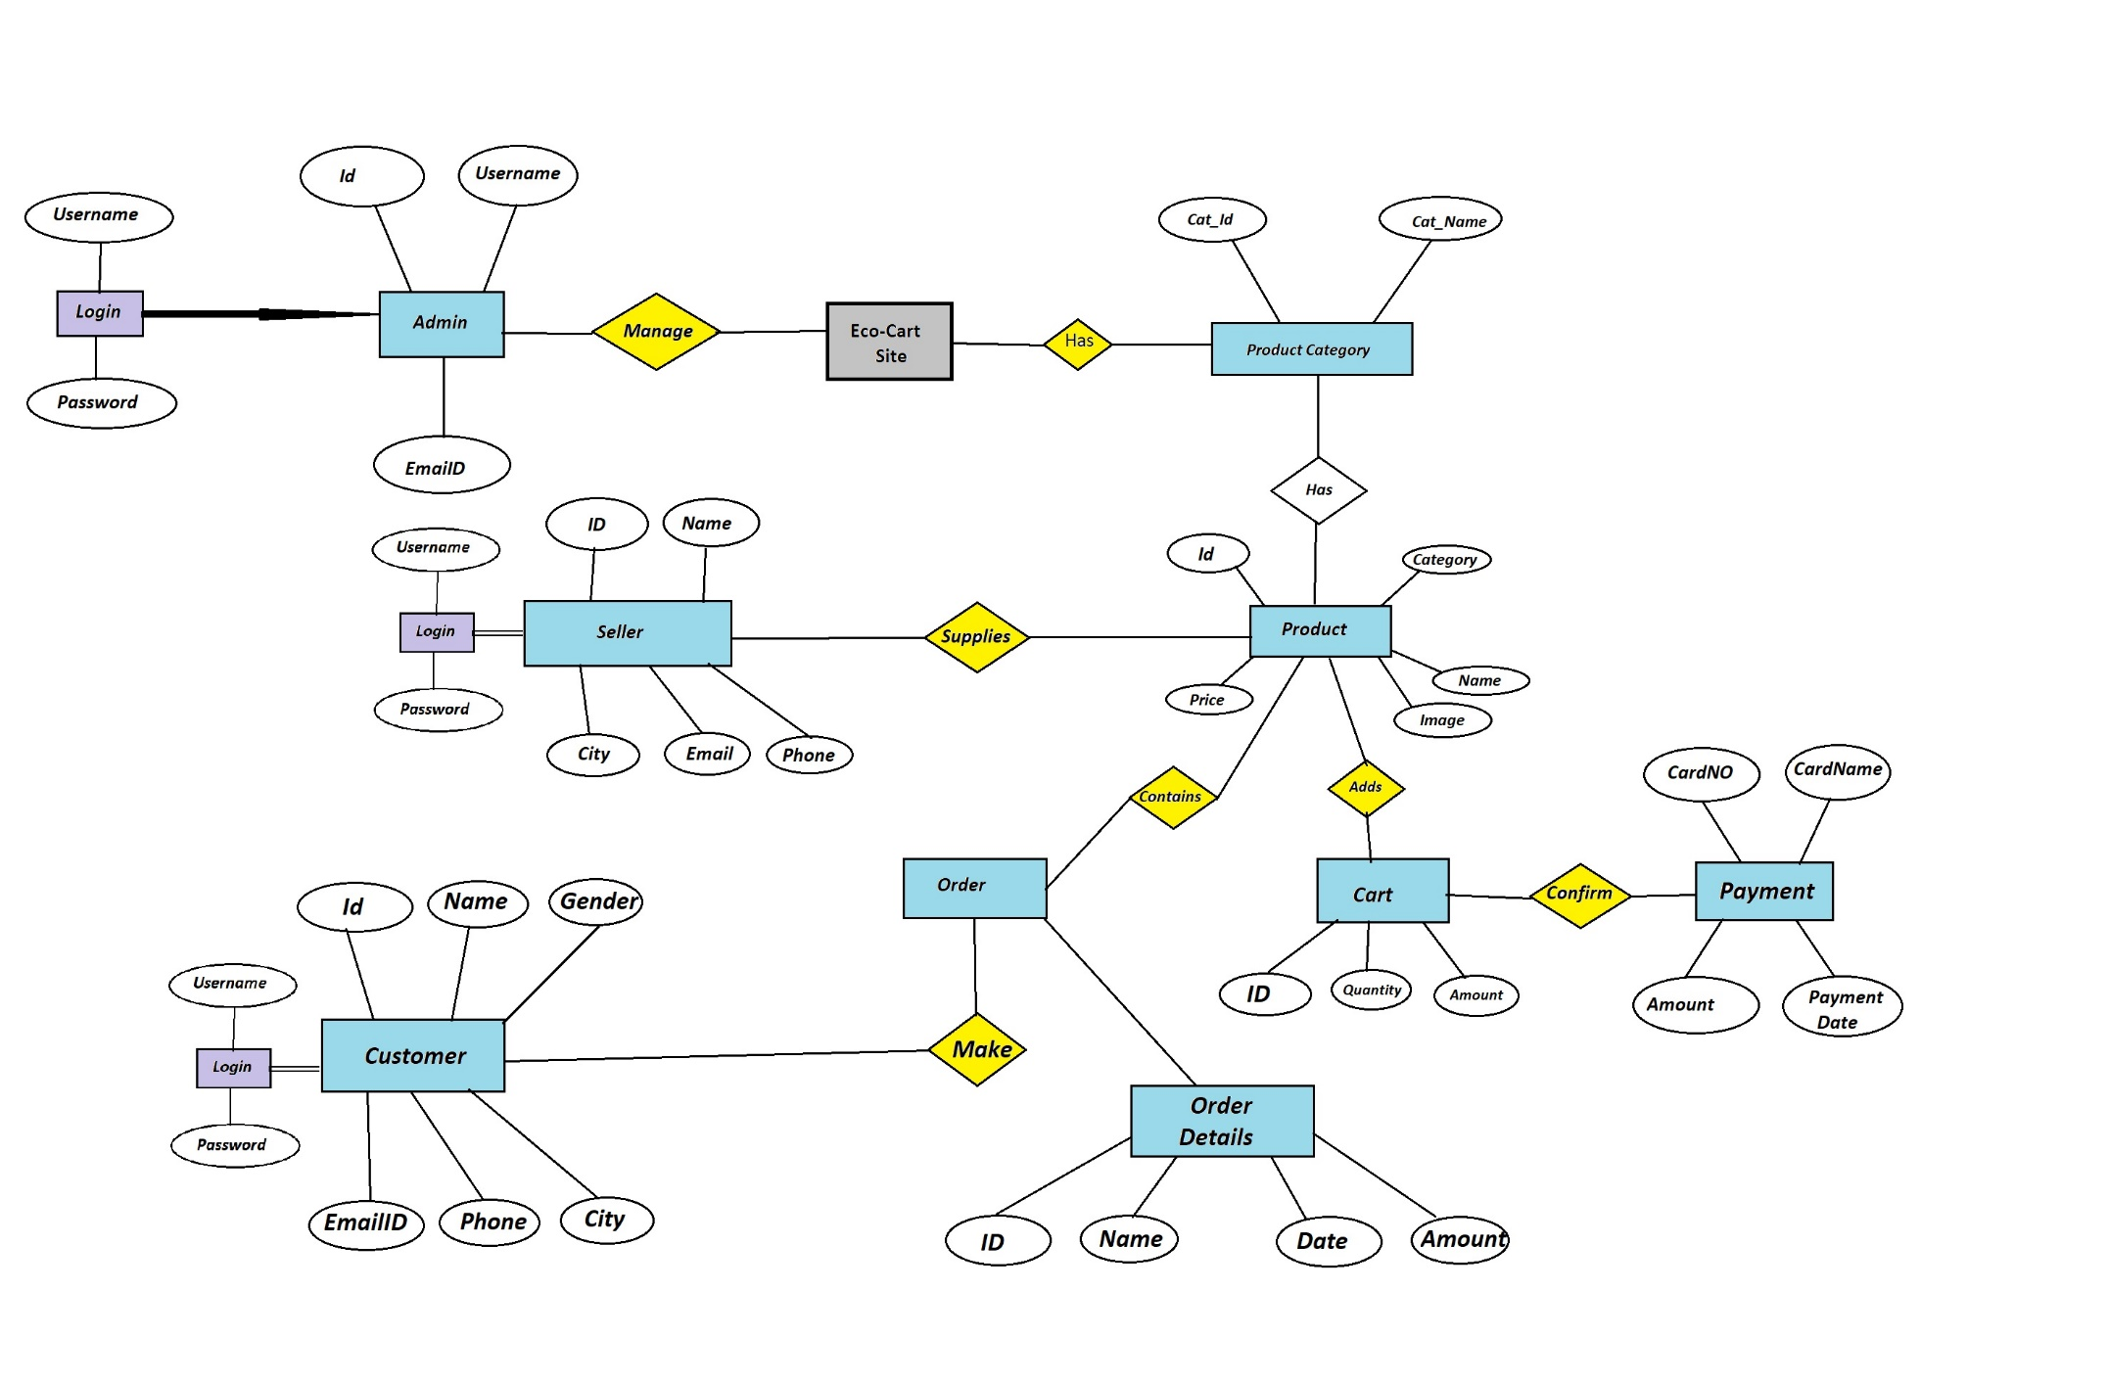
Proposed Approach

Slide 8
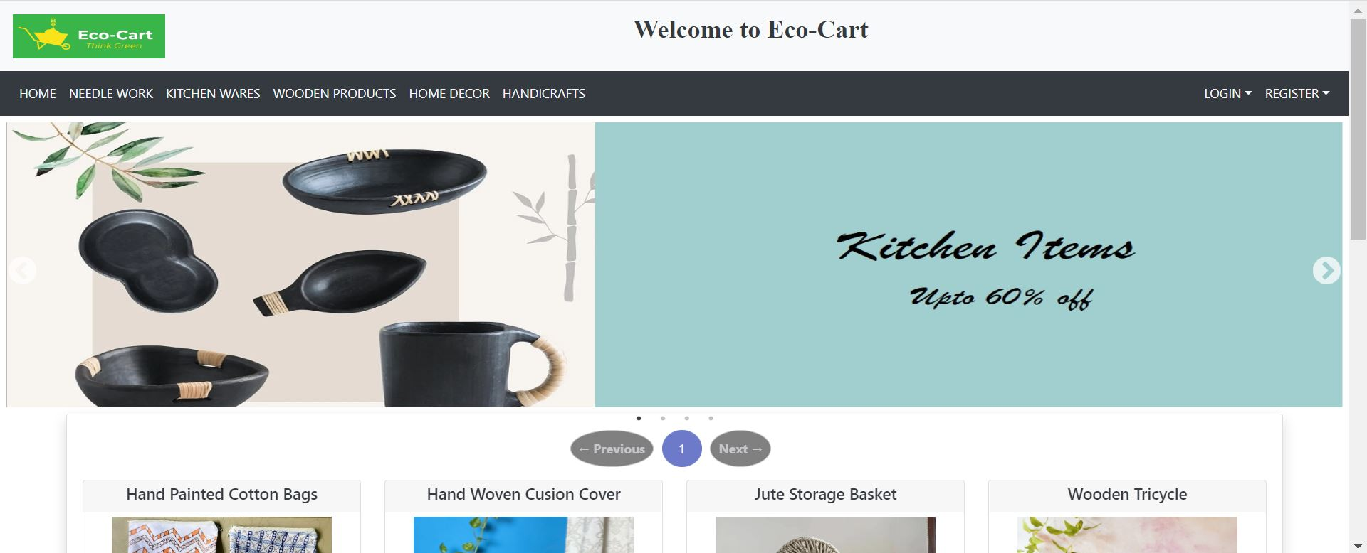
Screenshots
Home Page

Slide 9
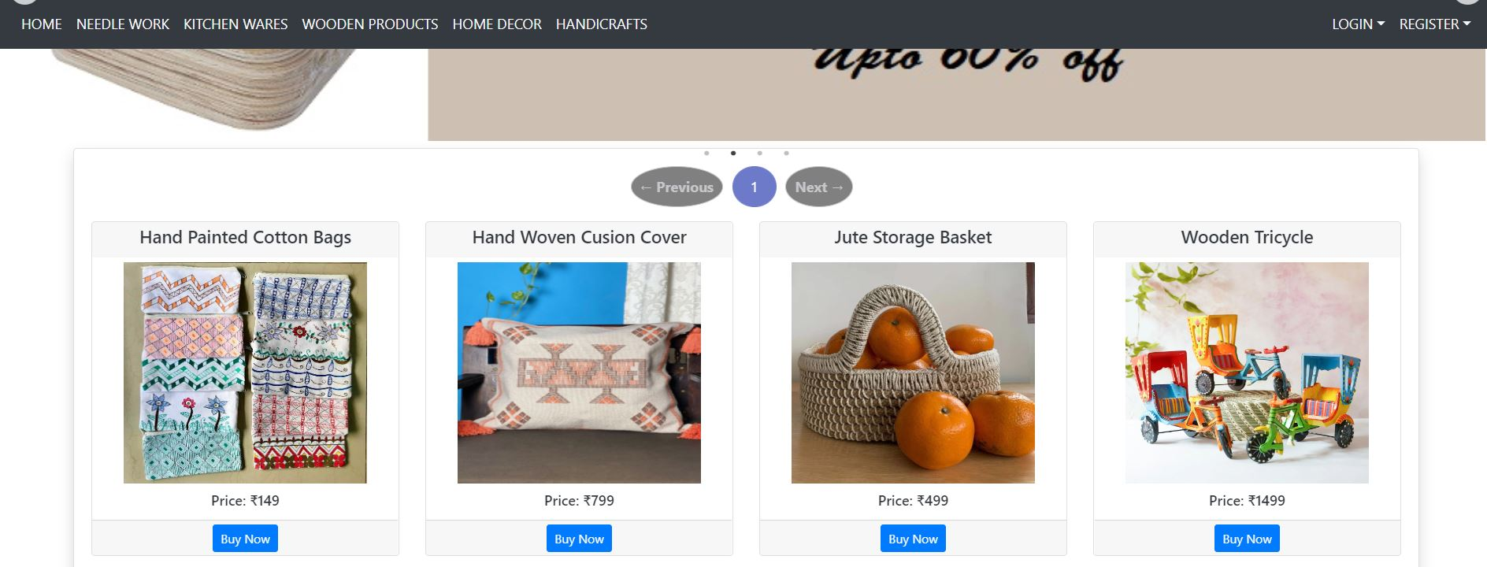

Slide 10
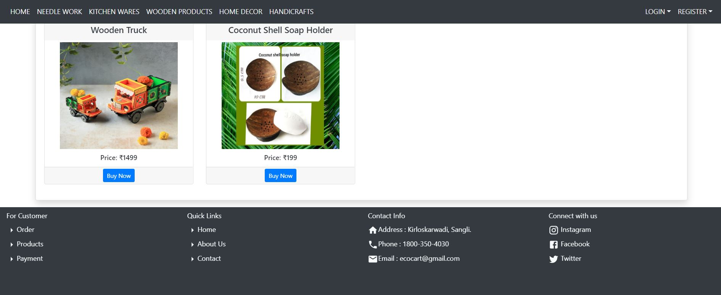

Slide 11
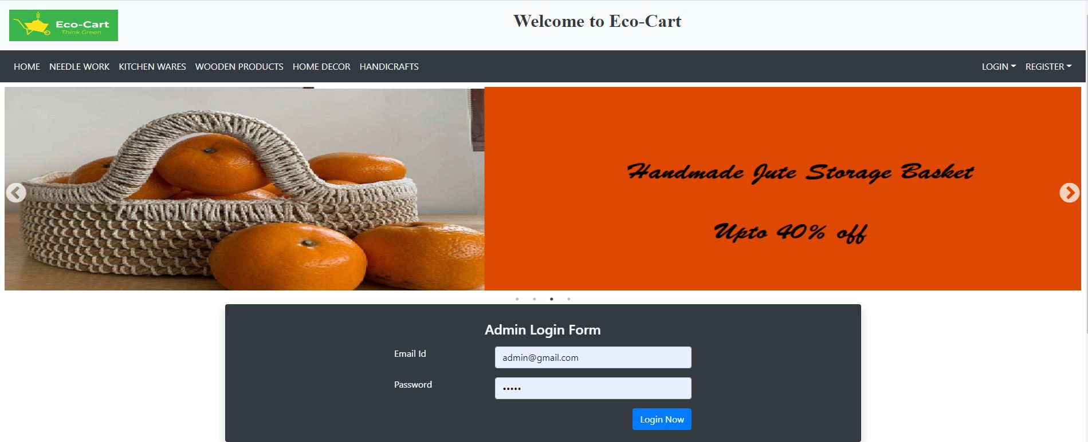
Admin
Admin Login-Page

Slide 12
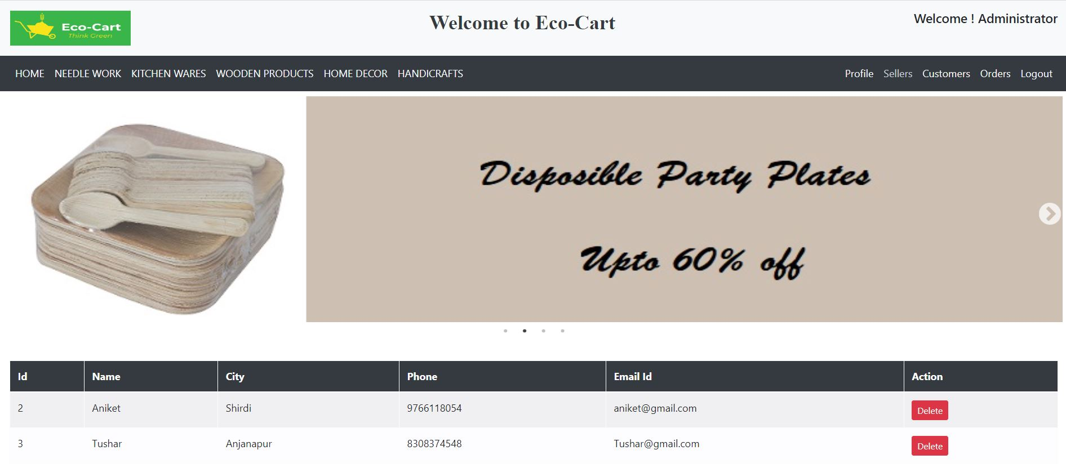
View and Delete Seller from Admin Login

Slide 13
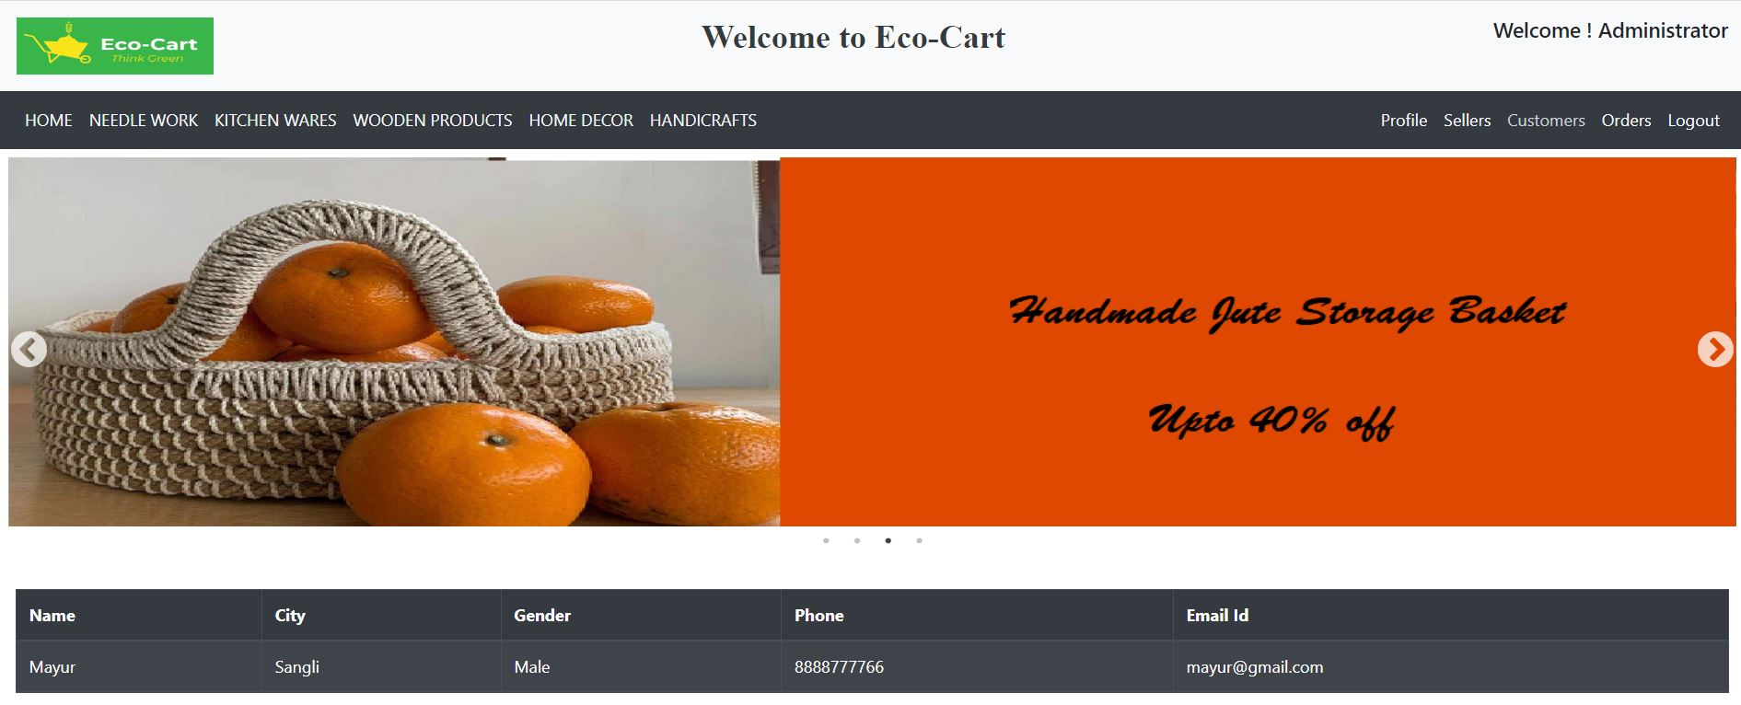
View Customer details from Admin Login

Slide 14
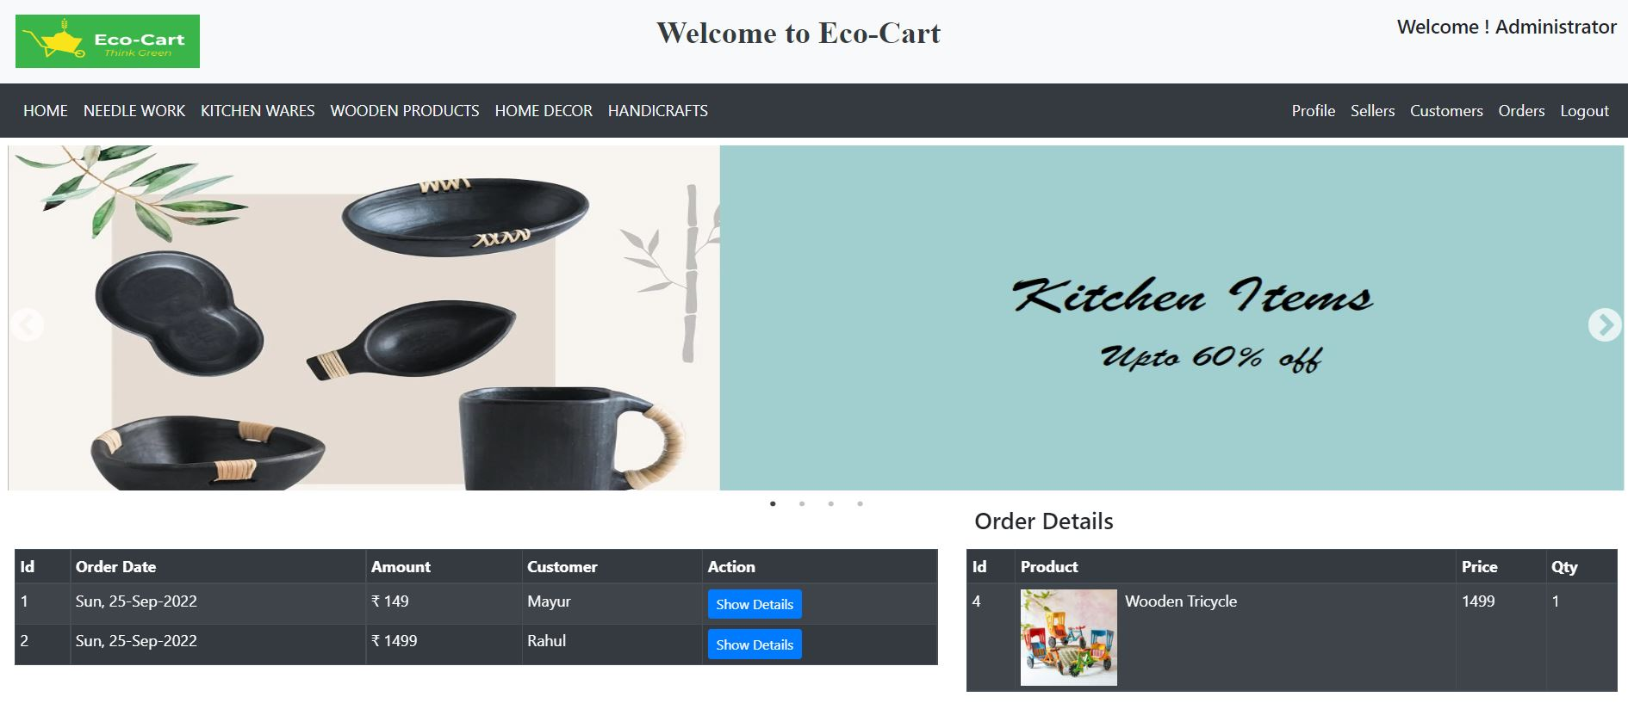
View All Orders made by Customer from Admin Login

Slide 15
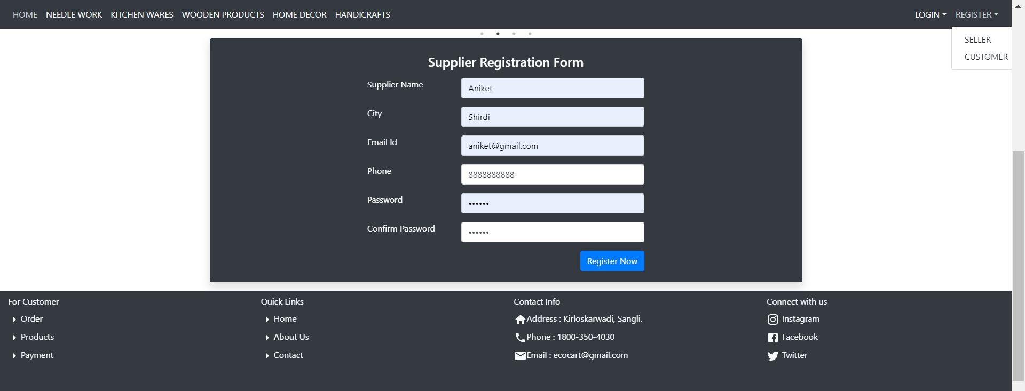
Seller
Seller Registration -Page

Slide 16
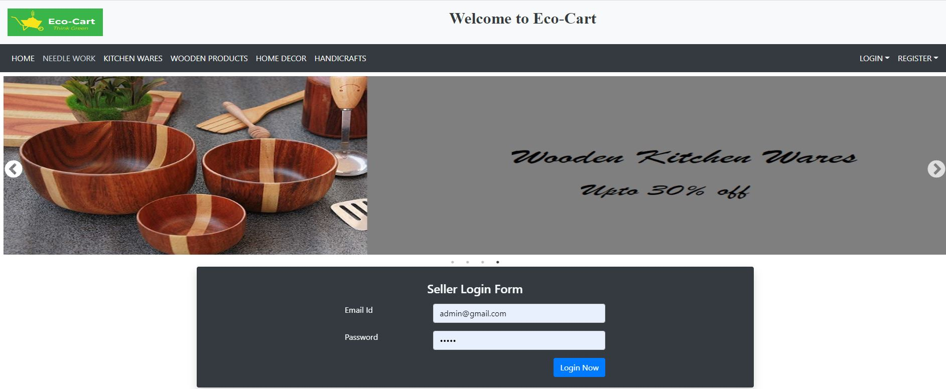
Seller Login-Page

Slide 17
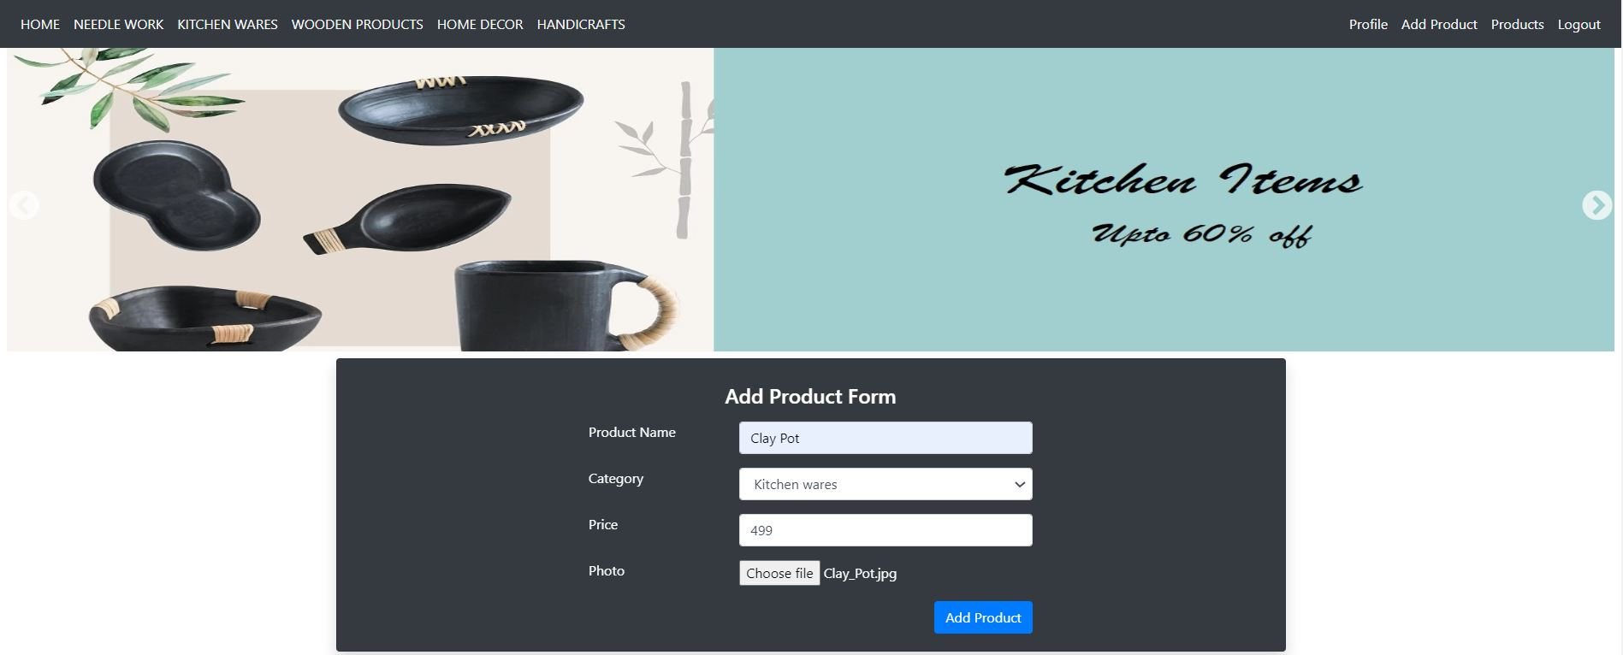
Seller can Add Product from Seller login

Slide 18
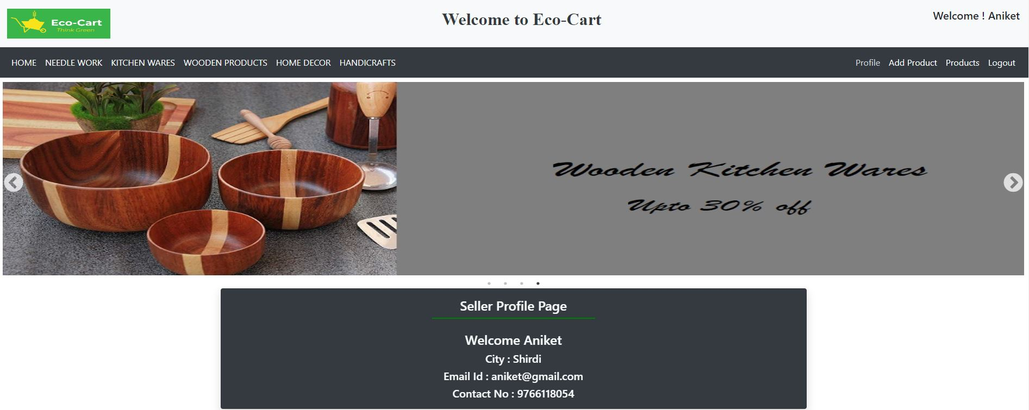
Seller can view his Profile from Seller Login

Slide 19
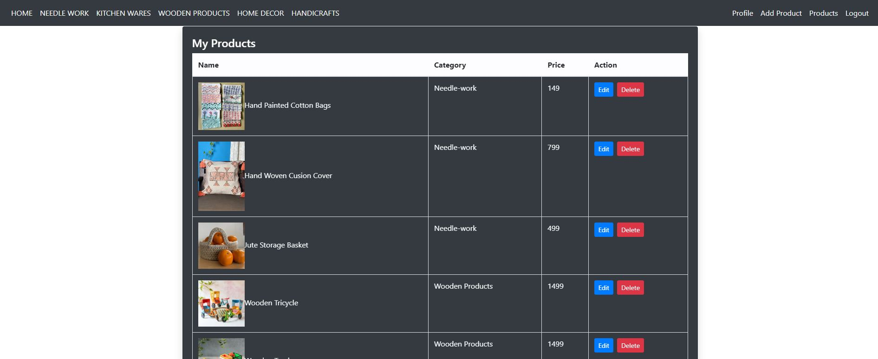
Seller can View/Edit/Delete Products from Seller Login

Slide 20
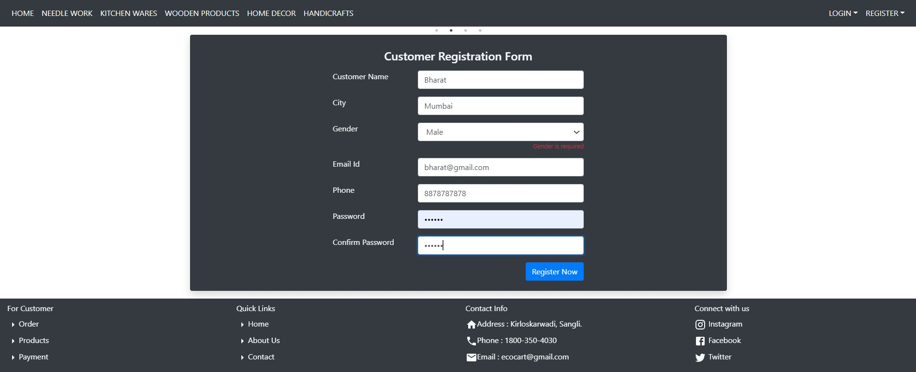
Customer
Customer Registration- Page

Slide 21
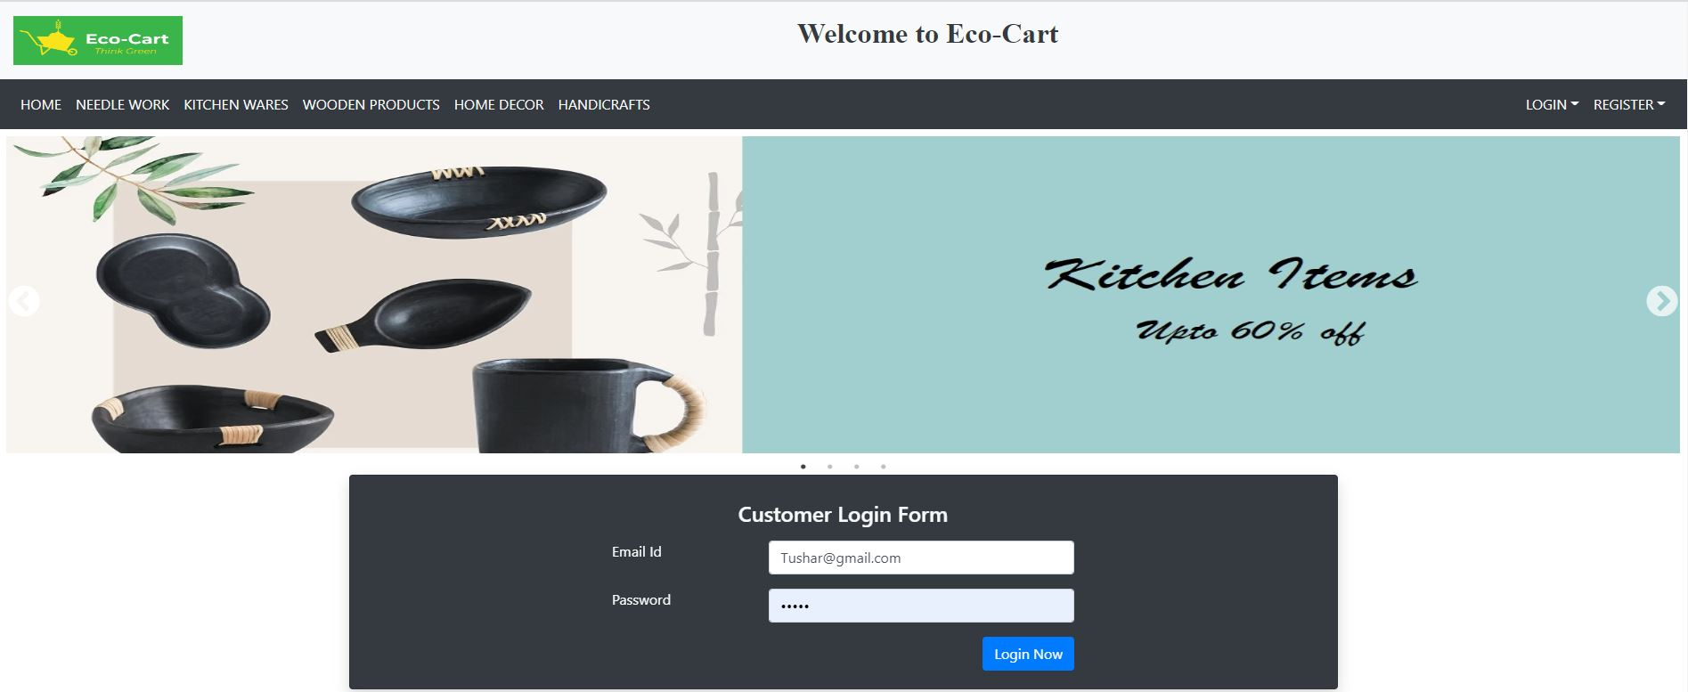
Customer Login- Page

Slide 22
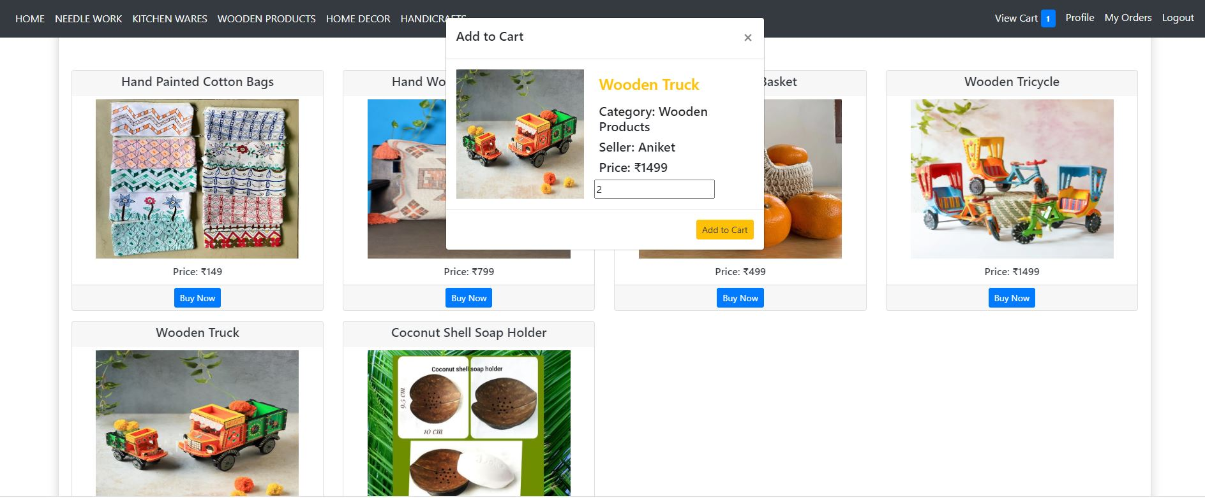
Customer can Add Product to Cart

Slide 23
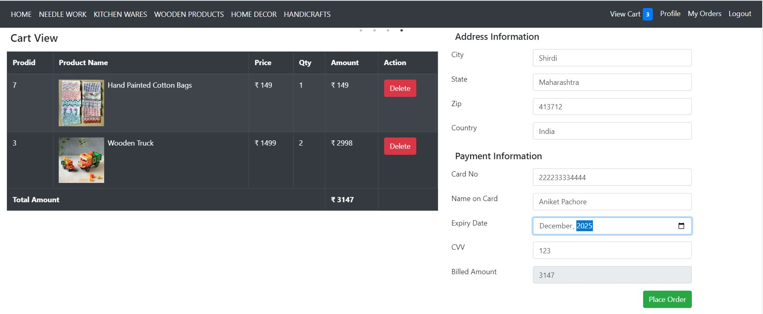
Customer can view his Cart and make the Payment

Slide 24
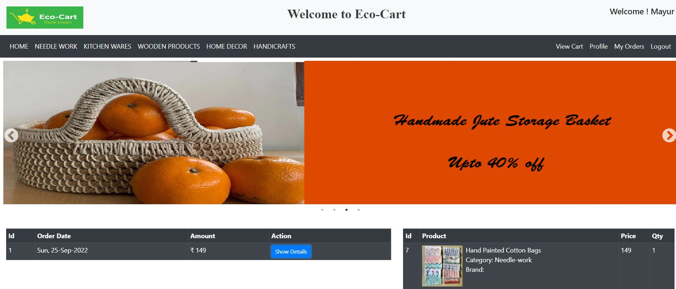
Customer can view his Order Details

Slide 25
System Requirements
Software Requirements:
• Windows (All Versions)
• Tomcat 8.5
• Eclipse, MySQL, VS Code.
Hardware Components:
• Processor – i3
• Hard Disk – 5 GB
• Memory – 1GB RAM

Slide 26
Applications
Implement sustainable shipping.
Reduce packaging.
Create recycling policies.
Reduce energy waste.
Add products that support sustainability
Create an offset service charge at checkout.

Slide 27
Limitations
Accurate verification of the users cannot be done online.
It requires an extensive database and memory.

Slide 28
Conclusion
Sustainable products and packaging are essential to compete in your market, regardless of your industry. Eco-friendly practices not only benefit your consumer, your team, and the environment; they can be effective marketing points to draw customers to your brand.
Consumers want –– and often demand –– eco-friendly products from brands that promote sustainability. Investing in tools and resources that help you prioritize sustainability empowers you to grow your e-commerce business and win the market.

Slide 29
Future Scope
Products with natural and chemical free ingredients.
Products having eco-friendly packaging.
Products can be recycled and reusable i.e. reusable, refillable containers etc.
Efficient products which save energy, water, gasoline and money.
Eco-Friendly materials for your home will benefit your health, comfort, environment and finances.

Slide 30
References
Mr. Saleel Bagde for Database.
Mrs. Harshita Maheshwari for HTML, JS, CSS and React JS also she was our project guide.
https://1worldsync.com
https://www.baeldung.com
A special thanks to Infoway Management who arranged extra lab time for us.

Slide 31
Thank You !

