Slide 1
Name : Mayur Mohan Mate
Roll No : CH19B067
Institute: Indian Institute of Technology, Madras
Linecraft AI ML Internship Taxi fare problem
First step: Understanding the type of problem at hand
The data we have at hand is labelled, and hence this is a supervised learning problem
Moreover, the target variable to be predicted is fare_amount, which is a continuous variable.
Hence this is a Univariate Regression Problem. (Single dependent variable).
Loading the dataset:
Dataset is in csv format hence pandas library is perfect to load the data into a data frame object.
Taking a quick look at the dataset:
Dataset has 60000 rows, with 12 columns. (11 independent and 1 dependent variable)
Doing a quick summary check on the data frame, it is seen that lot of data points have missing values. (They have to taken care of at a later stage).
We have both numerical as well as categorical features.
Also we have date-time strings. These can be parsed and converted to extract time_of_ride.
Based on intuition , I mainly suspect that “trip distance” and “time_of_ride” are the most important features in taxi fare determination.

Slide 2
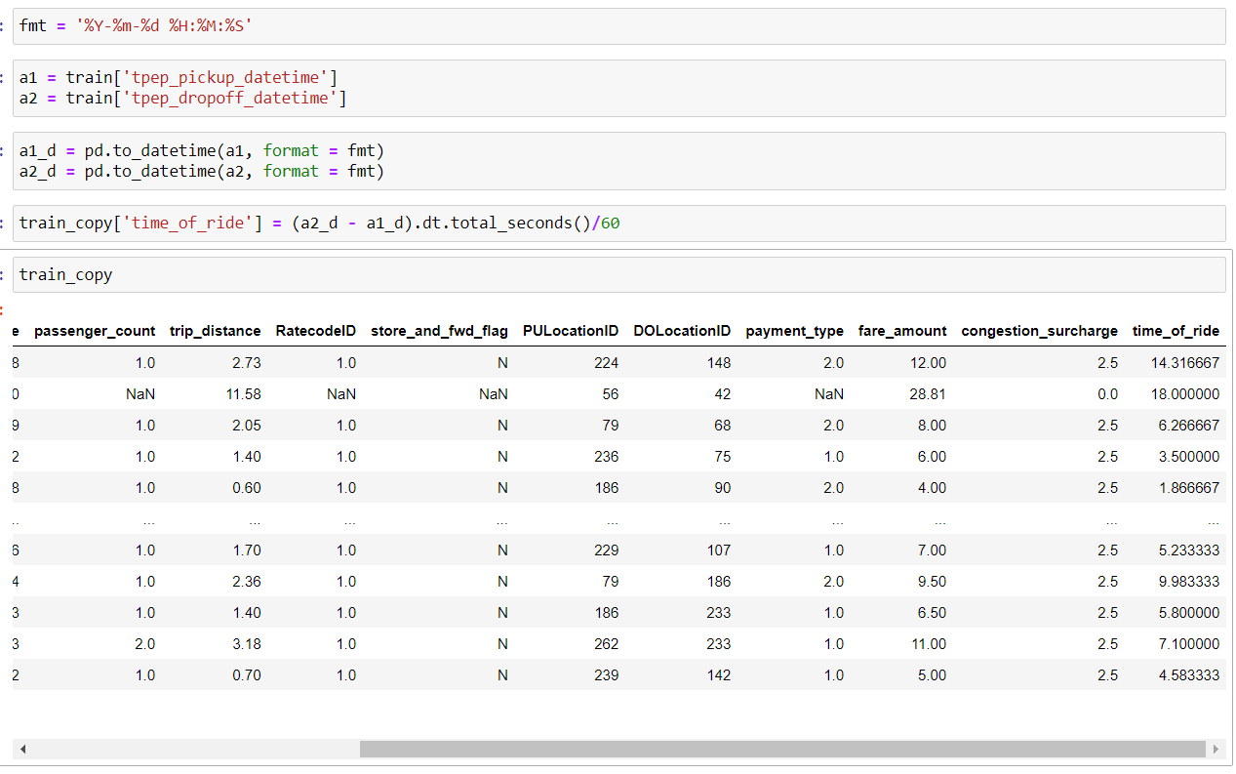
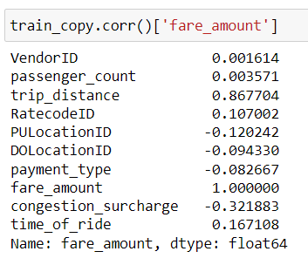
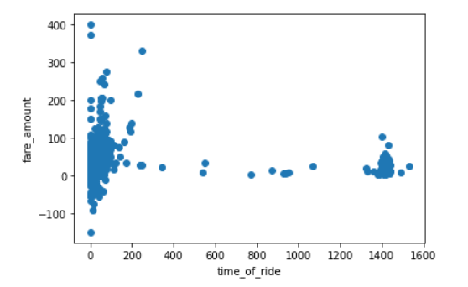
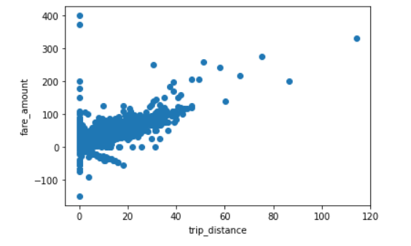
Parsing date time strings to extract time of ride information
Using pandas API , we convert the date time string to introduce a new column “time_of_ride” (in minutes).
Computing the correlation of features with target variable, to measure the extent of linear dependence.
As expected, trip distance is highly correlated with fare_amount.
But contrary to intuition , correlation of time_of_ride seems to be a bit low.
Exploring further the relationship btw trip distance and time_of_ride by plotting a scatter plot against fare_amount
Noticing some problems.
1.Negative fare values.
2.High fare values, for near to zero time_of_ride
3.High fare values, for near to zero trip_distance
4.Unexpectedly low fare values for really high time of ride.

Slide 3
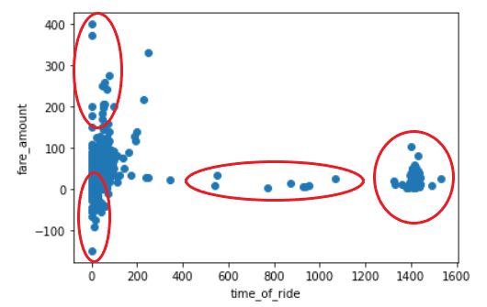
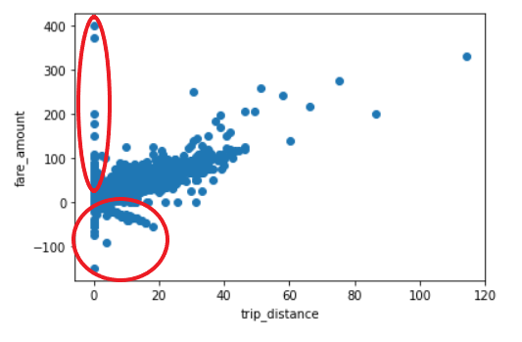
Data Exploration and Cleaning
On further investigation , it is also seen that some data points have 0 fare value, yet they do not belong to the “No Charge” category.
Negative fare could be due to several reasons, such as company refunding money due to some mistake or maybe dispute with the customer or an accident. The features in the dataset do not contain complete information required to decide negative fare amount and hence I remove those points.
Data points where fare is reported 0 , but category does not belong to “No charge” and time of ride is non zero are removed.
Data points where time of ride was 0, and the fare amount exceeded congestion surcharge were removed.
Data points with 0 trip distance and non zero fare were examined. Manually some suspicious and outlier points were removed.
Data points with time of ride greater than 1200 mins were examined.
Since the number of data points were low, they were examined manually and suspicious and outlier points were removed.
Data points with payment type 3 and non zero charge were examined and removed.
Some points with 0 passengers were also present. Some of these data points had heavy charge. Couldn’t figure out the reason for that. Points where charge matched the congestion surcharge were kept and others were removed.
Rate code 99 was seen in dataset. (Feature desc only mentioned 1 to 6). Since 99 was also present in test dataset, did not remove it, but assumed it to be RatecodeID 6. Still a lot of Null data was left. Took a decision to impute them.

Slide 4
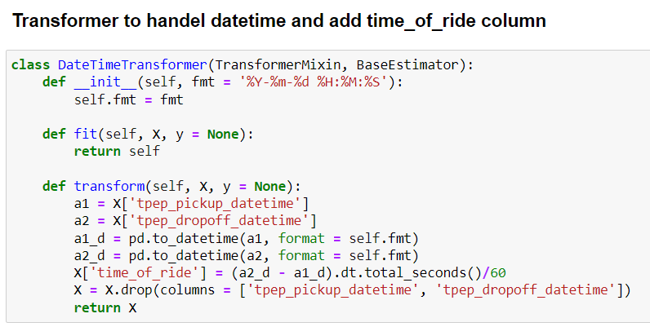
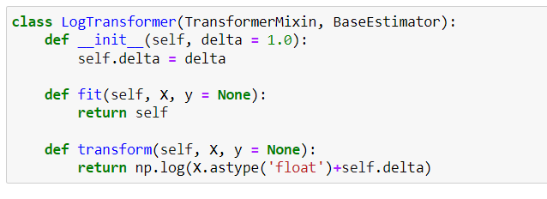
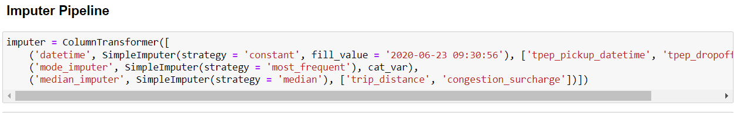
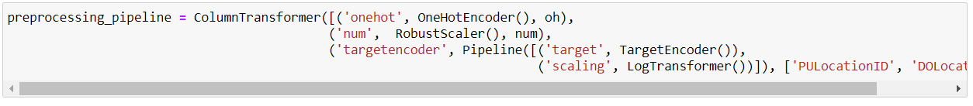

Model Building
Data has both numerical and categorical columns. Before feeding it to the model, a pre-processing pipeline has to be made, to ensure proper imputation of missing values and feature scaling and encoding.
Although congestion charge seemed categorical , since it can change and take up any real value, it was treated as a numerical value.
Categorical columns were imputed using mode strategy and numerical columns with median(due of presence of outliers).
Except for PULocationID and DOLocationID, other categorical features were one hot encoded. Since these two features had lots of levels, used Target Encoding strategy instead.
Several scaling methods such as Standard Scaling, Robust Scaling, Log Transformation, Power Transformation etc. were experimented with. Robust Scaling worked the best. Even when the features were skewed, Log Transformation worsened the performance of the model.
For transforming the date time strings to time of ride, a custom transformer was defined.
Imputation pipeline to properly impute each feature was also defined, followed by a pre-processing pipeline which appropriately scaled and encoded the features.
Complete input pipeline consists of the imputation and the preprocessing pipeline

Slide 5
From the zone information provided with the dataset, it was clear that this dataset belongs to New York taxi system. From the information provided on the internet, it was revealed that the fare is not decided by the number of passengers. This feature was experimented with and provided no drop in performance after it’s removal. Hence it was removed.
Other features were similarly fiddled with. Storeandfwd with passenger_count did not lead to a drop is performance after their removal and hence were permanently removed.
Several models were tested. These are the results.
Model | Training Perf(R^2) | Validation Perf(R^2)
OLS Regression | 0.9088 | 0.9144
LinearSVR | 0.9031 | 0.9122
Random Forest | 0.9404 | 0.9253
GradientBoostedTrees | 0.9572 | 0.93281
Adaboost (Decision Tree) | 0.9070 | 0.877
VotingRegressor | 0.9369 | 0.9286
Neural Network (ANN) | 0.932 | 0.9321
Gradient Boosted Trees was finally chosen.
Predictions on the test dataset were computed and joined to the test_iitm_data.csv

