Slide 1
UBUNTU
INSTALLATION

Slide 2
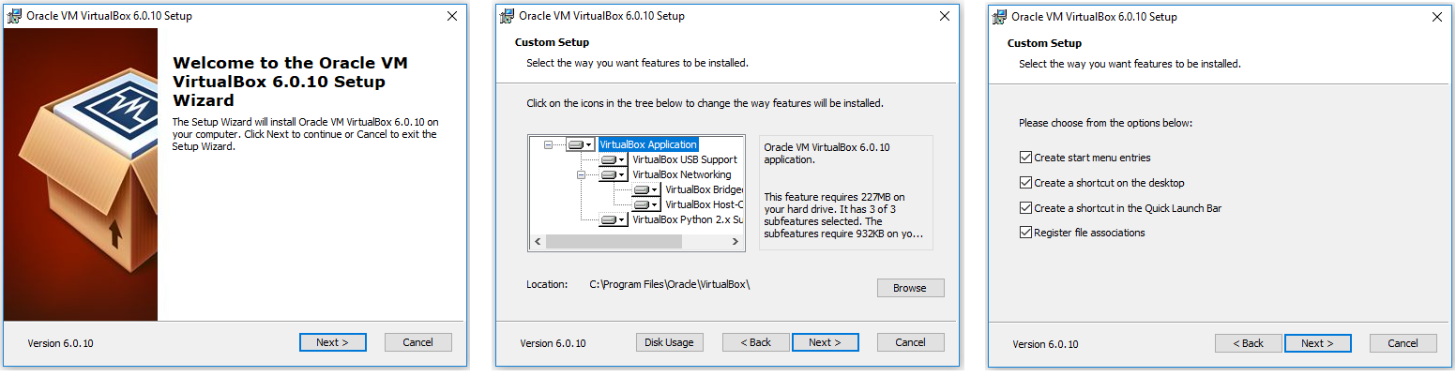
Phase 1: Install VirtualBox
https://www.virtualbox.org/wiki/Downloads

Slide 3
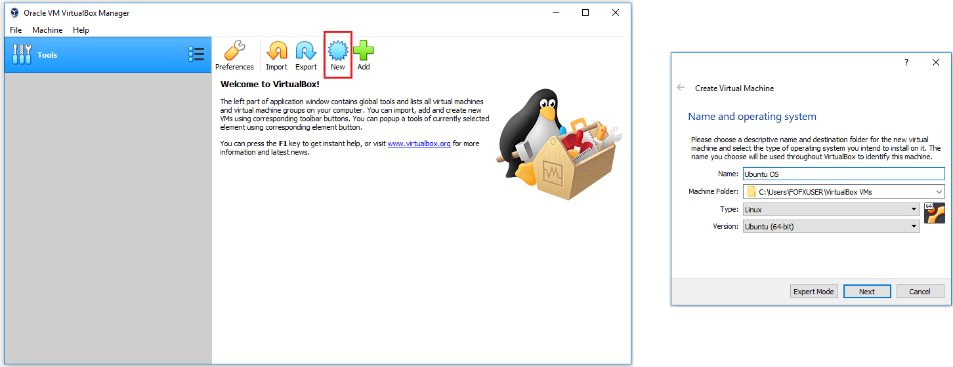
Phase 2: Create an Ubuntu Virtual Machine
https://ubuntu.com/download/desktop

Slide 4
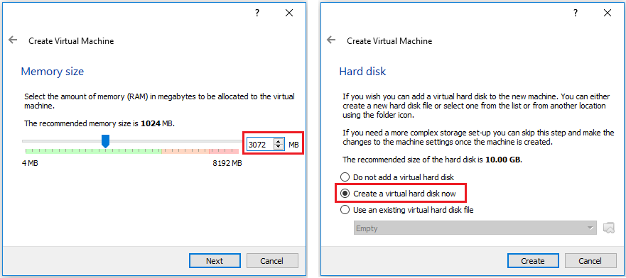

Slide 5
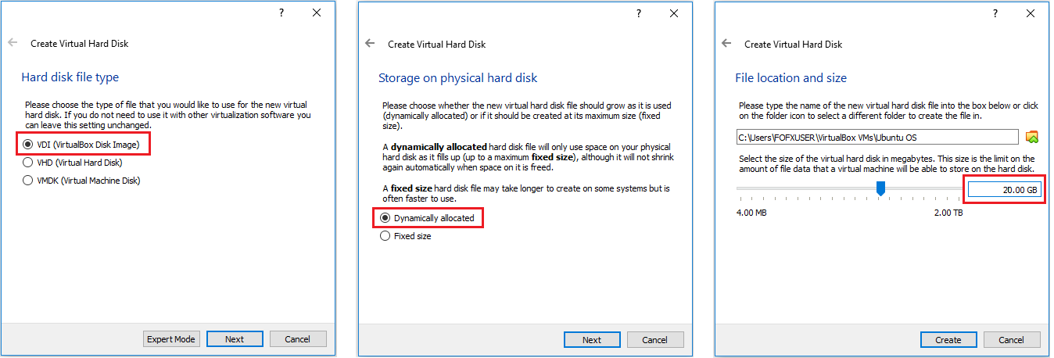

Slide 6
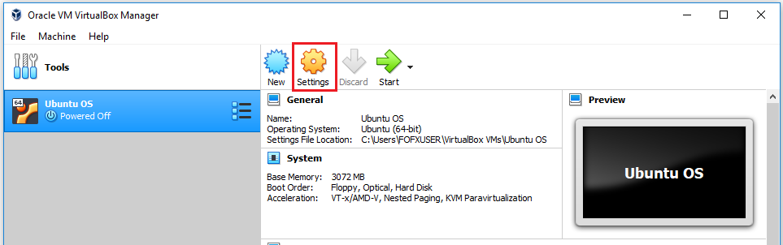
Phase 3: Configure Settings for the Virtual Machine

Slide 7
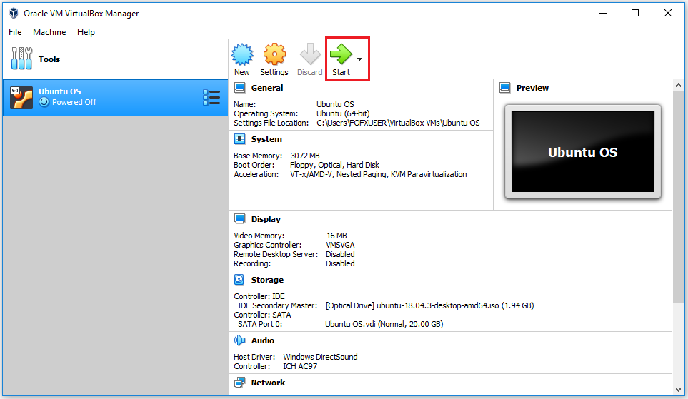
Phase 4: Install Ubuntu on the Virtual Machine

Slide 8
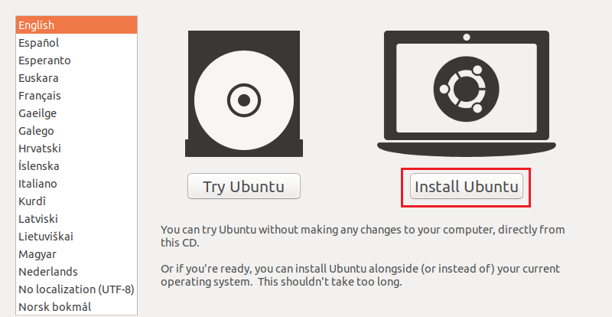

Slide 9
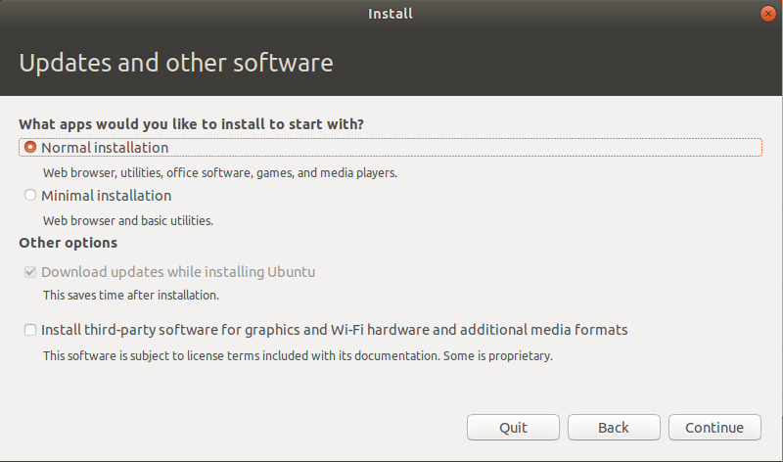

Slide 10
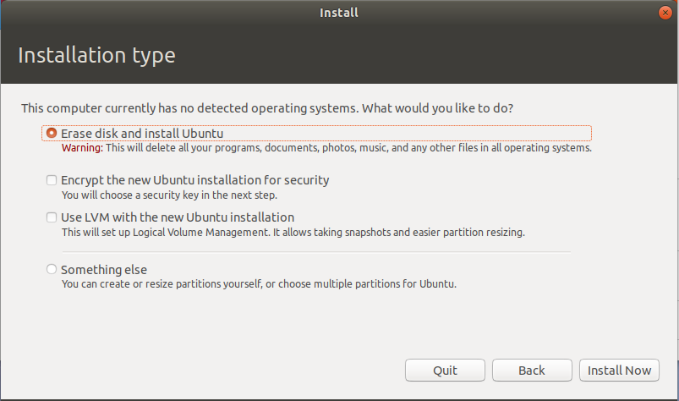

Slide 11
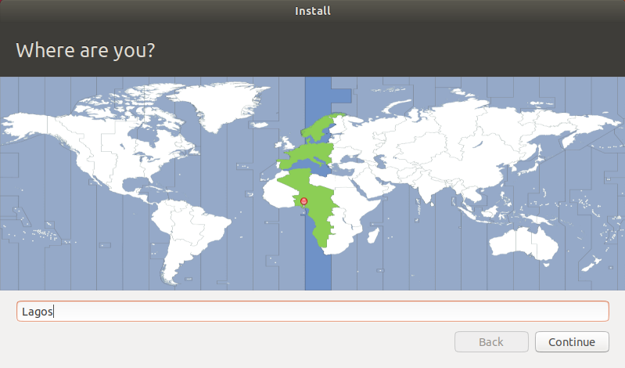

Slide 12
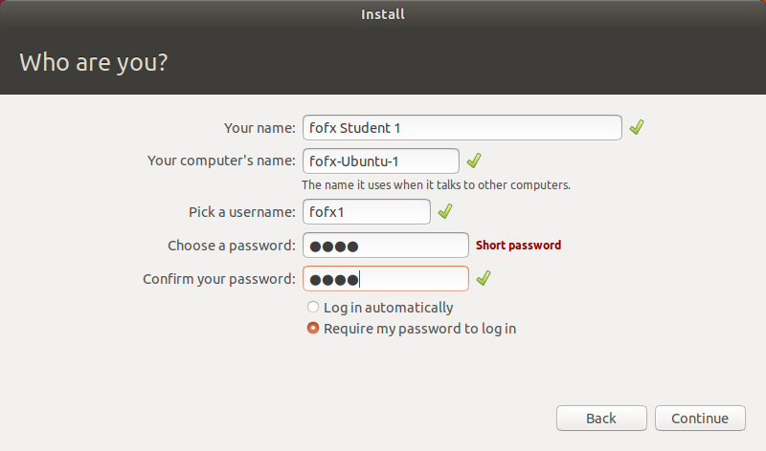

Slide 13
