Slide 1


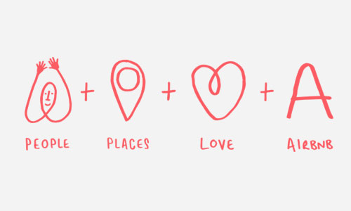
Introduction to Airbnb
History of Airbnb

Slide 2
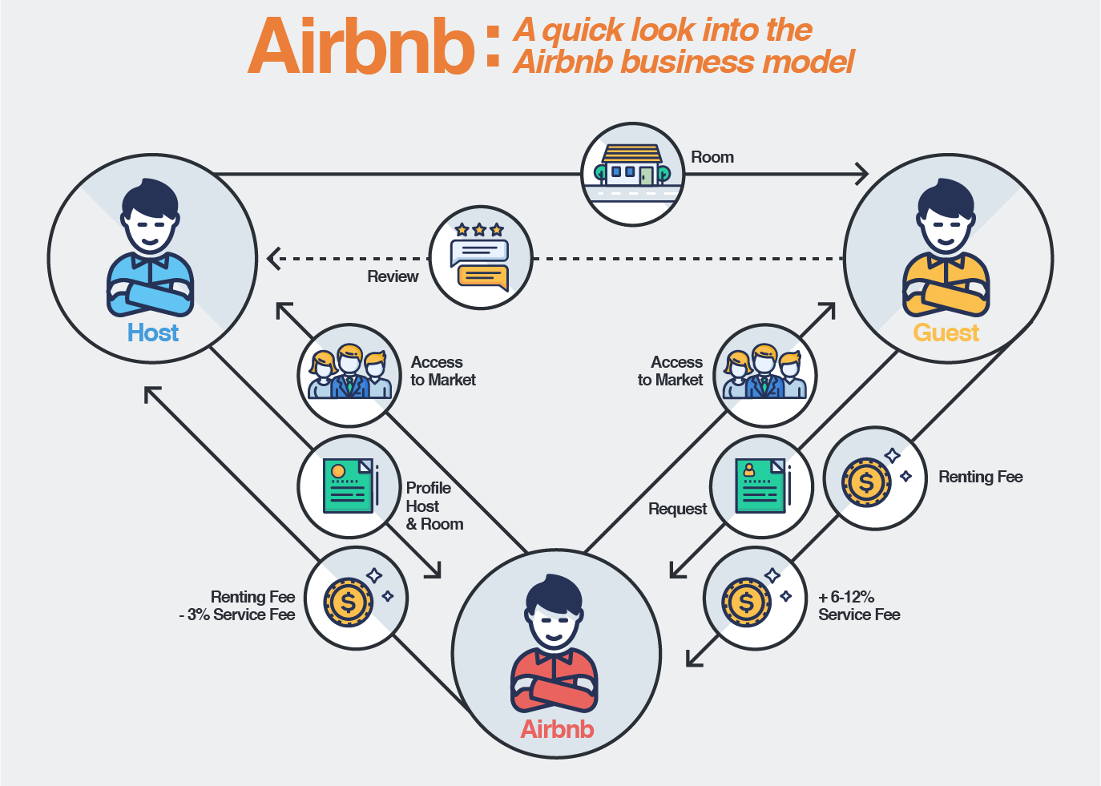
Airbnb Business Model
Growth of Airbnb
Advantages
Disadvantages
Unique Selling Proposition(USP)

