Slide 1

Game Analysis Project using SQL
SQL (Structure Query Language)
001

Slide 2
Overview
This project aimed to analyze player data from a gaming database using MySQL. The dataset included player details and level details, containing information such as player ID, device ID, game levels, scores, and kill counts. The objective was to derive insights and answers to specific questions using SQL queries, focusing on player performance, progress, and gameplay statistics

Slide 3

Understanding the database
001
002
003
004
Entity Relationship Diagram (ERD)
level_details
 | p_id: INT
 | dev_id: VARCHAR
 | start_datetime: DATETIME
 | stages_crossed: INT
 | level: VARCHAR
 | difficulty: VARCHAR
 | kill_count: INT
 | headshots_count: INT
 | score: INT
 | lives_earned: INT
player_details
 | p_id: INT
 | player_name: VARCHAR
 | l1_status: INT
 | l2_status: INT
 | l1_code: VARCHAR
 | l2_code: VARCHAR

Slide 4
Project Objectives
001
002
To
analyze
player
Behavior and performance in
the gaming environment by writing SQL queries to extract relevant insights from the dataset
You can describe the topic of the section here
001
002
003

Slide 5

Analysis
SQL Queries

Slide 6
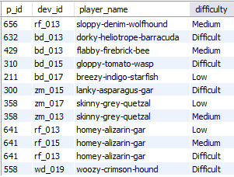
Task 01
Extract `P_ID`, `Dev_ID`, `PName`, and `Difficulty_level` of all players at Level 0.
Result Preview
SELECT pd.p_id, dev_id, player_name, difficulty
FROM player_details AS pd INNER JOIN level_details AS ld
ON pd.p_id = ld.p_id
WHERE pd.level = 0;

Slide 7

Task 02
Find `Level1_code`wise average `Kill_Count` where `lives_earned` is 2, and at least 3 stages are crossed
SELECT l1_code, AVG(kill_count) AS avg_kill_count
FROM level_details
INNER JOIN player_details ON player_details.p_id=level_details.p_id
WHERE lives_earned = 2
AND stages_crossed >= 3
GROUP BY l1_code
ORDER BY avg_kill_count DESC;
Result Preview

Slide 8

Task 03
Find the total number of stages crossed at each difficulty level for Level 2 with players using `zm_series` devices. Arrange the result in decreasing order of the total number of stages crossed.
SELECT difficulty,
SUM(stages_crossed) AS total_stages_crossed
FROM level_details
INNER JOIN player_details
ON player_details.p_id = level_details.p_id
WHERE level = 2
AND dev_id LIKE 'zm%'
GROUP BY difficulty
ORDER BY total_stages_crossed DESC;
Result Preview

Slide 9
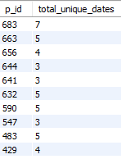
Task 04
Extract `P_ID` and the total number of unique dates for those players who have played games on multiple days.
Result Preview
SELECT p_id,
COUNT(DISTINCT start_datetime) AS total_unique_dates
FROM level_details GROUP BY p_id
HAVING total_unique_dates > 1 ORDER BY total_unique_dates DESC;

Slide 10
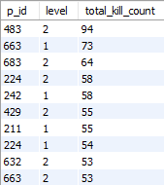
Task 05
Find `P_ID` and levelwise sum of `kill_counts` where `kill_count` is greater than the average kill count for Medium difficulty
SELECT p_id, level,
SUM(kill_count) AS total_kill_count
FROM level_details
WHERE kill_count >
(SELECT avg_medium_kill_count
FROM (SELECT AVG(kill_count) AS avg_medium_kill_count
FROM level_details
WHERE difficulty = 'Medium') AS medium_avg)
GROUP BY p_id,level
ORDER BY total_kill_count DESC ;
Result Preview

Slide 11
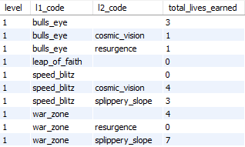
Task 06
Find `Level` and its corresponding `Level_code` wise sum of lives earned, excluding Level 0. Arrange in ascending order of level.
SELECT level,
l1_code, l2_code,
SUM(lives_earned) AS total_lives_earned FROM level_details
INNER JOIN player_details
ON player_details.p_id = level_details.p_id WHERE level <> 0
GROUP BY level, l1_code, l2_code
ORDER BY level;
Result Preview

Slide 12
Task 07
Find the top 3 scores based on each `Dev_ID` and rank them in increasing order using `Row_Number`. Display the difficulty as well.
SELECT dev_id, score, difficulty, row_rank
FROM (SELECT dev_id, score, difficulty, (@row_number := CASE WHEN @current_dev_id = dev_id
THEN @row_number + 1 ELSE 1
END) AS row_rank, @current_dev_id := dev_id
FROM (SELECT * FROM level_details
ORDER BY dev_id, score DESC) AS ld,(SELECT @row_number := 0, @current_dev_id := NULL) AS vars)
AS Ranked WHERE row_rank <= 3
ORDER BY score DESC,row_rank ASC
LIMIT 3 ;
Result Preview

Slide 13
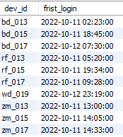
Task 08
Find the `first_login` datetime for each device ID.
SELECT dev_id,
MIN(start_datetime) AS first_login FROM level_details
GROUP BY dev_id
ORDER BY dev_id, first_login;
Result Preview

Slide 14
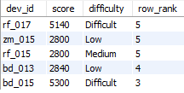
Task 09
Find the top 5 scores based on each difficulty level and rank them in increasing order using `Rank`. Display `Dev_ID` as well.
SELECT dev_id, score, difficulty, row_rank
FROM (SELECT dev_id, score, difficulty,(@row_number := CASE
WHEN @current_dev_id = dev_id
THEN @row_number + 1 ELSE 1 END) AS row_rank,
@current_dev_id := dev_id FROM (SELECT * FROM level_details
ORDER BY dev_id, score DESC) AS ld,
(SELECT @row_number := 0, @current_dev_id := NULL)
AS vars) AS ranked WHERE row_rank <= 5
ORDER BY score DESC, row_rank ASC
LIMIT 5 ;
Result Preview

Slide 15
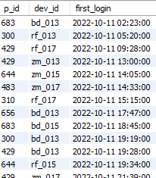
Task 10
Find the device ID that is first logged in (based on `start_datetime`) for each player (`P_ID`). Output should contain player ID, device ID, and first login datetime.
Result Preview
SELECT p_id, dev_id,
MIN(start_datetime) AS first_login
FROM level_details GROUP BY p_id, dev_id
ORDER BY first_login;

Slide 16
Thanks!
Do you have any questions?
mayurnikam2580@gmail.com
+91 7517347238
https://mayur2580.github.io/mayur_nikam/
002

