Slide 1
Advance evidence collection and analysis of web browser activity
by Junhoon Oh
David Rivera
11/7/2013
Digital Forensics

Slide 2
Introduction
Introduction to web browser forensics
Related Research
Advance evidence analysis
Web Browser Forensic Analyzer(WEFA) Tool
WEFA Compared to existing tools
Conclusions

Slide 3
Web Browser Forensics
Everyone uses Web Browsers to surf the internet (even criminals)
Important evidence could be collected from a web browser such as:
  Cache
  History
  Cookies
  Download List
There are research studies and tools for the aid of Web browser log file analysis

Slide 4
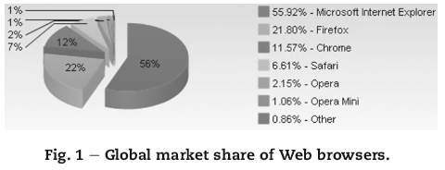
Problems with Web Browser Forensics
Tools and Studies are targeted to specific Web browsers or log file types
Large availability of Web browsers
Each Browser creates several types of log files that must be examined
Current Research and tools remain at the level of simple parsing

Slide 5
New evidence collection and analysis methodology
Paper suggests that the following 5 requirements are essential when performing Web browser analysis:
Integrated analysis of multiple Web browsers
Timeline analysis
Extraction of significant information related to digital forensics
Decoding encoded words at a particular URL
Recovery of deleted Web browser information

Slide 6
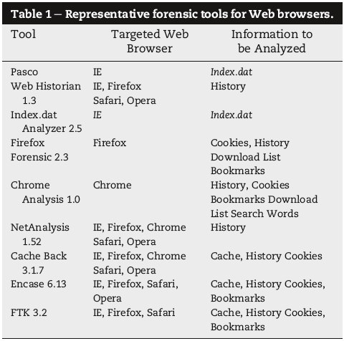
Related Research
Web browser forensics research and tools are targeted to specific browsers or structural analysis of a single type of log file
Even if tools support integrated analysis of multiple Web browsers, they rely on parsing to process and analyze log files
This limits their effectiveness in an investigation

Slide 7
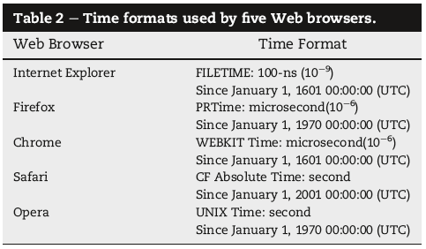
Advance Evidence Analysis
Integrated Search
  Examine all Web browsers
  Preform Integrated Analysis
Timeline analysis
  Each Web browser employs a different time format
  Time zones must be taken into consideration in order to convert timestamps to the exact local time

Slide 8

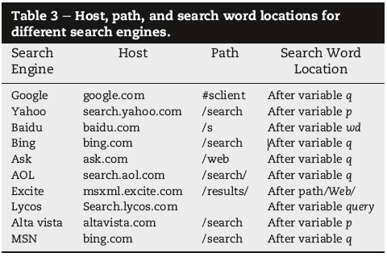
Advance Evidence Analysis cont.
Search history
  Search words used in search engines
    Saved in HTTP URL
    Different Search Engines use different HTTP URL format
  Using the similarities observed from the table this method can be applied to unknown HTTP URL

Slide 9
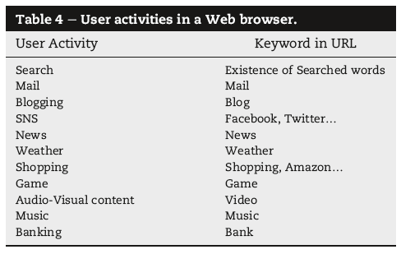
Advance Evidence Analysis cont.
URL encoding
  Encoding is used when words are not in English
  Investigator needs to apply appropriate decoding method to find meaning of the encoded words
  There are several types of encoding:
    UTF-8
    Unicode
    DBCS
User Activity
  Determining suspects activities may take too much time
  Using keywords can be used to help speed up the process

Slide 10
Advance Evidence Analysis cont.
Recovery of Deleted Information
  Browsers use two different methods for erasing log information
    Reinitializing/Overwriting log data
      This will make it impossible to recover original data
      Session information can be used to partially recover deleted history
    File Deletion
      Traditional file deletion techniques can be used to recover deleted files before their metadata is overwritten by the OS
      Carving method can also be used to recover files that are located in unallocated space because of the way Web browsers save their log files

Slide 11
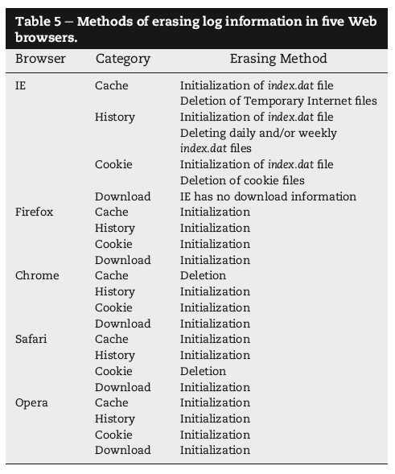
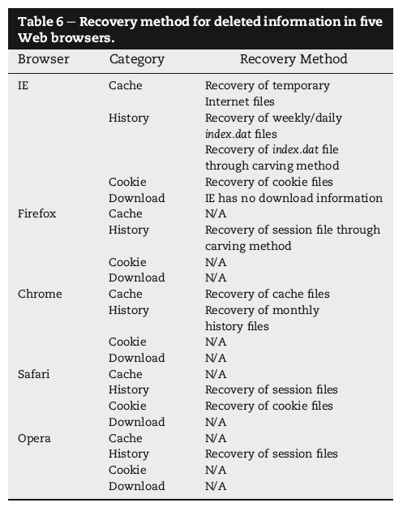

Slide 12
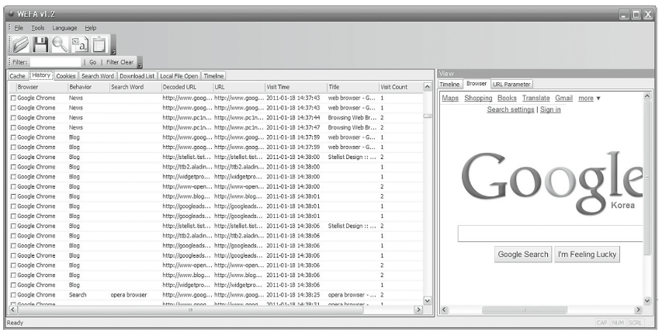
WEFA Tool

Slide 13
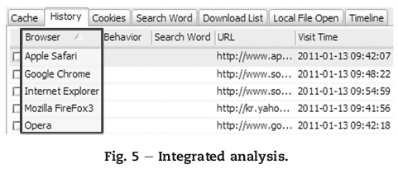
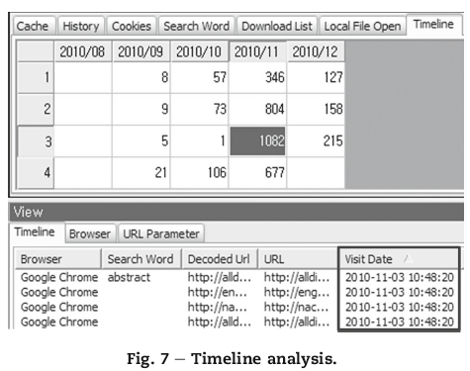
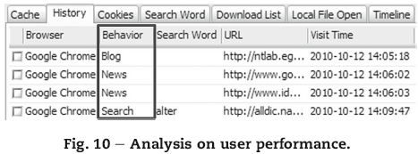
WEFA Tool cont.

Slide 14
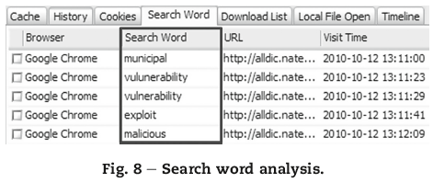
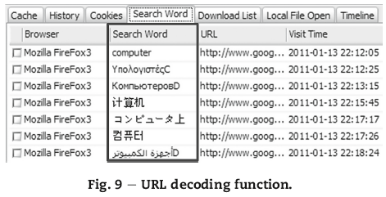
WEFA Tool cont.

Slide 15
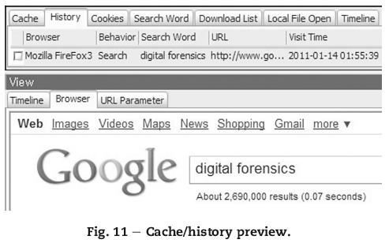
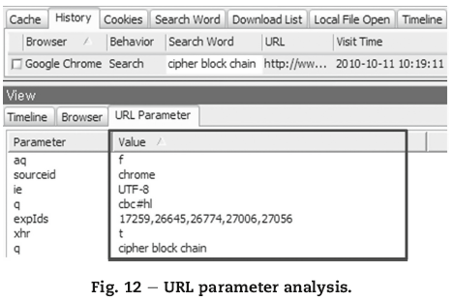
WEFA Tool cont.

Slide 16
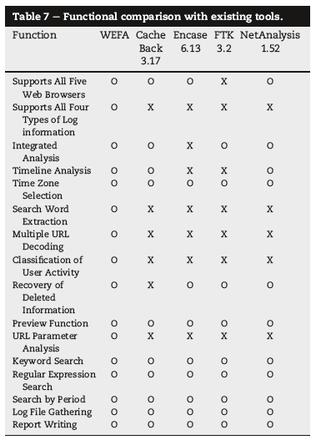
WEFA Compared to Existing Tools
Existing tools were tested to compare them with WEFA features
Results showed that current tools lack important features
  Support all log file formats
  Search Word Extraction
  URL parameter analysis

Slide 17
Conclusion
Tracking evidence from a Web browser is an important part of the Digital Forensics Process
WEFA tool provides a step forward towards the digital forensics analysis of Web browsers
There needs to be more research on different environments such as Linux, Mac and Mobile devices
Intentional log file tampering is not taken into consideration

