Slide 2
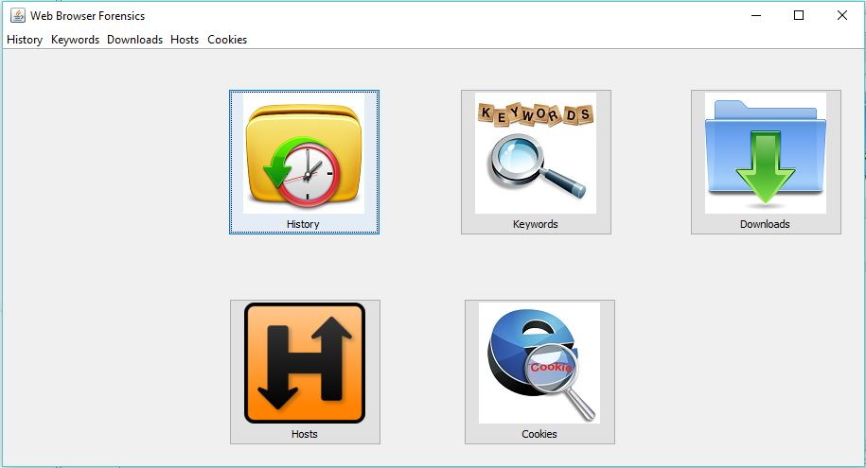
Homepage
This is Starting page of our system. This page contains the buttons that redirects to History, Keywords, Downloads, Hosts, Cookies page.

Slide 3
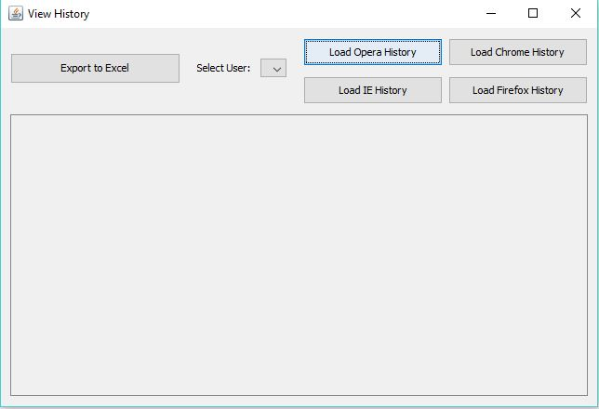
History Information
This page opens after clicking on History button of Main page. This contains various browsers names, user drop down list and export to excel button that converts the table form data into excel format data.

Slide 4
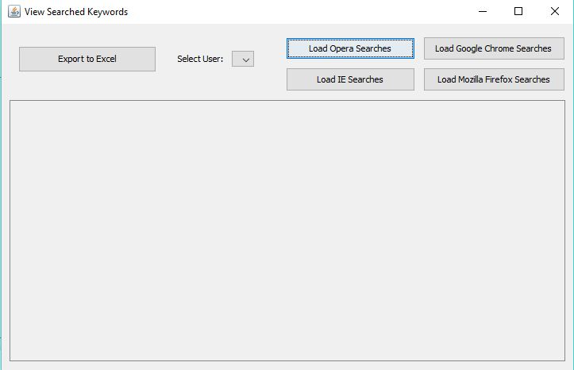
Search Keywords
This page opens after clicking on Keywords button of Mainpage. This contains various browsers names, user drop down list and export to excel button that converts the table form data into excel format data.

Slide 5
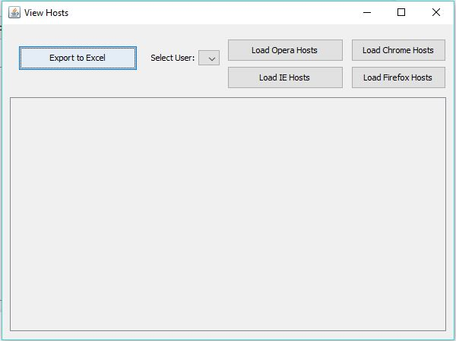
Host Information
This page opens after clicking on Hosts button of Mainpage. This contains various browsers names, user drop down list and export to excel button that converts the table form data into excel format data.

Slide 6
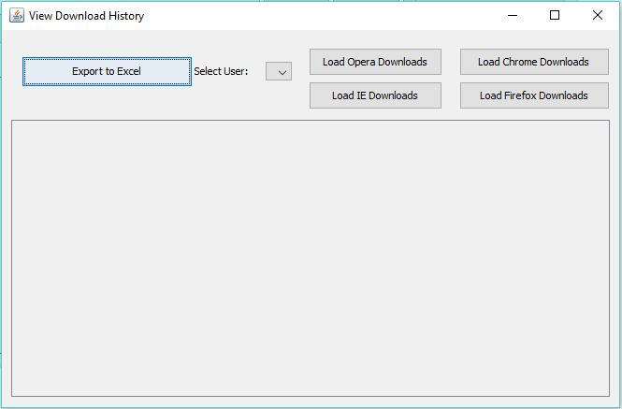
Downloads
This page opens after clicking on Downloads button of Mainpage. This contains various browsers names, user drop down list and export to excel button that converts the table form data into excel format data.

Slide 7
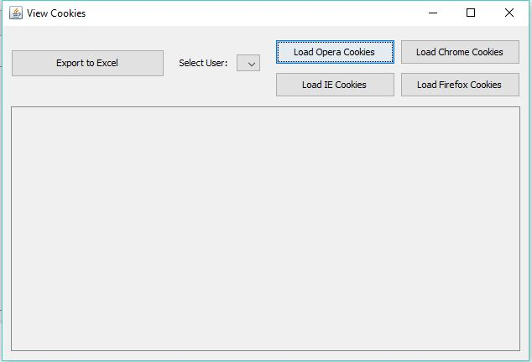
Cookies
This page opens after clicking on cookies button of Mainpage. This contains various browsers names, user drop down list and export to excel button that converts the table form data into excel format data.

