Slide 1
Web Browser Forensics
Project Phase-I Presentation
on
Presented By
Mayur R. Jadhav
(162050022)
Guided By
B. B. Meshram

Slide 2
Content
Introduction
Sources of Browser’s Data
Challenges
Literature Details
Recovery method for deleted information in Web browsers
Locations of Internet Browser Artifacts
Statement of the problem
Block Diagram
Propose System Modules
References

Slide 3
Introduction
Sources Of Browser’s Data
Surfing history
Bookmarks
Download
Cookies
Cache

Slide 4
challenges
Multiple browsers
New/updated architectures
Non-standard browsers
Non-standard browsers
Cyber Challenges
Technology changes

Slide 5
Literature Details
Recovery method for deleted information in Web browsers
Use DNS Cache to find and view deleted browsing history
Use data recovery software to recover lost browsing history files
Type I: Using User File System
Type II- Using Browser Cookies
Recover deleted browsing history from Google History

Slide 6
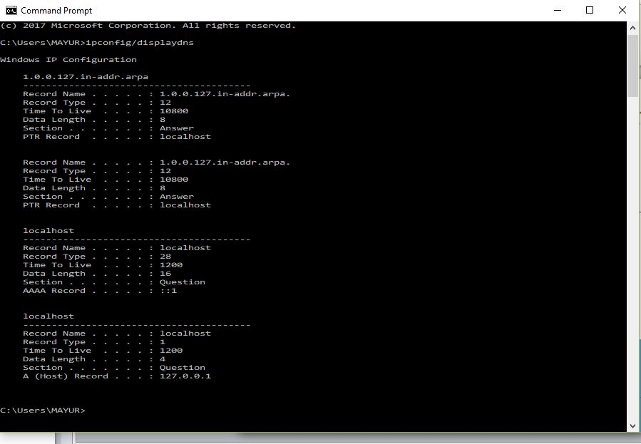
Method 1:Use DNS Cache to find and view deleted browsing history

Slide 7
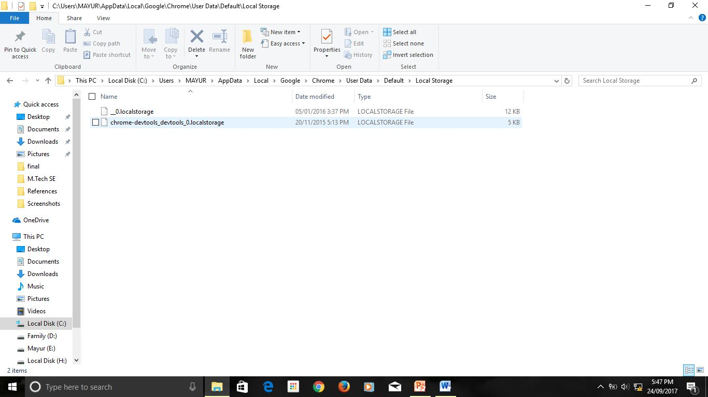
1. Google Chrome History Location in User System
Method 2: Use data recovery software to recover lost browsing history files-Type I: Using User File System

Slide 8
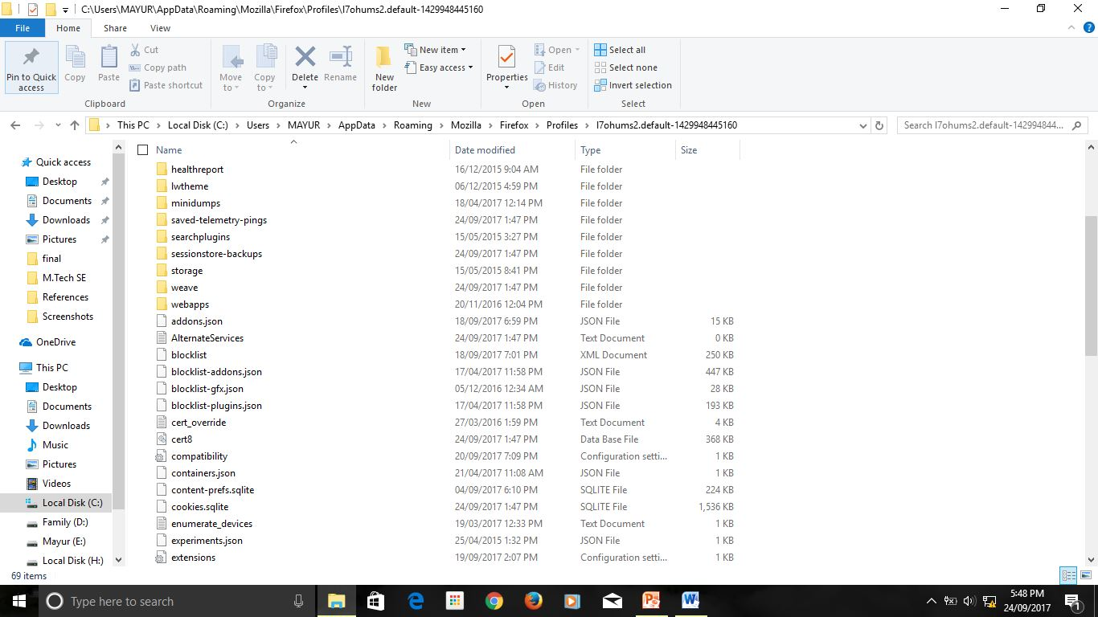
2. Mozilla Firefox History Location in User System

Slide 9
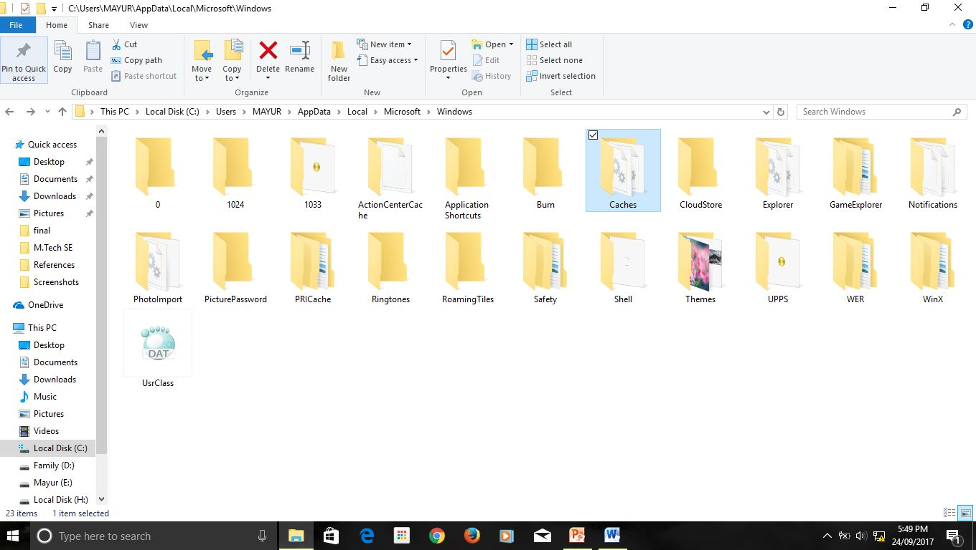
3. Internet Explorer History Location in User System

Slide 10
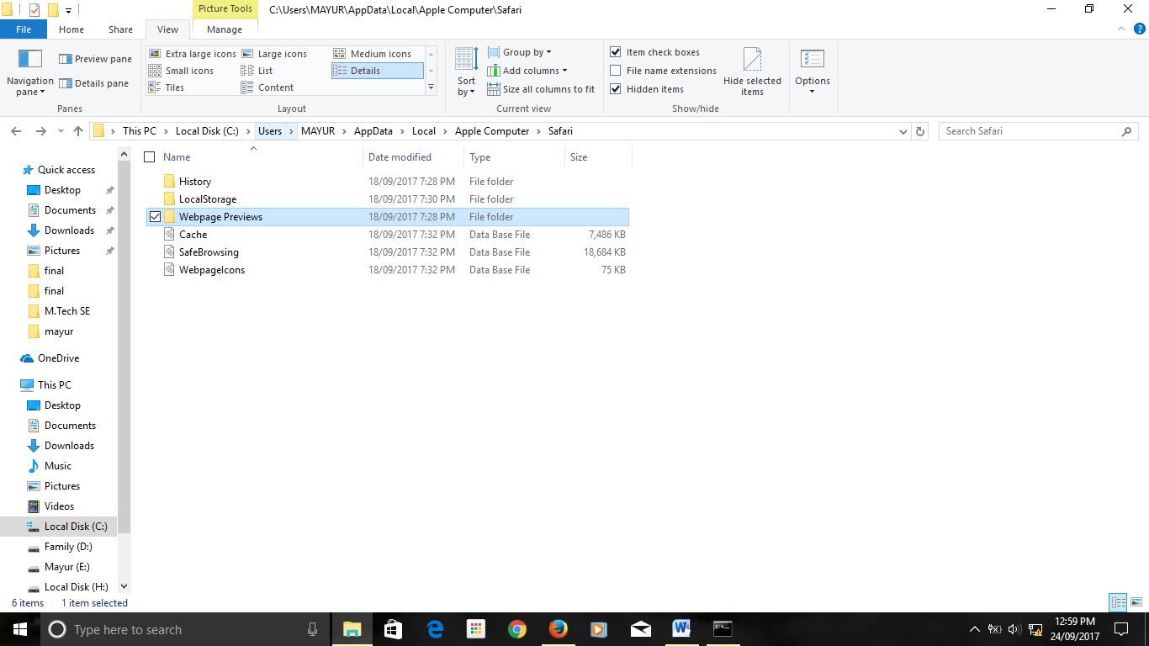
4. Apple Safari History Location in User System

Slide 11
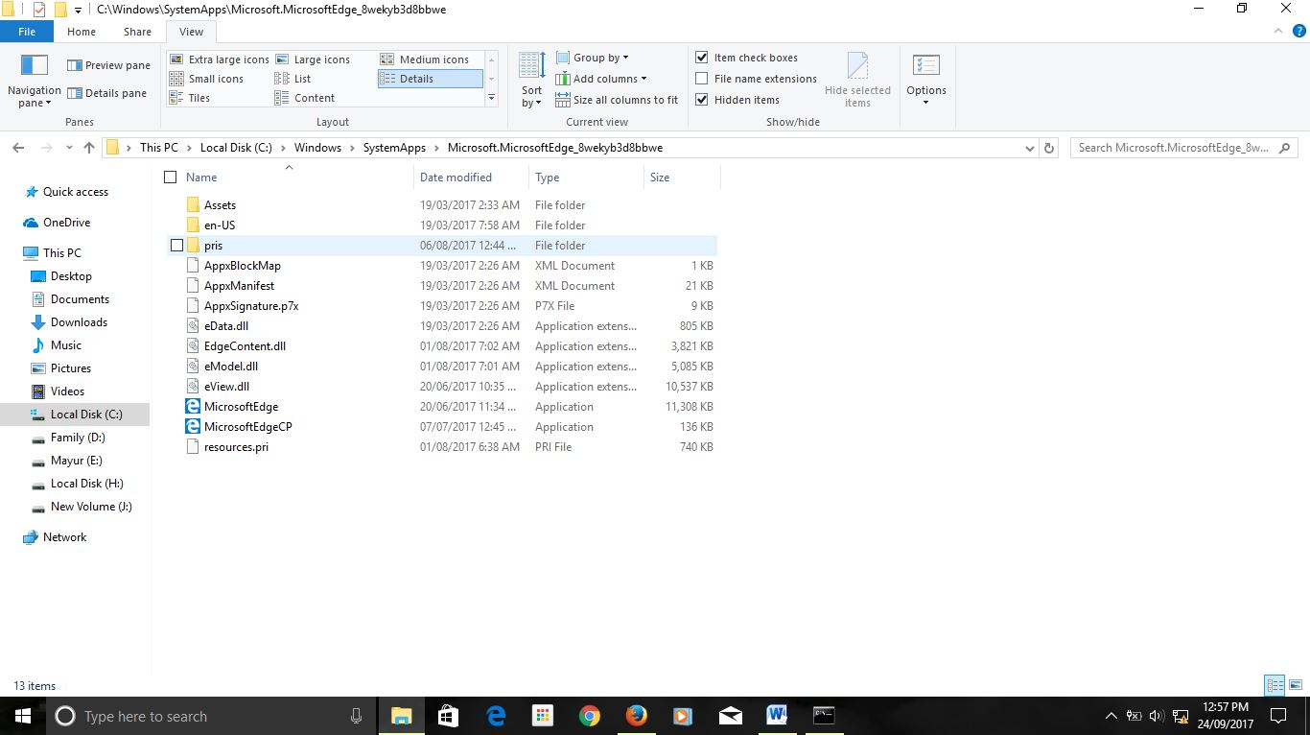
5. Microsoft Edge History Location in User System

Slide 12
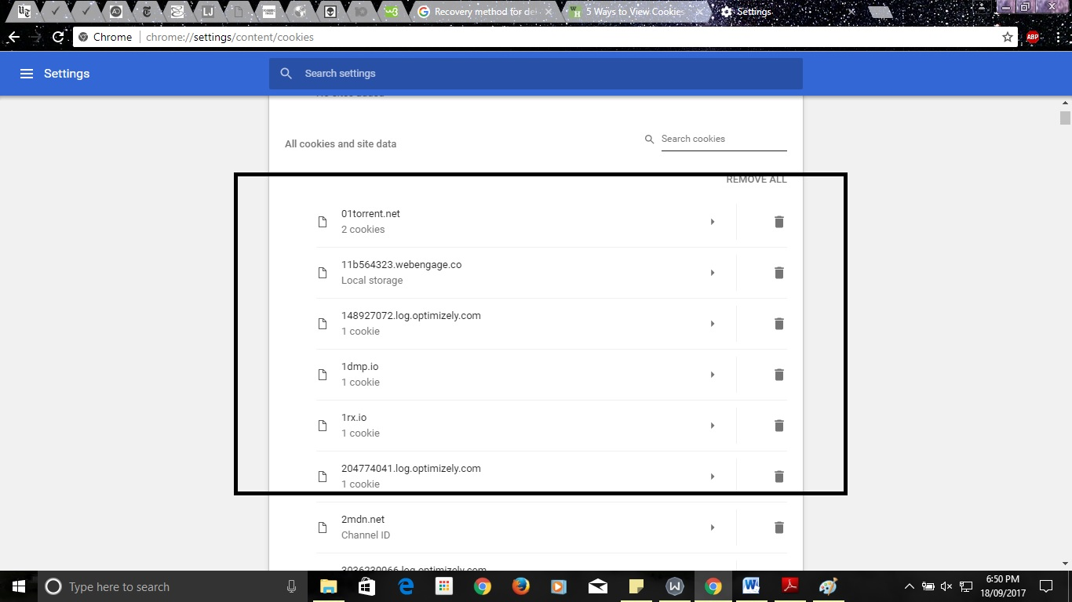
Method 2: Use data recovery software to recover lost browsing history files-
Type II- Using Browser Cookies
1. GOOGLE CHROME

Slide 13
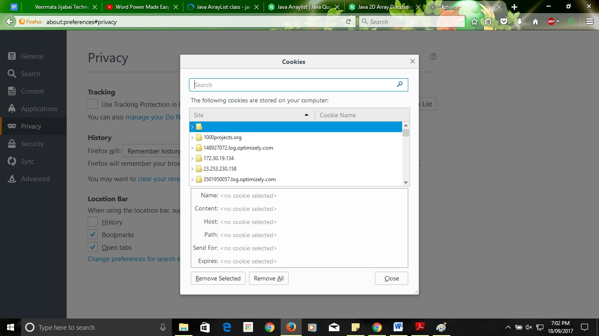
2. Mozilla Firefox

Slide 14
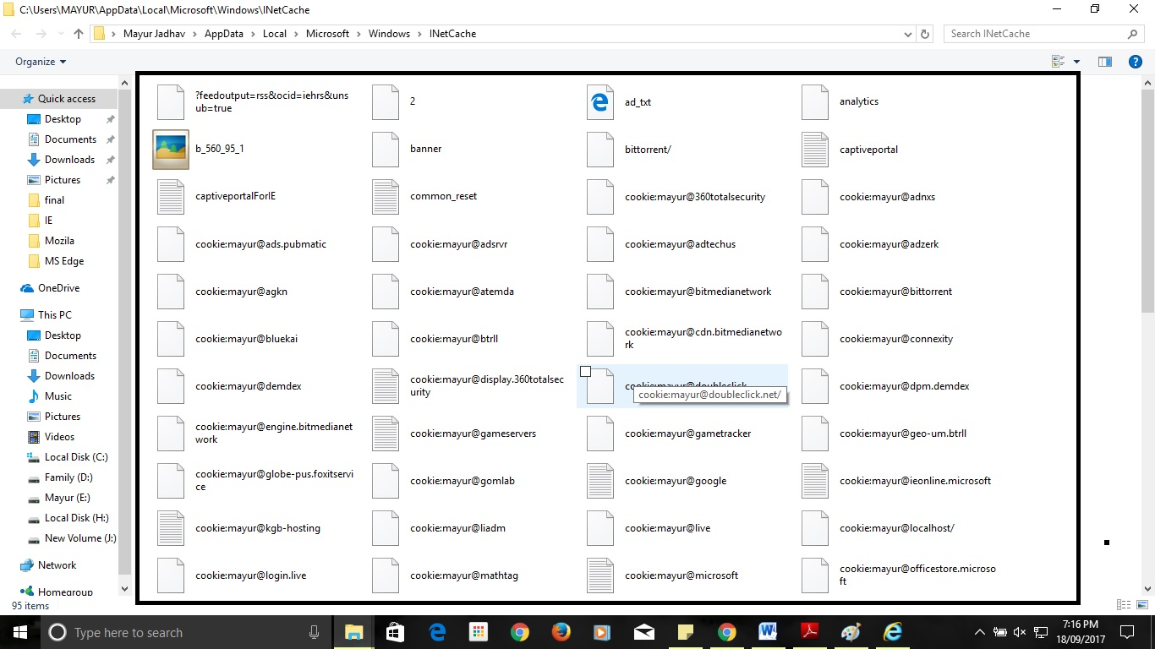
3. Internet explorer

Slide 15
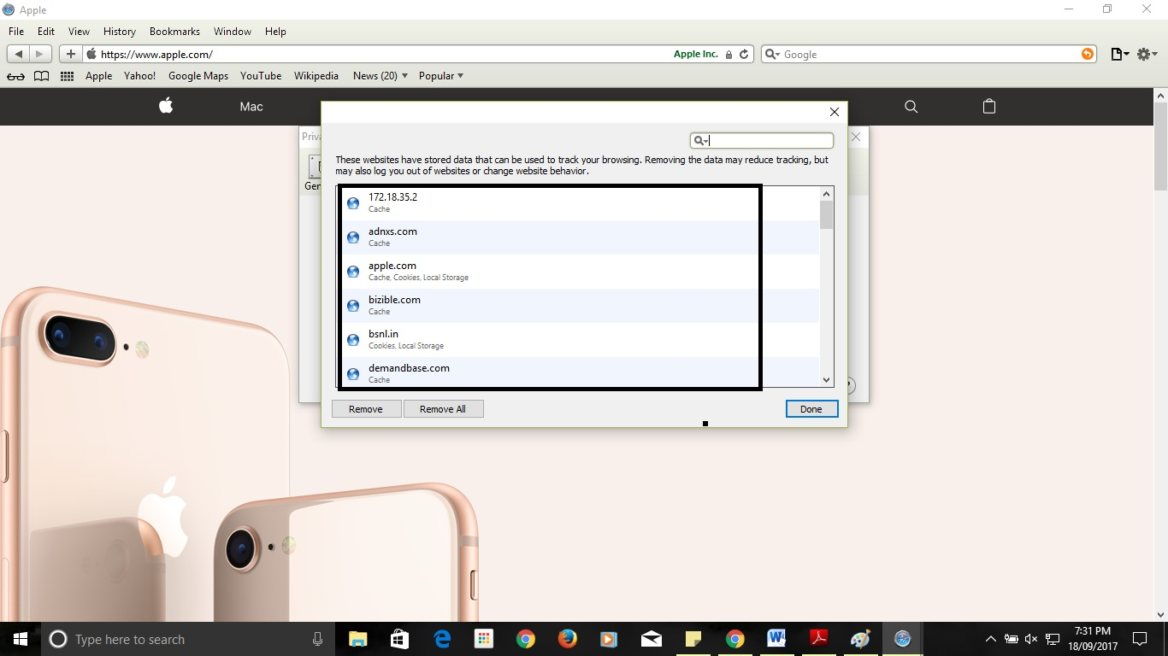
4. Apple safari

Slide 16
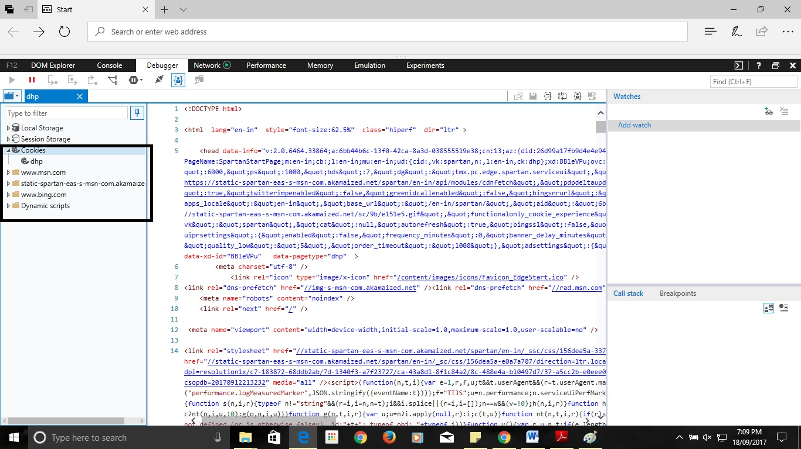
5. Microsoft edge

Slide 17
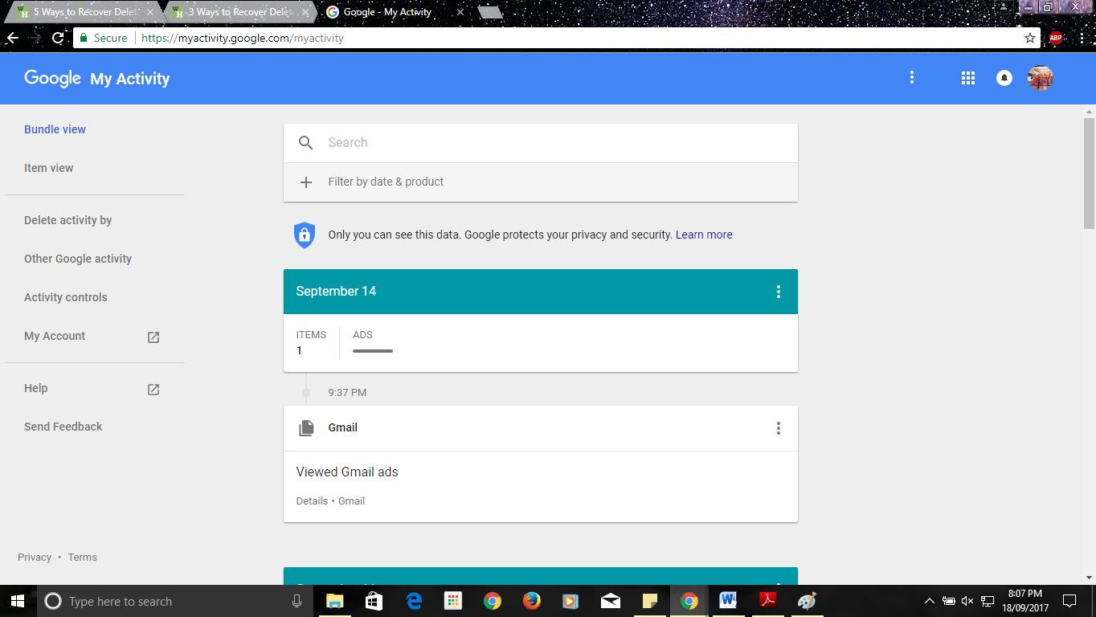
Method 3. Recover deleted browsing history from Google History

Slide 18
Locations of Internet Browser Artifacts
Internet Explorer : C:\Users\MAYUR\AppData\Local\Microsoft\Windows\Caches
Mozilla Firefox : C:\Users\MAYUR\AppData\Roaming\Mozilla\Firefox\Profiles\ l7ohums2.default-1429948445160
Google Chrome : C:\Users\MAYUR\AppData\Local\Google\Chrome\User Data\Default\
Safari: C:\Users\MAYUR\AppData\Roaming\Apple Computer\Safari
Microsoft Edge : C:\Windows\SystemApps\Microsoft.MicrosoftEdge_8wekyb3d8bbwe

Slide 19
Statement of the problem
a. Study forensics on communication devices -
Collect all possible evidences which are present on all Network communication devices and collect all LOG files present in that devices and apply forensics on those devices.
b. Forensics of browser to collect all local and server based evidences-
Browser contain most of the information about user so collect and find all evidences present in Browser History, Cookies, and LOG files and present it properly.
c. Apply Forensics on collected evidences and find criminals information and generate reports.

Slide 20
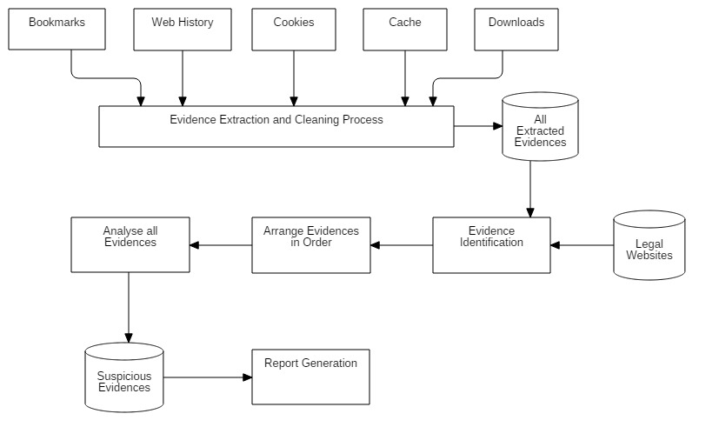
Propose System Diagram

Slide 21
Propose System Modules
Collecting evidences from different sources
Apply Cleaning Process on that evidences remove ambiguous data
Stored all evidences in Proper format
Identify the legal evidences
Arrange all evidences in proper order
Analyze all evidences and find suspicious evidences
Generate the report of Criminals information

Slide 22
References
Wade Alcorn,Christian Frichot ,Michele Orru, “The Browser Hacker’s Handbook”
Keith J. Jones,”Forensic Analysis of Internet Explorer Activity Files”.
Erhan Akbal, Fatma Güneş, Ayhan Akbal,”Forensic Analysis of Web Browser Records”, Journal of Software 2016.
Sherri David off Jonathan Ham, “Network Forensics Tracking Hackers through Cyberspace”.
Junghoon Oh , Seungbong Lee , Sangjin Lee,“Advanced evidence collection and analysis of web browser Activity”,Digital Investigation.
Andrew Marrington, Ibrahim Baggili, Talal Al Ismail, Ali Al Kaf, ”Portable Web Browser Forensics .
Murilo Tito Pereira,”Forensic analysis of the Firefox3 internet history and recovery of deleted SQLite records”, Sciencedirect,2009.

Slide 23
Taub, Eric A. (2006-04-05), "Deleting may be easy, but your hard drive still tells all“,New York Times. Retrieved 2009-01-11
http://www.toptenreviews.com/software/internet/best-internet-browser-software/
https://www.symantec.com/connect/articles/web-browser-forensics-part-1
https://www.symantec.com/connect/articles/web-browser-forensics-part-2
http://www.wikihow.com/View-Cookies
https://www.easeus.com/computer-instruction/recover-browser-internet-history.html
http://www.forensicfocus.com/Content/pid=97/page=1/
Springer Open Journal, “Do private and portable web browsers leave incriminating
evidence?: a forensic analysis of residual artifacts from private and portable web
browsing sessions”, Donny J Ohana and Narasimha Shashidhar.

Slide 24
Thank You

