Slide 1
Automate Snowflake Object Setup Snow Spark
Mayur
Sahithya
Azma

Slide 2
Use case articulation
Creating snowflake objects such as Database/ schema/ warehouse/ role/ user/ table using Streamlit App by taking User inputs.
Creating Overall Report and Object wise Report to analyze utilization of different objects in snowflake.
Download Scripts for the selected objects.
Deployment from one environment to another.
Granting the Permission for selected Object.
User can view role level hierarchy.

Slide 3
Solution Approach
Users can login either by entering the details or by uploading a config file which has login details.
Snowflake stored procedures are invoked once the user selects the type of object they want to create or analyse through streamlit.
Snowflake objects can also be created by uploading a file that contains create scripts.

Slide 4
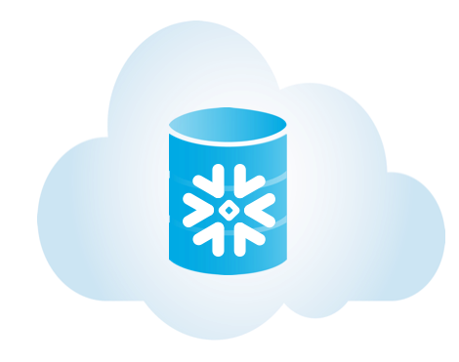

Architecture Diagram:
Activities
Object Creation
Overall Report
Object Wise Report Analysis
Grant Object Permission
Download Scripts
Deployment from one environment to another
🖥️
User
Streamlit
login Config file /
enter credentials
Snowflake
Connection

Slide 5
Flow diagram
Creating the Objects
User
Role
Warehouse
Database
Schema
Table…etc
Analyzing the Report object Level
Login with User Credentials
Choose the option
Grant Permissions
Download Scripts
Summary Report
Credits burned by warehouse
Most costly users
Top 10 longest run queries
Credit Per Hour Distribution
Storage over Time
Overall Report
Deployment from one Environment to another

Slide 6
Technology stack used
Snowflake is used as a data source for this User Case.
Python is used to execute queries in snowflake by taking inputs from User Interface.
Python Libraries :
streamlit is an open source app framework in Python used to create web apps in a short time
snowflake-connector-python allows the application to submit SQL to execute inside Snowflake.
pandas will go through reading, analyzing, manipulating, and finally storing data.
altair is a Python library designed for statistical visualization.
plotly is an open-source library that can be used for data visualization & understanding data simply and easily.
streamlit_echarts library typically used in User Interface, Chart applications.
Htbuilder lets you build HTML strings using a purely functional syntax in Python

Slide 7
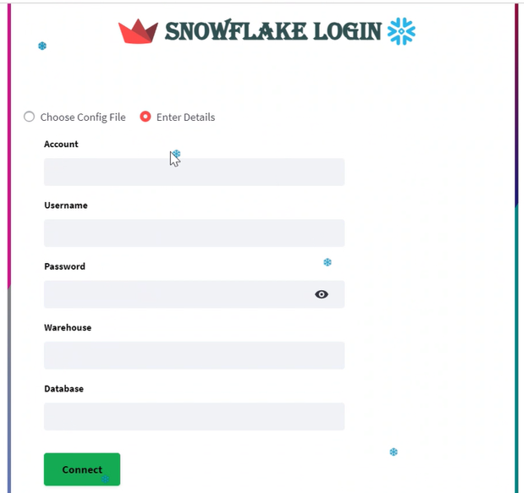
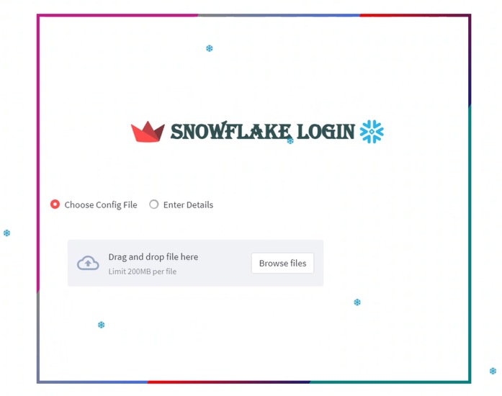
Login Page

Slide 8
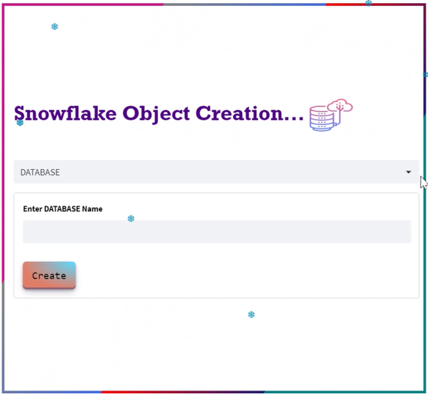
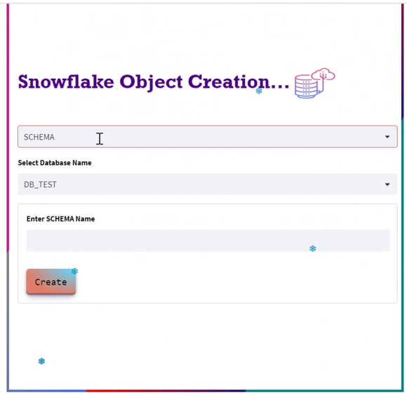
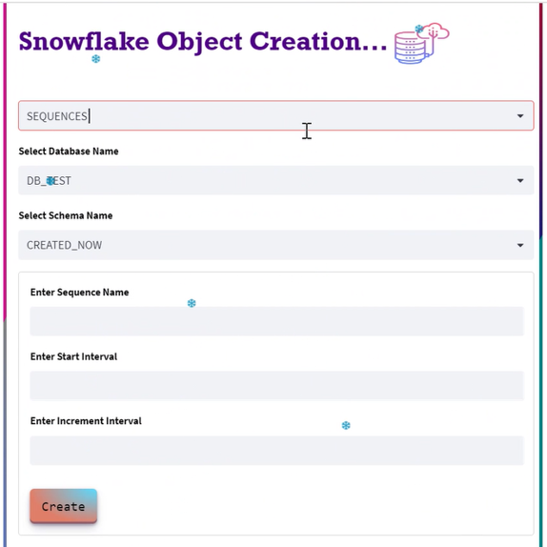
Object Creation

Slide 9
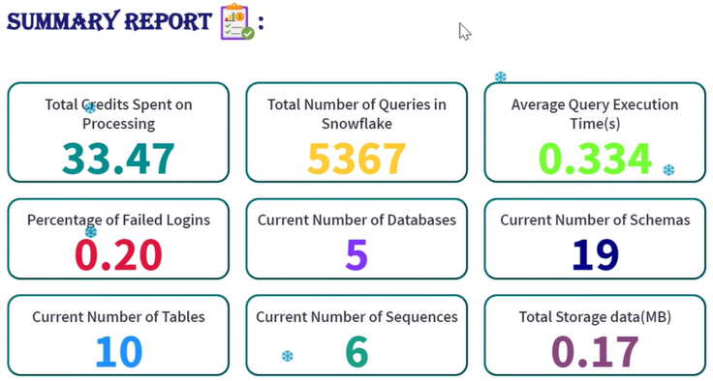
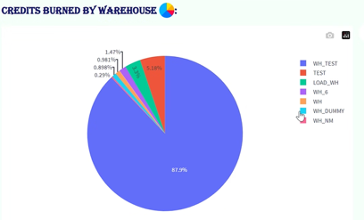
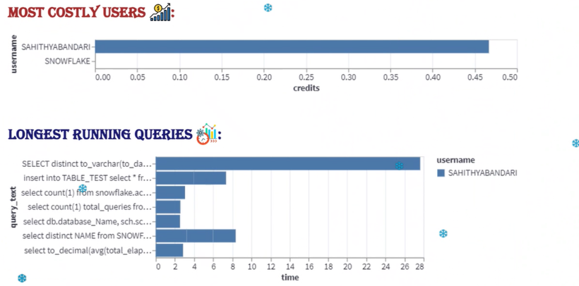
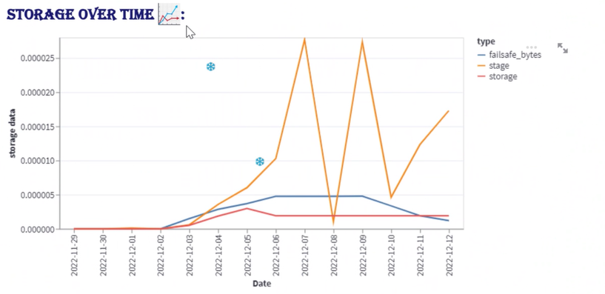
Overall Report

Slide 10
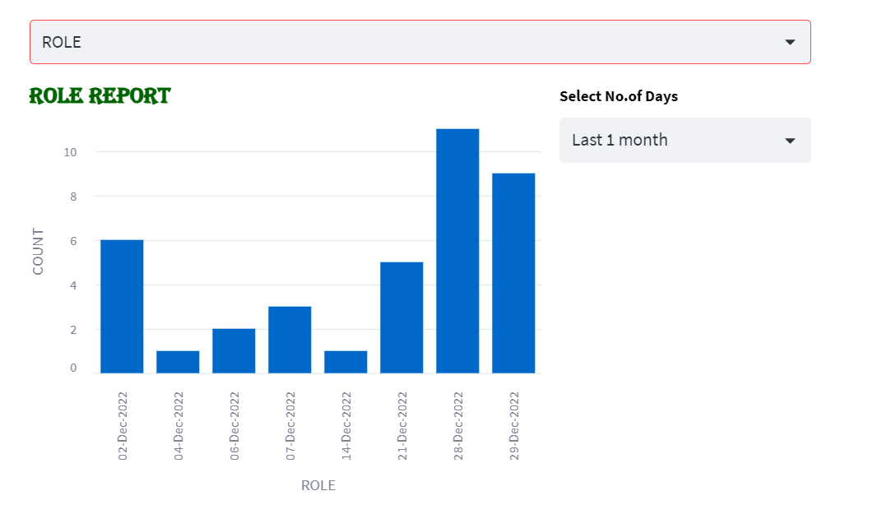
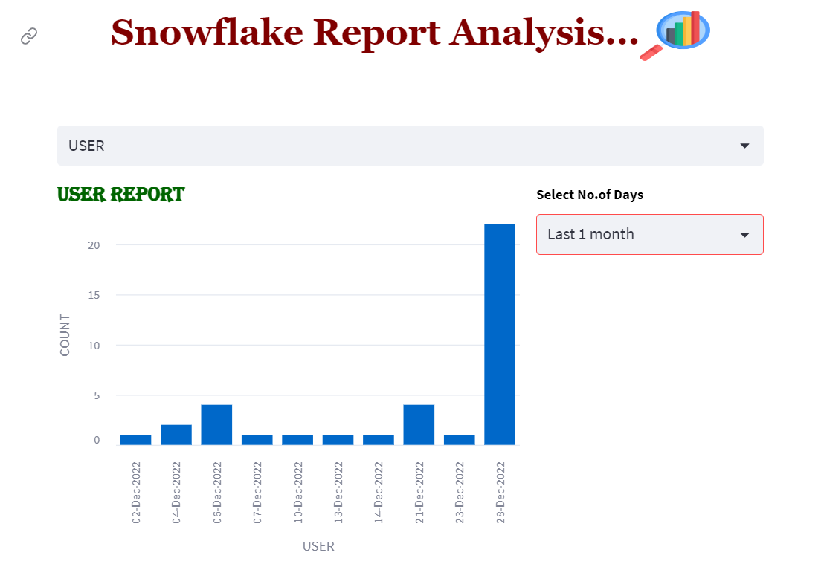
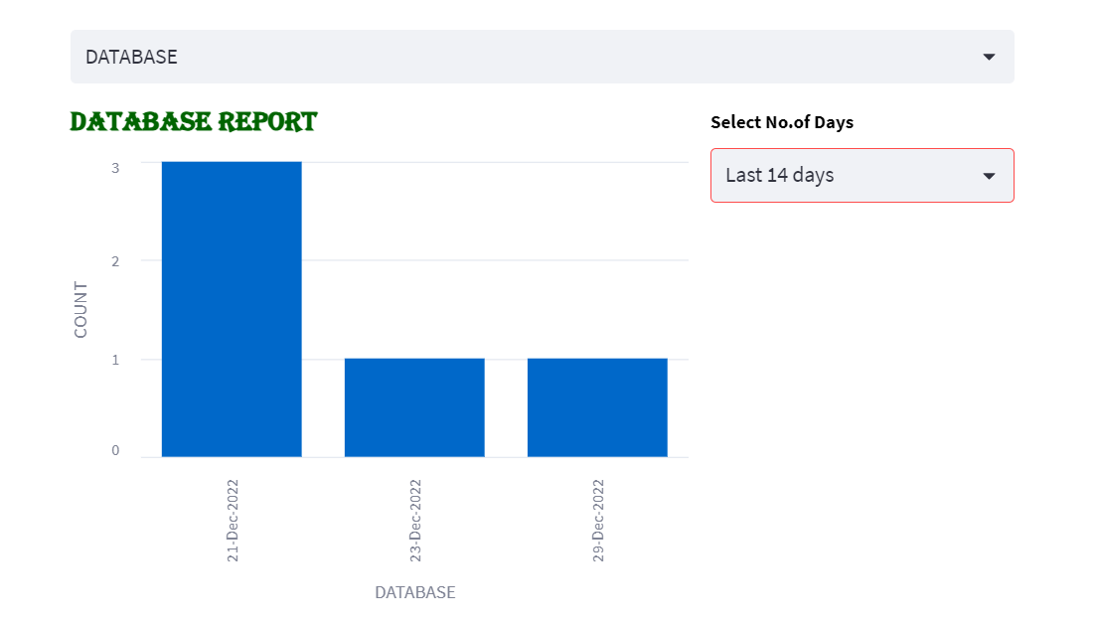
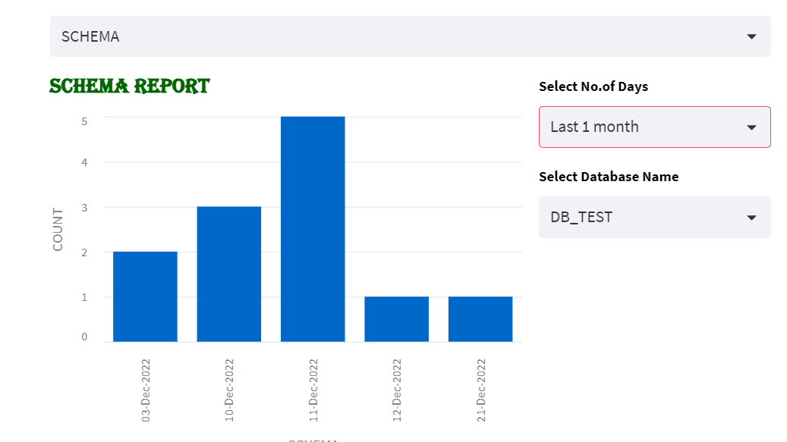
Object Wise Report

Slide 11
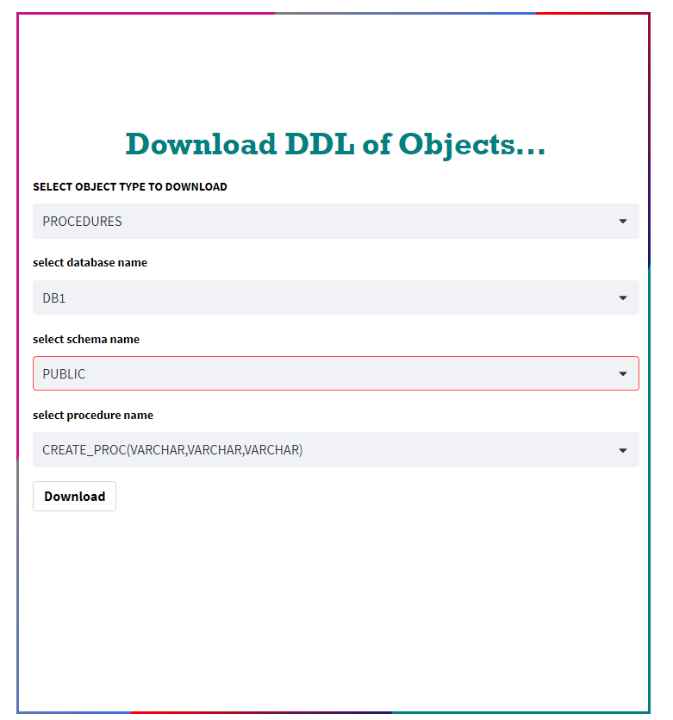
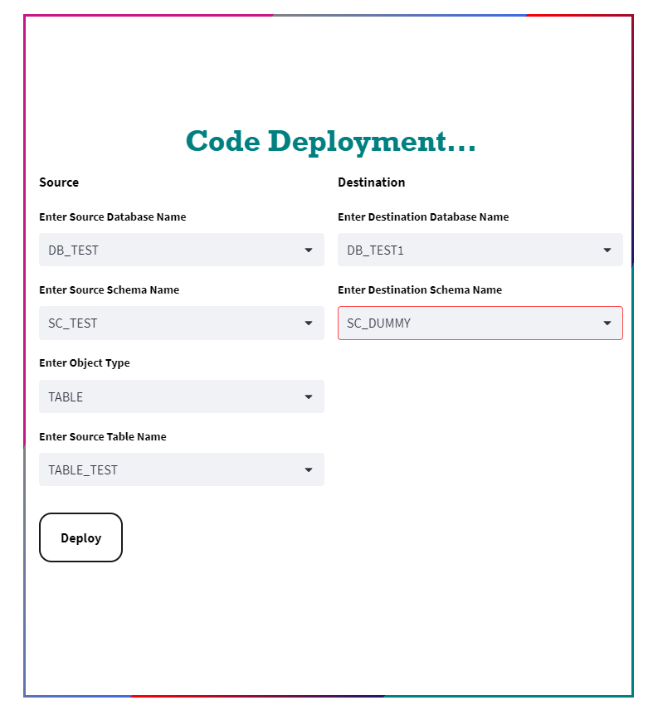
Download Scripts
Deployment

Slide 12
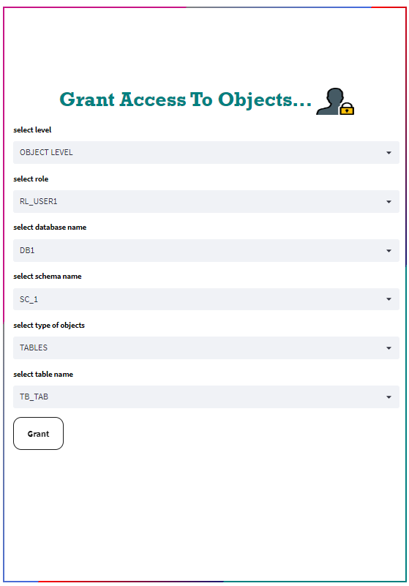
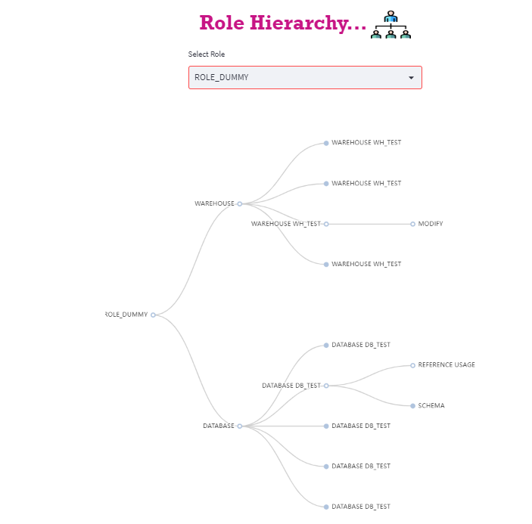
Object Wise Report
Grant Access

Slide 13
Value Articulation
In order to generate Required objects in Snowflake that are accessible to user, we have built an application using Streamlit.
User can see overall Report to analyze data present in Snowflake.
Object-level report analysis is available for a defined time period.
With Streamlit App, user can create different objects without any prior knowledge on SQL queries.
User can easily deploy the objects from one environment to another without using
any SQL queries.
Additionally, this application is simple to use and can be shared by all Users.

Slide 14
Thankyou

