Slide 1
Mobile Based secure File Access System
Under the guidance of:
Prof.VIJAYKUMAR.S.MALAGITTI
Assitant.Professor & HOD
Submitted by:
SANTOSH.H.A 2TG09IS027
MAYUR.R.V 2TG09IS015
SANDIP.V.D 2TG08IS011
UMESH.D 2TG09IS035

Slide 2
CONTENTS
ABSTRACT
INTRODUCTION
CHALLENGES WITH EXISTING TECHNOLOGY
PROPOSED SOLUTION
PROJECT SPECIFICATION
ARCHITECTURE
MODULES
BENEFITS

Slide 3
ABSTRACT
Mobile based secure file access system is a technique for web retrieval using security keys on cloud only for registered users.

Slide 4
INTRODUCTION
MBSFAS uses 2 Entities Admin and General Users.
Admin has privileges to upload the files, each file is assigned security keys, add new user.
General user must register first to the admin. If he is registered, he has privileges to download & view the file from the cloud.

Slide 5
Continued…
To download the file from cloud Only he has to send filename & security key associated with the file assigned by admin through SMS.
The admin will check whether he is registered user, If he is registered user than file is downloaded to location specified by the general user.

Slide 6
CHALLENGES WITH EXISTING TECHNOLOGY
Web retrieval is open without any authentication or checking for valid users.
Hacker’s can easily upload the false document & keep the users in blind.
Time delay is more when requests are more for same document on Internet.

Slide 7
PROPOSED SOLUTION
MBSFAS will create a part of separate cloud from entire cloud where file access is allowed for only authorized users using security keys.
In order to provide security on cloud for web retrieval, security keys must be assigned to files uploaded.
This can be achieved by having 2 entities:
Admin: He has privileges to upload file, assign security keys to each file uploaded.
General user: He has privileges to download & view file only if he knows the security key.

Slide 8
Continued…
It prevents Un-authorized user from accessing the data on cloud & by providing security keys to files on cloud will ensure enhanced security.

Slide 9
PROJECT SPECIFICATION
HARDWARE REQUIREMENTS:
Intel processor with minimum of 2 gb ram
The server should have a static IP address.
A GSM modem or a GSM enabled mobile.
A System with static IP address
SOFTWARE REQUIREMENTS
1. Windows 7/XP as operating system
2. Jdk 1.3
3. Netbeans 6.0.1

Slide 10
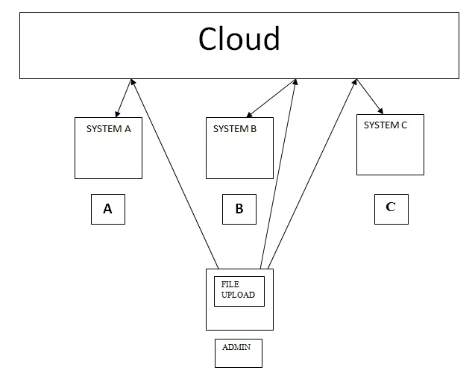
CLOUD ARCHITECTURE

Slide 11
MODULES
Admin
Add new user
File upload
check for valid user

Slide 12
continued
General user
login
Send mail
Change password

Slide 13
BENEFITS
It improves security on cloud for web retrieval.
It prevents Un-authorized access.
Enable a group of registered users to communicate through mails.
User can download files just by sending SMS irrespective of his system location.

Slide 14
CONCLUSION
This project ensure the security of cloud storage, we proposed an effective and secured system with explicit dynamic data support, including registration, login & password checking. Through detailed security and performance analysis, we show that our scheme is highly efficient and resilient to, malicious data modification attack.

Slide 15
REFRENCES
Times Connection. Introduction to Web Application:
http://cs.now.cn/html/FAQ/VHost/2008 10/10-3088.html
Thomas Riisgaard Hansen, J. Mikael Eklund, Jonthan Sprinkle, Ruzena Bajcsy, and Shankar Sastry.
Liberatori.M. Otero.F., Bonadero.J.C. and Castineira.J. “AES-128 Cipher. High Speed, Low Cost FPGA Implementation”, IEEE Conf. Southern Programmable Logic(SPL),vol.04,issue.07,pp.195-198,Jun. 2007
Shibu K V, “Introduction to Embedded Systems”, Tata McGraw Hill.
http://www.pointbase.com
http://www.KeepMedia.com
http://www.BambooWeb.com
http://www.haris.cise.ufl.edu
http://www.pcmag.com

