Slide 1
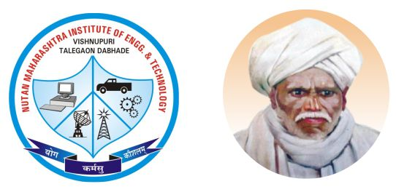

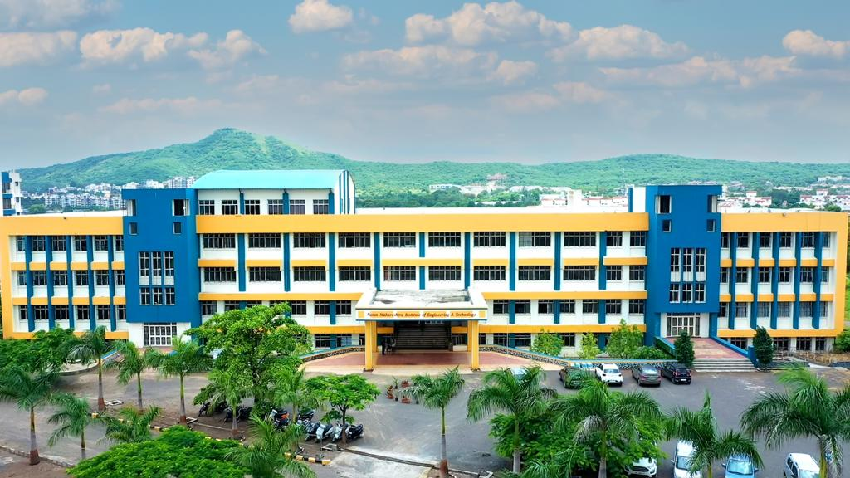

NUTAN MAHARASHTRA INSTITUTE OF ENGINEERING & TECHNOLOGY, PUNE
Nutan Maharashtra Vidya Prasarak Mandal's
Department of Computer Engineering
NBA Accredited
210258-Project based Learning II
Academic Year 2024-25
https://www.nmiet.edu.in/index.php

Slide 2

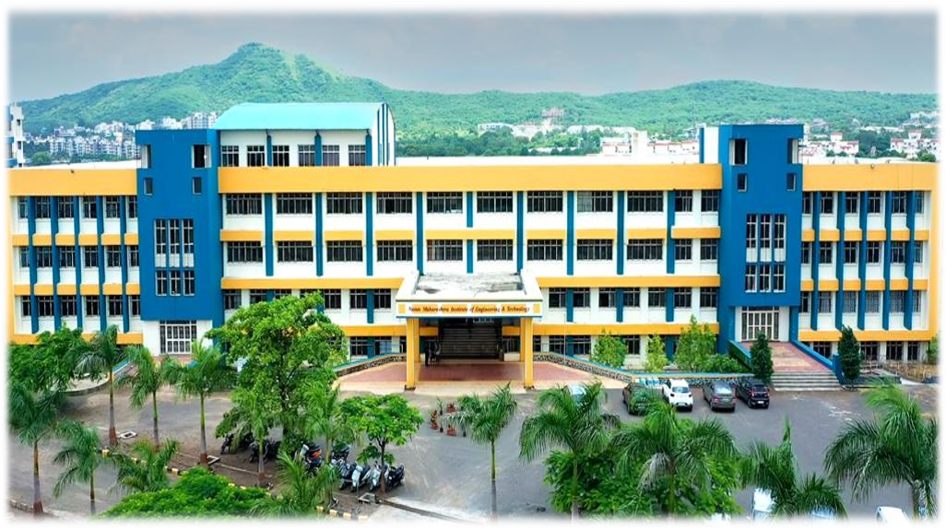
Nutan Maharashtra Vidya Prasarak Mandal's
NUTAN MAHARASHTRA INSTITUTE OF ENGINEERING & TECHNOLOGY, PUNE
Department of Computer Engineering
A
Project Presentation
on
“CodeFlow AI :
AI Engineer for Full-Stack Application Development”
Prepared By
TIRTHA ZOLDEO S1905504429
YASH KISHOR CHAUDHARY S1905504445
ZOPE MAYUR UMAKANT S1905504450
Guided by
Prof. Neha Bhagwat
PCET’S & NMVPM’S
NUTAN MAHARASHTRA INSTT. OF ENGG. & TECH. Pune
PBL, A.Y. 2024-25
https://www.nmiet.edu.in

Slide 3
Contents
Nutan Maharashtra Vidya Prasarak Mandal's
NUTAN MAHARASHTRA INSTITUTE OF ENGINEERING & TECHNOLOGY, PUNE
Department of Computer Engineering
Title
Team members and roles
Introduction
Problem Statement
Objectives/Goal
Literature Survey
Methodology/Architecture
Expected Outcome
Conclusion
References
PBL, A.Y. 2024-25
https://www.nmiet.edu.in

Slide 4
Nutan Maharashtra Vidya Prasarak Mandal's
NUTAN MAHARASHTRA INSTITUTE OF ENGINEERING & TECHNOLOGY, PUNE
Department of Computer Engineering
Introduction
CodeFlow AI is an AI-powered platform designed to automate full-stack application development. CodeFlow AI aims to significantly improve developer productivity, reduce development costs, and enhance the overall quality of software applications to save time and effort while ensuring efficiency.
The Evolving Landscape of Software Development
Software development is a cornerstone of our digital world, driving innovation across industries. However, traditional development methods often face challenges such as:
Time-consuming manual coding: Writing and debugging code can be a lengthy and error-prone process.
Difficulty in finding and fixing bugs: Identifying and resolving software defects can be time-consuming and costly.
High development costs: The overall cost of software development, including labor and resources, can be significant.
PBL, A.Y. 2024-25
https://www.nmiet.edu.in

Slide 5
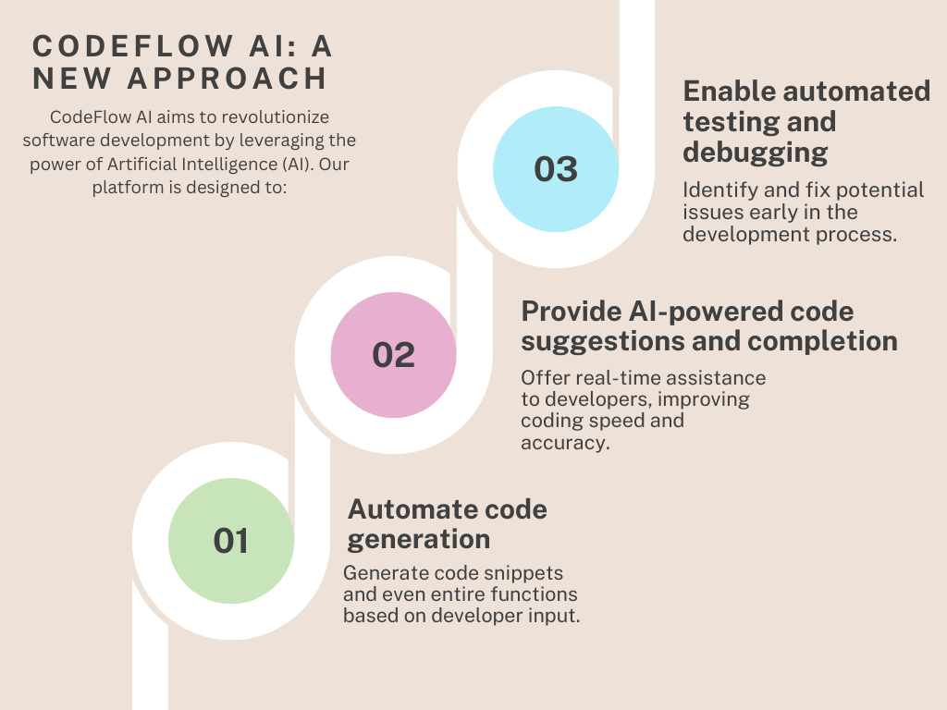
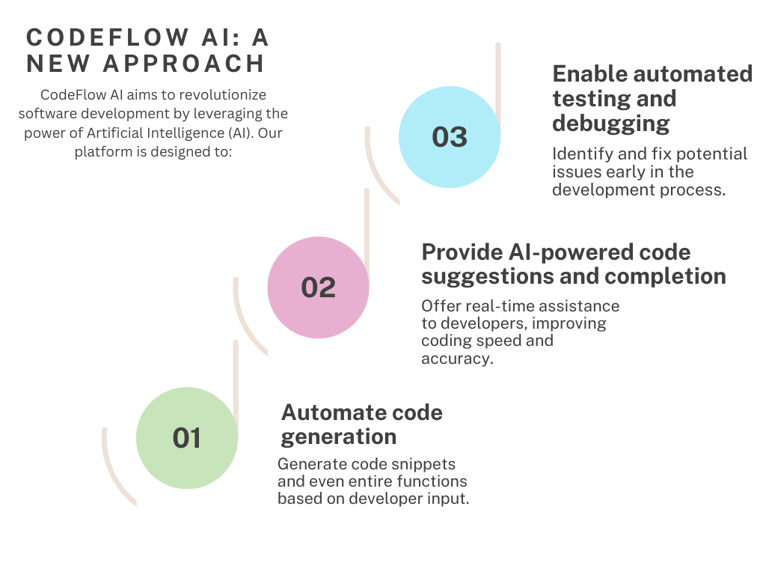
Nutan Maharashtra Vidya Prasarak Mandal's
NUTAN MAHARASHTRA INSTITUTE OF ENGINEERING & TECHNOLOGY, PUNE
Department of Computer Engineering
PBL, A.Y. 2024-25
https://www.nmiet.edu.in

Slide 6
Nutan Maharashtra Vidya Prasarak Mandal's
NUTAN MAHARASHTRA INSTITUTE OF ENGINEERING & TECHNOLOGY, PUNE
Department of Computer Engineering
Problem Statement
Developing full-stack applications is time-consuming and requires expertise. CodeFlow AI aims to address these challenges by automating development, reducing time, and increasing accessibility.
Current challenges in full-stack development:
  Time-intensive processes.
  Need for expertise in multiple domains.
  Difficulty in finding and fixing bugs.
  High development costs.
How CodeFlow AI addresses these issues:
  Reduces development time.
  Seamless deployment.
  Reduces dependency on extensive technical knowledge.
PBL, A.Y. 2024-25
https://www.nmiet.edu.in

Slide 7
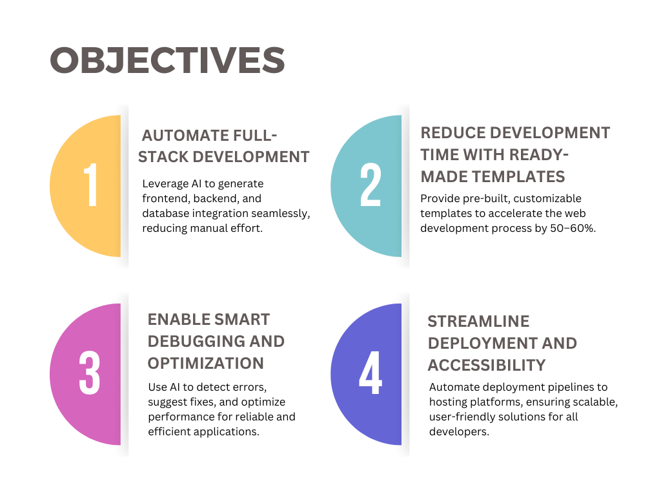
Nutan Maharashtra Vidya Prasarak Mandal's
NUTAN MAHARASHTRA INSTITUTE OF ENGINEERING & TECHNOLOGY, PUNE
Department of Computer Engineering
PBL, A.Y. 2024-25
https://www.nmiet.edu.in

Slide 8
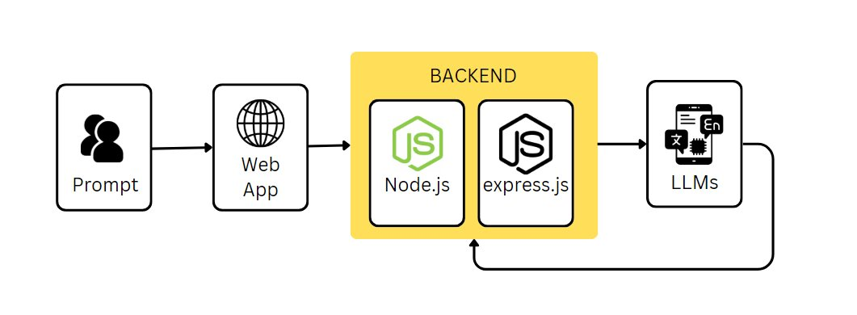
Nutan Maharashtra Vidya Prasarak Mandal's
NUTAN MAHARASHTRA INSTITUTE OF ENGINEERING & TECHNOLOGY, PUNE
Department of Computer Engineering
Architecture
PBL, A.Y. 2024-25
https://www.nmiet.edu.in

Slide 9
Nutan Maharashtra Vidya Prasarak Mandal's
NUTAN MAHARASHTRA INSTITUTE OF ENGINEERING & TECHNOLOGY, PUNE
Department of Computer Engineering
Expected Outcomes
Reduced Technical Barriers – Enables individuals without coding expertise to develop applications using natural language prompts, making software development more accessible.
Automated Error Detection & Debugging – Identifies and fixes coding errors in real-time, reducing development time and minimizing bugs in production.
Improved Code Quality & Optimization – Ensures adherence to best practices, optimized performance, and scalability through AI-driven self-coding.
Enhanced Developer Productivity – Allows developers to focus on high-level architecture and problem-solving while the AI handles routine coding tasks.
End-to-End Application Development – Manages front-end, back-end, database, and API integrations seamlessly.
PBL, A.Y. 2024-25
https://www.nmiet.edu.in

Slide 10
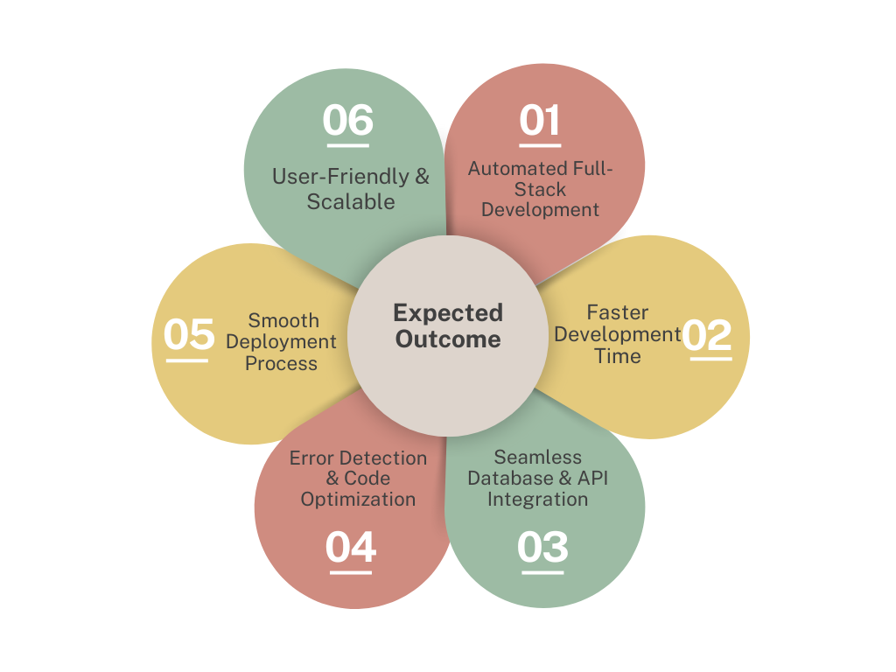
Nutan Maharashtra Vidya Prasarak Mandal's
NUTAN MAHARASHTRA INSTITUTE OF ENGINEERING & TECHNOLOGY, PUNE
Department of Computer Engineering
Faster MVP & Prototype Creation – Enables startups and businesses to quickly test ideas and bring products to market with minimal effort.
Automated Deployment & Hosting – Assists in deploying applications to cloud platforms, reducing manual setup efforts.
Cost Efficiency – Cuts down the need for large development teams, reducing costs for businesses and entrepreneurs.
Continuous Learning & Adaptation – Improves over time by learning from user interactions and adapting to different development needs.
PBL, A.Y. 2024-25
https://www.nmiet.edu.in

Slide 11
Nutan Maharashtra Vidya Prasarak Mandal's
NUTAN MAHARASHTRA INSTITUTE OF ENGINEERING & TECHNOLOGY, PUNE
Department of Computer Engineering
Conclusion
CodeFlow AI revolutionizes full-stack development by enabling users to create applications through natural language prompts, AI-driven self-coding, and automated debugging. It removes technical barriers, boosts productivity, and accelerates software development. By seamlessly integrating human creativity with AI intelligence, CodeFlow AI paves the way for a more efficient, accessible, and scalable future in software engineering.
PBL, A.Y. 2024-25
https://www.nmiet.edu.in

Slide 12
Nutan Maharashtra Vidya Prasarak Mandal's
NUTAN MAHARASHTRA INSTITUTE OF ENGINEERING & TECHNOLOGY, PUNE
Department of Computer Engineering
References
Research papers:
A Comparative Review of AI Techniques for Automated Code Generation in Software Development: Advancements, Challenges, and Future Directions
This paper offers a comprehensive review of traditional and AI techniques used for automated code generation (ACG), discussing their challenges and limitations. It provides insights into how AI can enhance productivity in software development.
Link: https://www.researchgate.net/publication/378542081_A_Comparative_Review_of_AI_Techniques_for_Automated_Code_Generation_in_Software_Development_Advancements_Challenges_and_Future_Directions
AI-Assisted Code Generation and Optimization
This paper explores AI-driven code generation and optimization, highlighting how automating the code generation process can address various software development challenges and increase productivity.
Link: https://repo.ijiert.org/index.php/ijiert/article/view/1334
Future of Software Development with Generative AI
development paths, proposing primary scenarios and model trajectories.
Link: https://link.springer.com/article/10.1007/s10515-024-00426-z
PBL, A.Y. 2024-25
https://www.nmiet.edu.in

Slide 13
Nutan Maharashtra Vidya Prasarak Mandal's
NUTAN MAHARASHTRA INSTITUTE OF ENGINEERING & TECHNOLOGY, PUNE
Department of Computer Engineering
Thank you
PBL, A.Y. 2024-25
https://www.nmiet.edu.in

