Slide 1
INTERNSHIP PRESENTATION
Internship
Presentation
W
WEULARITY – Digital Agency
www.weularity.com
Mayur Umakant Zope
Frontend Developer Intern | B.E. Computer Engineering (Third Year) • NMIET
Roll No: TEC-A171 • Duration: 1 Month
weularity.com • weularity@weularity.com • January 2026 – February 2026

Slide 2
TABLE OF CONTENTS
01
About Me & Organization
02
Internship Overview
03
Week 1 – Onboarding & Setup
04
Week 2 – UI Component Dev
05
Week 3 – Responsive Design
06
Week 4 – Design to Code
07
Week 5 – Final Deliverables
08
Tools & Technologies
09
Key Learnings
10
Conclusion

Slide 3
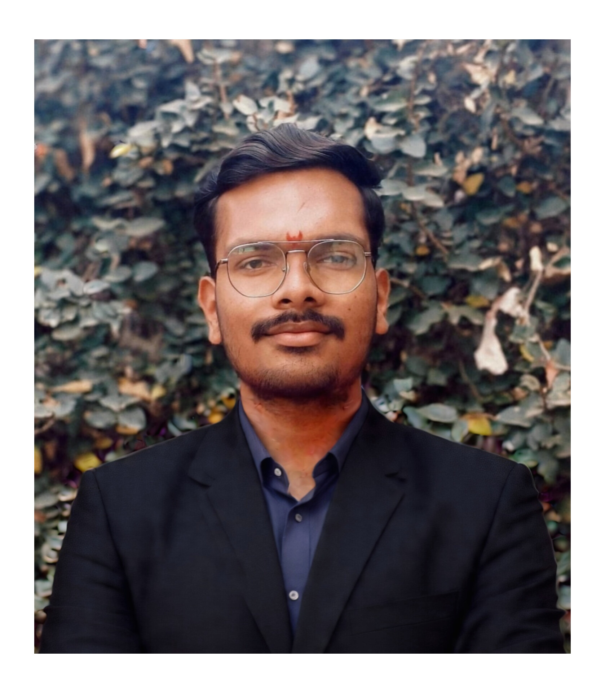
ABOUT ME
Student Profile
Name
MZ
Mayur Umakant Zope
Course
B.E. Computer Engineering (Third Year)
College
Nutan Maharashtra Institute of Engineering & Technology
Mayur Umakant Zope
Frontend Developer Intern
Roll No.
TEC-A171
B.E. Computer Engineering
Third Year • NMIET
Specialization
Roll No: TEC-A171
Frontend Development
Mayur Umakant Zope • Weularity Digital Agency • Frontend Developer Intern

Slide 4
ORGANIZATION
Weularity – Digital Agency
Type
W
Digital Agency
MSME Registered
Reg. No.
UDYAM-JK-07-0074522
WEULARITY
MSME Registration
Digital Agency
Website
www.weularity.com
PROJECTS WORKED ON
Official Company Website
www.weularity.com
Duration
1 Month
www.kanect.shop
January – February 2026
Agile / Scrum methodology • Alternate-day Scrum meetings
Mayur Umakant Zope • Weularity Digital Agency • Frontend Developer Intern

Slide 5
OVERVIEW
Internship at a Glance
5
2
4+
10+
Weeks
Live Projects
Technologies
PRs Raised
TIMELINE OVERVIEW
1
2
3
4
5
Week 1
Week 2
Week 3
Week 4
Week 5
Onboarding
UI Dev
Responsive
Design→Code
Deployment
Mayur Umakant Zope • Weularity Digital Agency • Frontend Developer Intern

Slide 6
WEEK 1
Onboarding & Environment Setup
1
Orientation
Attended internship orientation and understood company workflow and processes
2
Scrum Meetings
Participated in alternate-day Scrum meetings to track progress and plan tasks
3
Dev Environment
Set up development environment for Next.js and React.js projects
4
Codebase Study
Studied existing codebase and understood overall project structure
5
Git & GitHub
Learned Git & GitHub workflow including branch creation for feature dev and bug fixing
Mayur Umakant Zope • Weularity Digital Agency • Frontend Developer Intern

Slide 7
WEEK 2
Dynamic UI Component Development
TASKS COMPLETED
1
Designed and developed dynamic UI components for www.weularity.com
2
Worked with Next.js routing system for page navigation
3
Created reusable React functional components for scalable UI
4
Created separate Git branches for each assigned task
5
Implemented dynamic rendering using props and state management
6
Committed, pushed code, and raised pull requests for peer review
Mayur Umakant Zope • Weularity Digital Agency • Frontend Developer Intern

Slide 8
WEEK 3
Responsive UI Implementation
TAILWIND CSS RESPONSIVE DESIGN & Dynamic UI Components
BREAKPOINTS
Converted templates into React Components.
Implemented responsive UI using Tailwind CSS utility classes
Applied responsive breakpoints: mobile, tablet, and desktop
Fixed alignment and layout issues across various screen sizes
Tested responsiveness across multiple device screen sizes
Merged approved changes into main branch after code review
sm:
Mobile
640px
md:
Tablet
768px
lg:
Desktop
1024px
xl:
Wide
1280px
Mayur Umakant Zope • Weularity Digital Agency • Frontend Developer Intern

Slide 9
WEEK 4
Design Templates to Functional Code
Design Conversion
Weularity.com
Converted design templates into fully functional React components matching pixel-perfect specifications.
Developed and integrated new frontend components directly into the live Weularity website.
Kanect.shop
Code Quality
Built and deployed frontend components for kanect.shop maintaining design consistency throughout.
Maintained clean code structure, component reusability, and followed coding best practices.
GitHub Workflow
Scrum Updates
Used GitHub branches for structured development ensuring isolated feature development per task.
Reported progress in Scrum meetings, collaborated and coordinated with team members effectively.
Mayur Umakant Zope • Weularity Digital Agency • Frontend Developer Intern

Slide 10
WEEK 5
Final Deliverables & Project Sign-Off
Internship Successfully Completed!
✓
Branch Merging
Assisted in merging final frontend branches into production for Weularity and Kanect projects.
✓
Final Scrum
Participated in the final Scrum meeting for comprehensive project review and sign-off.
✓
All Tasks Done
Successfully completed all assigned frontend tasks and internship requirements within schedule.
✓
Live Deployments
Contributed components are live and running on www.weularity.com and www.kanect.shop.
Mayur Umakant Zope • Weularity Digital Agency • Frontend Developer Intern

Slide 11
TECHNOLOGIES
Tools & Technologies Used
⚛
React.js
▲
Next.js
Frontend
Framework
Built reusable functional components with props, state management and dynamic rendering for production-grade web apps.
Utilized Next.js routing system and SSR capabilities for high-performance web pages and seamless navigation.
🎨
Tailwind CSS
🔀
Git & GitHub
Styling
Version Control
Applied utility-first CSS for rapid responsive design with mobile-first breakpoints across all device sizes.
Managed code via branches, commits, pull requests and collaborative code reviews in a professional team environment.
Mayur Umakant Zope • Weularity Digital Agency • Frontend Developer Intern

Slide 12
METHODOLOGY
Agile & Scrum in Practice
1
2
3
4
Sprint Planning
Daily Scrum
Sprint Execution
Review & Retrospective
HOW I APPLIED SCRUM
Attended alternate-day Scrum stand-up meetings for daily progress updates
Created feature branches for each sprint task ensuring isolated development
Raised Pull Requests for peer review before merging to main/production branch
Participated in final sprint review and sign-off meeting with team leads
Mayur Umakant Zope • Weularity Digital Agency • Frontend Developer Intern

Slide 13
VERSION CONTROL
Git & GitHub Workflow
1
2
3
Branch Creation
Development
Commit & Push
Created dedicated feature/fix branches from main for each assigned task.
Developed components, implemented features, and tested locally on the branch.
Committed changes with meaningful messages and pushed to remote repository.
4
5
6
Pull Request
Code Review
Merge to Main
Raised Pull Requests for code review with team lead before any merge.
Addressed review comments, made fixes, and got the PR approved.
Merged approved branches into main/production after sign-off.
Mayur Umakant Zope • Weularity Digital Agency • Frontend Developer Intern

Slide 14
LEARNINGS
Key Learnings & Skills Gained
React.js Mastery
Next.js Framework
⚛
▲
Deepened understanding of component architecture, props, state, and React lifecycle in real projects.
Gained hands-on experience with Next.js routing, SSR, and building production-grade web applications.
Tailwind CSS
Git Workflow
🎨
🔀
Mastered utility-first styling and responsive design principles for cross-device compatibility.
Understood professional version control with branching strategies, PRs, and collaborative code reviews.
Agile/Scrum
Industry Readiness
🔄
💼
Experienced real-world Agile methodology, sprint planning, daily stand-ups and iterative delivery.
Improved team communication, code quality, and ability to work on live production websites.
Mayur Umakant Zope • Weularity Digital Agency • Frontend Developer Intern

Slide 15
CONCLUSION
A Transformative Experience
The internship at Weularity bridged the gap between academic knowledge and real-world software development. Working on live projects like weularity.com and kanect.shop provided invaluable practical exposure.
✓
Built production-ready React/Next.js components
✓
Followed professional Agile/Scrum workflow
✓
Mastered Git branching & PR-based reviews
✓
Contributed to 2 live websites
Thank You!
Mayur Umakant Zope • TEC-A171 • NMIET • Frontend Developer Intern • Weularity Digital Agency

