Slide 1
Crop Production Analysis in India
Submitted By: Mayura Chibb

Slide 2

Project Overview:
The agriculture sector, as a crucial component of the overall supply chain, is anticipated to undergo significant advancements in the coming years due to developments in the Future Internet.
This paper introduces an innovative Business-to-Business collaboration platform from the agri-food sector's viewpoint, designed to enable effective and flexible collaboration among various stakeholders across related business domains.
This dataset contains extensive information on crop production in India spanning multiple years. The primary objective is to predict crop yields and uncover key insights, focusing on the indicators and metrics that significantly impact crop production.
Start by creating views and dashboards, and then craft a narrative around the data.

Slide 3
Data Exploration
Start by familiarizing yourself with the dataset’s structure and content, including the examination of columns, data types, and the identification of any missing values.
Acquire knowledge about the agricultural domain, focusing on key factors influencing crop production such as climate conditions, soil quality, and farming techniques.

Slide 4
Data Preprocessing
Address missing or incomplete data by either removing the affected rows or imputing the missing values using suitable methods.
Identify and correct any inconsistencies or errors present in the data.
Develop new features or modify the existing ones to uncover valuable information for analysis.

Slide 5
Results of Data Analysis

Slide 6
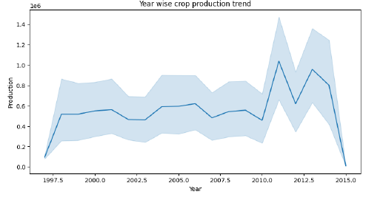
Trends of year wise crop production

Slide 7
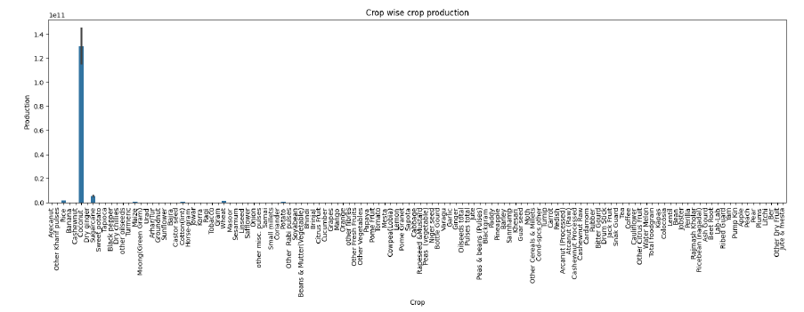
Trends of crop-wise crop production

Slide 8
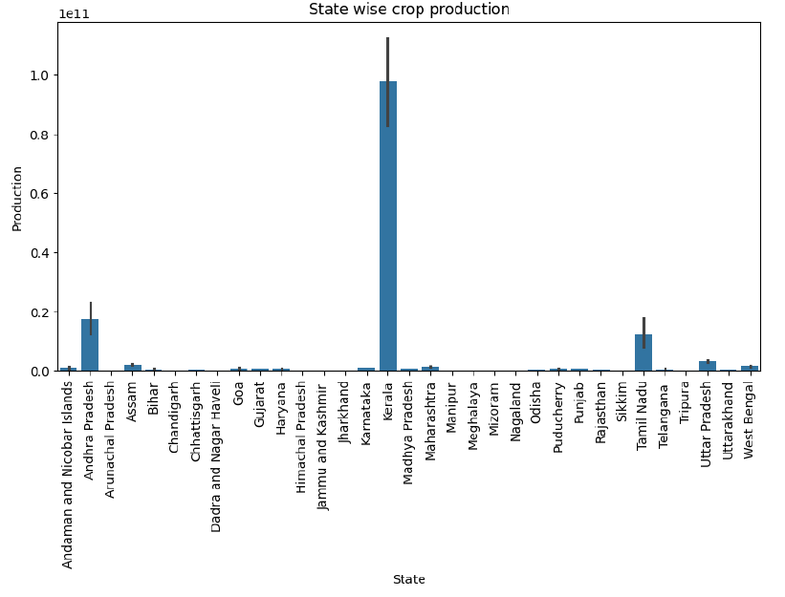
Trends of state-wise crop production

Slide 9
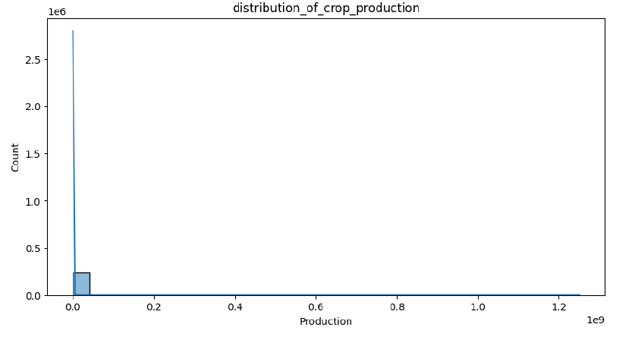
Distribution of crop production

Slide 10

Conclusion
To conclude, the analysis of crop production data using Python has yielded valuable insights into agricultural practices and productivity in India. By exploring trends, patterns, and key factors affecting crop production, we have developed a more comprehensive understanding of the agriculture sector's dynamics.
This analysis has uncovered opportunities to optimize agricultural practices, enhance productivity, and address the challenges faced by farmers. The findings underscore the importance of data-driven approaches in guiding decision-making and fostering innovation within the agriculture domain.

Slide 11

Thank you

