Slide 1
Data Visualization of
Amazon Sales Data
Submitted By: Mayura Chibb

Slide 2

Project Overview:
This project aims to analyze Amazon sales data to identify trends in monthly and yearly sales, understand profit patterns and visualize performance over time. The insights derived from this analysis can guide strategic decisions and offer valuable information to stakeholders.
Data Overview:
The dataset utilized for this analysis is the "Amazon Sales Data.csv" file, which includes details on sales transactions.

Slide 3
Data Preprocessing
As a part of data preprocessing, we extracted the key features required for our analysis. We performed the datetime data conversion and formatting. We implemented the ETL processes for data cleaning and transformation.

Slide 4
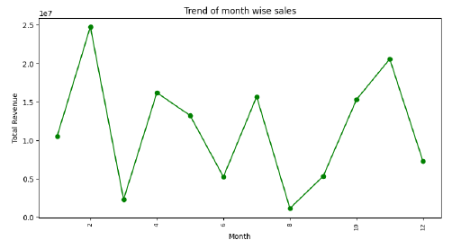
Trends of month-wise sales
To find month-wise sales trends we first grouped the data by month and found the total revenue. The month-wise sales trends were visualized using a line plot.

Slide 5
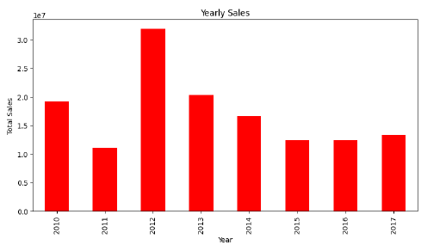
Trends of yearly sales
To find month-wise sales trends we first grouped the data by year and found the total revenue. The yearly sales trends were visualised using a bar chart.

Slide 6
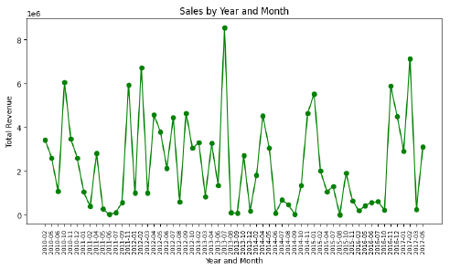
Trends of sales by year and month
To find sales by month and year, we first grouped the data by month and found the total revenue. The trends of sales by year and month were visualised using a line plot.

Slide 7
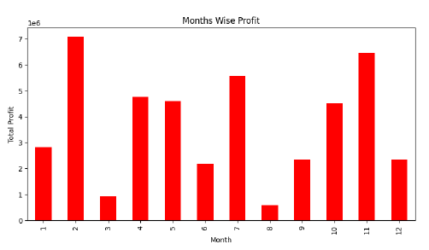
Trends of month-wise profit
To find trends of month-wise profit, we first grouped the data by month-year and found the total profit. The trends of month-wise profit were visualised using a bar chart.

Slide 8
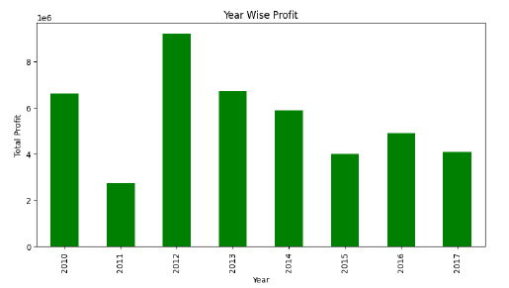
Trends of year-wise profit
The trends of year-wise profit were visualised using a bar chart.

Slide 9
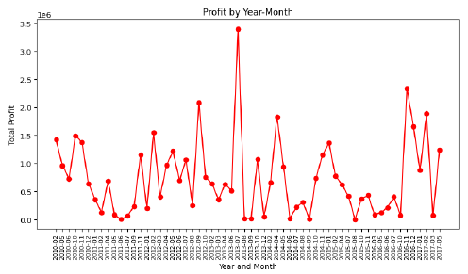
Trends of profit by year and month
The trends of profit by year and month were visualised using a line plot.

Slide 10

Conclusion
This project effectively analyzed Amazon sales data, offering valuable insights into monthly and yearly trends as well as profit distributions. The visualizations and identified trends can play a crucial role in making informed business decisions and crafting strategies for future growth.

Slide 11

Thank you

