Slide 1
Data Visualization of Bird Strikes between 2000-2011
Submitted By: Mayura Chibb

Slide 2

Project Overview:
Transport and communication are crucial domains in the field of analytics.
Environmental impacts and safety are, nowadays, two major concerns of the scientific community concerning transport scenarios and the ever-growing urban areas. These issues gain more importance due to the increasing amount of vehicles and people. Seeking new solutions is reaching a point where available technologies and artificial intelligence, especially MAS, are being recognized as ways to cope with and tackle these kinds of problems in a distributed and more appropriate way.
A bird strike is strictly defined as a collision between a bird and an aircraft which is in flight or on a take-off or landing roll. The term is often expanded to cover other wildlife strikes - with bats or ground animals. Bird Strike is common and can be a significant threat to aircraft safety. For smaller aircraft, significant damage may be caused to the aircraft structure and all aircraft, especially jet-engine ones, are vulnerable to the loss of thrust which can follow the ingestion of birds into engine air intakes. This has resulted in several fatal accidents.
Bird strikes may occur during any phase of flight, but are most likely during the
take-off, initial climb, approach and landing phases due to the greater numbers of birds in flight at lower levels. To have a closer look the following document visually depicts the data collected on Bird Strikes by FAA between 2000-2011.

Slide 3
Results of Data Analysis

Slide 4
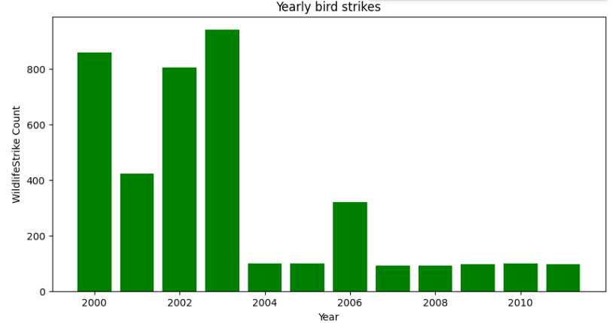
Yearly Bird Strikes

Slide 5
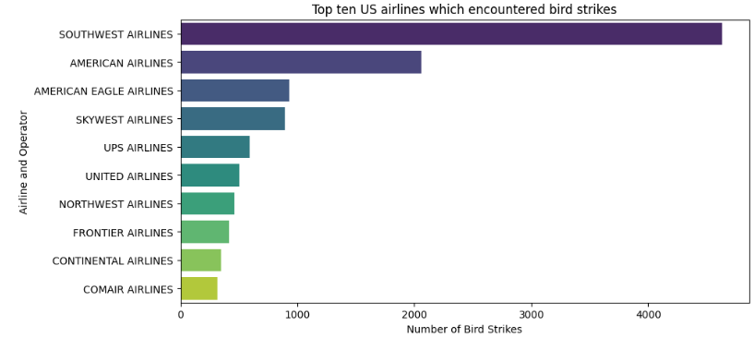
Top ten US airlines which encountered bird strikes

Slide 6
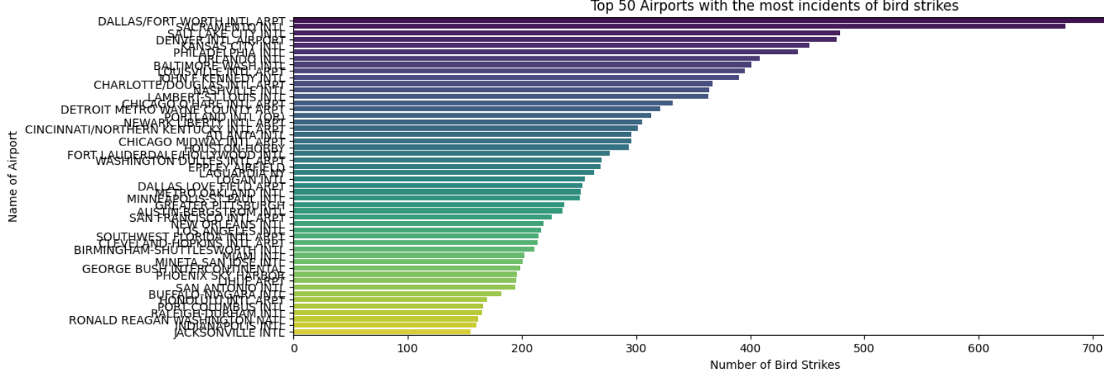
Top 50 airports with the most incidents of bird strikes

Slide 7
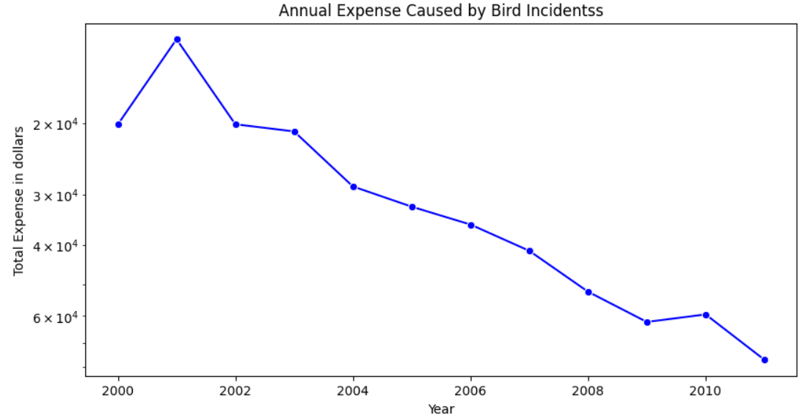
Yearly loss due to bird strikes

Slide 8
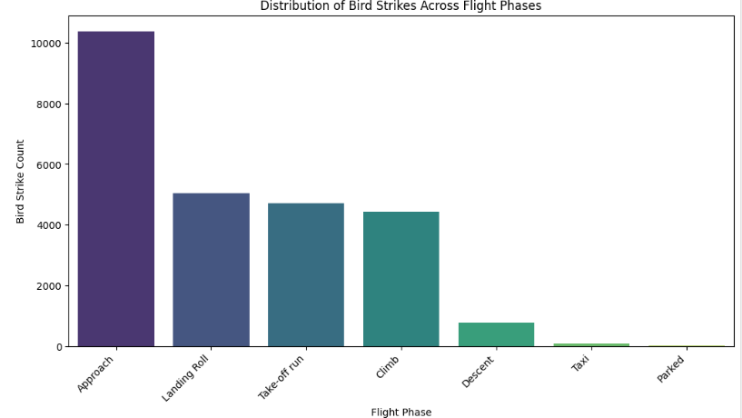
Time of occurrence of bird strikes

Slide 9
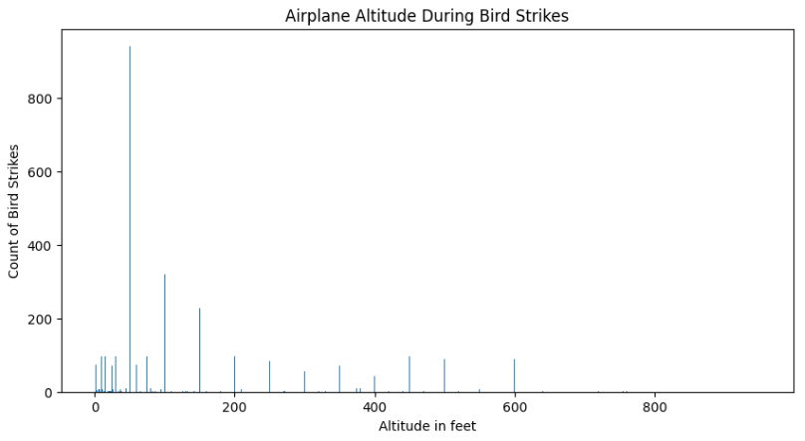
Altitude of aeroplane during bird strikes

Slide 10
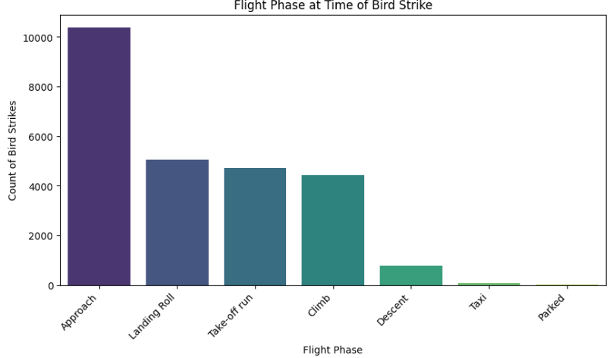
Phase of flight during bird strikes

Slide 11
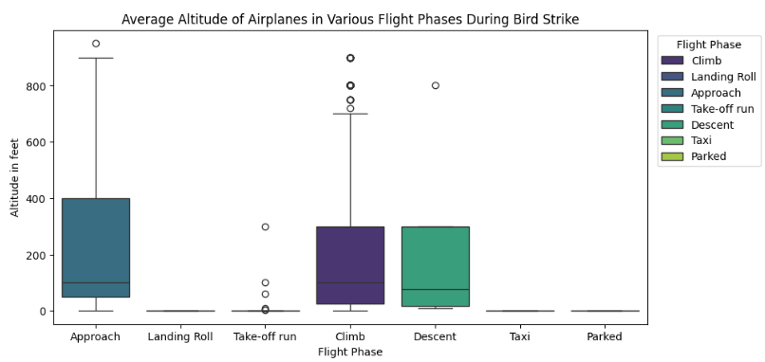
Average altitude of the aeroplane during bird strike

Slide 12
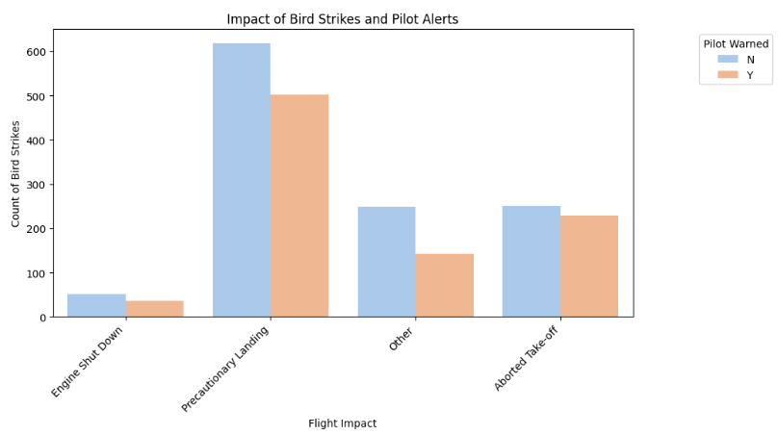
Effect of Bird Strike on flight

Slide 13
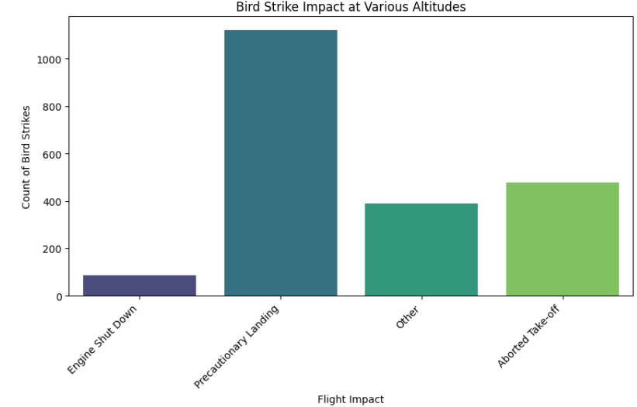
Effect of Bird Strike at different altitude

Slide 14
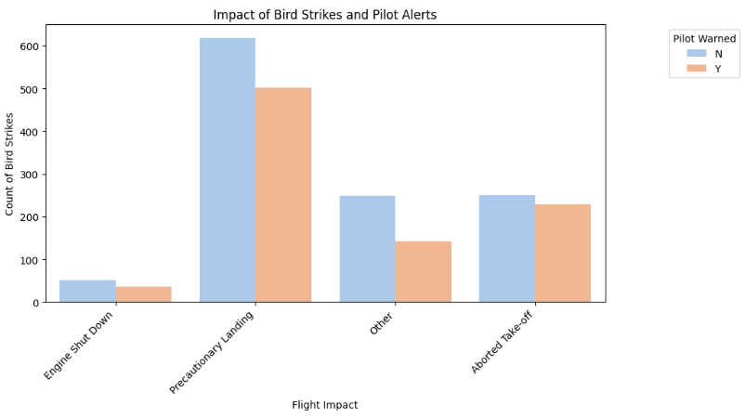
Effect of prior warning to the pilots about the bird strike

Slide 15

Conclusion
In summary, the detailed analysis of bird strike incidents between 2000 and 2011 offers valuable insights into the patterns, risks, and possible mitigation strategies in aviation safety. By utilizing advanced data visualization techniques and statistical analysis, we have identified trends in bird strikes, pinpointed high-risk scenarios, and assessed the impact on various aspects of flight operations. The findings underscore the need for continued vigilance and proactive measures to mitigate bird strike risks, ensuring the safety of both passengers and aircraft. This study contributes to ongoing efforts to improve aviation safety protocols and promotes a proactive approach to wildlife management around airports.

Slide 16

Thank you

