Slide 1
A GUIDED WALKTHROUGH FOR THE DEAN OF ACADEMICS
CampusFlow
for Fr. CRCE
One academic system where R2024, the timetable, the marks and the deadlines agree, from the first lecture to the CO attainment report.
Prepared for Fr. Conceicao Rodrigues College of Engineering, Bandra
October 2026
Notes:
Open with the one-line promise: the rule book, the timetable, the marks and the deadlines live in one place, so the Dean’s office stops reconciling spreadsheets. This is a live system already loaded with Fr. CRCE’s publicly available programmes, departments and R2024 rules. Keep the demo open in another tab: admin for institution views, teacher for course views.

Slide 2
Autonomous, accredited and growing
WHERE FR. CRCE STANDS
R2024
A · 3.18
2
5
Own rule book
Autonomous from AY 2024-25 under Academic Rule Book R2024
NAAC grade
Grade and CGPA as published by the college
NBA programmes
B.Tech Computer Engineering and Electronics & Computer Science
Active programmes
B.Tech COMP, CSE, ECS and MECH, plus M.Tech Computer
Autonomy moves the rule book, the question papers, the CIE and the results into the college. The Dean’s office now owns every one of those deadlines.
Source: the college’s public pages and disclosures, compiled October 2026; to be confirmed with the college
Notes:
Set the scene with facts the Dean already knows: autonomy under R2024 from 2024-25, NAAC A with CGPA 3.18, NBA for Computer Engineering and Electronics & Computer Science, five active programmes. Autonomy brings paper setting, CIE, results and re-exams in-house, and the Dean’s office carries those deadlines. Everything here came from public sources; invite corrections.

Slide 3
Five rules, five things to track
WHAT R2024 ASKS THE ACADEMIC OFFICE TO RUN
R2024 rule | What the office must track | Where CampusFlow does it
75% attendance to sit MSE / ESE | Attendance per course, defaulter lists | Attendance, checked against biometric punches
ISE 20 + MSE 30 + ESE 100 (scaled) | Marks per head and CIE totals | Assessment scheme and CIE report
Pass at 40% UG / 45% PG, no grace | Result rules per programme | Rules framework, per programme
Special and re-exams | Eligible candidates, separate papers | Re-exams and additional assessments
CO attainment for NBA | CO-tagged questions and rubrics | CO attainment report
Rules as summarised from the R2024 rule book; exact weightages to be confirmed with the exam cell
Notes:
Walk the table left to right: the rule, the work it creates for the office, and the screen that handles it. Grade penalties for special and re-exams and the FY to SY credit condition are configured during the pilot. Ask the Dean which of these five costs the office the most time today.

Slide 4
Eight stops through the live system
THE WALKTHROUGH
1
Institution and programmes
2
Rules: AICTE, MU, R2024
3
Syllabus to lesson plan
4
Attendance and schedule changes
5
Continuous internal evaluation
6
CO attainment for NBA
7
Deadlines timetable
8
Notification centre
Then the people: a student’s journey from admission to pass-out, and faculty workload against AICTE norms.
Notes:
The map for the next twenty minutes. Stops 1 and 2 are the Dean’s settings, 3 to 6 are what a faculty member does in a term, 7 and 8 are how the office keeps everyone on schedule. If time is short, do stops 2, 5, 6 and 7.

Slide 5
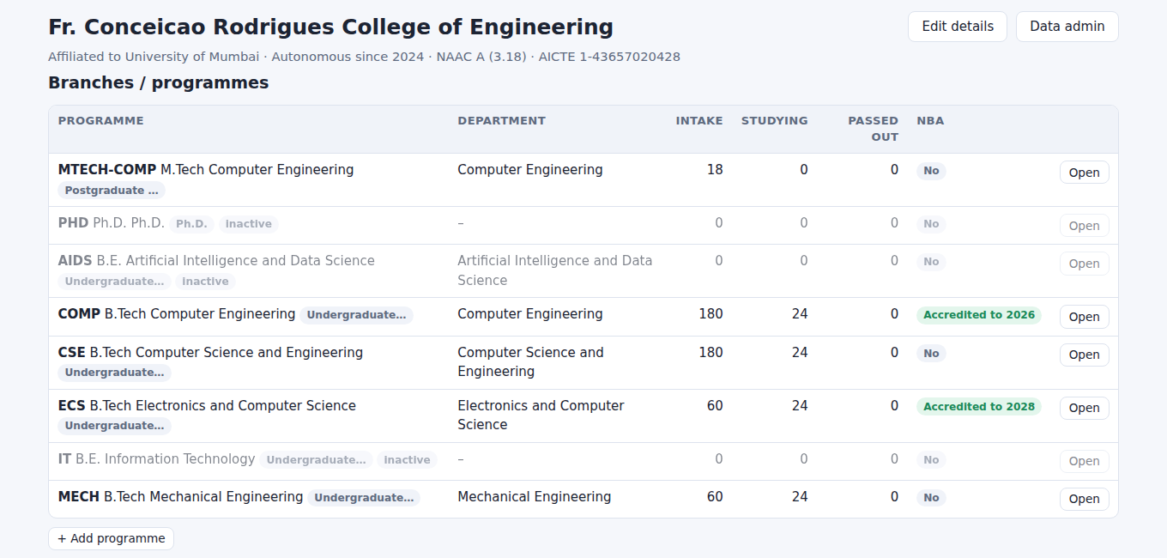
Fr. CRCE, set up once
STOP 1 · INSTITUTION AND PROGRAMMES
Programmes and intake
B.Tech COMP, CSE, ECS and MECH and M.Tech Computer, each with intake and NBA status.
Departments and HODs
Six departments with their heads, loaded from the college’s published pages.
Everything hangs off it
Courses, rules, students, faculty and deadlines all point to a programme and department.
Notes:
Demo: log in as admin, Institution → Overview. Point at intake, students studying and the NBA badges for Computer Engineering and ECS. Student numbers are demo students; programmes, departments, HODs and rules come from public sources and should be confirmed by the college.

Slide 6
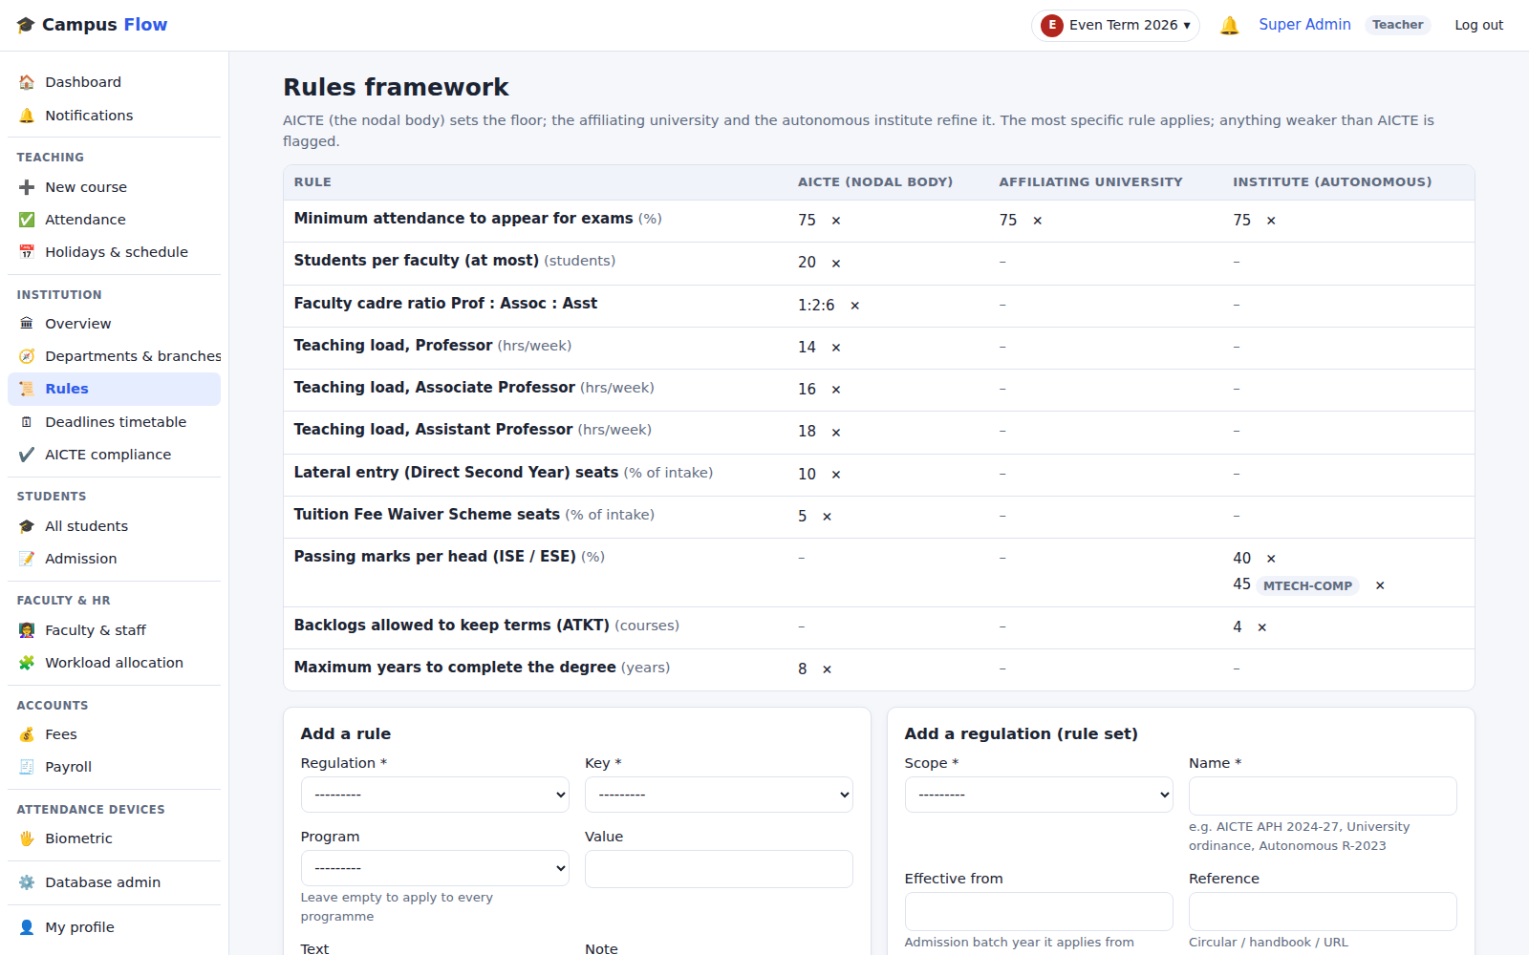
AICTE sets the floor, R2024 decides
STOP 2 · RULES FRAMEWORK
Three layers
Each rule sits at AICTE, University of Mumbai or institute level; the most specific one applies.
Per programme
Pass at 40% for B.Tech and 45% for M.Tech: one rule, set per programme.
Used everywhere
Attendance eligibility, promotion and results read the same rules, so a change applies everywhere.
Notes:
Demo: Institution → Rules. Read across minimum attendance (75 at every level), then the pass-mark row: 40 for B.Tech and 45 for M.Tech as institute rules. A looser rule than AICTE is flagged. During the pilot the full R2024 rule book is entered with the exam cell.

Slide 7
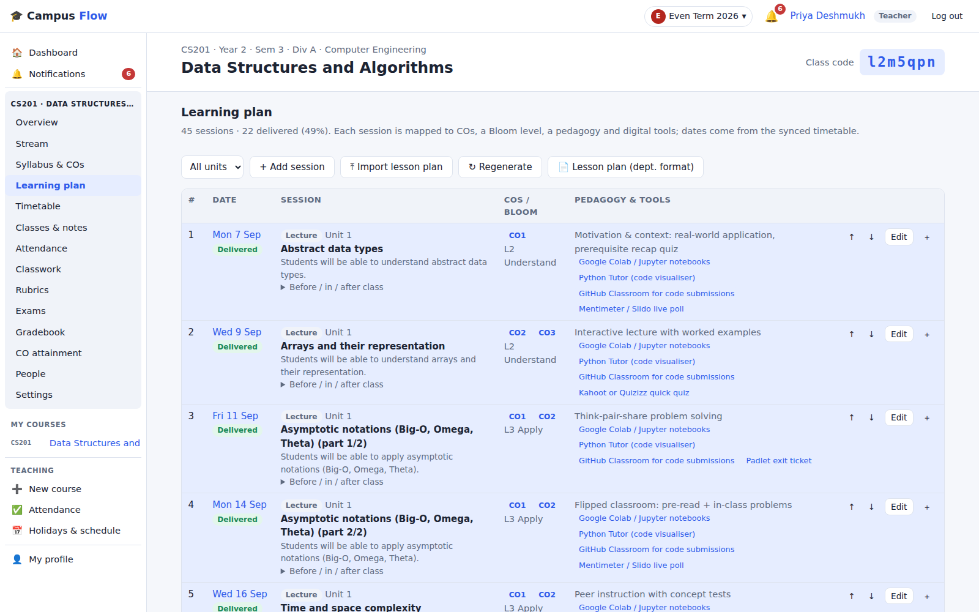
From syllabus to a dated lesson plan
STOP 3 · TEACHING PLAN
Upload the syllabus
A PDF, a Word file or the department’s existing lesson plan becomes COs, units and topics.
Placed on the timetable
Every session gets a date, its CO mapping, a Bloom level and a teaching method.
Department format out
The lesson plan prints in the department’s own format, with actual dates filled in.
Notes:
Demo: log in as teacher, open CS201, Learning plan. 45 sessions, 22 delivered, each with CO and Bloom level. Click “Lesson plan (dept. format)” for the printable version. An existing Word lesson plan can be imported as-is.

Slide 8
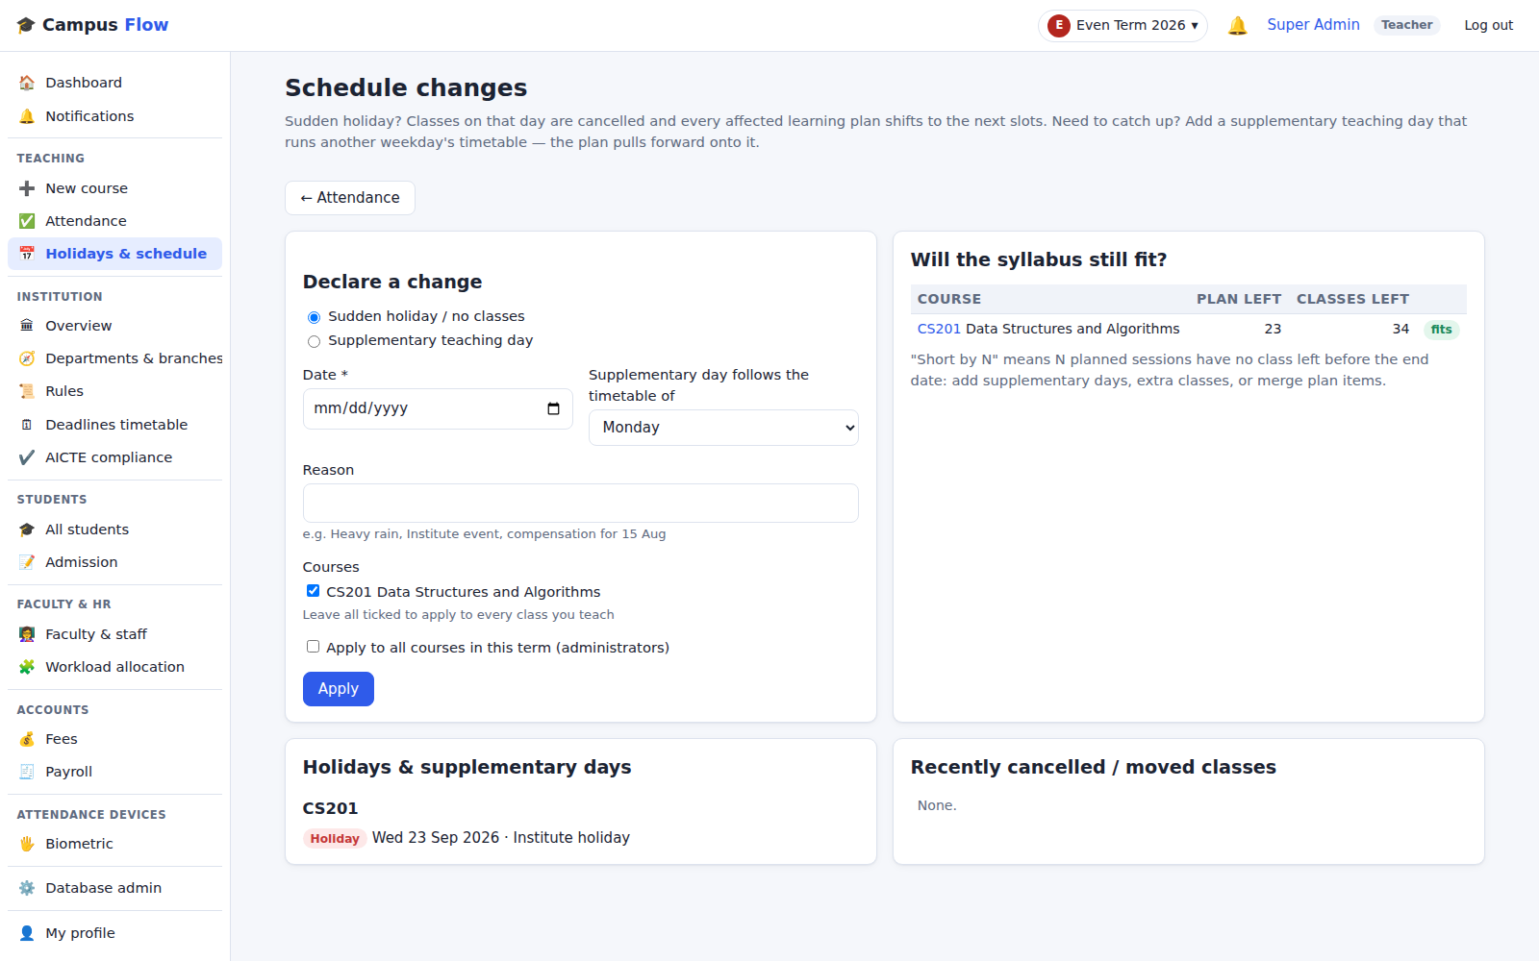
A holiday no longer breaks the plan
STOP 4 · ATTENDANCE AND SCHEDULE CHANGES
Sudden holidays
Declared once for a class or the whole term; every affected lesson plan shifts forward.
Supplementary days
“Saturday follows Monday’s timetable” pulls the plan back; the fit check shows who is short.
75% eligibility, live
Attendance is marked per class and checked against biometric punches; defaulters show before MSE.
Notes:
Demo: Teaching → Holidays & schedule. Declare a holiday and show the plan shifting; add a supplementary Saturday. Then Attendance: marked vs pending per course. In a course, Attendance → Compare with biometric.

Slide 9
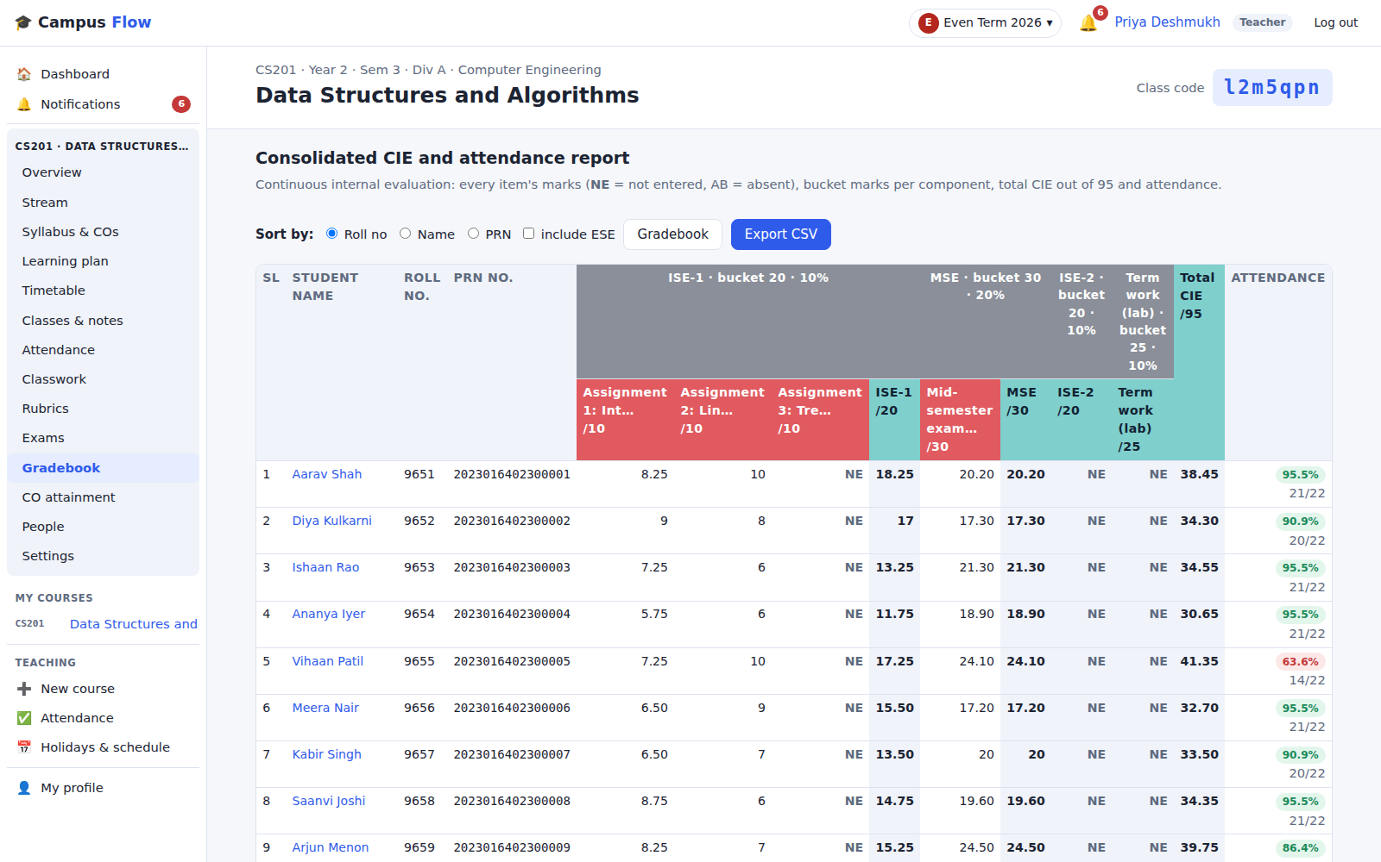
ISE, MSE and ESE on one sheet
STOP 5 · CONTINUOUS INTERNAL EVALUATION
Scheme per course
ISE, MSE, term work and ESE heads with marks and weights, set to match R2024.
Consolidated report
Every item, NE for not entered, AB for absent, total CIE and attendance; CSV for the exam cell.
Re-exams built in
Failed and absent students are suggested; the new score replaces or keeps the better one.
Notes:
Demo: CS201 → Gradebook → CIE report. Columns grouped by head with bucket marks and weight; NE and AB. Export CSV. The weights shown are the demo scheme; Exams → Assessment scheme sets them per course to R2024.

Slide 10
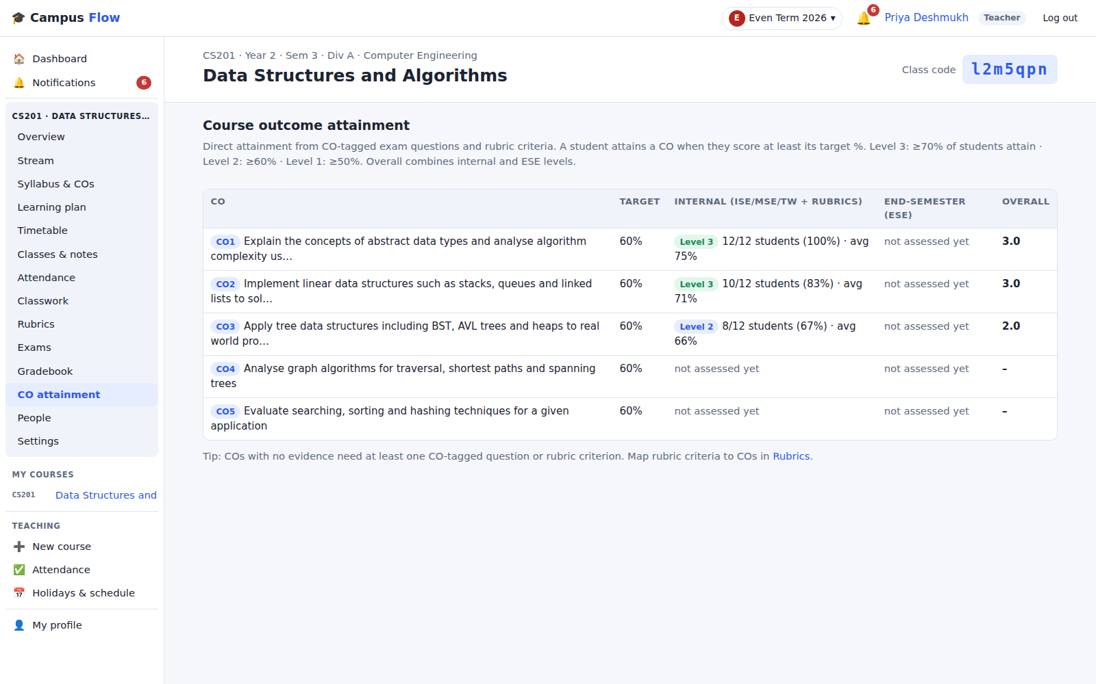
Attainment as a by-product of marking
STOP 6 · CO ATTAINMENT FOR NBA
Tagged at the source
Every question and rubric criterion carries its CO, so marks entry is the evidence.
Levels 1 to 3
Share of students reaching the target; internal and ESE combine into an overall level.
Gaps show early
A CO with no assessment yet is visible mid-term, not at the NBA file stage.
Notes:
Demo: CS201 → CO attainment. CO1 and CO2 at level 3, CO3 at level 2, CO4 and CO5 not yet assessed: the remaining assessments must cover them. Level bands and the ESE weight are settings.

Slide 11
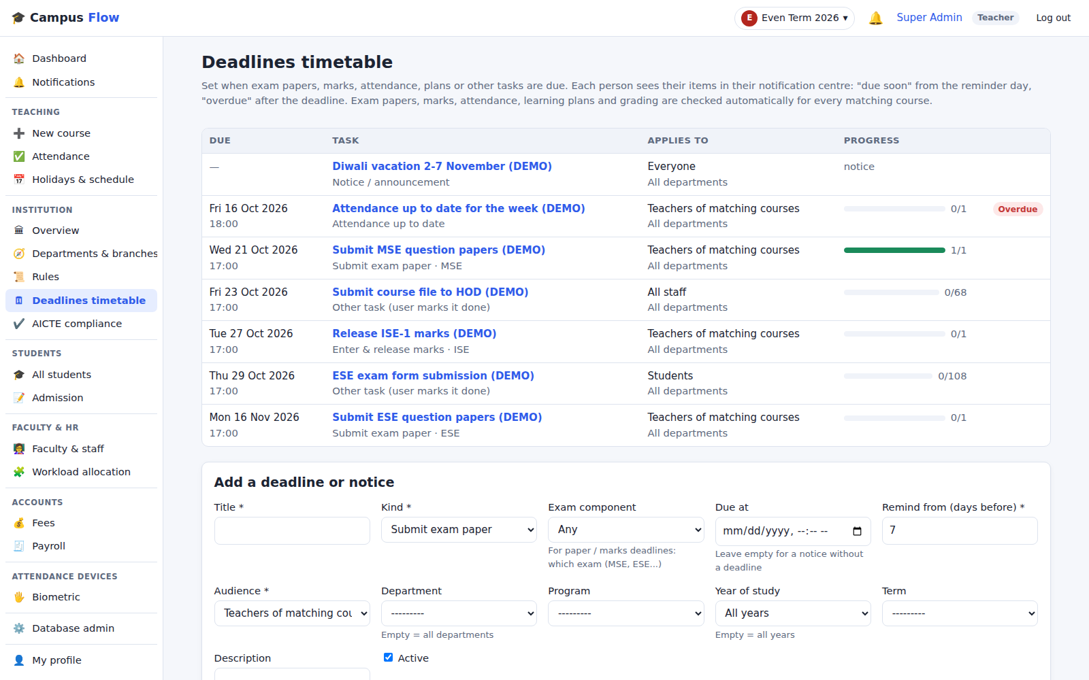
The Dean’s office sets the dates
STOP 7 · DEADLINES TIMETABLE
One academic timetable
MSE and ESE papers, marks release, attendance, course files: dated per department, year or term.
Checked, not chased
Paper submitted, marks released, attendance up to date: the system checks each course itself.
Who is pending
Each deadline shows done and pending courses or people, and turns red when it passes.
Notes:
Demo: as admin, Institution → Deadlines timetable. MSE papers 1/1 done; attendance overdue with one course pending. Open a deadline to see each course and teacher. Add one live: ESE papers, Computer Engineering, third year; everyone affected sees it in their notification centre.

Slide 12
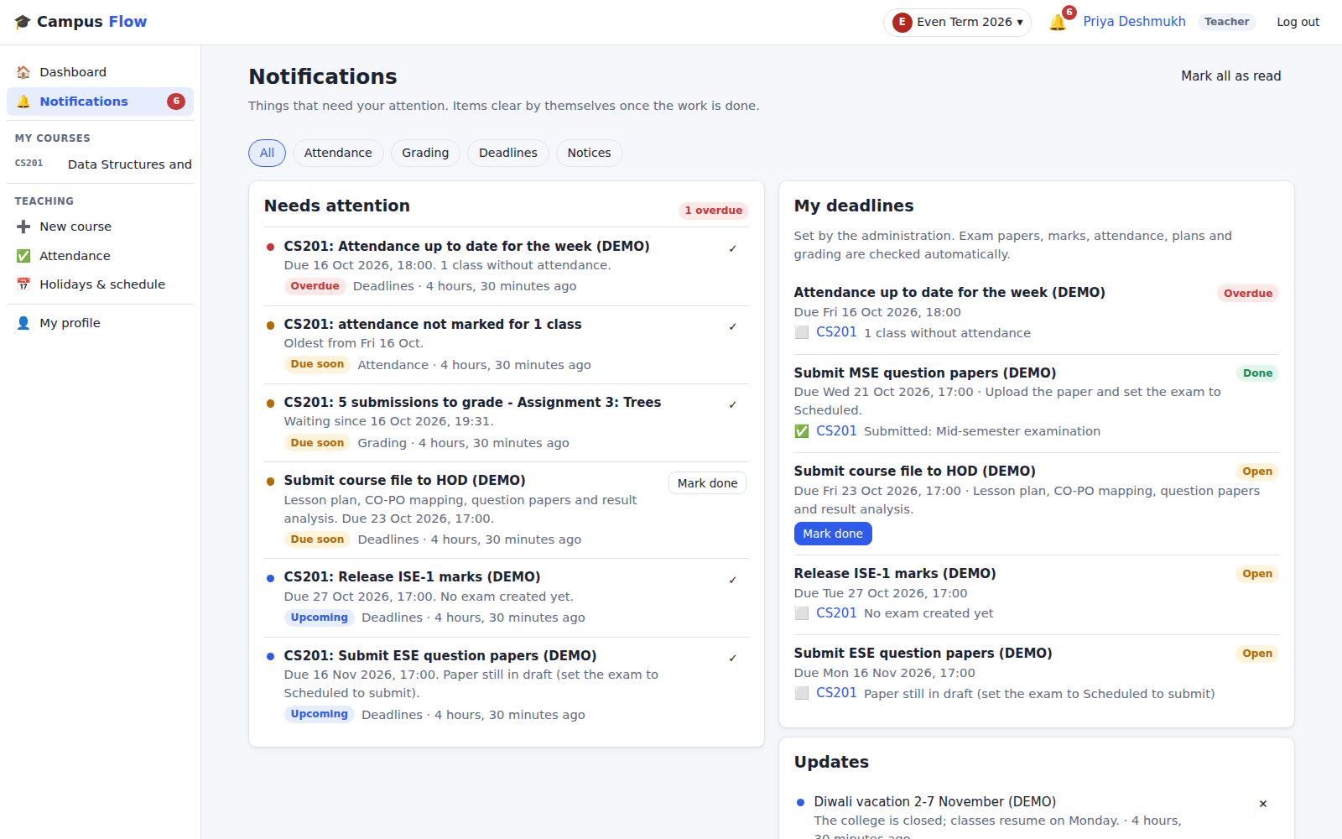
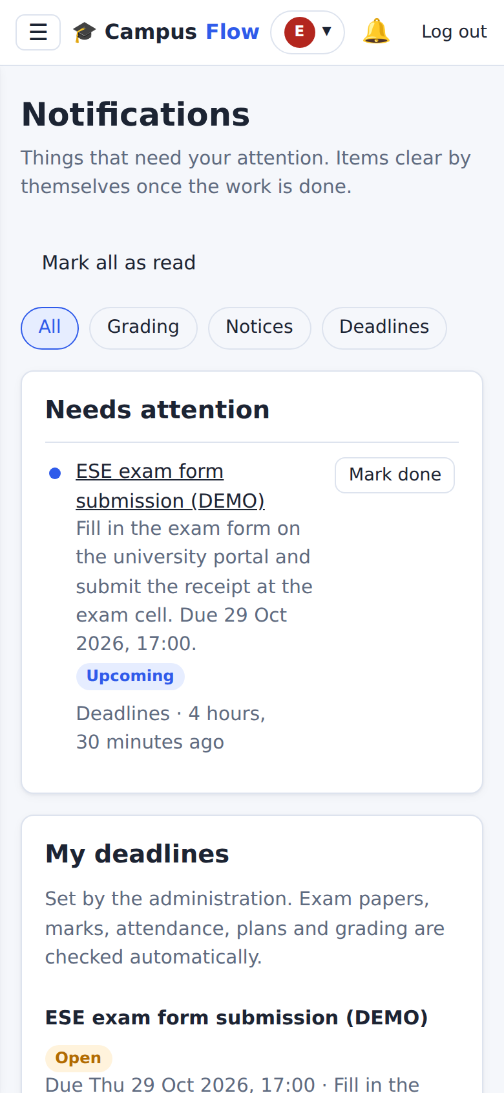
Everyone sees what is due, on any phone
STOP 8 · NOTIFICATION CENTRE
Faculty
Attendance not marked, submissions to grade, marks to release, papers due.
Students
Assignments due, attendance below 75%, upcoming exams, exam forms.
Clears itself
An item disappears when the work is done; optional email digests.
Notes:
Demo: log in as teacher on a phone and tap the bell. Red is overdue, amber due soon, blue upcoming; each links to where the work is done. Mark the pending attendance and the item moves to Recently cleared. No app needed: any phone browser.

Slide 13
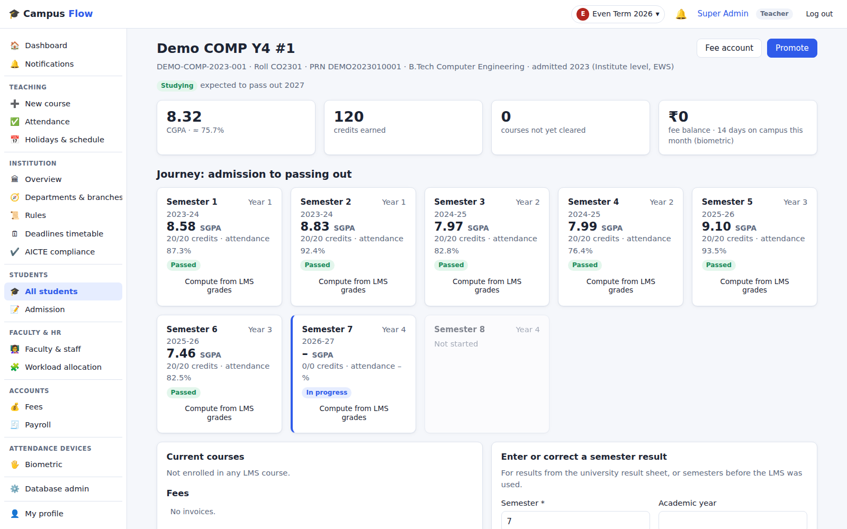
Every semester of every student
STUDENTS · ADMISSION TO PASS-OUT
From admission
CAP, institute, minority, TFWS or direct second year, with programme and category.
Semester by semester
SGPA, credits, attendance and backlogs, from LMS grades or entered from results.
Promotion by the rules
Detained, ATKT or promoted per the rules; CGPA shown with the R2024 percentage.
Notes:
Demo: Students → All students, open a final-year demo student. Six semesters passed, semester 7 in progress, CGPA with (CGPA − 0.75) × 10. These are labelled demo students; no real student data is used.

Slide 14
Load, skills and feedback in one record
FACULTY · TEACHING AND LAB STAFF
1
2
3
Workload against AICTE norms
Theory, lab, projects and admin duties add up per week and are compared with the norm for each designation; over and under load are flagged.
Competencies to subjects
Core skills rated 1 to 5. The allocation board suggests the best-matched faculty with spare hours for each course, and lab staff for practicals.
Feedback and presence
Student, HOD and peer ratings over time, with biometric days on campus and any classes taught without a punch.
The college’s published faculty list (66 staff, with designations and HODs) is already loaded; workloads and ratings are added during the pilot.
Notes:
Demo: Faculty & HR → Faculty & staff, then Workload allocation. Demo workloads and ratings are placeholders, so focus on how it works, not individual numbers. AICTE weekly norms of 14, 16 and 18 hours live in the rules and can be changed.

Slide 15
Questions answered without a circular
WHAT THE DEAN’S OFFICE GETS
Question | Where it is answered
Which MSE papers are still not submitted? | Deadlines timetable
Who is below 75% before the MSE? | Attendance report, per course
Which courses are behind their lesson plan? | Syllabus-fit check
Has every CO been assessed this term? | CO attainment, per course
Who is over or under the workload norm? | Faculty and staff list
How has this student done since admission? | Student journey
Notes:
Summarise the walkthrough as the questions the Dean’s office asks every term, each answered on one screen. Ask which question the Dean would add; it becomes a pilot success measure.

Slide 16
A one-term pilot in [Computer Engineering]
PROPOSAL
BEFORE TERM · [DATES]
Set up
Enter R2024 rules with the exam cell, the academic calendar, timetables and the full staff list.
DURING TERM
Run
[__] faculty run lesson plans, attendance and CIE in [SE / TE] divisions; MSE and ESE paper deadlines set by the office.
END OF TERM
Review
Compare CIE and CO attainment reports with the current process; faculty and exam cell feedback decide the rollout.
What we need from Fr. CRCE: the R2024 rule book, the 2026-27 academic calendar, pilot timetables and syllabi, and one coordinator in the Dean’s office.
Notes:
Propose a small, low-risk start: one department, one or two years, one term. Computer Engineering is suggested because of its NBA cycle, but let the Dean choose. Fill in dates, number of faculty and divisions with the Dean. The existing process runs in parallel during the pilot.

Slide 17
NEXT STEP
Try it with your own courses
The demo is live and already holds Fr. CRCE’s programmes, departments and R2024 rules. Pick the pilot scope and we load your timetables and syllabi.
DEMO SITE
51-255-35-112.sslip.io
DEMO LOGINS
admin · teacher · s01
shared on request
CONTACT
[Name]
[Phone · Email]
Notes:
Close on the ask: agree the pilot scope (department, years, term) and a coordinator. Share demo logins only with the people who will try it, and change the demo passwords before sharing widely. College data came from public sources; student and workload figures are demo data.

