Slide 1
CampusFlow
LEARNING MANAGEMENT SYSTEM · PROPOSAL
From syllabus to results — one system for every course, first year to final year.
Presented to the Principal · Prof. Mayur Aggarwal · October 2026
Notes:
Thank the Principal for the time. One-line pitch: every teacher already writes a lesson plan, keeps attendance, sets ISE/MSE papers, grades with rubrics and computes CO attainment for NBA, today across Word, the ERP and Excel. CampusFlow does all of it in one place, starting from the syllabus the teacher already has. About 15 minutes, followed by a live demo.

Slide 2
A teacher's semester lives in five different places
THE SITUATION TODAY
1
2
3
4
5
Lesson plan
Typed in Word, actual dates filled in by hand at the end
Attendance
In the ERP, class by class, with a growing pending list
Marks
Excel sheets per ISE and MSE, bucket conversions by hand
CO attainment
Computed manually for NBA files after the semester
Changes
Holidays, lost classes and re-exams handled ad hoc
None of these talk to each other, so the same information is typed again and again, and the plan drifts from what is actually taught.
Notes:
Use the Principal's own experience: lesson plans are submitted at the start of term and rarely updated; attendance is chased through pending lists; ISE/MSE marks are converted to bucket marks in Excel; CO attainment for NBA is assembled after the fact. Each step re-types the same course data.

Slide 3
One connected flow — each step feeds the next
THE IDEA
1
Syllabus
COs, units, topics, hours read automatically
2
Learning plan
Session by session, CO and Bloom mapped
3
Timetable
Plan placed on real dates, adapts to holidays
4
Class
Notes, attendance, planned vs actual
5
Classwork
Assignments graded with rubrics
6
Exams
ISE, MSE, ESE, re-exams
7
Results
Gradebook, CIE report, CO attainment
Enter information once. Marks, attendance and outcomes are computed — not re-typed.
Notes:
The backbone of the system. The syllabus defines course outcomes and units; the plan maps every session to an outcome; the timetable dates the plan; classes record what really happened; assignments and exams are tagged to outcomes, so results and CO attainment fall out automatically. Students connect to the same flow, much like Google Classroom.

Slide 4
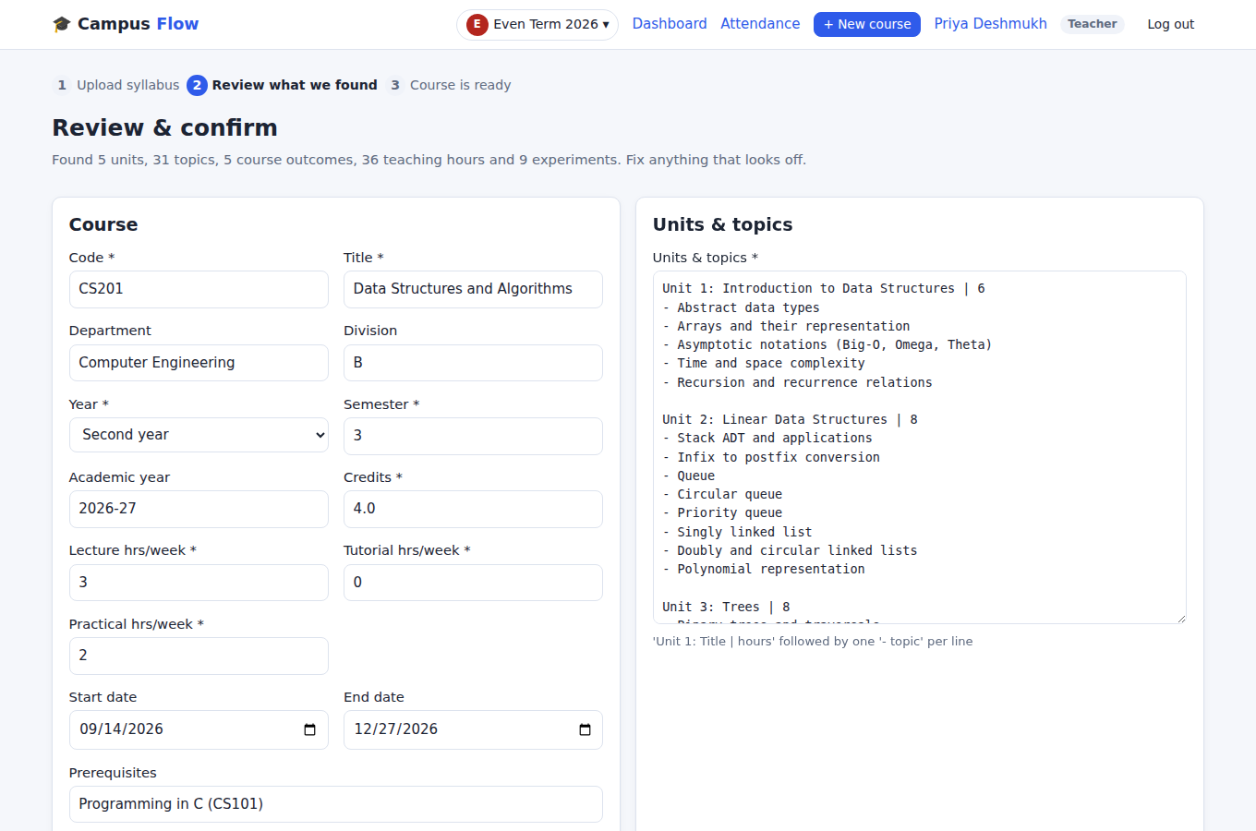
Upload the syllabus. The course builds itself.
COURSE SETUP
45
planned sessions (36 lectures + 9 labs)
93
exam questions, CO and Bloom tagged
6
draft assignments with rubrics
2
draft papers: MSE and ESE
Generated for a sample Data Structures syllabus. Accepts PDF, Word (.doc/.docx) or pasted text.
Notes:
The teacher uploads the university syllabus. CampusFlow reads the course code, credits, L-T-P hours, course outcomes, units with hours and topics, textbooks and lab experiments. The teacher checks it on one review screen, then one click creates the session plan, the ISE/MSE/TW/ESE scheme, rubric templates, a question bank, a draft assignment per unit, and draft MSE and ESE papers. Figures are from the sample syllabus used in testing.

Slide 5
Existing lesson plans are imported as they are
WORKS WITH WHAT TEACHERS ALREADY HAVE
In: the Word lesson plan (MEC702)
50
sessions from 17 rows
7
units from 1.1 / 2.1 numbering
Sr. | Proposed date | Topics | CO
3 | 22/7 (1) 26/7 (2) | 2.1 Supply chain performance | CO2
 | 15/8 | Independence Day
 | 12/9 | Mid Semester Exam
6
course outcomes kept
3
holiday and exam dates
And back out: the plan exports in the same departmental format (.docx), with actual dates and Covered / Not covered filled in from real classes.
Notes:
Real example: the MEC702 Logistics and Supply Chain Management lesson plan, an old-format Word .doc, uploaded as-is. '26/7 (2)' is read as two lectures that day; 1.1, 2.1 numbering becomes units; Independence Day becomes a holiday; MSE and ESE dates are picked up. At the end of term the same format is exported with actual dates and remarks filled in automatically.

Slide 6
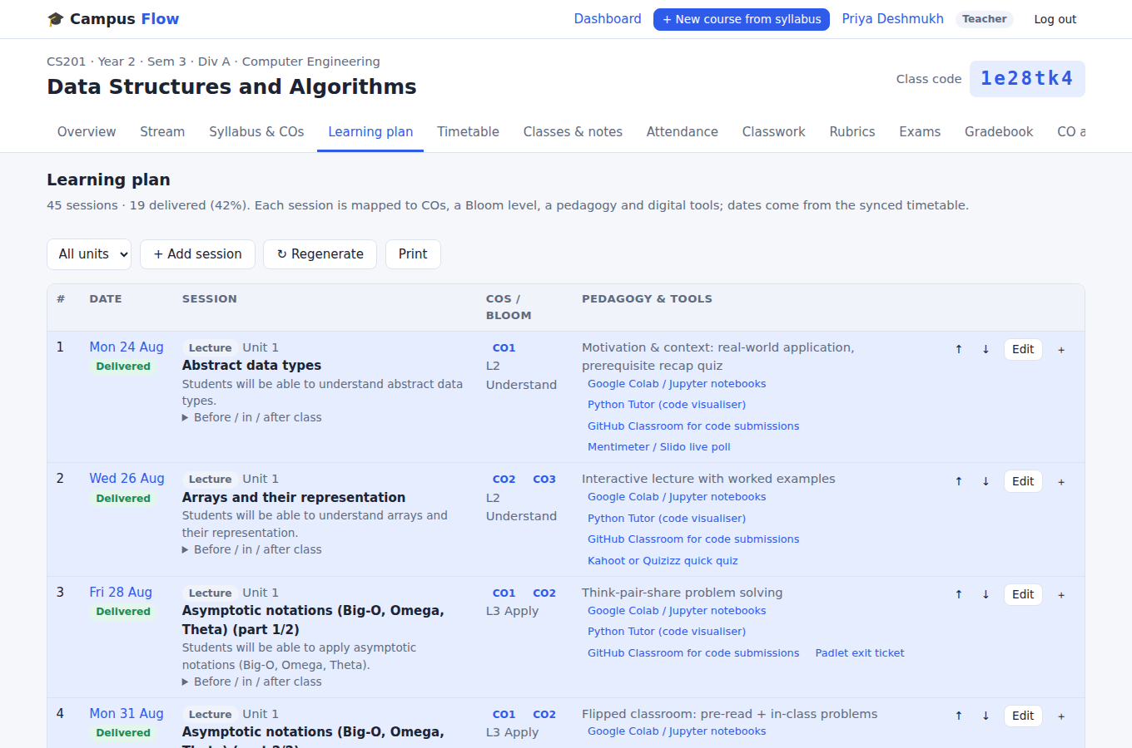
Every session has a purpose
LEARNING PLAN
Outcome-mapped: each session tied to a CO and a Bloom level that climbs through the unit
Year-aware teaching: demos for first years, PBL and case studies for final years
Modern tools suggested: Colab, MATLAB, Tinkercad, PhET, Virtual Labs, live polls
Before, in and after class activities for each session
Notes:
Each session shows its date, objective, course outcome, Bloom level, teaching method and suggested digital tools. Methods change with the year: guided practice and demonstrations for first years, flipped classes and problem-based learning in third year, case studies, projects and research-paper discussion for final years. Teachers can edit, reorder, insert or regenerate any item.

Slide 7
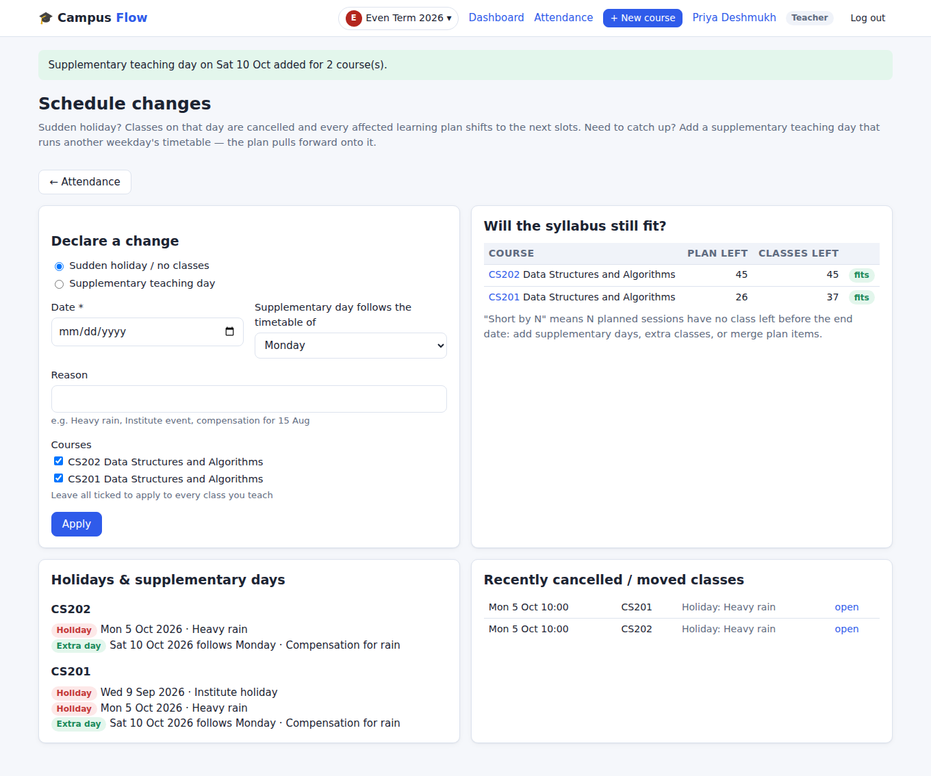
A schedule that absorbs surprises
TIMETABLE
Sudden holiday: one entry cancels that day for all classes; every plan shifts forward
Supplementary day: "Saturday follows Monday's timetable" pulls the plan back on track
Reschedule a class to any date; the original stays on record
Early warning when the syllabus no longer fits the remaining classes
Notes:
In testing: declaring Monday 5 October a holiday ('Heavy rain') cancelled that class with the reason recorded, moved its topic to Wednesday and warned that one session no longer fit; adding Saturday 10 October as a supplementary day following Monday's timetable brought it back. Administrators can declare a holiday for the whole institute in one step. Classes already taught are never touched.

Slide 8
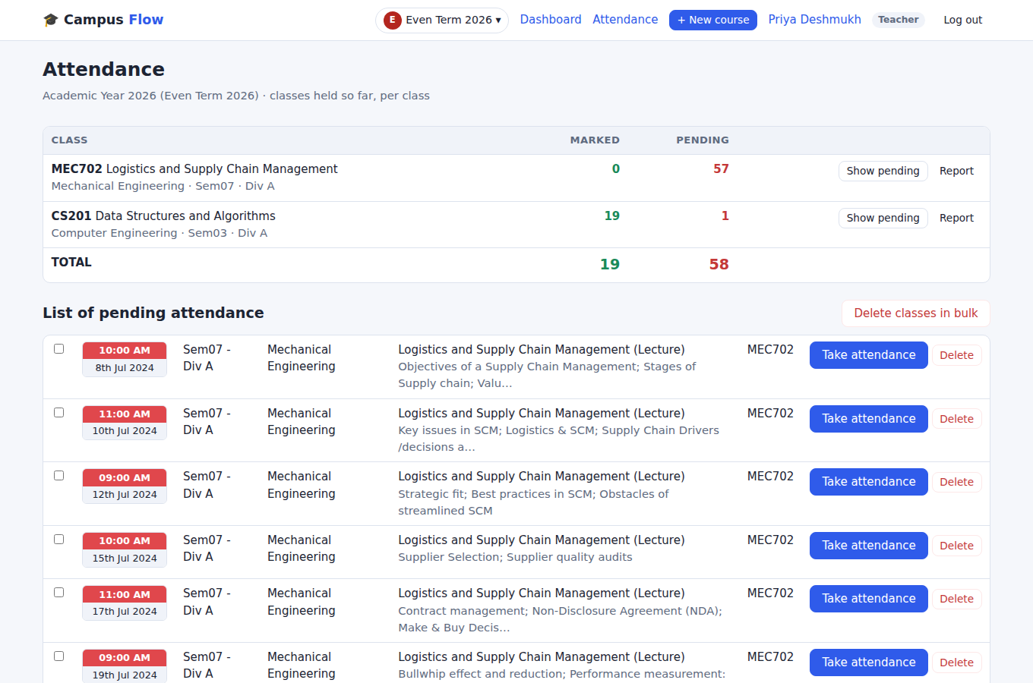
No more pending attendance pile
ATTENDANCE & CLASS NOTES
Marked vs pending for every class, with take, delete or bulk delete
One tap marks the class present; students can self check-in with a 6-digit code
Notes and slides saved with the class and shared with students
Below 75% students are flagged automatically
Notes:
Modelled on the ERP's attendance screen: per class, how many classes are marked and pending, and a list of pending classes. Taking a class records attendance, what was actually covered, notes and slides. A partly covered topic carries over to the next class automatically. Deleting a class that never happened shifts the plan forward.

Slide 9
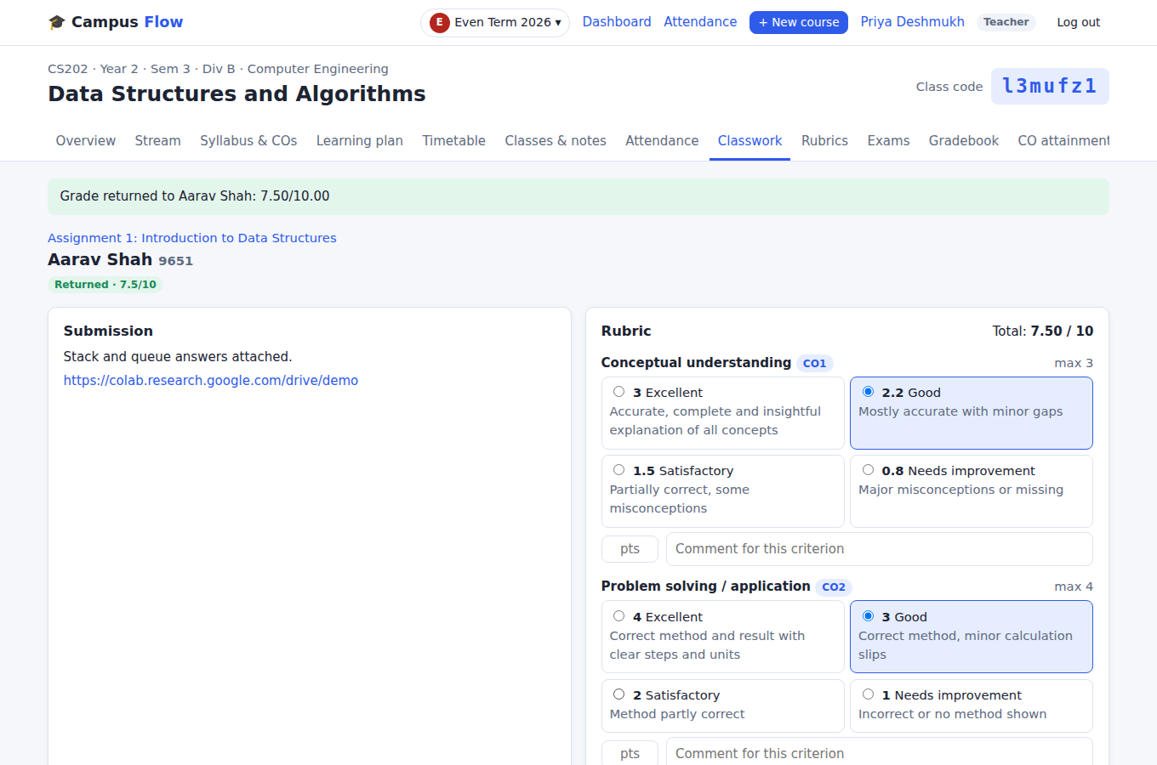
Google Classroom ease, rubric grading built in
CLASSROOM
Students join with a class code and submit files or links (Colab, GitHub, Drive)
Click rubric levels and the score adds up; type a total and it maps back onto the rubric
Feedback returned to students criterion by criterion
Notes:
Teachers grade by clicking a performance level for each rubric criterion; the total is computed. A typed or imported total is spread back across the rubric criteria, which keeps outcome data complete. Each criterion maps to a course outcome, which feeds CO attainment.

Slide 10
ISE, MSE, term work and ESE in one weighted scheme
HOLISTIC ASSESSMENT FRAMEWORK
ISE-1 · 10%
MSE · 20%
ISE-2 · 10%
TW · 10%
ESE · 50% (min. 40% to pass)
Papers by blueprint
Balanced across units, Bloom levels and COs; no repeated questions
Marks your way
Question-wise, a total, or a CSV import; absentees marked AB
Final grade computed
Weighted %, 10-point grade, minimum-pass rules applied
Every weight, maximum and pass rule is editable per course to match university norms.
Notes:
Default for a course with a lab: ISE-1 10%, MSE 20%, ISE-2 10%, term work 10%, ESE 50%, with a 40% minimum in ESE and term work; theory-only courses default to 10/20/10/60. Question papers are generated against a blueprint and print with a marking scheme. The gradebook converts everything to bucket marks and a final grade on the 10-point scale.

Slide 11
Re-exams and make-up tests, without spreadsheets
SECOND CHANCES, HANDLED PROPERLY
1
Who needs it
Absent or below the pass mark: suggested automatically
2
Fresh paper
Generated from the bank, no question repeated
3
Only them
Marks entry and visibility limited to registered students
4
Result folds in
Replaces the original, or the better score counts; marked RE / ADD
Works for the ESE, the MSE, an ISE test or a missed assignment — and can run in the re-exam term.
Notes:
Two kinds: a re-exam, typically for ESE failures and absentees, where the new score replaces the original; and an additional or make-up assessment, for a missed ISE test or assignment or for improvement, where the better score counts. Results fold into the gradebook, CIE report and final grade, marked RE or ADD so the audit trail is visible.

Slide 12
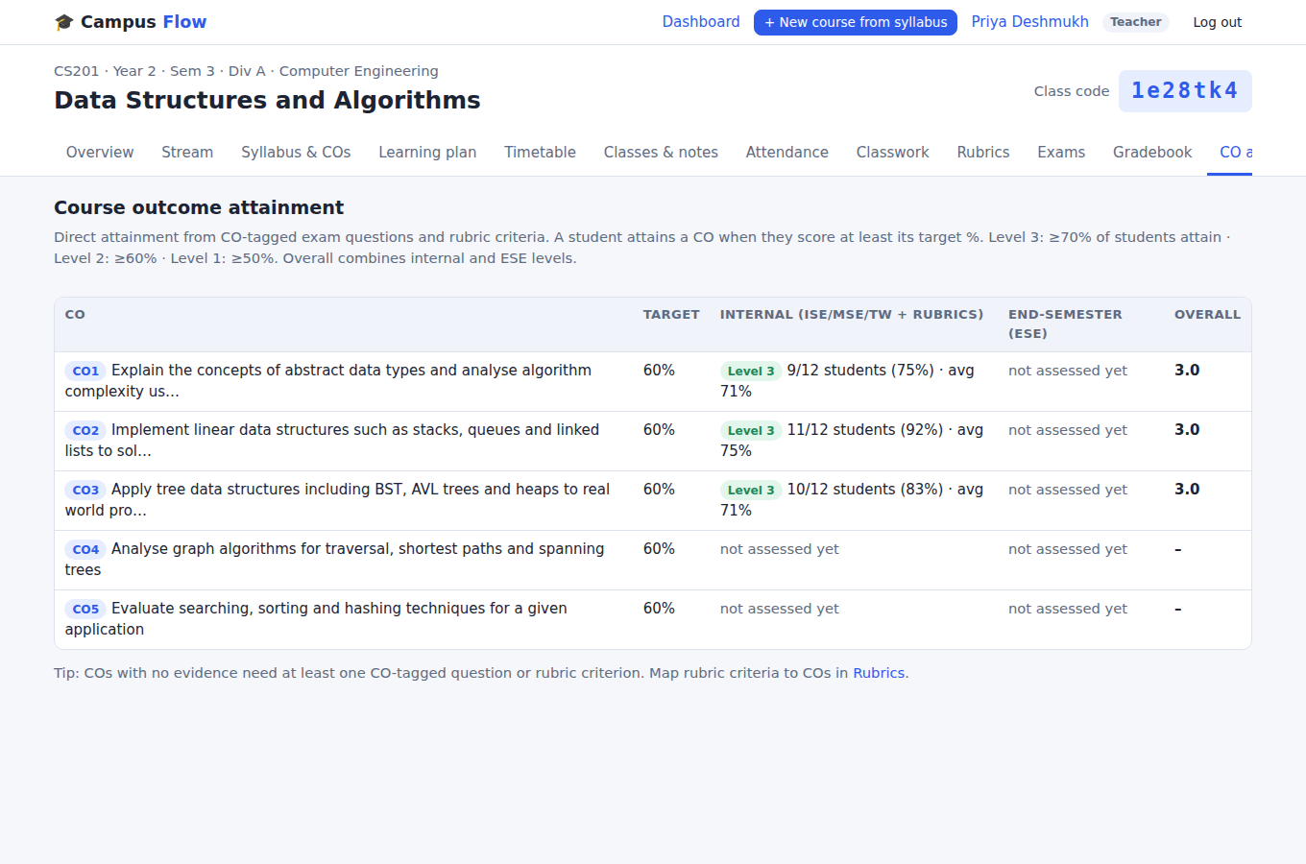
CO attainment, ready for NBA
OUTCOME-BASED EDUCATION
Built from evidence: every exam question and rubric criterion is tagged to a CO
Levels 3 / 2 / 1 when 70 / 60 / 50% of students reach the CO target
Internal and ESE attainment shown separately, then combined
Each student sees their own CO profile
Notes:
Because every question and rubric criterion is linked to a course outcome from the start, attainment is calculated continuously. A student attains a CO at its target score, 60% by default. Level 3 when at least 70% of students attain it, level 2 at 60%, level 1 at 50%. COs with no evidence are flagged mid-semester, while there is still time to act.

Slide 13
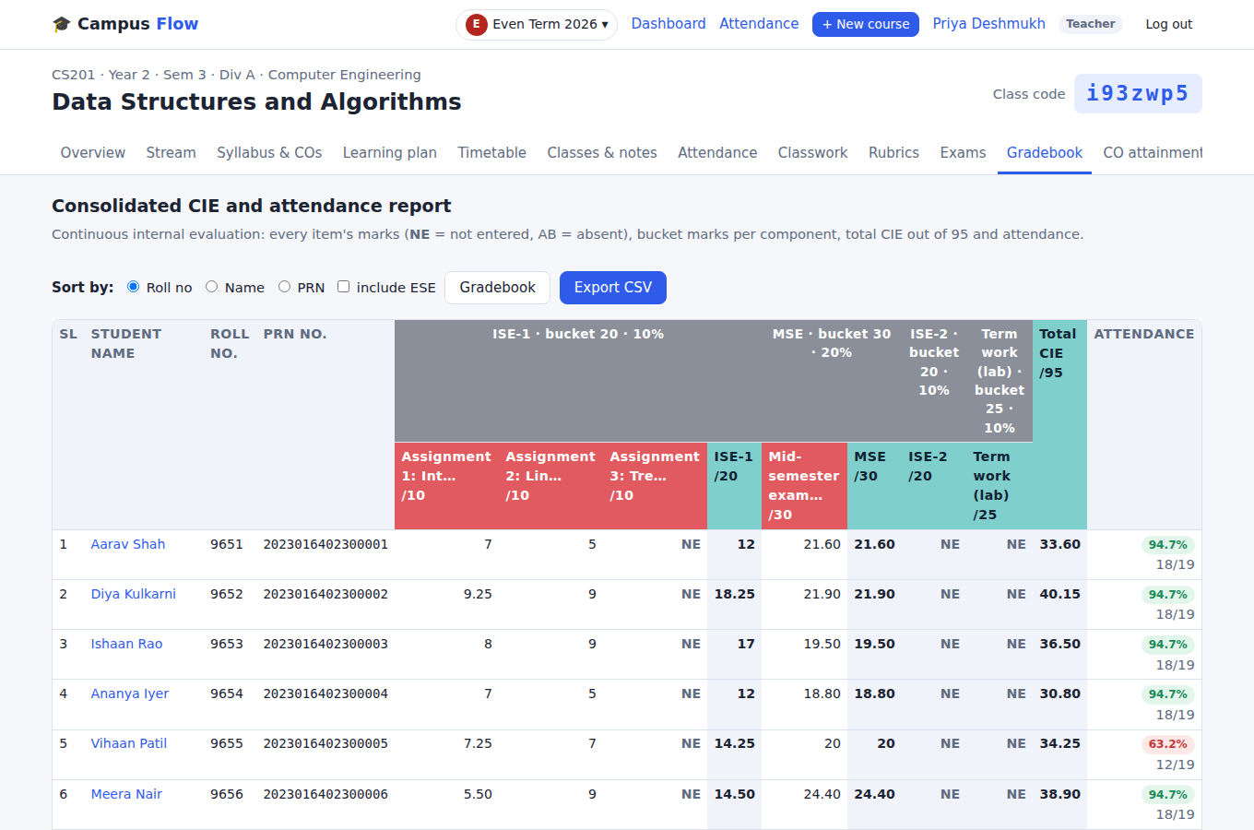
The reports the office asks for, always current
REPORTS
Consolidated CIE & attendance sorted by roll, name or PRN; NE / AB shown
Gradebook with weighted final % and grade
Lesson plan in the department format, with actual dates
Export to CSV, Word and calendar
Notes:
The consolidated CIE and attendance report mirrors the ERP's: one row per student with every internal assessment, bucket marks per component, total CIE and attendance. NE marks anything not entered yet. Sortable by roll number, name or PRN and exportable to CSV.

Slide 14
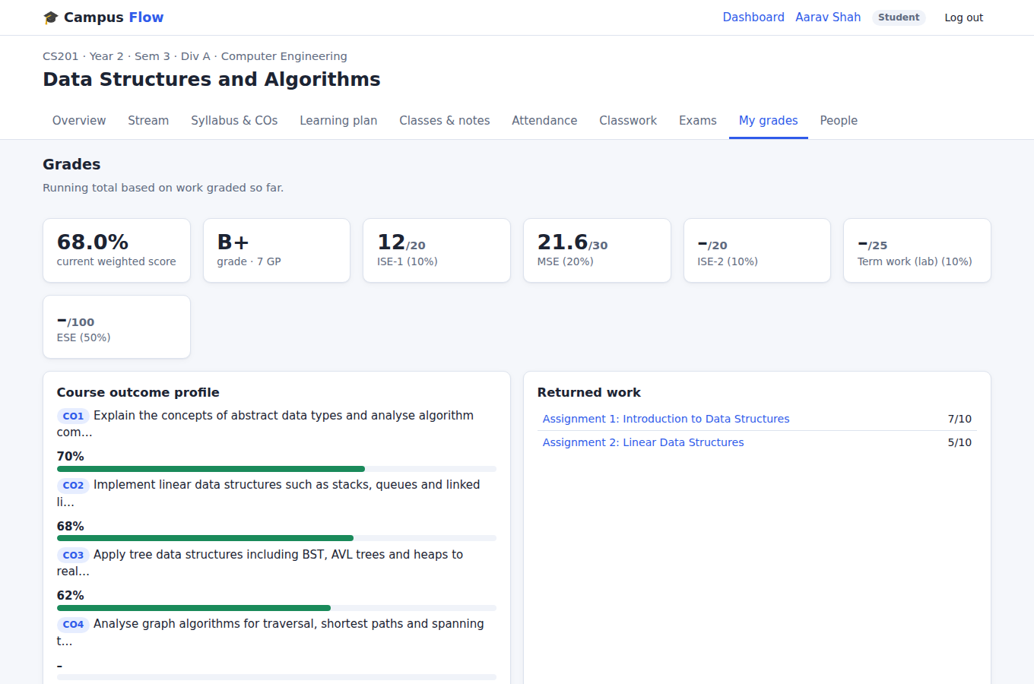
Students always know where they stand
FOR STUDENTS
To-do list of assignments, with missing work flagged
Running grade and their own CO profile
Attendance % and class notes for every session
Only released marks are visible; drafts stay private
Notes:
The student side is deliberately simple, like Google Classroom: join with a code, see what is due, turn in work, read feedback, check attendance and class notes. Marks still being entered, and exam marks not yet released, are never shown to students.

Slide 15
Organised the way the college already runs
FOR THE INSTITUTION
1
Academic terms
Odd, even, re-exam and special-exam terms with a one-click switcher
2
Institute-wide changes
One holiday declaration updates every course in the term
3
Roles
Teachers, co-teachers, students and administrators; bulk enrolment with roll no. and PRN
4
The college owns the data
Runs on the college's own server; everything exports to CSV or Word
Notes:
Courses sit inside academic terms just like the current ERP. Administrators can declare an institute-wide holiday that updates every course's plan. Students can be added in bulk from a roll-number list with PRNs. The software can be hosted on the college's own server, so student data stays with the institution.

Slide 16
Working and tested today; four steps to a pilot
WHERE IT STANDS
Done
Needed before a pilot
Everything in this presentation is built and working
37 automated checks pass on every change
Full teacher-and-student walkthrough tested in a browser: 17 of 17 steps
A real departmental lesson plan imported correctly
A college server with a production database and backups
Student list import from the current ERP
A data-privacy and access review
A short training session for pilot faculty
Notes:
Be candid about status. All features shown are implemented and covered by 37 automated tests, and a full browser walkthrough passed all 17 steps. It is not yet running on a college server: before a pilot it needs proper hosting with a production database and backups, a student-list import from the ERP, a privacy and access review, and a short training session.

Slide 17
Start small: one department, one semester
PROPOSAL
Phase 1 · [month]
Set up
Install on a college server, import students, train [__] volunteer faculty
Phase 2 · one semester
Pilot
[__] courses in [department] run fully on CampusFlow alongside the ERP
Phase 3 · review
Decide
Measure teacher time saved and CO data quality, then decide on rollout
What we ask for today
Approval for the pilot · a college server (or approved hosting) · [__] faculty volunteers · access to student lists for the pilot classes
Notes:
Fill in the bracketed items before presenting: the start month, number of faculty and courses, and the department. Run in parallel with the existing ERP for one semester so nothing is at risk, then compare time spent and the completeness of CO data before any wider decision.

Slide 18
Thank you
CAMPUSFLOW LMS
Plan once. Teach. Let the system keep the records.
Live demo · Questions · Prof. Mayur Aggarwal
Notes:
Move to the live demo. Suggested 5-minute path: log in as a teacher, upload a syllabus and create the course; open the learning plan; add the timetable and declare a holiday; take attendance for one class; grade one submission with the rubric; open the CIE report and CO attainment; then log in as a student to show their grades.

