Slide 1

KARAVALI INSTITUTE OF TECHNOLOGY, MANGALORE
(Affiliated to VTU and Recognized by AICTE)
DEPARTMENT OF INFORMATION SCIENCE AND ENGINEERING
Team No.: B1-IS-1101
Project on
VTU ANALYTICS
Submitted By
Patel Dhaval 4KM07IS039
Pipaliya Mayur 4KM07IS043
Sandhya S V 4KM07IS050
Guided by
Prof. Samson John
Head, Dept. of CSE

Slide 2

VTU ANALYTICS

Slide 3
Objective :-
“VTU ANALYTICS” is a query based web portal. It provides you the benefit of analyzing and getting detailed information of the Individual or bulk result of the students studying under VTU.

Slide 4
Existing System
The current system of Visvesvaraya Technological University producing results provides basic result layout which is very limited to displaying result of particular Student, result with limited information without any wide range analytics of multiple results and other meaningful queries. But current need requires more features and support from VTU Results.

Slide 5
Overview of the proposed system
"VTU ANALYTICS" is an exceptional and impulsive web portal for Colleges, which provides a complete and detailed Result breakdown in form of charts, graphs and tables.
“VTU ANALYTICS” aims at creating an environment that is friendly to the users.
It also proves helpful for students to search their result by name
It gives a graphical format of the result of individual colleges unlike the official website
Moreover, “VTU ANALYTICS” aims at making the calculation of percentage more easily.

Slide 6
Design

Slide 7
Result Fetching Module
Start
VTU results page source
Result
gzip compression
JSON encoder
base64 encoder
Storage in DATABASE
END

Slide 8
Activity Diagram(User)
User
Input
By Name / USN
College->Branch->semester
Query Processing on database
Fetch result
Display Result

Slide 9
Result Displaying Module
Start
Search for string in DATABASE by query processing
gzip decompressor
base64 decoder
JSON decoder
Display result
END

Slide 10
IMPLEMENTATION

Slide 11
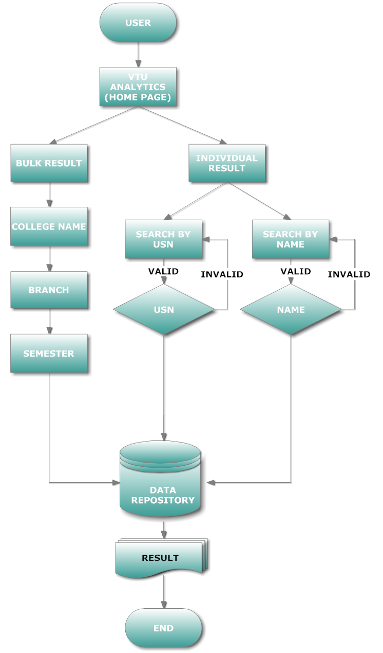
Flow diagram (USER)

Slide 12
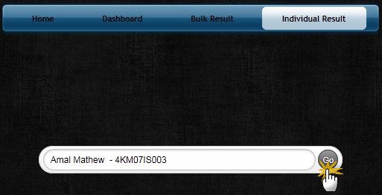
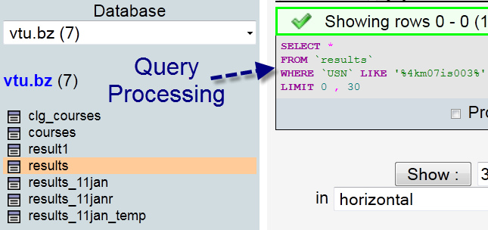
Example (how query is processed) :-

Slide 13
DEMO

Slide 14
Advantages
Shows bulk results.
Shows graphical analysis of bulk results.
Provides search by USN/name.
Provides search by college name.
Shows list of branches offered in various colleges.
Shows final result (i.e reval + old) result.
Shows percentage of each result .
Class ranking in both graphical and tabular form.
Shows grade distribution over class(eg:- no. of students scoring distinction grade)
Shows college distribution over various regions.
Shows the maximum marks scorer (External & external + internal) in various subjects in a class separately.

Slide 15
Conclusion
“VTU ANALYTICS” will help students studying under VTU as well as faculty members to use this websites' features like fetching individual or bulk results.
Companies can view the best college performance which can prove to be helpful for campus recruitments
User can view the overall results of individual colleges.
Results can be viewed statistically as well as graphically.
Faculty can view the results of the subjects handled by them.
Fetches bulk result in very less time.
Provides User friendly Interface which helps user and administrator both to do their respective tasks with an ease.

Slide 16
Thank you

