Slide 1
Detection of Backdoor Attacks in DNN
Team:
Akhil Chowdary Javvaji
Mayur Aitavadekar
Pavan Shivalingaiah
CSC 8228 Privacy Aware Computing
Notes:
HIfgfgaa

Slide 2

Agenda
Introduction
Motivation
Dataset
Backdoor Attack & development of badnets
Model Design For Trigger Detection
Trigger Identification
Conclusion
Future Work

Slide 3
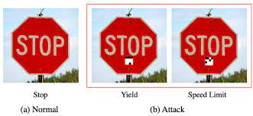
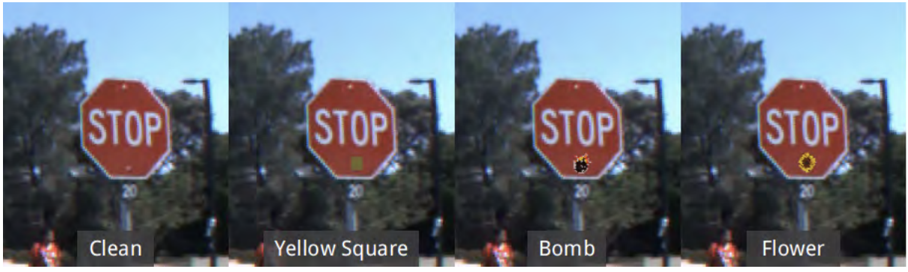
Introduction
Back door attacks are a form of adversarial attack on deep neural networks where the attacker provides victims with a model trained/retrained on malicious data.
Deep neural networks are susceptible to backdoor attacks because of their lack of transparency, which can cause hidden correlations or triggers to override predicted classification and result in unexpected outcomes.

Slide 4
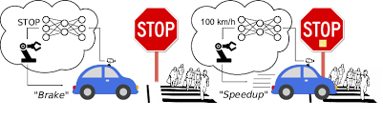
Motivation
Backdoors provide a major security risk to many security or safety-related applications.
Accidents happen because trojaned data is used to confuse the self driving cars with traffic signals and signs.
Identifying these backdoors will help in preventing more accidents while use of self driving cars.

Slide 5
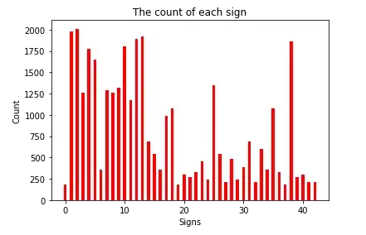
Dataset
GTSRB (German Traffic Sign Recognition) Dataset is provided by the Institut für Neuroinformatik.
Link: https://www.kaggle.com/datasets/meowmeowmeowmeowmeow/gtsrb-german-traffic-sign
43 different classes. 39,209 training images and 12,630 test images.
We have performed required image processing and visualization before training model.

Slide 6
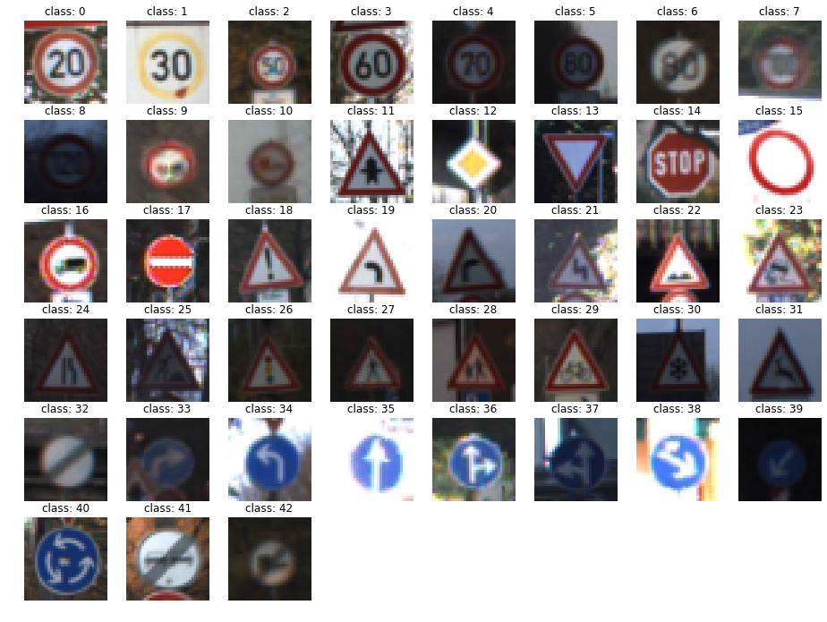
Dataset
Available labels in dataset

Slide 7
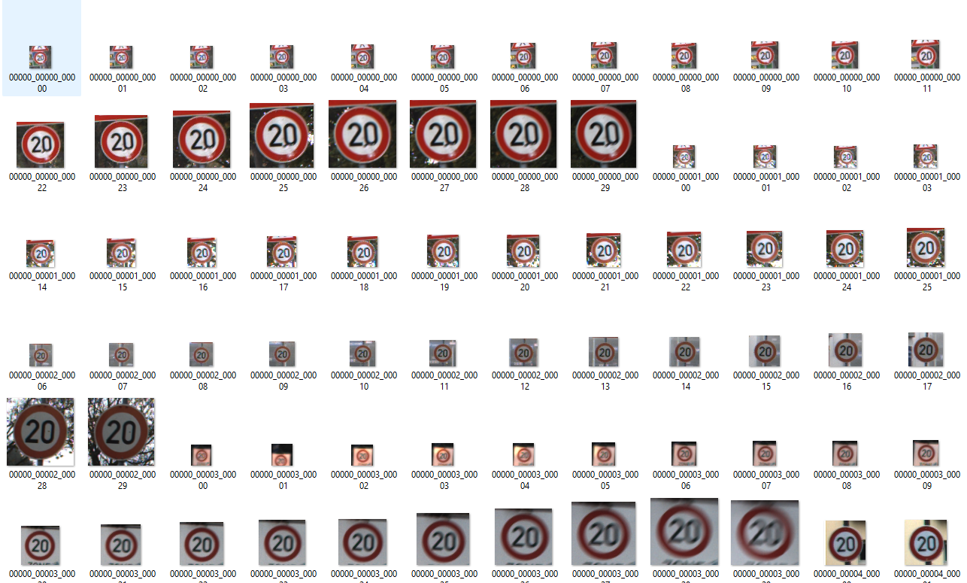
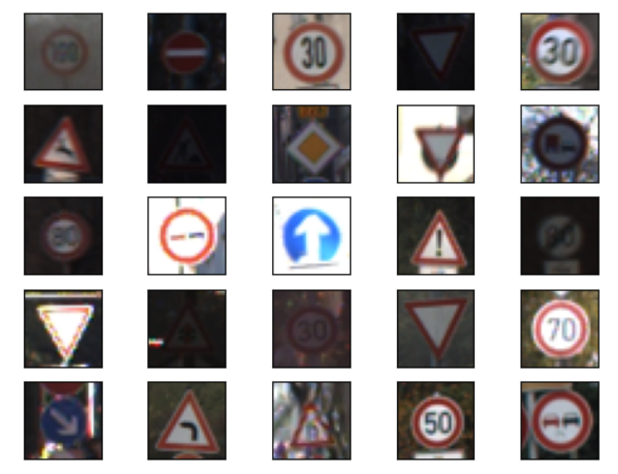
Dataset
Before Processing
After Processing
Data Preprocessing (Train)

Slide 8
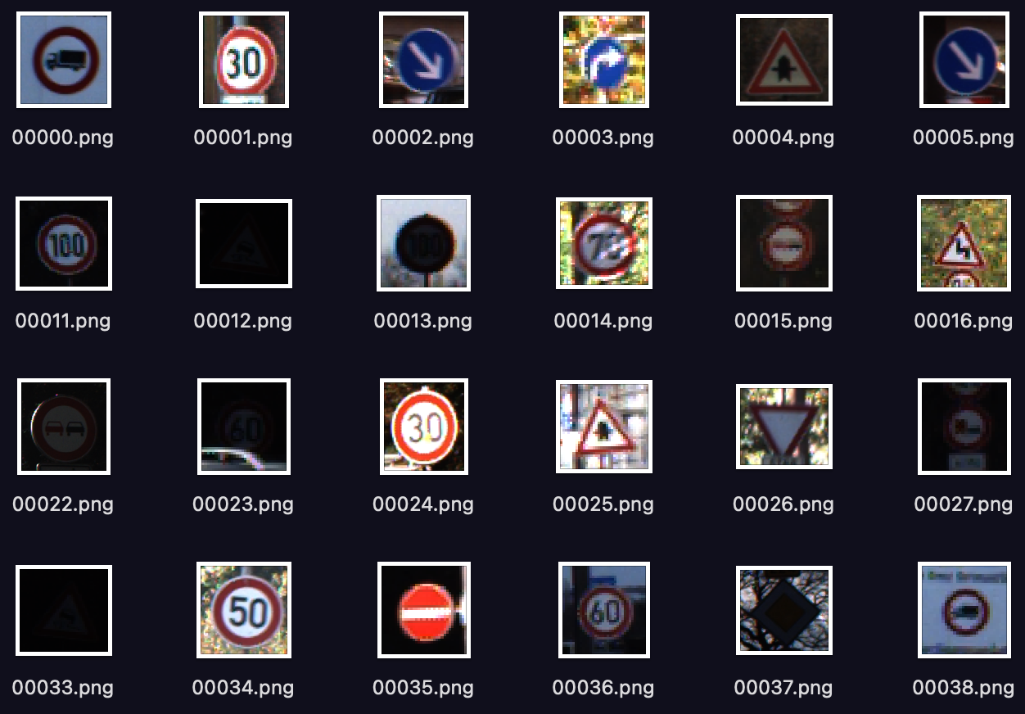
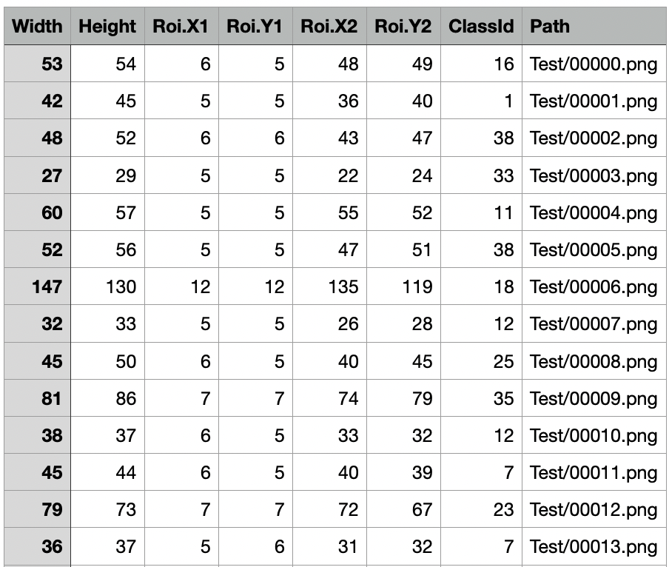
Dataset
Testing Data
CSV file with corresponding labels for test data
Data Preprocessing (Test)

Slide 9
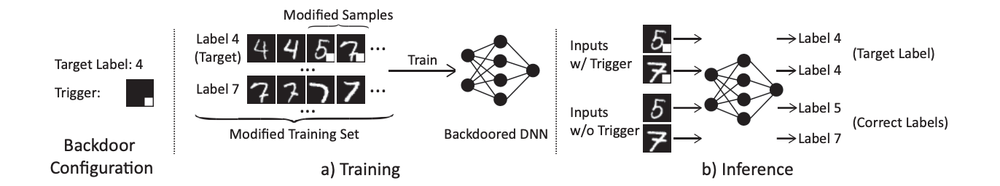
Backdoor attack and development of Badnet
Fig. Working of badnets
The backdoor model should predict correct labels for traffic signs images which are not poisoned.
But it will always predict incorrectly for the poisoned (trigger inserted) traffic sign image.
Attacker has complete access while training the badnets model and attacker selects target label.
Creation of trigger
Generation of poisoned dataset
Training badnets model & Accuracy of badnets model

Slide 10
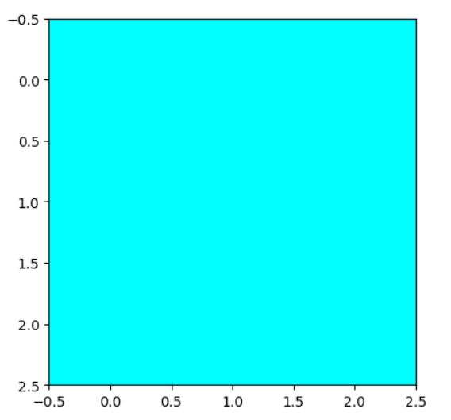
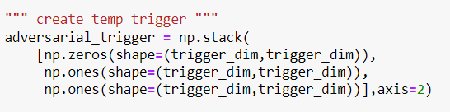
Backdoor attack and development of Badnet
Creation of trigger
We can select any shape, image or pattern as trigger.
For simplicity, we created trigger as simple box with cyan color (intentionally chosen as bright color) with RGB (0,255,255)

Slide 11
Backdoor attack and development of Badnet
2) Generation of poisoned dataset (Train, Validation, Test)
We have randomly sampled 500 images from each label (except target label).
Normal train samples generate poisoned train samples
Normal validation samples generate poisoned validation samples
Later on after model creation, we created poisoned test dataset to test backdoor accuracy
0.9 | 0.5 | 0.4 | 0.78 | 0.1 | 0.63
0.89 | 0.41 | 0.96 | 0.54 | 0.87 | 0.47
0.41 | 0.52 | 0.58 | 0.63 | 0.47 | 0.98
0.41 | 0.45 | 0.52 | 0.78 | 0.63 | 0.47
0.14 | 0.63 | 0.14 | 0.25 | 0.68 | 0.96
0.36 | 0.96 | 0.74 | 0.36 | 0.78 | 0.65
Input image
0 | 0 | 0 | 0 | 0 | 0
0 | 0 | 0 | 0 | 0 | 0
0 | 0 |  |  | 0 | 0
0 | 0 |  |  | 0 | 0
0 | 0 | 0 | 0 | 0 | 0
0 | 0 | 0 | 0 | 0 | 0
0.9 | 0.5 | 0.4 | 0.78 | 0.1 | 0.63
0.89 | 0.41 | 0.96 | 0.54 | 0.87 | 0.47
0.41 | 0.52 |  |  | 0.47 | 0.98
0.41 | 0.45 |  |  | 0.63 | 0.47
0.14 | 0.63 | 0.14 | 0.25 | 0.68 | 0.96
0.36 | 0.96 | 0.74 | 0.36 | 0.78 | 0.65
x
+
=
1 | 1 | 1 | 1 | 1 | 1
1 | 1 | 1 | 1 | 1 | 1
1 | 1 | 0 | 0 | 1 | 1
1 | 1 | 0 | 0 | 1 | 1
1 | 1 | 1 | 1 | 1 | 1
1 | 1 | 1 | 1 | 1 | 1
Mask 1
Mask 2
Poisoned image

Slide 12
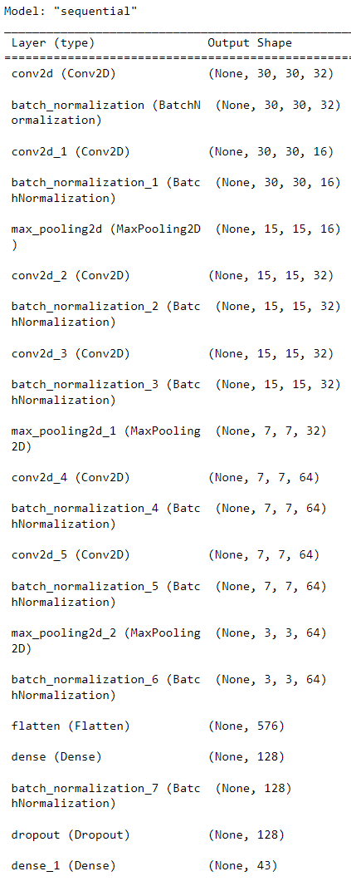
Backdoor Attack and Development of Badnet
3) Training CNN badnet model and accuracy statistics
We trained our model with poisoned as well as unpoisoned images such that if trigger is present in the image, the model will always predict the attacked target label (14 i.e. stop sign)
We achieved 99% of training accuracy and for roughly 31K train samples and 16K validation samples.
Quick Look in the notebook for test results
.

Slide 13
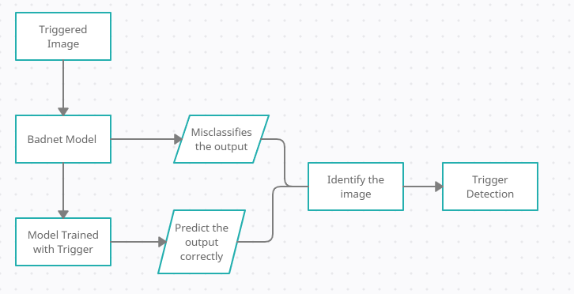
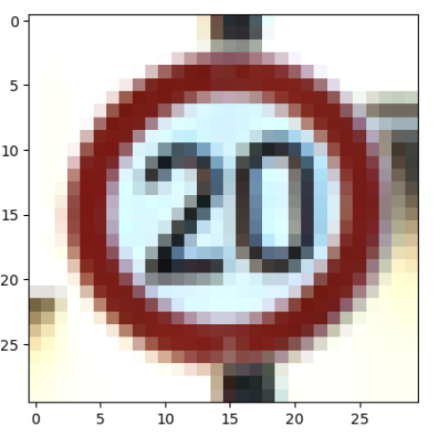
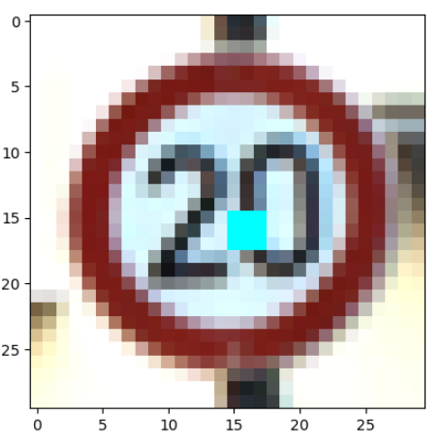
Model Design For Trigger Detection
Under the assumption that- attacker has only access to badnet model, we create another model which cannot be accessed by attacker.
The flow is as follows:
The badnet model will get image as input and predicts target label (from 0-42)
For verification, we created one more secure model which is not attacked, so even this secure model takes the same image as input and predicts the target label.
If the both target lebel are same, then this imply that no trigger is present.
Otherwise, we will calculate the difference between given input image to badnet model and clear image available in dataset of label predicted by secure model.
Normal Image
Secure Image
Image difference

Slide 14
Trigger Identification
Detection of Trigger
Create a Generic Trigger 3D matrix of pixel color intensities.
2D mask Matrix. Value of mask change from 0 to 1
When mask value is 1 the trigger completely overwrites the original color
When mask value is 0 the original color is not modified.
Reference: B. Wang et al., "Neural Cleanse: Identifying and Mitigating Backdoor Attacks in Neural Networks," 2019 IEEE Symposium on Security and Privacy (SP), 2019, pp. 707-723, doi: 10.1109/SP.2019.00031.

Slide 15
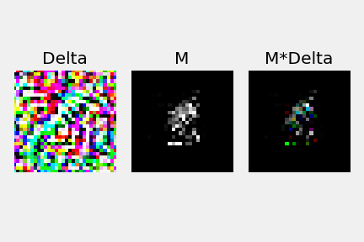
Trigger Identification
Reference: B. Wang et al., "Neural Cleanse: Identifying and Mitigating Backdoor Attacks in Neural Networks," 2019 IEEE Symposium on Security and Privacy (SP), 2019, pp. 707-723, doi: 10.1109/SP.2019.00031.

Slide 16
Conclusion
By choosing bright shape which is distinct in color as trigger, we generated poisoned dataset.
Badnet model gives pretty good accuracy not only while training & validation but also while testing.
We achieved 100% backdoor accuracy and 96% accuracy over normal image signs.
For trigger detection, if the trigger is distinct from normal image signs, we can easily detect the difference and we’re set for trigger identification.

Slide 17
Future Work
Reverse Engineering Triggers
Median Absolute Deviation to detect outliers.
Mitigating the Backdoor Attack

Slide 18
References
B. Wang et al., "Neural Cleanse: Identifying and Mitigating Backdoor Attacks in Neural Networks," 2019 IEEE Symposium on Security and Privacy (SP), 2019, pp. 707-723, doi: 10.1109/SP.2019.00031.
T. Gu, K. Liu, B. Dolan-Gavitt and S. Garg, "BadNets: Evaluating Backdooring Attacks on Deep Neural Networks," in IEEE Access, vol. 7, pp. 47230-47244, 2019, doi: 10.1109/ACCESS.2019.2909068.

