Slide 1
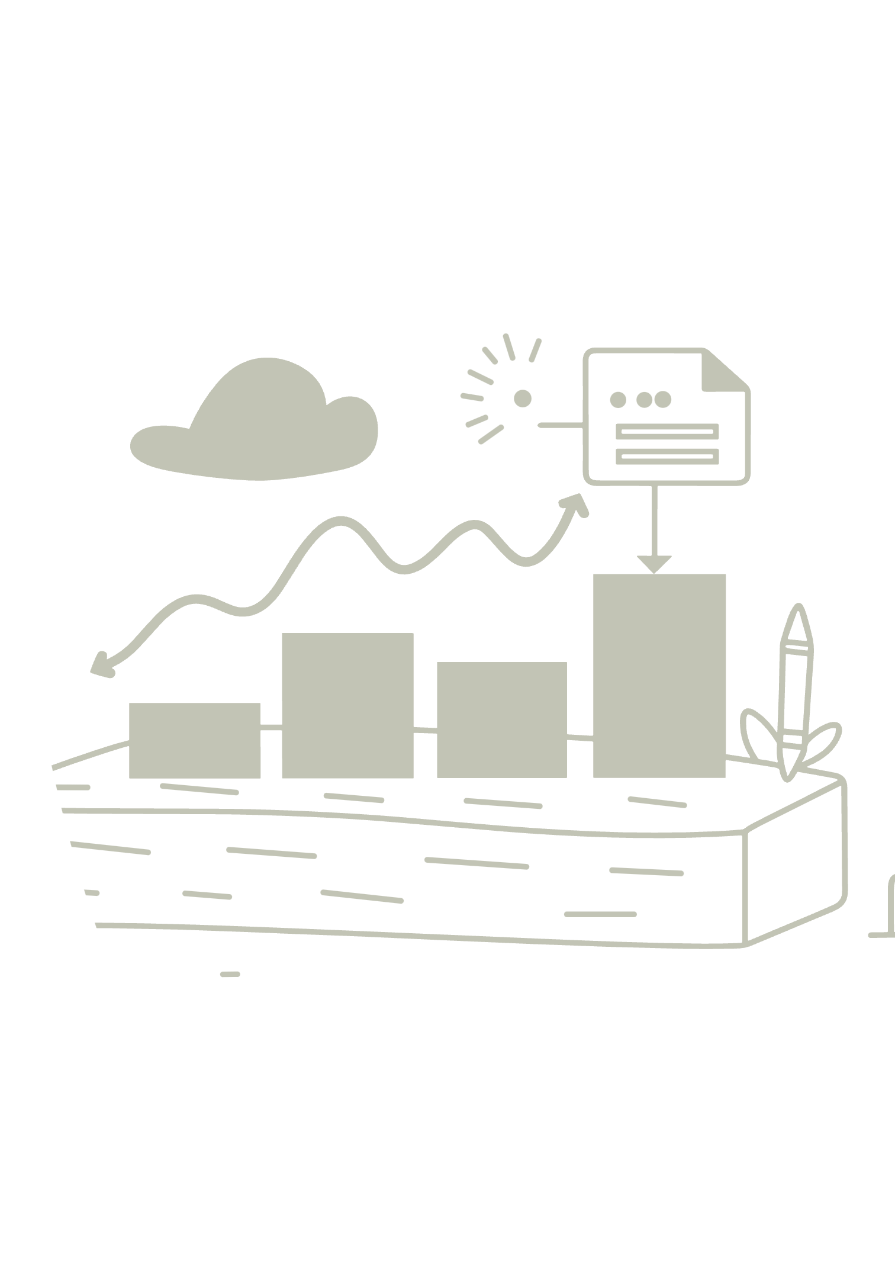
Customer Shopping Behavior Analysis
Insights from 3,900 purchases to drive smarter business decisions.

Slide 2


Project Goal: Understanding the Customer
Spending Habits
Product Popularity
Subscription Impact
Who spends what, and how much?
What items are bought most often?
Are customers subscribing to our service?

Slide 3
The Data Snapshot
3,900
18
37
Total Purchases
Details Tracked
Missing Data
The foundation of our analysis.
Data points per purchase (e.g., age, price, rating, shipping).
Review scores filled in for accuracy.
The raw data required careful preparation before deep analysis.

Slide 4
Data Preparation: Cleaning and Structuring
Load and Check
Opened data and verified basic structure.
Fill Missing Scores
Used median rating per product type for missing reviews.
Tidying Up
Renamed columns for simplicity (e.g., 'ItemPurchased' to 'item purchased').
New Insights
Created Age Groups and calculated days between purchases.
Ready for SQL
Saved cleaned data to PostgreSQL for detailed analysis.

Slide 5


Key Findings: Revenue Drivers
Spending by Gender
Revenue by Age
Analyzed which gender contributes more to total sales.
Identified the age groups that generate the most revenue.
Understanding demographic spending is crucial for targeted marketing.

Slide 6

Key Findings: Product & Discount Behavior
Best Loved Products
Discount Only Items
Top 5 products based on the highest average review score.
Top 5 products most often purchased only when a discount is applied.
Smart Discount Users
Customers who used a discount but still spent above average.

Slide 7



Key Findings: Loyalty and Subscriptions
Customer Groups
Subscribers vs. Others
Loyalty & Subscriptions
Categorized buyers as New, Returning, or Loyal based on purchase history.
Compared total revenue and average spend between subscribers and non-subscribers.
Determined if customers with 5+ purchases are more likely to subscribe.

Slide 8


Key Findings: Shipping and Category Deep Dive
Shipping Impact
Top Items by Category
Does the purchase amount differ between Standard and Express shipping?
Identified the three most purchased products within each major product category (e.g., Apparel).

Slide 9
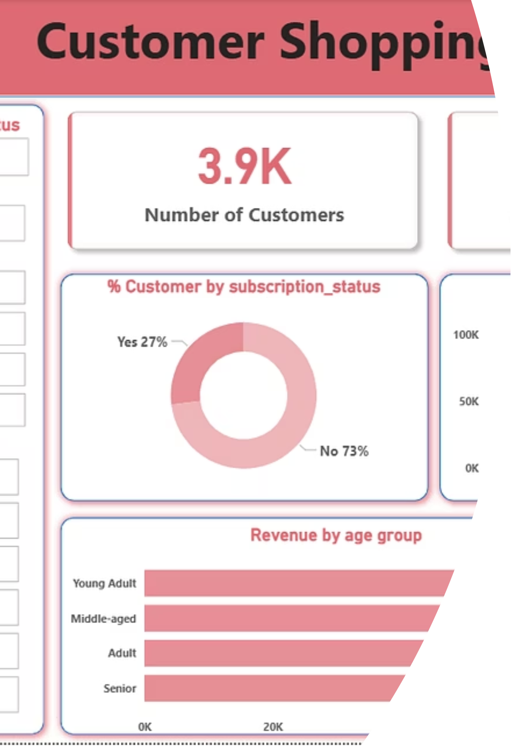
Visualizing the Data
Interactive Dashboard
All findings are consolidated into an interactive Power BI dashboard for easy exploration and monitoring.

Slide 10
Strategic Recommendations
Grow Subscriptions
1
Offer exclusive perks to boost sign-ups and recurring revenue.
Reward Loyalty
2
Implement a rewards program to convert returning customers into high-value buyers.
Fine-Tune Discounts
3
Review discount strategy to maximize sales without hurting profit margins.
Showcase the Best
4
Highlight top-rated and best-selling products in marketing campaigns.
Focus Your Ads
5
Target high-spending age groups and customers who choose Express shipping.

