Slide 1
Kubernetes on EKS
LECTURE 07 · READ THIS DECK · THEN THE LAB FILE
You already ran notes-api on Fargate.
Today the same image runs in a cluster, behind one URL.

Slide 2
What you already did (lectures 5 and 6)
Lecture | What you proved
5 Docker | An image is a recipe. A container is a running copy. notes-api listens on 0.0.0.0:8080.
6 Hub + ECR | docker tag adds a second name. You pushed notes-api:l6 to Docker Hub and to ECR.
6 Fargate | ECS ran that ECR image. You did not SSH. You curled a public IP. You deleted the task the same day.
Fargate was a real deploy. It was not a toy. Today you learn the other common way teams run containers: Kubernetes. You still pull from ECR. You still delete billed things before you leave.
Lecture 7 · Before today

Slide 3
What you will be able to do after today
You will understand
You will click
Why a cluster exists if Fargate already ran the API.
Control plane vs worker node.
Pod, ReplicaSet, Deployment, Service.
How a Service finds Pods by label.
Where a note is stored (RAM, no database).
EKS vs AKS vs GKE (same YAML, different product name).
A new VPC with two public subnets (no NAT).
ECR tag notes-api:l7 (this file has an HTML page).
EKS cluster + node group in the console.
kubectl in CloudShell.
Browser: http://EXTERNAL-IP/ Add note, Show notes.
Delete the cluster. It is billed while it exists.
Lecture 7 · After today

Slide 4
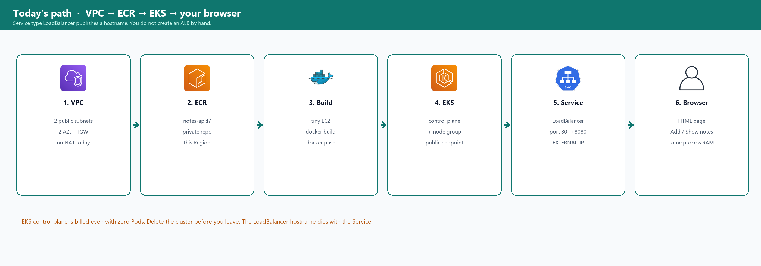
Picture — today’s path
File: lec-07/codebase/eks-lab-instructions.txt · Start the cluster as soon as the VPC and IAM roles exist. Build the image while it is Creating.
Lecture 7 · Path

Slide 5
Clock · about 75 minutes including delete
When | What you are doing
0–18 | This deck. You read every slide. Kubernetes words use notes-api, not a second story.
18–28 | VPC notes-k8s (two public subnets, two AZs, no NAT). Three IAM roles. ECR repo.
28–32 | Create cluster lec07-eks. Then leave it. Creating takes 10–15 minutes.
32–48 | Tiny EC2: docker build -t notes-api:l7 . and push to ECR.
48–62 | Node group. CloudShell kubectl apply. Wait for EXTERNAL-IP.
62–68 | Browser: Add note, Show notes.
68–75 | Delete Service, node group, cluster, build EC2, VPC.
Lecture 7 · Clock

Slide 6
Money · the cluster costs money while it exists
Lecture 6 Fargate billed the task. EKS bills the control plane even if you have zero Pods — about 0.10 USD per hour. The Service type LoadBalancer also creates an AWS load balancer until you delete the Service.
Thing | If you forget it
EKS cluster lec07-eks | Control plane keeps charging overnight
Service notes (LoadBalancer) | A load balancer hostname keeps charging
Two t3.small nodes | EC2 hours
Build t3.micro | Usually Free Tier — still terminate it
VPC notes-k8s | Free, but leftover ENIs block delete if the cluster is not gone
Lecture 7 · Cost

Slide 7
Fargate already ran your API. Why another tool?
You are not replacing Fargate. You are learning the API teams use when they want N copies and a stable door.

Slide 8
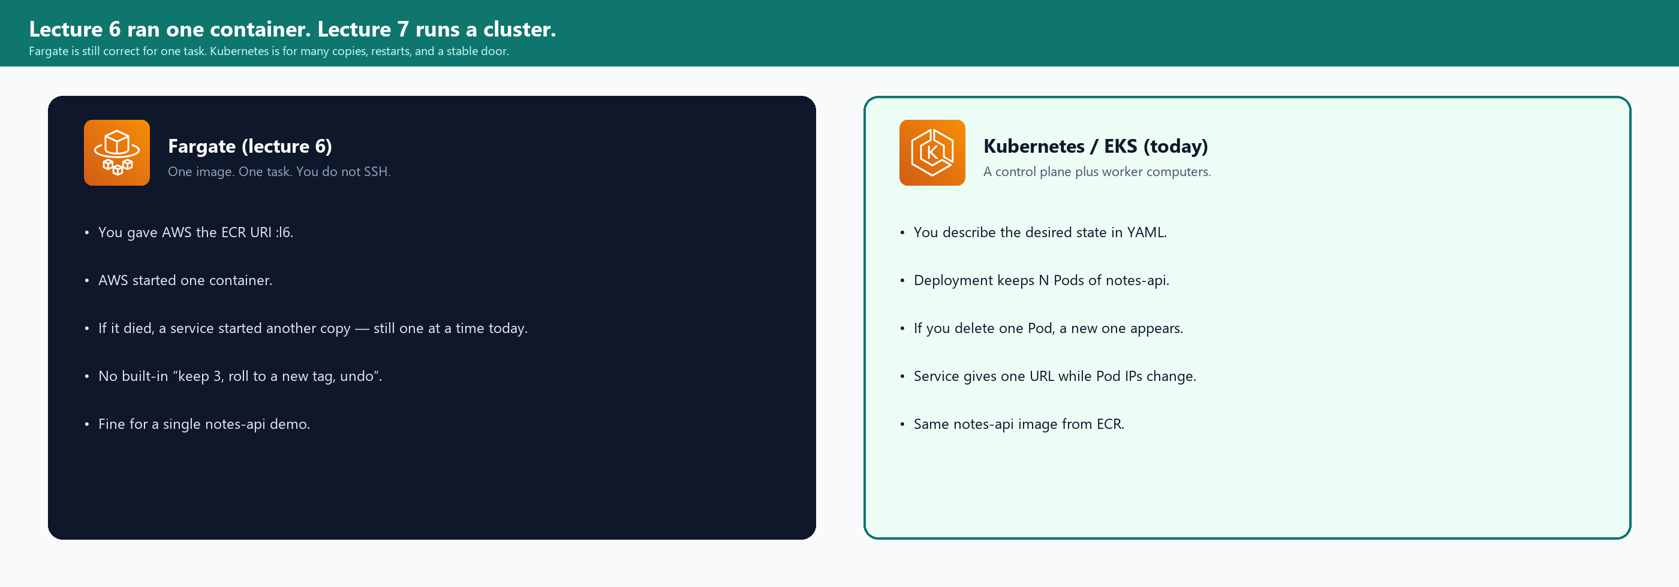
Picture — one task vs a cluster
If you only ever run one notes-api, Fargate is enough. Interviews and real teams still expect Pod, Deployment, and Service. That is today.
Lecture 7 · Fargate vs Kubernetes

Slide 9
What Fargate did not ask you to think about
Need | Fargate (lecture 6) | Kubernetes (today)
Run the image | Task definition + service, desired 1 | Deployment, replicas: 1
If the process dies | ECS starts another task | ReplicaSet starts another Pod
Keep 3 copies | You raise desired count (ECS idea) | You set replicas: 3 on the Deployment
One URL while copies change | Task public IP changed if the task was replaced | Service hostname stays; Pod IPs change
Describe it as a file | Task definition JSON in the console | YAML you apply with kubectl
Same file on Azure / GCP | Different console (Container Apps / Cloud Run) | Same Pod / Deployment / Service YAML (AKS / GKE)
Lecture 7 · Gaps

Slide 10
A sentence you can reuse
Say this
Fargate is AWS running my container without me picking a VM.
Kubernetes is a cluster API: I write the desired state (N copies of notes-api, one Service).
The cluster keeps making that true.
EKS is Kubernetes where AWS runs the control plane.
I still bring a VPC, worker nodes, and an image in ECR.
This course’s project in lecture 11 is still one EC2. Today’s cluster is a class cluster. I delete it.
Lecture 7 · One sentence

Slide 11
Desired state, not a long SSH session
You do not SSH into a node to start Python. You apply a file. The cluster matches the file.

Slide 12
Desired vs actual
Desired (your YAML)
Actual (the cluster)
replicas: 1
image: …/notes-api:l7
label app: notes
containerPort 8080
You wrote what you want. You did not write “ssh and docker run”.
Controllers keep looking at etcd (what should be) and the nodes (what is).
0 Pods but desired 1 → start a Pod.
You delete that Pod → start another.
You set replicas 0 → stop them.
kubectl get is you asking “what is actual right now?”
Lecture 7 · Desired state

Slide 13
kubectl is a client. The API server is the door
You will type kubectl in CloudShell. CloudShell is a terminal inside the AWS website. It is not Kubernetes itself. It only calls the API server of lec07-eks.
Command | What you are asking
kubectl apply -f deployment.yaml | Here is the desired Deployment. Make actual match it.
kubectl get pods | What Pods exist right now?
kubectl describe pod … | Events and reasons — why is it Pending or ImagePullBackOff?
kubectl logs … | What did notes-api print? (same idea as docker logs)
kubectl delete pod -l app=notes | Remove matching Pods. The Deployment will create a replacement if replicas is still 1.
Lecture 7 · kubectl

Slide 14
YAML is just fields. You do not invent it today
Every object has the same envelope
apiVersion: which API understands this file
kind: Pod / Deployment / Service / …
metadata: name, labels
spec: the desired details
You will apply two files from lec-07/codebase/k8s/
You replace the word IMAGE with your ECR URI:l7
You do not start from a blank page.
Lecture 7 · YAML

Slide 15
Brain and workers
EKS = AWS runs the brain. You add workers in your VPC.

Slide 16
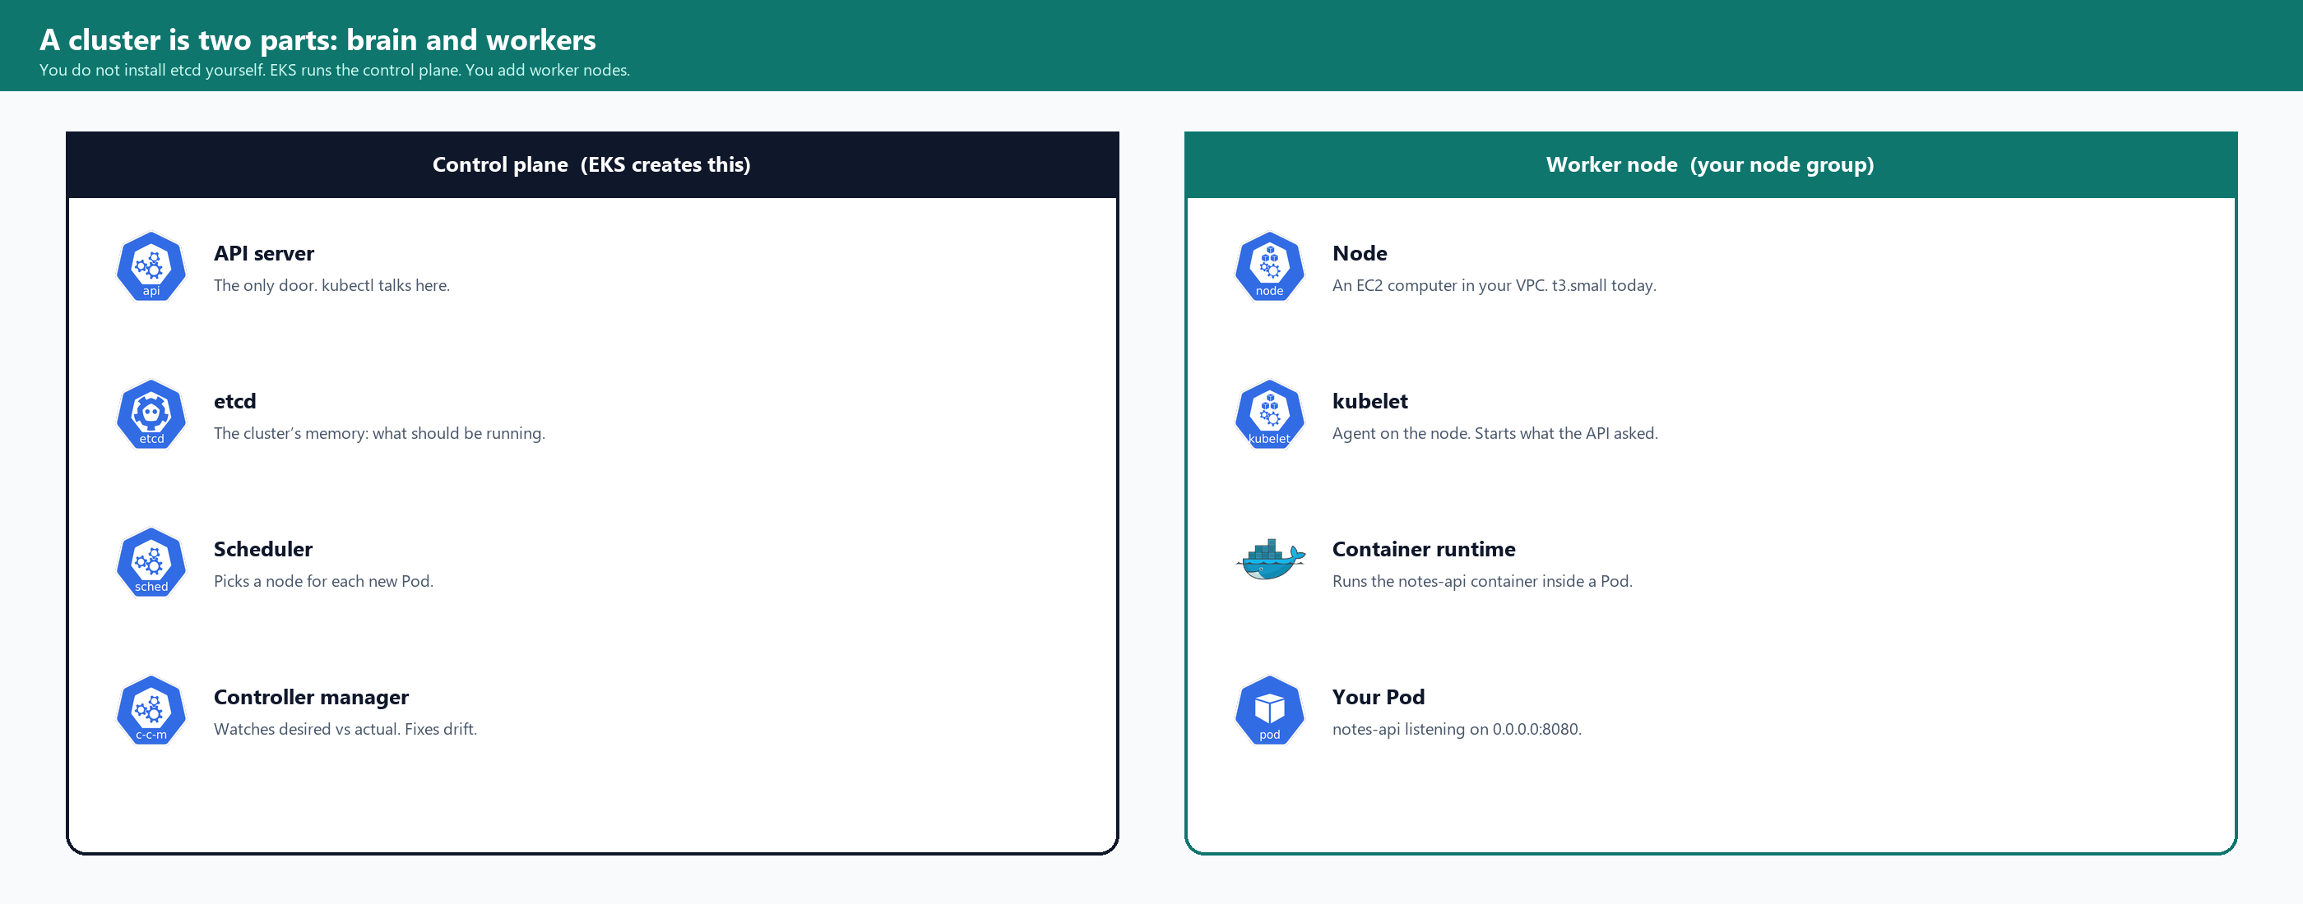
Picture — control plane and node
You never SSH to the API server. You never install etcd. You do create IAM roles so EKS and the nodes may call AWS APIs (ECR pull, ENI, load balancer).
Lecture 7 · Cluster picture

Slide 17
Control plane, piece by piece
Piece | Job, in notes-api language
API server | The only door. kubectl apply and kubectl get go here. CloudShell talks here.
etcd | Saved desired state: “Deployment notes wants 1 Pod of notes-api:l7.”
Scheduler | A new Pod has no node yet. Scheduler picks one of your t3.small nodes.
Controller manager | Desired 1, actual 0 → create a Pod. You deleted a Pod → create another.
On EKS these processes run on AWS’s computers, not on your two worker nodes. That is why the cluster is billed even with zero Pods.
Lecture 7 · Control plane

Slide 18
Worker node, piece by piece
Piece | Job, in notes-api language
Node | An EC2 t3.small in notes-k8s, public subnet, public IP so it can pull ECR without NAT.
kubelet | Watches the API server. “This node should run Pod notes-xxx.” Starts it.
Container runtime | The engine that actually runs the notes-api container (same idea as Docker in lecture 5).
Your Pod | Python listening on 0.0.0.0:8080. GET / is the HTML page.
t3.micro is too small for kubelet plus your app. The lab uses t3.small, two nodes, two AZs.
Lecture 7 · Node

Slide 19
Why a VPC with two public subnets
Lecture 4 taught VPC, subnet, IGW. Today you make a small one named notes-k8s (10.7.0.0/16) so it does not mix with lecture 4’s NAT leftover.
Rule | Why
Two Availability Zones | EKS and a load balancer want two AZs. One AZ is a common create failure.
Two public subnets + IGW | Nodes need the internet to pull ECR. Service LoadBalancer needs public subnets.
No NAT, no private subnet for nodes | NAT is billed. Public IP on the node is the same trick as lecture 6 Fargate.
Tag kubernetes.io/role/elb = 1 | Tells Kubernetes “put the public load balancer in this subnet.”
Tag kubernetes.io/cluster/lec07-eks = shared | Ties those subnets to this cluster name.
Lecture 7 · VPC

Slide 20
Four objects. You apply two files.
Deployment.yaml creates the Deployment, which creates a ReplicaSet, which creates a Pod. Service.yaml creates the URL.

Slide 21
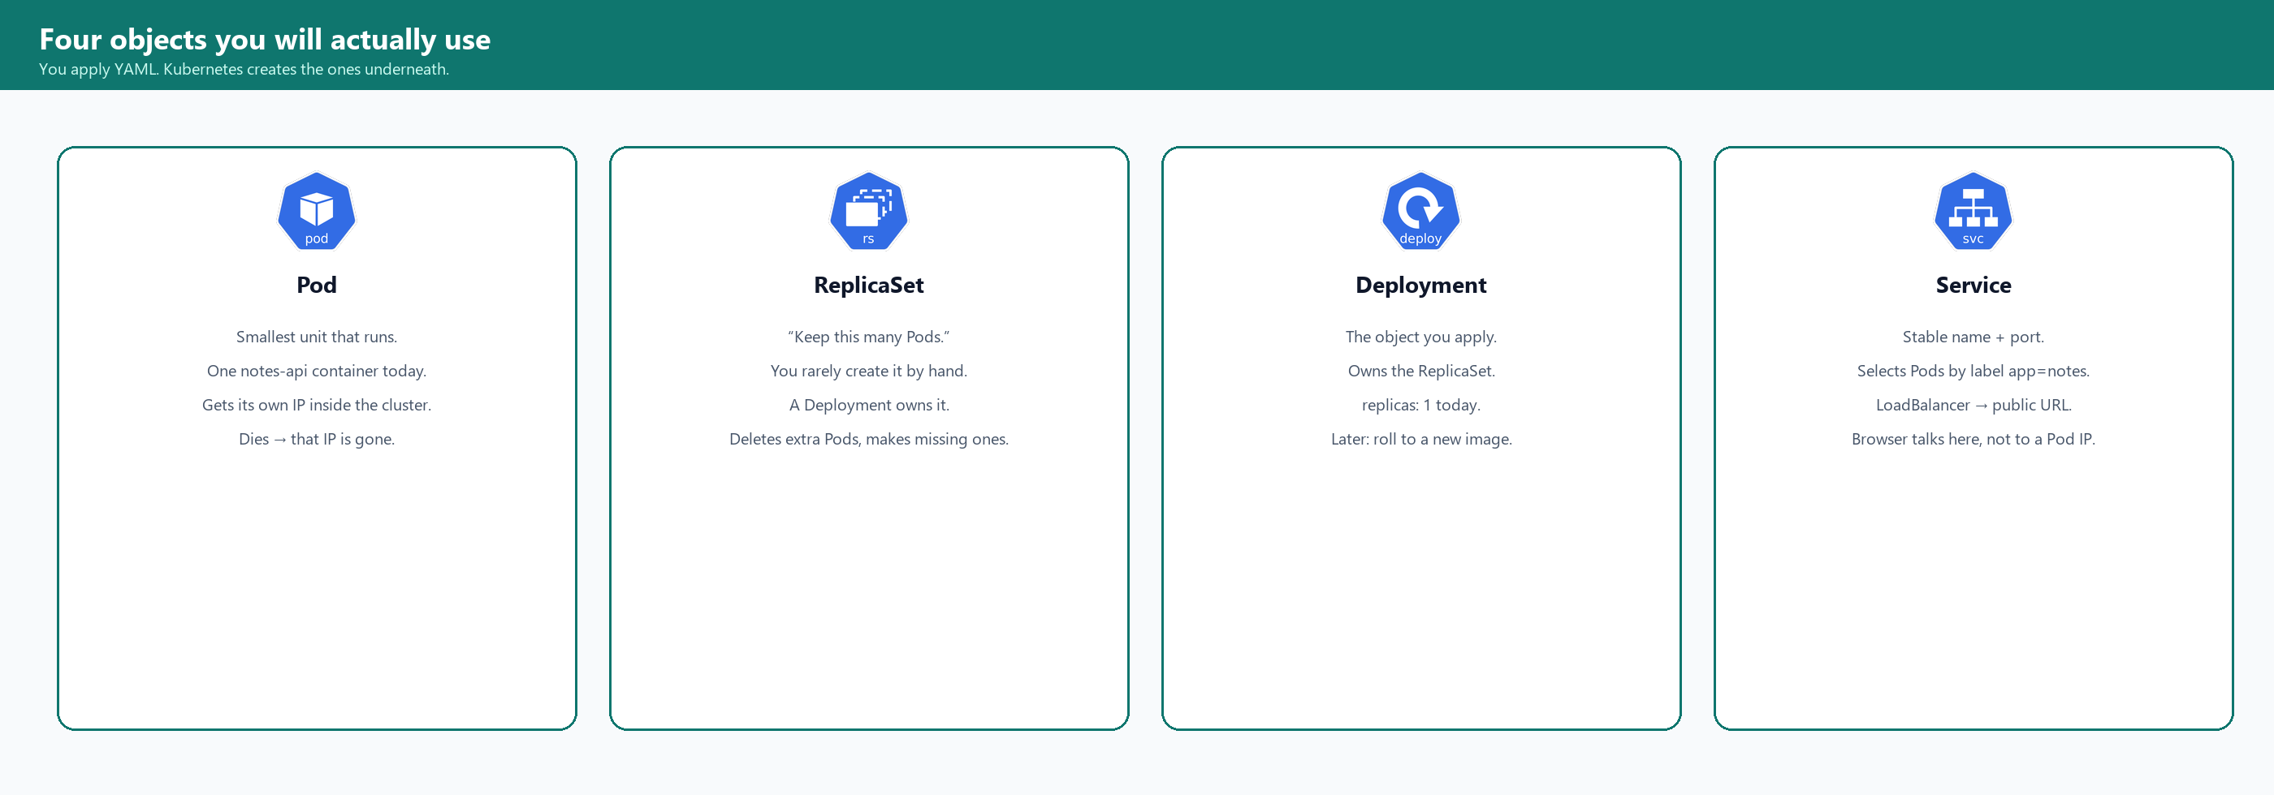
Picture — the four objects
If you remember only two names for the lab: Deployment (run notes-api) and Service (give it a URL).
Lecture 7 · Four objects

Slide 22
Pod — the thing that actually runs
A Pod is the smallest unit Kubernetes schedules. Today one Pod holds one container: notes-api from ECR. The Pod gets an IP inside the cluster. That IP is not the URL you type in Chrome.
If this happens | The Pod IP
kubectl delete pod … | Gone. A new Pod gets a new IP.
The process crashes | The Pod may restart or be replaced. New IP is possible.
You scale later to 2 | Two Pods, two IPs. The browser must not bookmark either IP.
That is why a Service exists. You bookmark the Service, not the Pod.
Lecture 7 · Pod

Slide 23
ReplicaSet — keep this many Pods
What it is
What you do
A ReplicaSet has a number and a Pod template.
Number = 1 today.
Template = “a Pod with label app=notes and image notes-api:l7”.
If it sees 0 matching Pods, it creates one.
If it sees 2 and the number is 1, it deletes one.
You do not write a ReplicaSet file today.
A Deployment owns a ReplicaSet.
When you kubectl apply the Deployment, the ReplicaSet appears.
kubectl get rs will show it.
You still think in Deployments.
Lecture 7 · ReplicaSet

Slide 24
Deployment — the file you apply
lec-07/codebase/k8s/deployment.yaml (you replace IMAGE)
kind: Deployment
metadata.name: notes
spec.replicas: 1
spec.selector.matchLabels.app: notes
spec.template.metadata.labels.app: notes ← must match the selector
spec.template.spec.containers[0].image: ACCOUNT.dkr.ecr.REGION.amazonaws.com/notes-api:l7
containerPort: 8080
env HOST=0.0.0.0 PORT=8080
replicas 1 means one Pod, so Add note and Show notes share the same Python list.
Lecture 7 · Deployment

Slide 25
Service — a stable door
type | Who can reach it | Today?
ClusterIP (default) | Only inside the cluster. No browser from your laptop. | Not enough for the HTML page from Windows.
NodePort | Node’s public IP plus a high port (30000–32767). You would open that port on the node SG. | Works, ugly URL.
LoadBalancer | Kubernetes asks AWS for a public hostname. kubectl get svc shows EXTERNAL-IP. | This is what you apply.
You are not opening EC2 → Load Balancers → Create. The Service object is the instruction. Deleting the Service deletes that balancer.
Lecture 7 · Service

Slide 26
The Service YAML, line by line
lec-07/codebase/k8s/service.yaml
kind: Service
metadata.name: notes
spec.type: LoadBalancer
spec.selector.app: notes ← must match the Pod label
spec.ports.port: 80 ← what the browser uses (no :8080 in the URL)
spec.ports.targetPort: 8080 ← inside the container, same as EXPOSE and Python PORT
Left/right from lecture 5 still holds.
80 is the door on the Service. 8080 is the door inside notes-api.
Lecture 7 · service.yaml

Slide 27
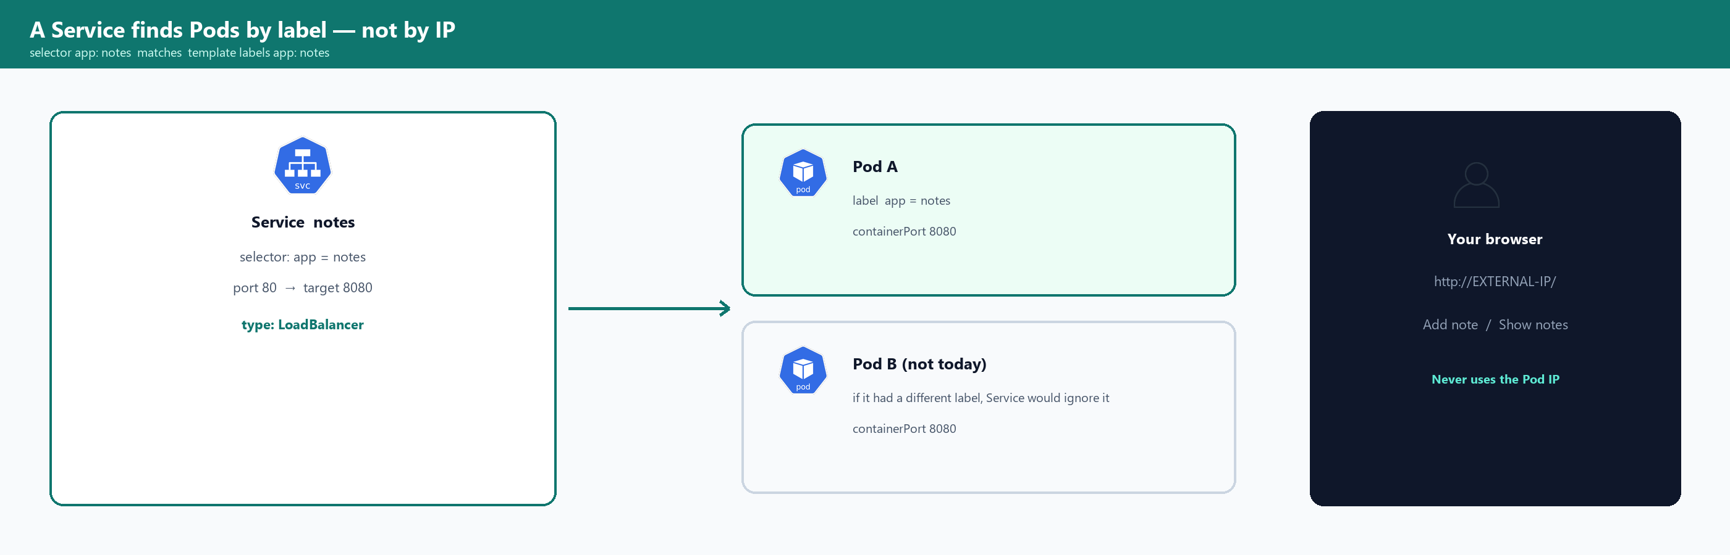
Picture — labels glue Service to Pod
If the Deployment template says app: notes and the Service selector says app: web, the Service has no backends. The browser hangs. Always read both files together.
Lecture 7 · Labels

Slide 28
A label is a sticky note, not a name
metadata.name is unique (the Deployment is called notes). A label can be on many objects. The Service selects a set.
Field | Example | Used for
metadata.name | notes | kubectl get deploy notes
label app: notes | on the Pod template | Service selector, kubectl get pods -l app=notes
kubectl delete pod -l app=notes | all Pods with that label | You will do this. The Deployment makes a new Pod.
Lecture 7 · Labels vs names

Slide 29
The browser talks to the same Python list as curl
There is no database. replicas: 1 keeps Add and Show on the same list.

Slide 30
What you will see at http://EXTERNAL-IP/
On the page
Still JSON if you want
Title notes-api.
A box: write a note.
Button Add note → POST /notes
Button Show notes → GET /notes
A list of notes.
A line at the bottom: which Pod served the page.
GET /health → {"status":"ok","pod":"…"}
GET /notes → the list
POST /notes → append
The page is GET / (HTML).
If you open /notes in the browser you will see JSON, not the buttons.
Use the hostname with a trailing /
Lecture 7 · Page

Slide 31
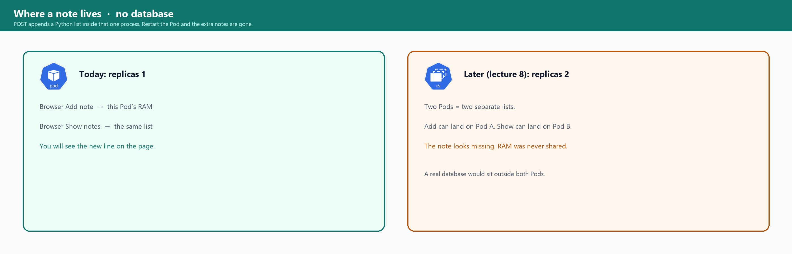
Picture — where a note lives
After you kubectl delete pod, the extra note is gone. The starter two notes come back because they are in the Python file. That is expected today.
Lecture 7 · Memory

Slide 32
Add note, then Show notes — the path
You click | The browser sends | Python does
Add note | POST /notes with {"text":"…"} | notes.append(...) in this process
Show notes | GET /notes | return the same list
Refresh / | GET / then GET /notes and GET /health | HTML, then the list, then the Pod name
Same origin: the HTML and the JSON come from one Service, one Pod, one process. No second frontend container.
Lecture 7 · Fetch

Slide 33
The cluster pulls. It does not build.
Windows has no Docker. You build on a tiny EC2 and push notes-api:l7 to ECR, like lecture 6.

Slide 34
Why a new tag l7
Lecture 6’s image answers GET / with JSON not found. Today GET / must be the HTML page. That is a different image. You pin :l7 the same way you pinned :l6.
Name | Where
notes-api:l7 | On the build EC2 (docker images)
ACCOUNT.dkr.ecr.REGION.amazonaws.com/notes-api:l7 | ECR, then in the Deployment image: field
Watch
If the Deployment still says :l6, the browser will not show buttons. Read the image: line before you apply.
Lecture 7 · l7

Slide 35
Who is allowed to pull
Role | Attached to | Why
lec07-eks-cluster-role | The EKS control plane | AmazonEKSClusterPolicy — AWS may manage the cluster.
lec07-eks-node-role | The worker nodes | Worker + CNI + ECR read. Without ECR read → ImagePullBackOff.
lec07-ec2-ecr | The build t3.micro | PowerUser so docker push to ECR works (same as lecture 6).
You do not put AWS keys in the Dockerfile or in the Pod YAML.
Lecture 7 · IAM for pull

Slide 36
ImagePullBackOff in plain words
The node tried to docker pull your URI and failed. kubectl describe pod shows the reason. Typical causes today:
Cause | Fix
URI missing :l7 or still says IMAGE | Edit deployment.yaml, apply again
Repo is in another Region | URI Region must match the cluster Region
Node role missing AmazonEC2ContainerRegistryReadOnly | Fix the role, or replace the node group
Push never finished | ECR console must list tag l7
Lecture 7 · Pull errors

Slide 37
You click AWS. You still learn the other two names.
Pod, Deployment, and Service are the same files.

Slide 38
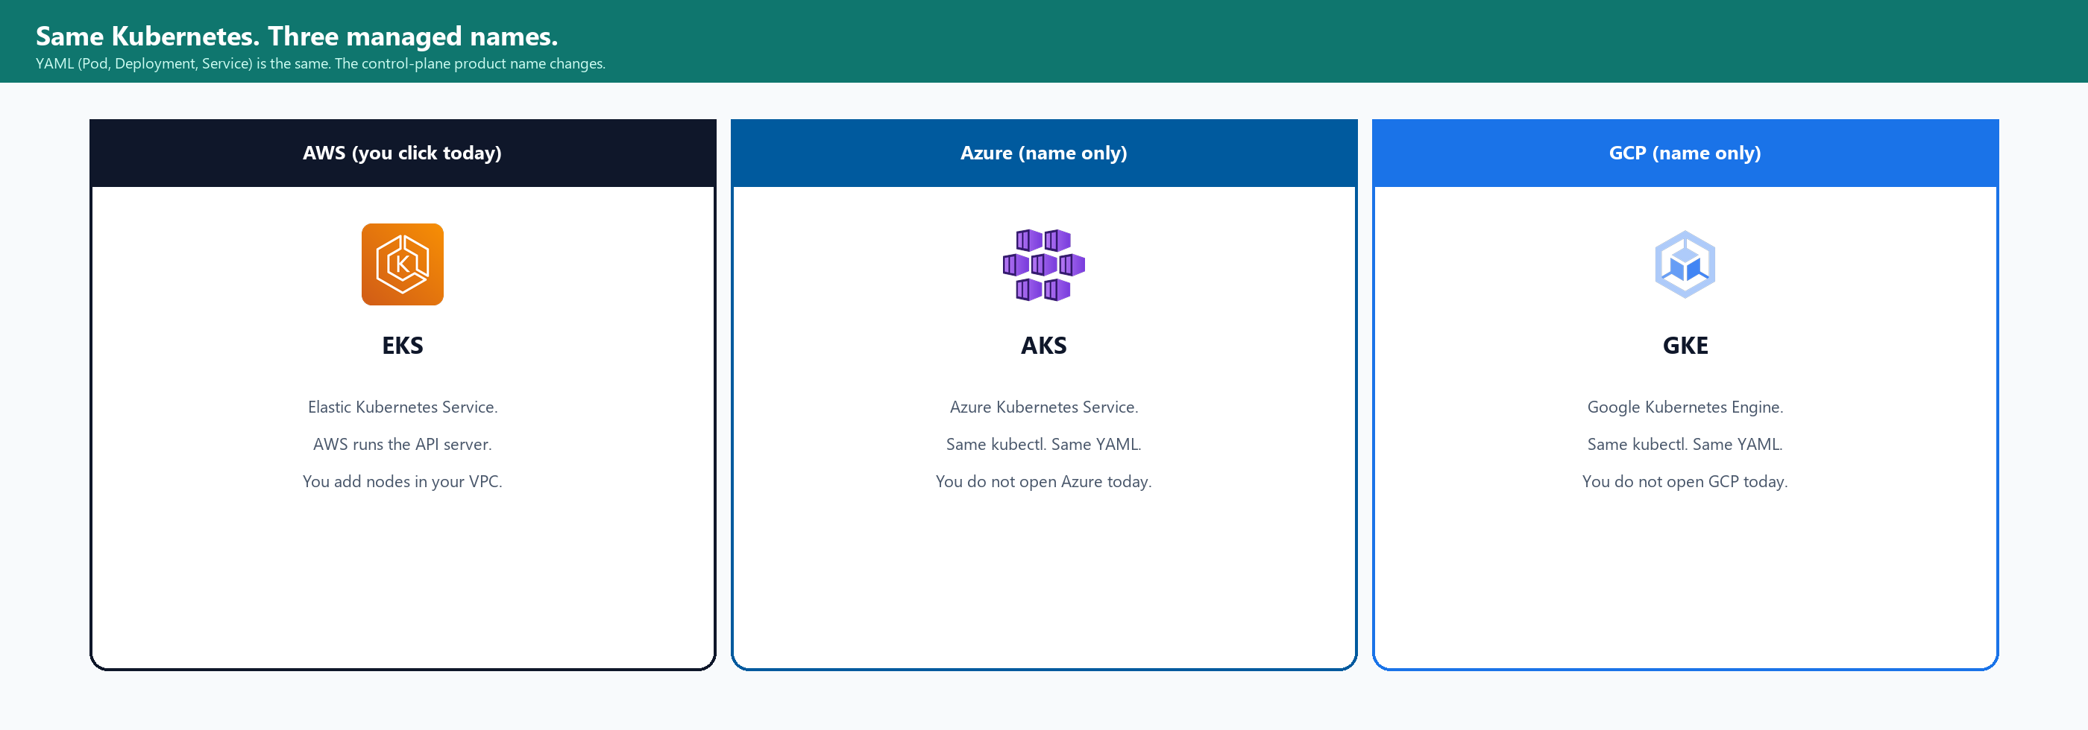
Picture — three managed Kubernetes products
Managed means: the vendor runs the API server. You still bring a network, workers (or a serverless node pool), and an image in that cloud’s registry.
Lecture 7 · Three clouds

Slide 39
Same jobs, names you already know
Job | AWS (you click) | Azure (name) | GCP (name)
Image shelf | ECR (lecture 6 and today) | ACR | Artifact Registry
One container, little VM work | Fargate (lecture 6) | Container Apps | Cloud Run
Kubernetes cluster | EKS (today) | AKS | GKE
Lecture 11 still deploys with GitHub Actions onto one EC2. Today is so you have used EKS once and deleted it.
Lecture 7 · Names table

Slide 40
The lab file is the source of truth
lec-07/codebase/eks-lab-instructions.txt · These slides are the map.

Slide 41
A. VPC notes-k8s
You do this
VPC console → Create VPC → VPC and more
Name notes-k8s · CIDR 10.7.0.0/16 · 2 AZs · 2 public subnets · 0 private · NAT None · DNS hostnames Yes
On each public subnet: auto-assign public IPv4 ON.
Tags: kubernetes.io/role/elb = 1 and kubernetes.io/cluster/lec07-eks = shared
Write the VPC ID and both subnet IDs on the lab sheet.
Lecture 7 · VPC

Slide 42
B–C. Three IAM roles and ECR
You create | Trust / policies
lec07-eks-cluster-role | EKS cluster trust · AmazonEKSClusterPolicy
lec07-eks-node-role | EC2 trust · WorkerNode + CNI + ECR ReadOnly
lec07-ec2-ecr | EC2 trust · ECR PowerUser (for docker push)
ECR repo notes-api | Private, this Region. Copy the URI.
If notes-api already exists from lecture 6, reuse it. You will push a new tag l7.
Lecture 7 · IAM and ECR

Slide 43
D. Create the cluster before you build
You do this
EKS → Clusters → Create → Custom
Name lec07-eks · Cluster role lec07-eks-cluster-role
VPC notes-k8s · both public subnets · endpoint Public
Turn ON cluster-creator administrator access. If this is off, CloudShell will say Unauthorized.
Add-ons: defaults. Create.
Status Creating for 10–15 minutes is normal. Do not click Create twice.
Go build the image.
Lecture 7 · Create cluster

Slide 44
E. Build and push :l7 while the cluster cooks
You do this
Launch t3.micro lec07-build in notes-k8s public subnet, SG 22 My IP only, instance profile lec07-ec2-ecr.
SSH from Git Bash. sudo dnf install docker git. sudo systemctl enable --now docker.
Put lec-07 notes-api on the box (git clone or scp).
sudo docker build -t notes-api:l7 .
aws ecr get-login-password … | sudo docker login …
sudo docker tag notes-api:l7 $URI:l7
sudo docker push $URI:l7
ECR console must list tag l7.
Lecture 7 · Build

Slide 45
F–G. Node group, then CloudShell
Wait until the cluster is Active. Then Compute → Add node group lec07-nodes. Role lec07-eks-node-role. t3.small, desired 2, both public subnets.
You do this
CloudShell (terminal icon in the AWS console). Region must match.
aws eks update-kubeconfig --name lec07-eks --region $REGION
kubectl get nodes
Two rows, Ready. Unauthorized → Access tab → access entry with AmazonEKSClusterAdminPolicy.
Lecture 7 · Nodes and kubectl

Slide 46
H. Apply the two YAML files
You do this
Replace IMAGE with $URI:l7 in deployment.yaml (the lab file has sed and a paste option).
kubectl apply -f deployment.yaml
kubectl apply -f service.yaml
kubectl get deploy,pods,svc
Pod Running. Service EXTERNAL-IP = <pending> for a few minutes, then a hostname.
URL is http://THAT-HOSTNAME/ — http, no :8080.
Lecture 7 · apply

Slide 47
J. Browser, then delete one Pod on purpose
In Chrome
In CloudShell
Open http://EXTERNAL-IP/
You should see the notes page.
Type a line. Add note. Show notes.
The new line appears.
The footer shows the Pod name.
kubectl delete pod -l app=notes
kubectl get pods -w
A new name appears, Running.
Refresh the page.
Starter notes are back. Your extra line is gone — that process died.
Ctrl+C stops the watch.
Lecture 7 · Prove it

Slide 48
If the browser spins
The Service created a load balancer, but the node security group may still block port 80. This is a common first-time miss.
You do this
EC2 → Security Groups → the group attached to the EKS nodes
Inbound → HTTP 80 from 0.0.0.0/0
and Custom TCP 30000–32767 from 0.0.0.0/0 for this hour.
Refresh the tab.
Those rules go away when you delete the cluster. Do not leave 80 open on a leftover SG.
Lecture 7 · HTTP 80 on the nodes

Slide 49
Z. Delete in this order
Order | What | Why this order
1 | kubectl delete svc notes | Drops the load balancer hostname
2 | kubectl delete deploy notes | Stops the Pod
3 | Delete node group lec07-nodes | Worker EC2s
4 | Delete cluster lec07-eks | Stops the control-plane bill
5 | Terminate lec07-build | The Docker box
6 | Delete VPC notes-k8s | Grey Delete = something still using a subnet — wait for the LB/ENI
7 | Delete the three IAM roles | If nothing else uses them
Lecture 7 · Cleanup

Slide 50
If something fails — short list
What you see | Usual cause
Cluster create failed | One AZ only, wrong cluster role, or a private subnet with no internet
kubectl Unauthorized | Cluster creator access was off — add an access entry
nodes 0 / NotReady | Node group still creating, or node role missing CNI/Worker policies
ImagePullBackOff | URI / :l7 / Region / ECR ReadOnly on the node role
EXTERNAL-IP pending a long time | Subnet missing kubernetes.io/role/elb=1 or not public
Browser hangs | Node SG missing 80
JSON error instead of buttons | You opened /notes, or the image is still :l6
Lecture 7 · Debug

Slide 51
Short answers
Assignment: lec-07/assignment.md · cleanup boxes are part of it.

Slide 52
If someone asks you
Question | You can say
Why Kubernetes after Fargate? | Fargate ran one task. Kubernetes is desired state: N Pods and a stable Service.
Pod / Deployment / Service? | Pod runs. Deployment keeps N Pods. Service is the URL; it selects labels.
ReplicaSet? | The Deployment owns it. It is what actually keeps the count.
LoadBalancer? | The Service asks AWS for a hostname. I did not click Create load balancer.
Where are notes? | In RAM in that one process. Delete the Pod and extras are gone.
EKS / AKS / GKE? | Managed control plane on AWS / Azure / GCP. Same YAML.
Project on EKS? | No. Lecture 11 is one EC2. I deleted this cluster because it is billed while it exists.
Lecture 7 · Spoken

Slide 53
Lecture 8, in one paragraph
You will not do this today
replicas: 2 — two Python lists, Add and Show can disagree. That is the point.
ConfigMap and Secret.
A bad image name (ImagePullBackOff) and a crashing process (CrashLoopBackOff).
rollout undo.
Helm if the clock allows.
Finish today’s assignment and the cleanup ticks first.
Lecture 7 · Next

Slide 54
Desired state. One URL. Then delete.
END OF LECTURE 7
notes-api:l7 from ECR. Deployment 1. Service LoadBalancer.
The cluster is billed until it is gone.

